Slide 1
CONTEXT DIAGRAM / LEVEL 0

Slide 2
ADMIN
FARMER
Request
Response
Response
Request
FARMERS_HELP
SPECIALIST
Request
Response
PUBLIC
Response
Request
Request
Response
Response
Request
Response
Request
EXPORTERS
SUPPLIERS
INVESTORS

Slide 3
LEVEL 1

Slide 4
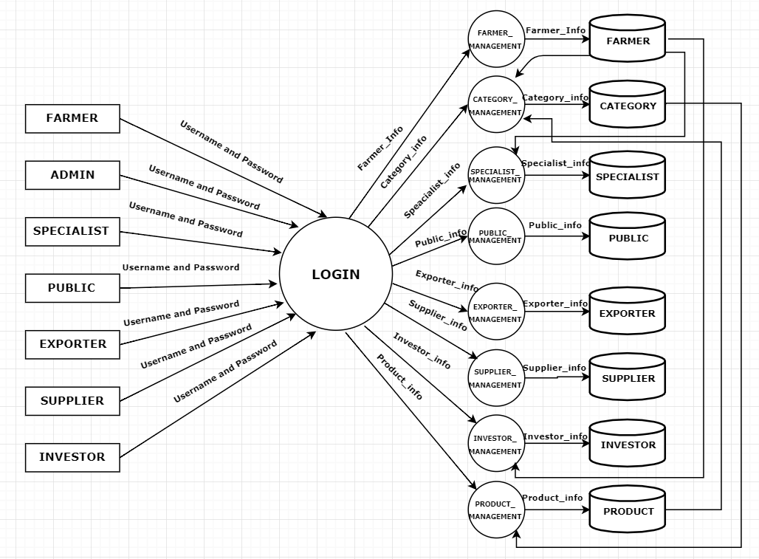

Slide 5
LEVEL 2

Slide 6
2.1 Farmer Management

Slide 7
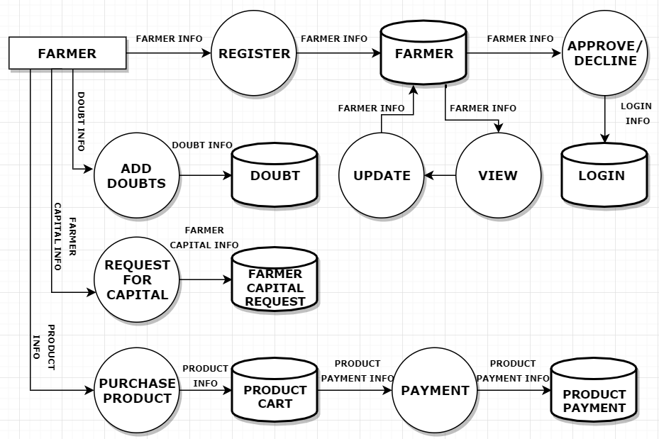

Slide 8
2.2 Specialist Management

Slide 9
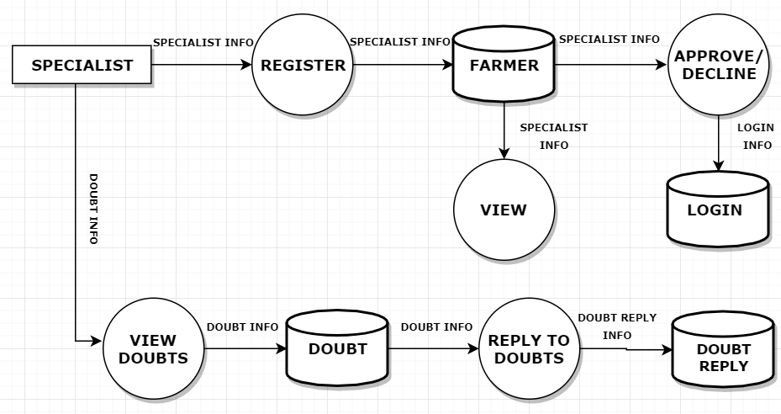

Slide 10
2.3 Public Management

Slide 11
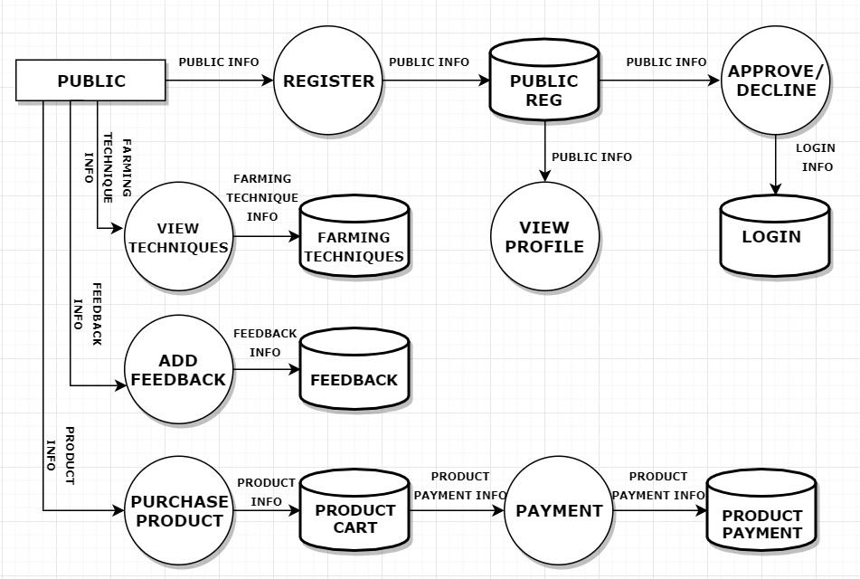

Slide 12
2.4 Supplier Management

Slide 13
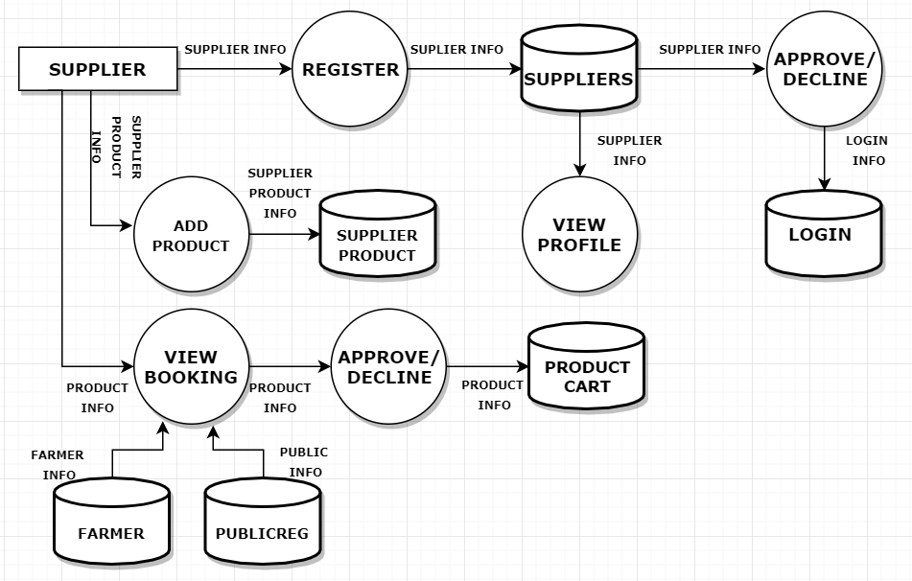

Slide 14
2.5 Exporters Management

Slide 15
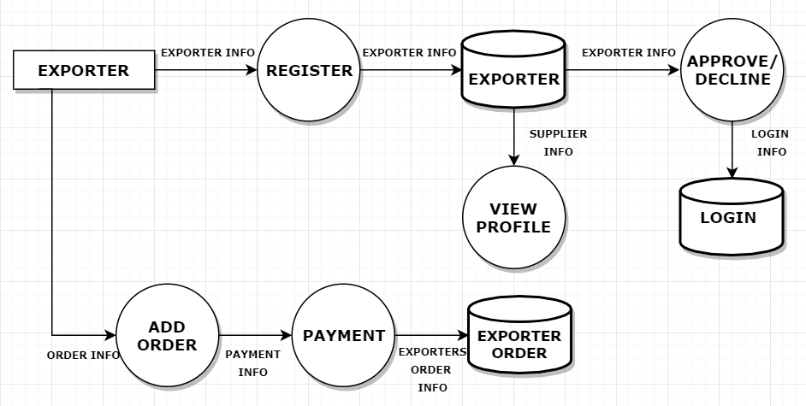

Slide 16
2.6 Investor Management

Slide 17
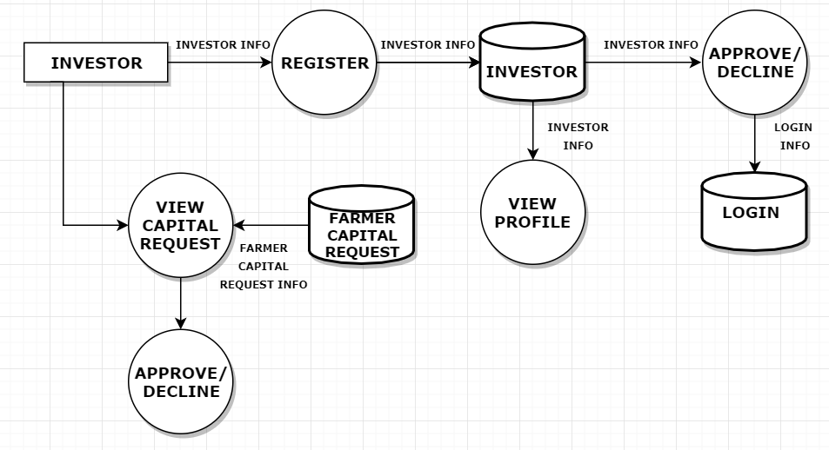

Slide 18
2.7 Category Management

Slide 19
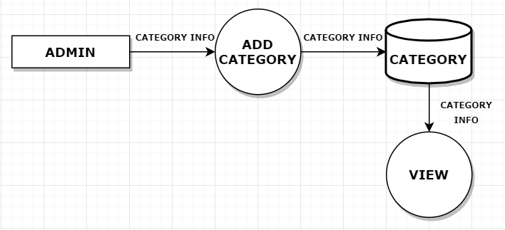

Slide 20
2.8 Product Management

Slide 21
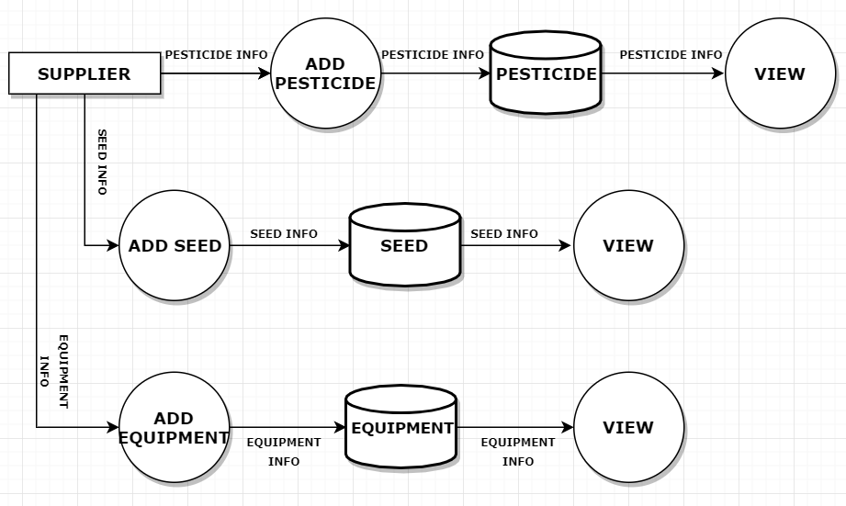

Slide 22
ER Diagram

Slide 23
supplier name
Product
name
Phone
number
Registration Code
Sup_reg
number
Provided By
name
quantity
Suppliers
Product
Suppliers
Account
number
Phone
number
email
Image
item
name
email
pub
name
productid
email
rate
cat
followupid
email
address
password
Add
Viewed By
pub
id
Buy
Technique
Public
password
Feed
back
dates
email
feed
id
Viewed By
Technique
name
name
Add
Feedback
mobile
password
status
unit
Product
id
Exp_reg_no
Farmer
id
file
email
email
rate
quantity
quantity
Account
number
name
email
Farmer
name
proof
Add
cat
pro
name
Phone
number
pro
name
Order
amount
Farmer
Products
order
id
Exporters
address
Phone
number
Invest
id
Account
number
address
amount
dates
name
Phone
number
Office
contact
Apply for
mobile
email
Given By
Investorid
Capital
Investors
email
Account
number
email
name
Ask for
Enquiries
Viewed By
Doubt
Specialist
Specialist
id
pro
name
doubt
email
replay
id
replay
dates
doubt
dates
name
doubt
id
Replay to doubt
Viewed By
pro
name
email
Phone
number
email
Doubt
replay
Specialized

