Slide 1

CAR RENTAL SYSTEM

Slide 2

Introduction
Welcome! This presentation outlines the Car Rental System database, a robust solution designed to optimize car rental agency operations. By centralizing data, enhancing efficiency, and improving customer experiences, this system delivers a powerful platform for growth and success.

Slide 3
Database Purpose
The Car Rental System database is designed to provide a comprehensive and integrated solution for managing all aspects of car rentals. From customer management and vehicle inventory tracking to booking processes and maintenance records, this system streamlines every operation.
Key Features
Efficient rental vehicle management streamlines inventory, bookings, maintenance, and customer service.
Branch and Employee Management
Dynamic Maintenance Scheduling
Customer Feedback Integration
Multi-Branch Functionality
Billing Management

Slide 4
Objectives for Optimizing Rental Operations
Comprehensive Vehicle Management
1
Track every vehicle across branches, including details like type, brand, model, fuel, and maintenance status. Ensure optimal fleet utilization, streamlined scheduling, and reliable availability.
2
Integrated Branch Operations
Link branches to their vehicles, employees, and customers for localized management with centralized oversight. Maintain operational consistency across your network.
Customer-Centric Approach
3
Capture comprehensive customer profiles, including booking history and feedback. Provide personalized service, reduce check-in/out times, and keep customers satisfied.
4
Seamless Booking & Billing
Manage bookings, link them to customers and vehicles, and generate detailed billing reports. Track payment status for accuracy and transparency.
Maintenance and Service Tracking
5
The system maintains detailed records of vehicle cleaning, repair, and service history to ensure optimal vehicle condition, reduce downtime, and enhance customer safety.
6
Feedback & Performance Monitoring
Enables collection and analysis of customer feedback, providing insights for service improvement. Tracks key performance metrics, such as average rental durations and vehicle utilization rates, to optimize operations.
Scalability and Growth
7
The database is designed to scale with growing customer bases, vehicle inventories, and new branch additions, ensuring long-term sustainability and adaptability for expanding operations.

Slide 5
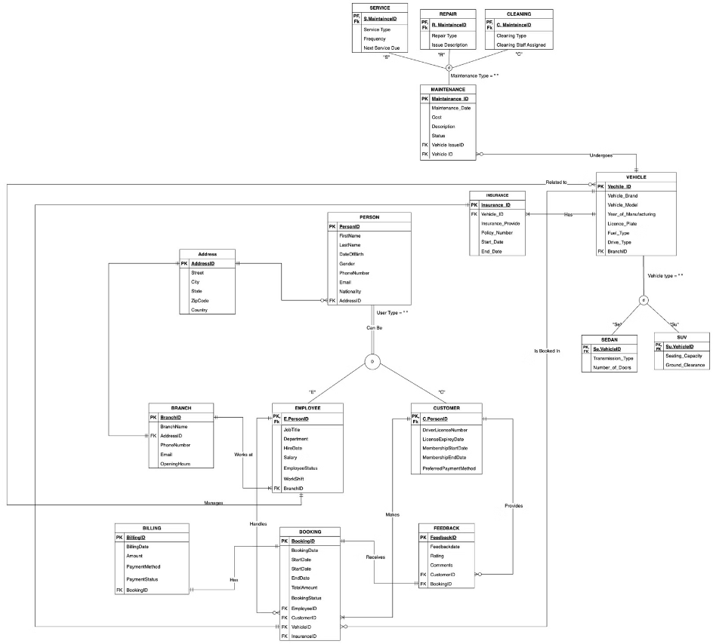
ERD

Slide 6

Key Database Objects
STORED PROCEDURES
VIEWS
Get Branch Details by City: Retrieves branch details and calculates total branches with error handling.
Vehicle Availability View: Displays vehicle availability status using dynamic CASE statements.
Calculate Total Revenue for a Branch: Computes total revenue with efficient aggregate functions.
Revenue by Branch: Summarizes bookings and revenue by branch for performance insights.
USER-DEFINED FUNCTIONS (UDFs)
TRIGGERS AND INDEXES
Get Vehicle Utilization Rate: Calculates utilization percentage for fleet management.
Booking Status Change Logger: Logs booking status changes for auditability.
Calculate Booking Duration: Returns booking duration in days for operational analysis.
Non-Clustered Index (e.g., idx_Booking_BookingDate): Optimizes search queries for faster response.

Slide 7
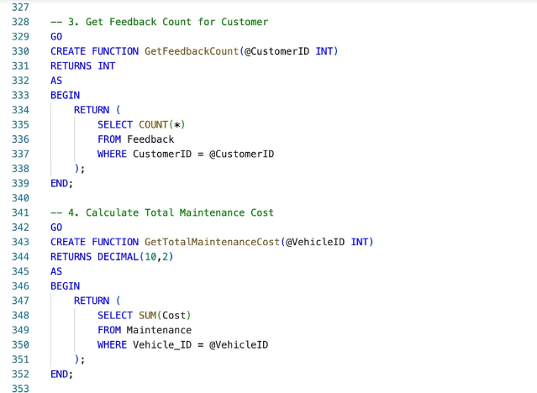
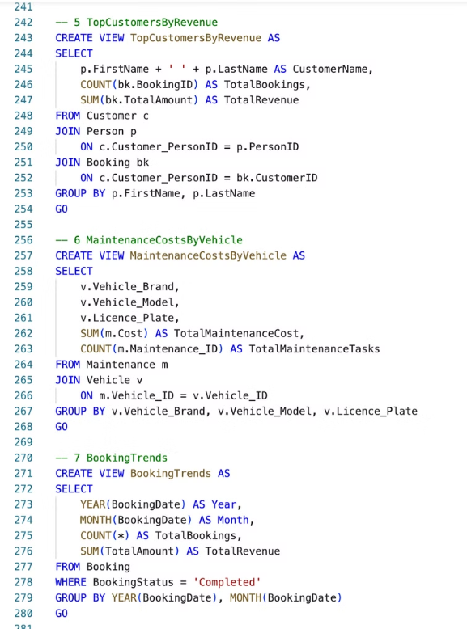
VIEWS/ STORED PROCEDURES/ UDF

Slide 8
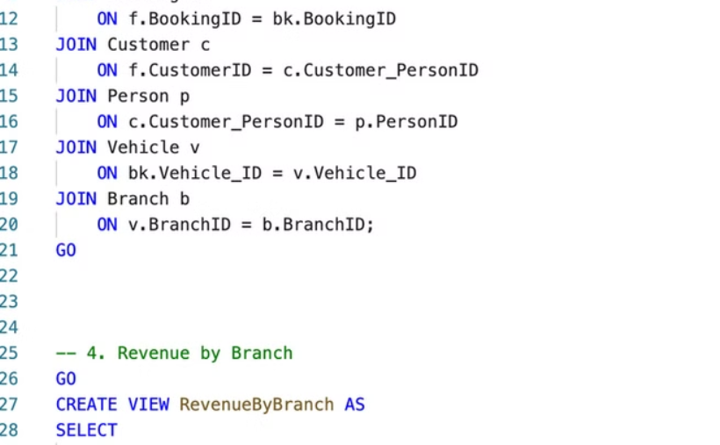
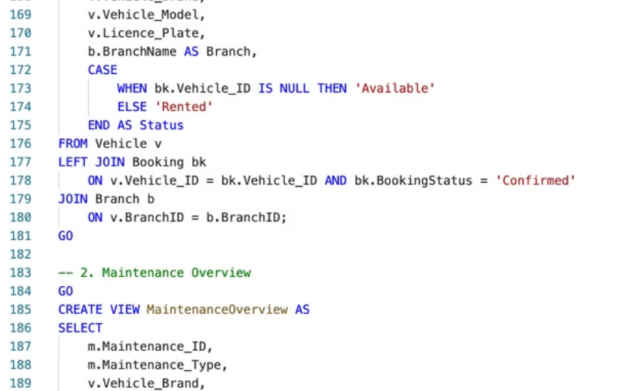

Slide 9
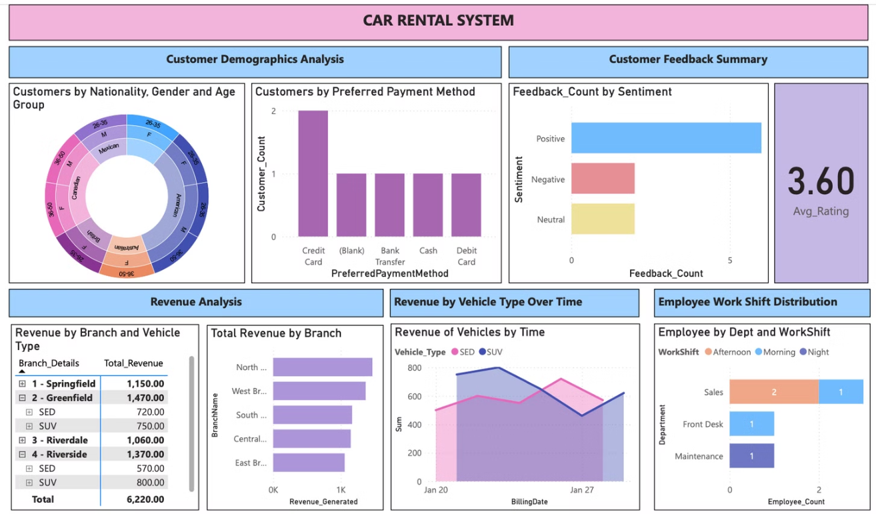
PowerBI Dashboard

Slide 10
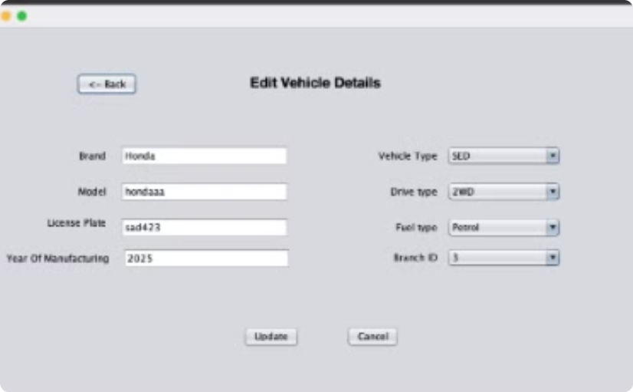
GUI - JavaSwing
Add, Edit and Manage all CRUD operations without any foreign key violations
Vehicle Inventory Management

Slide 11
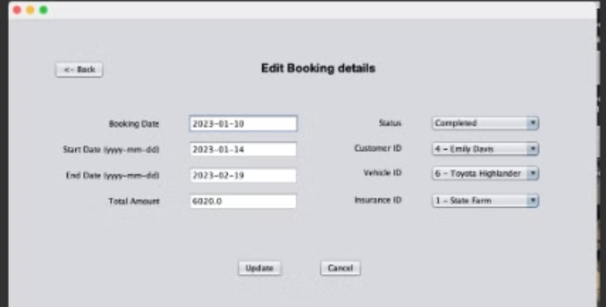
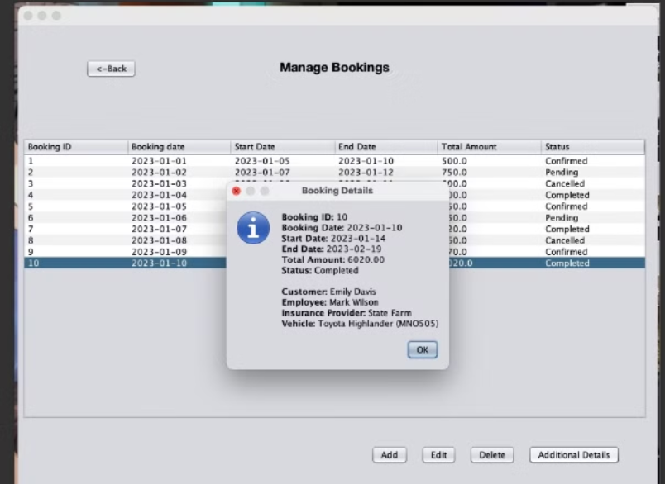
Booking and Billing Management

Slide 12
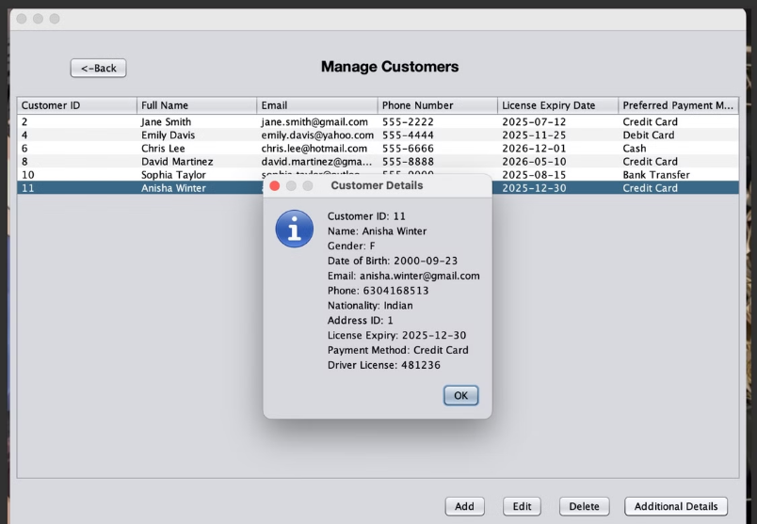
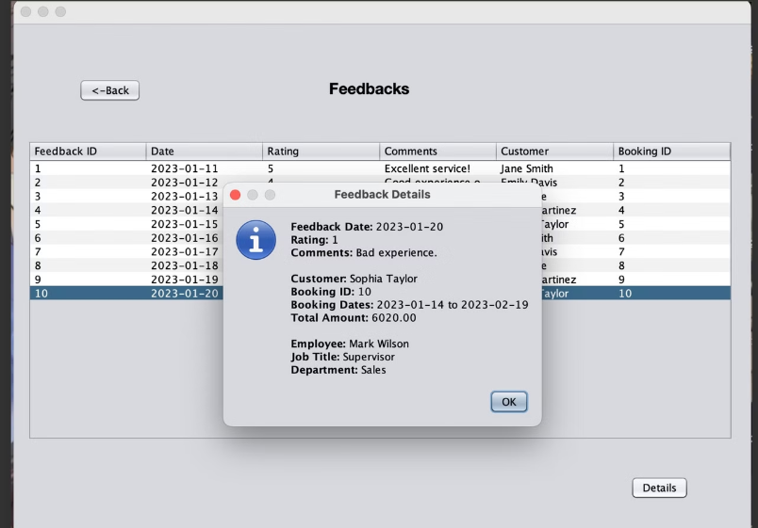
Customer and Feedback Management

Slide 13
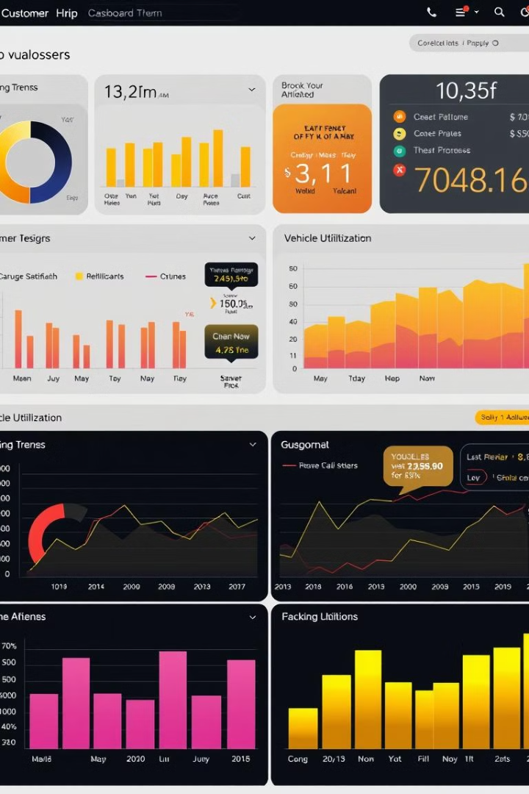
Thank You
Conclusion:
Our System database optimizes operational efficiency, improves customer satisfaction, and enables informed decision-making by centralizing key processes. Its scalable architecture ensures that car rental businesses can grow and adapt to evolving needs, providing long-term value and sustainability.

