Slide 1
CRAFTIFY
ANJANA GOPAN K Assistant Prof.HUSAIN AHAMED
MCA, Semester VI Department of Computer Application
Government Engineering College, Thrissur
Main Project Final Review, 2022
1/40

Slide 2




Outline
1
INTRODUCTION
2
OBJECTIVES
PROPOSED SYSTEM
SYSTEM ARCHITECTURE
DFD
ER DIAGRAM
RESULTS
SCOPE FOR FUTURE ENHANCEMENT
1/40

Slide 3
INTRODUCTION
The project work entitled, “CRAFTIFY” is an Ecommerce Business Mobile app to support sellers and customers for selling and buying of craft products as well as the accessories.
It also promotes tutors for online teaching of making crafts. It also provides an opportunity for an online photo exhibition.
Tutorials will be provided free for 7 days, continue to access the tutorials only after subscribe the app
INTRODUCTION
3/40

Slide 4
OBJECTIVES
The main objective of the system is that all process is online. The system gives more interaction between sellers and customers which helps to improve quality of service.
It manages the smooth working of a craft shop. It reduces the effort and time wastage of customers. It provides an online photo exhibition.
It provides personal login for the registered customers, sellers and tutors. It also sells craft accessories.
OBJECTIVES
4/40

Slide 5
PROPOSED SYSTEM
The existing system is not efficient, and no opportunities for online tutors. There is no option for an online photo exhibition
The proposed system overcome all the drawbacks of Existing system Proposed system consists of mainly three modules, they are:
ADMIN SELLER CUSTOMER
PROPOSED SYSTEM
5/40

Slide 6
Admin module
Admin has all the control over the system. Admin can do the following activities.
View Approved/Rejected Seller Exhibition Management Package Management
View Users View Profit
PROPOSED SYSTEM
5/40

Slide 7
Seller module
A seller can sell products. Typically one who teaches a single pupil or a very small group. The main function of the seller is teaches the making of craft products. Seller can do the following activities.
Tutorial Management Product Management View/Apply Exhibition View Booking
View Rating
PROPOSED SYSTEM
5/40

Slide 8
User module
User can buy products and can access tutorials. user can do the following activities.
View Tutorials payment Management View Exhibition View/buy Products Add Rating
PROPOSED SYSTEM
5/40

Slide 9
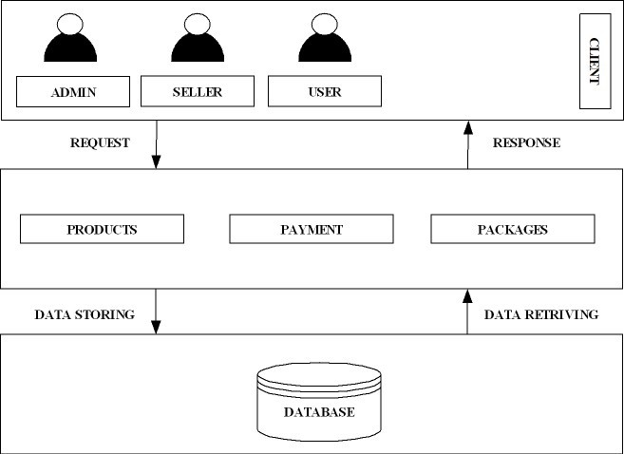
System Architecture
SYSTEM ARCHITECTURE
9/40

Slide 10
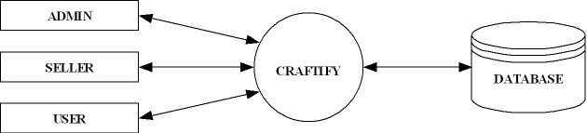
DFD -Level 0
DFD

Slide 11
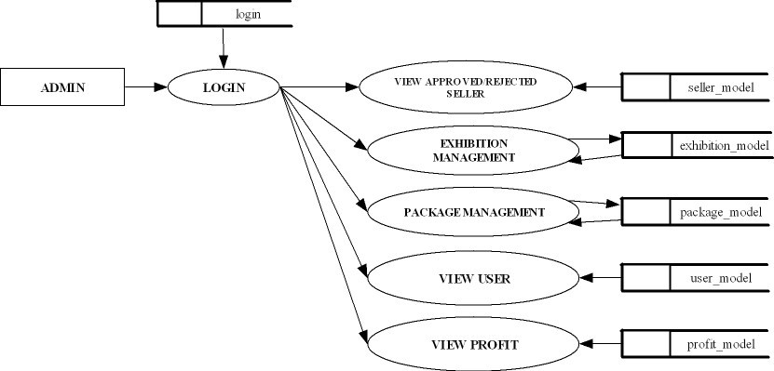
DFD -Level 1(Admin module dfd)

Slide 12
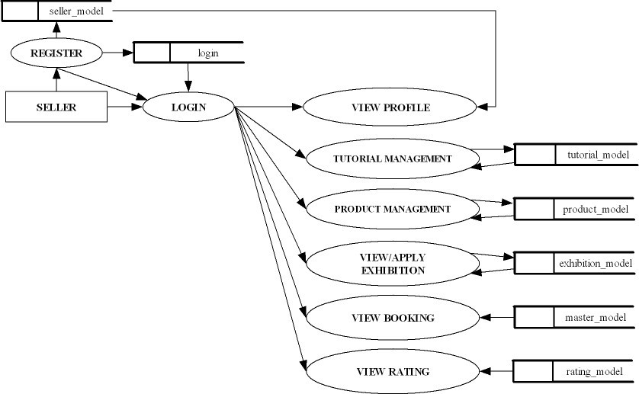
DFD -Level 1(Seller module dfd)

Slide 13
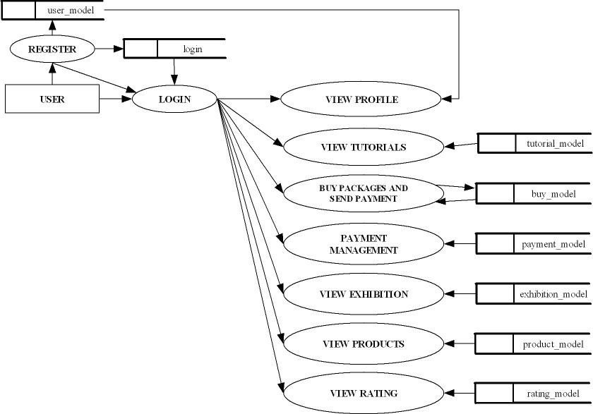
DFD -Level 1(User module dfd)

Slide 14
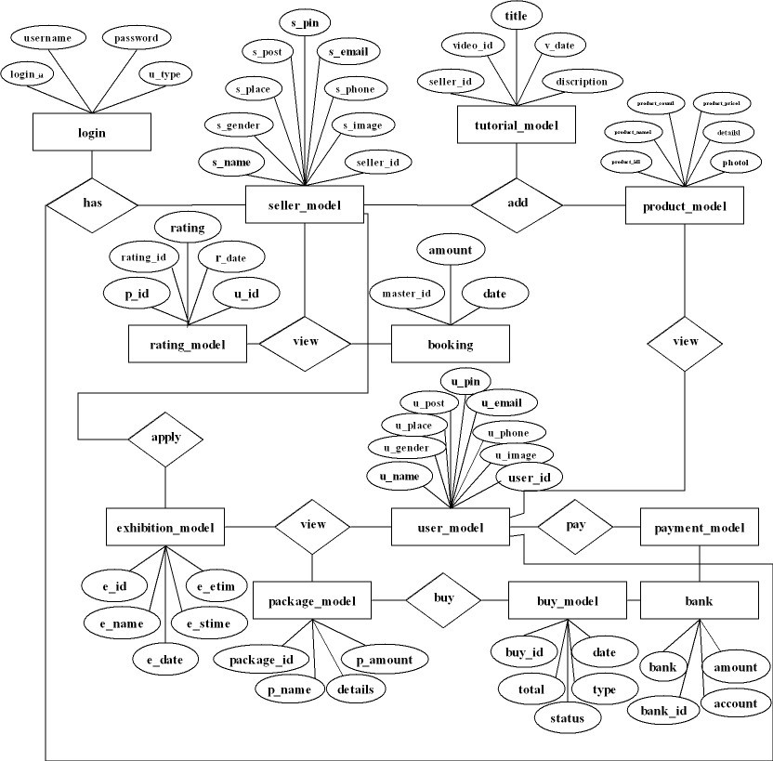
ER Diagram
ER DIAGRAM

Slide 15
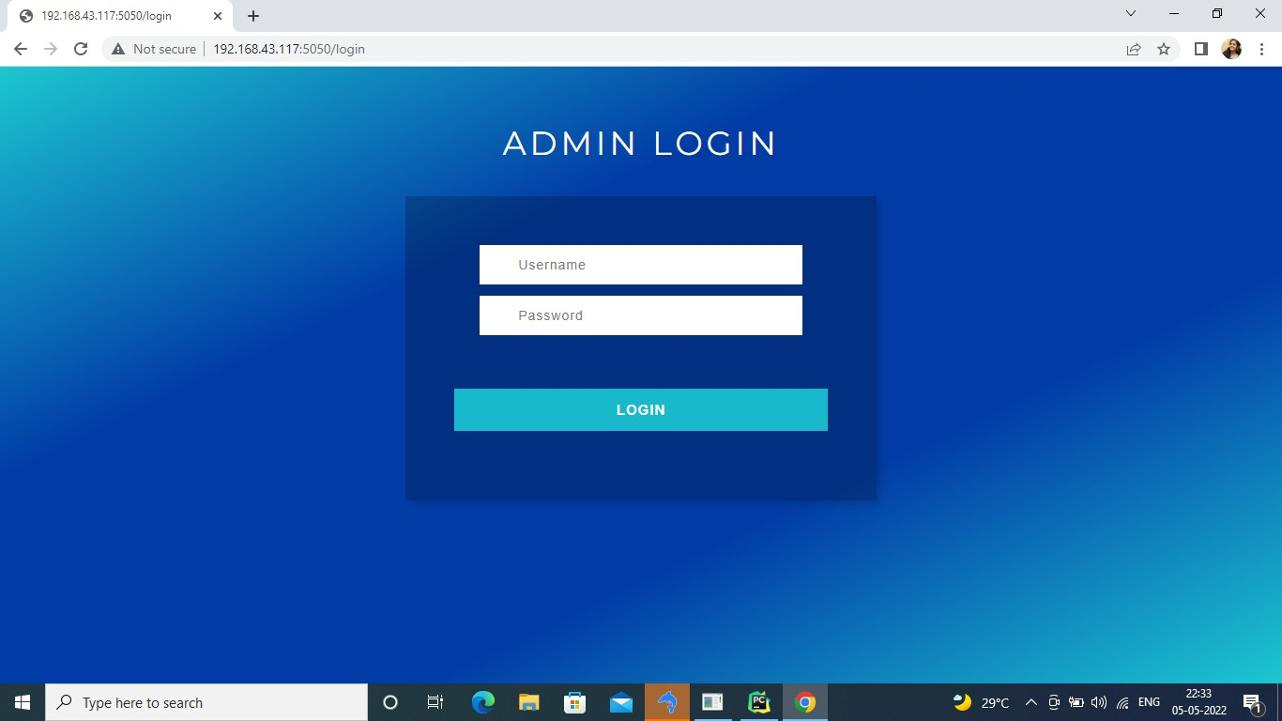
ADMIN MODULE
Figure: admin login page
RESULTS
15/40

Slide 16
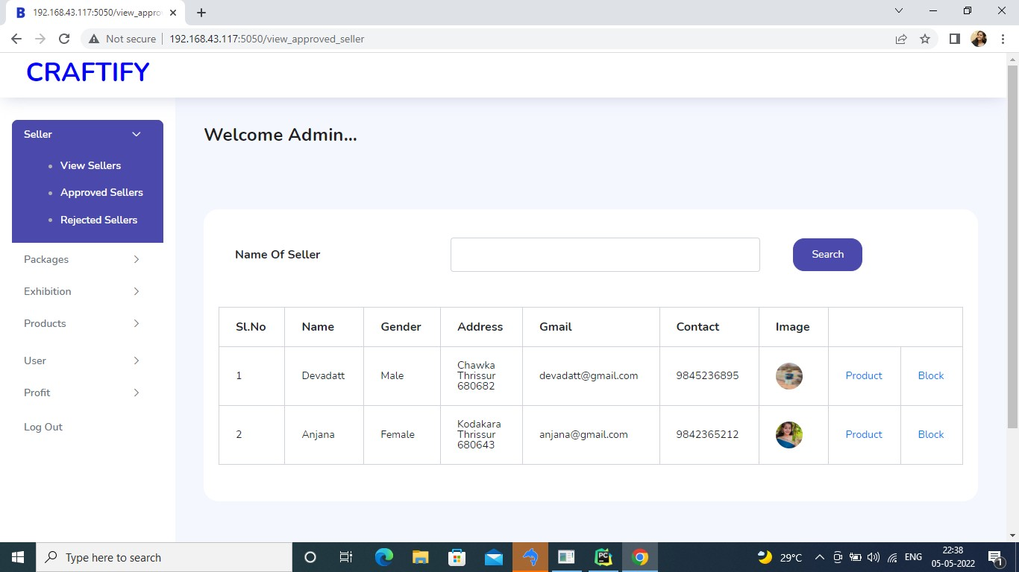
ADMIN MODULE
Figure: view sellers

Slide 17
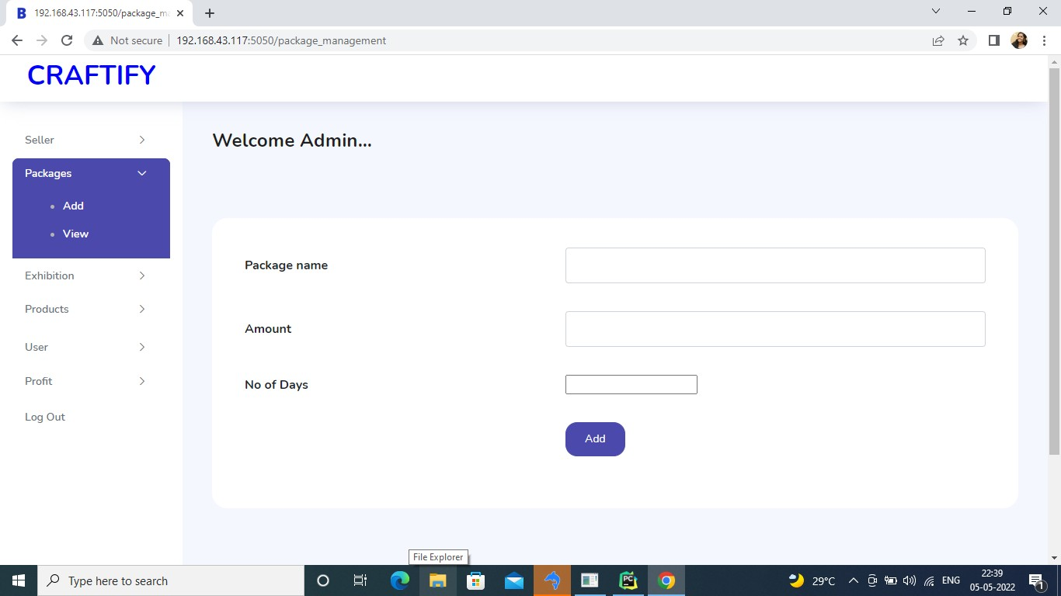
ADMIN MODULE
Figure: add packages

Slide 18

ADMIN MODULE
Figure: view packages

Slide 19
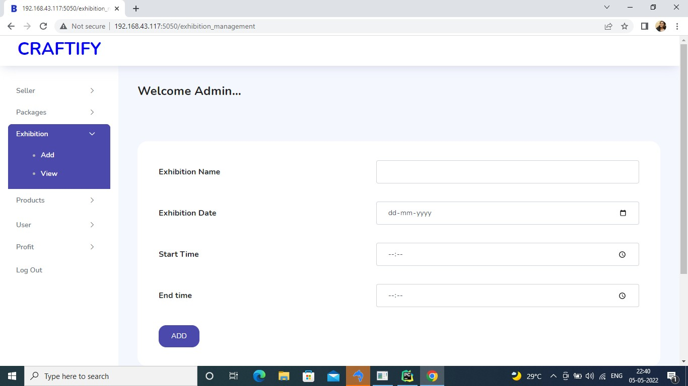
ADMIN MODULE
Figure: add exhibitions

Slide 20
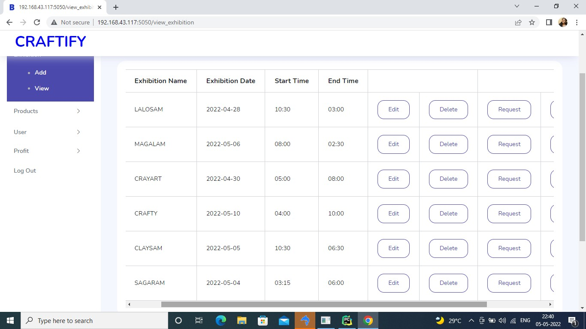
ADMIN MODULE
Figure: view exhibitions

Slide 21
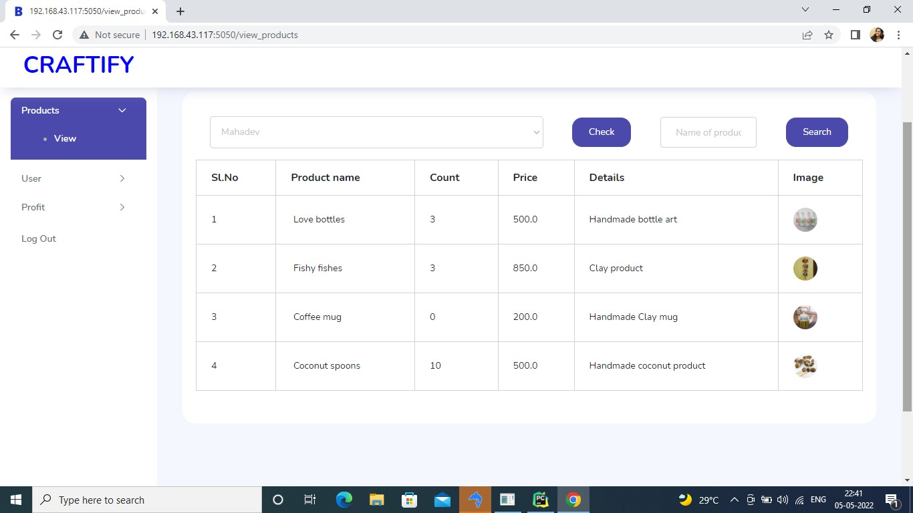
ADMIN MODULE
Figure: view products

Slide 22
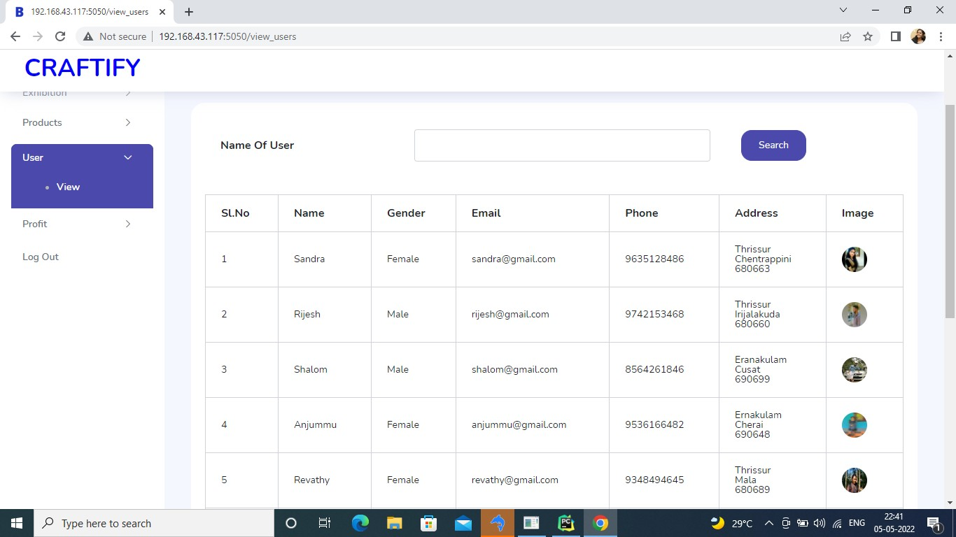
ADMIN MODULE
Figure: view users
22/40

Slide 23
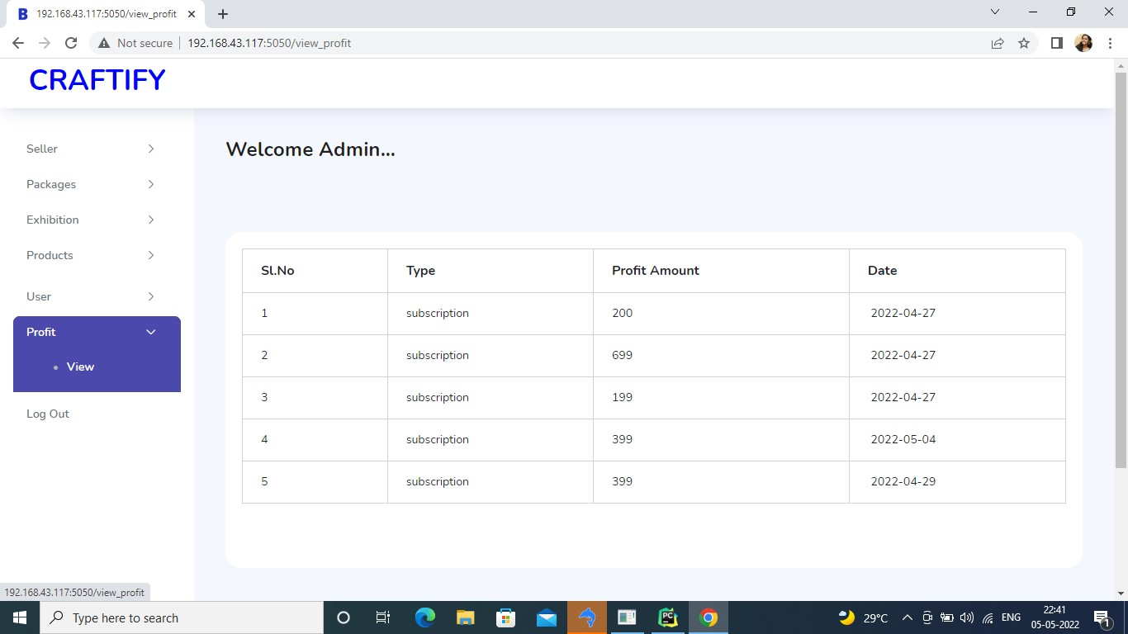
ADMIN MODULE
Figure: view profit

Slide 24
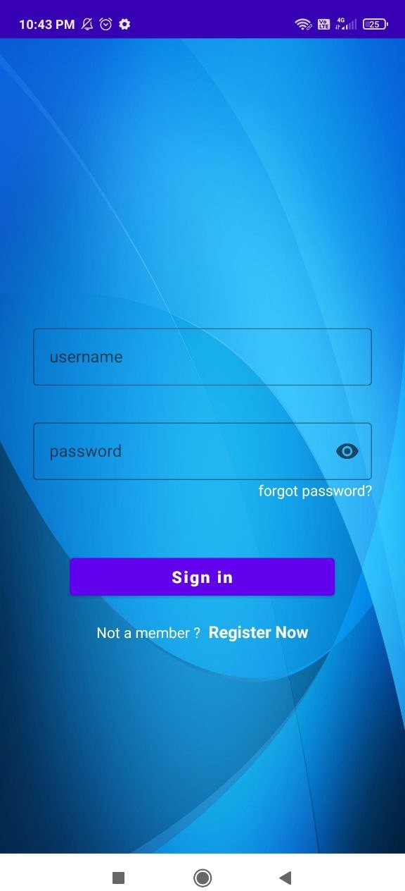
SELLER MODULE
Figure: login page

Slide 25
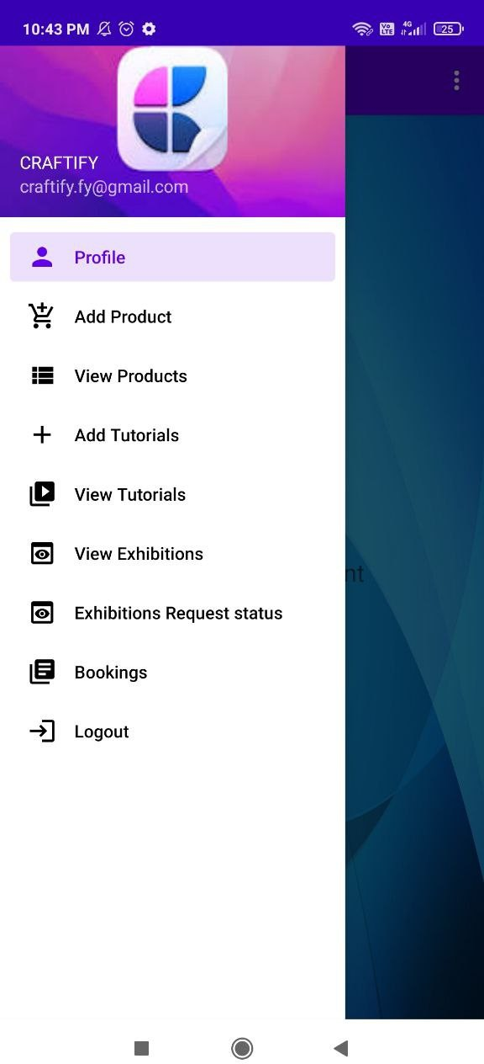
SELLER MODULE
Figure: home page

Slide 26
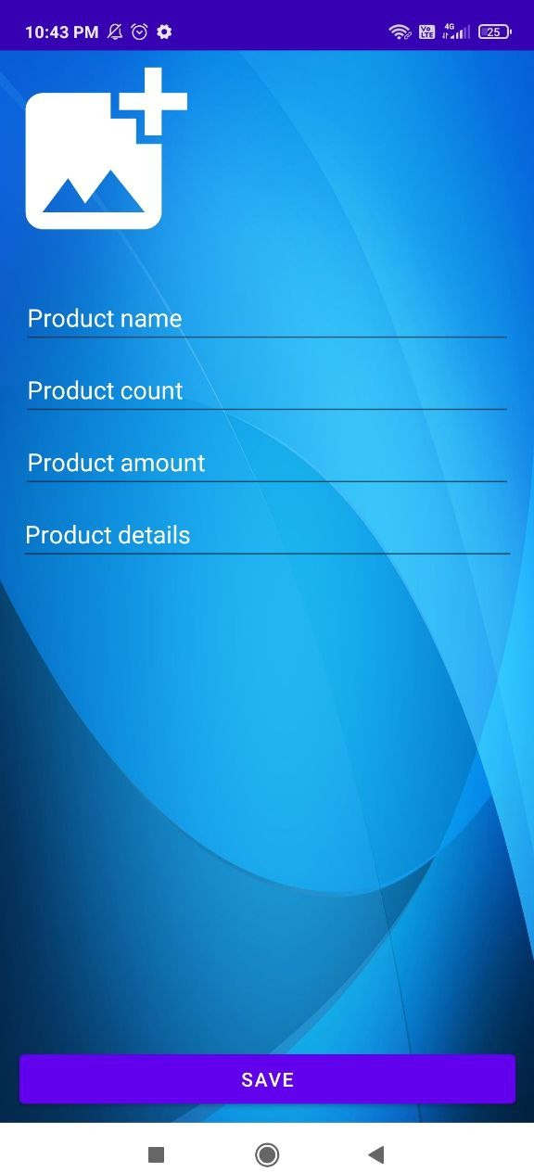
SELLER MODULE
Figure: add products

Slide 27
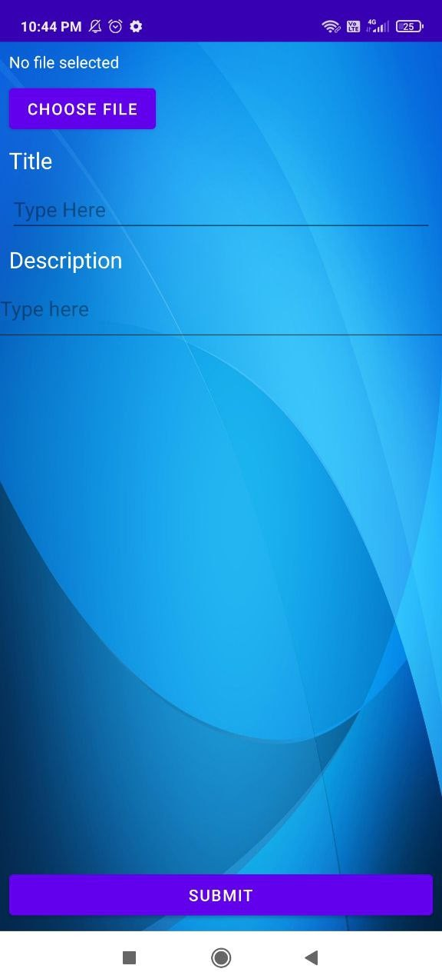
SELLER MODULE
Figure: add tutorials

Slide 28
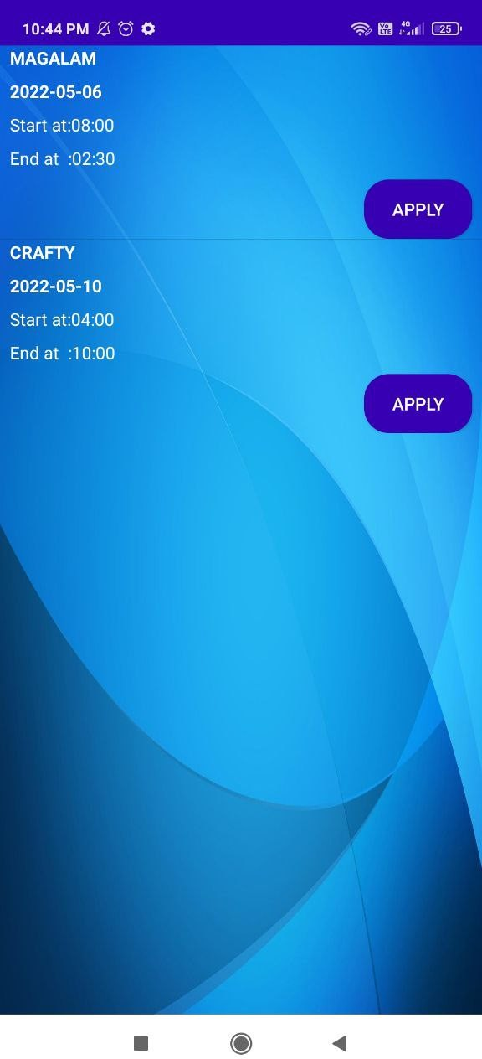
SELLER MODULE
Figure: view exhibition

Slide 29
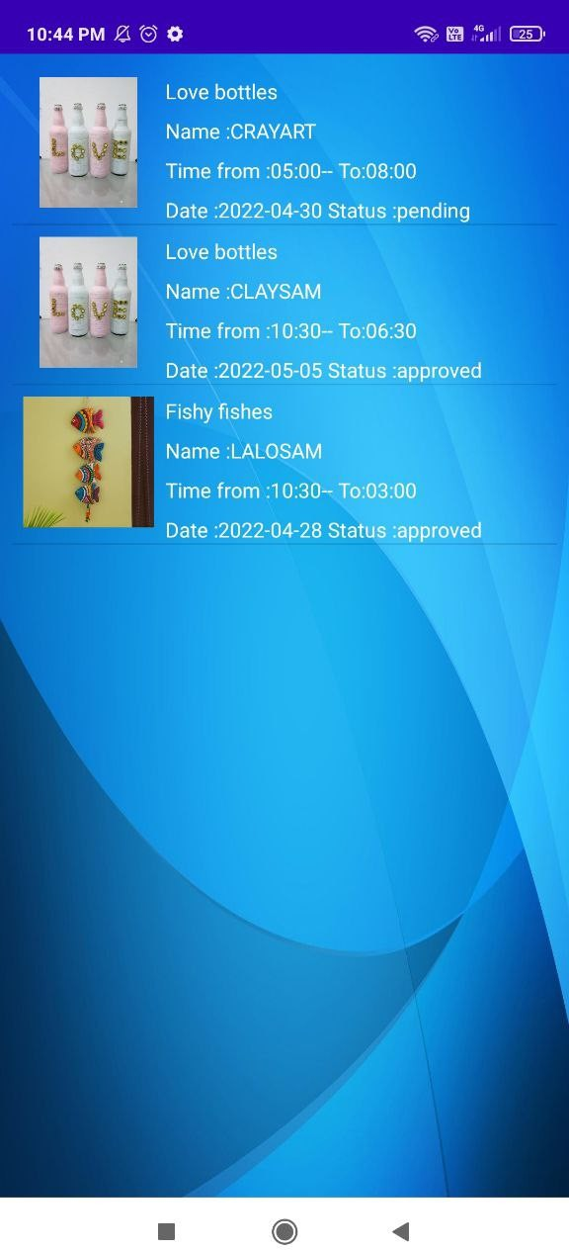
SELLER MODULE
Figure: view exhibition apply status

Slide 30
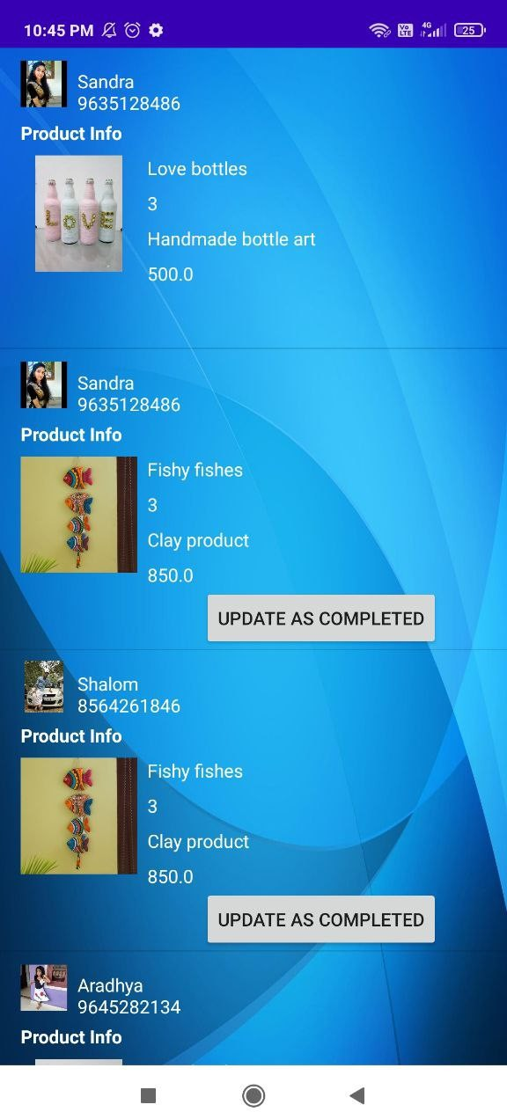
SELLER MODULE
Figure: view bookings

Slide 31
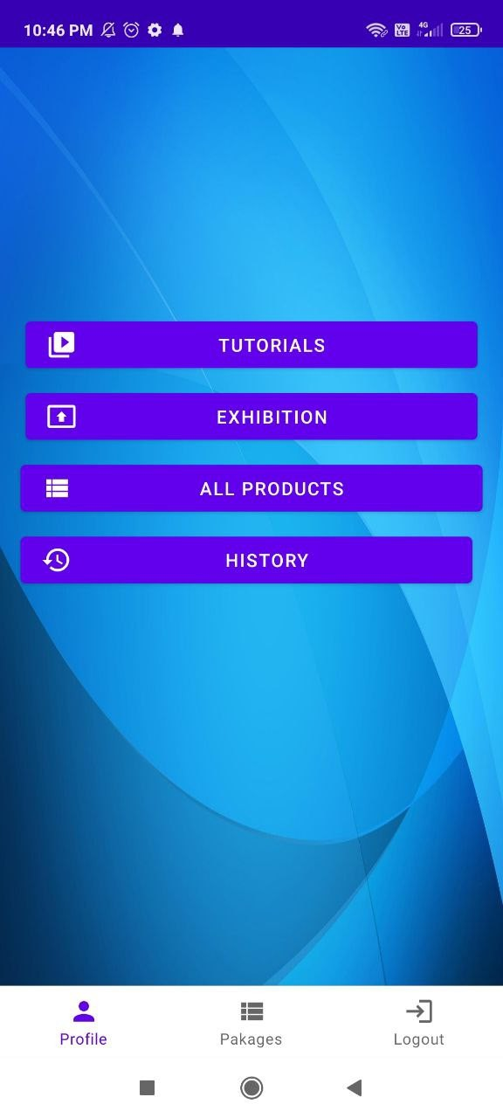
USER MODULE
Figure: home page

Slide 32
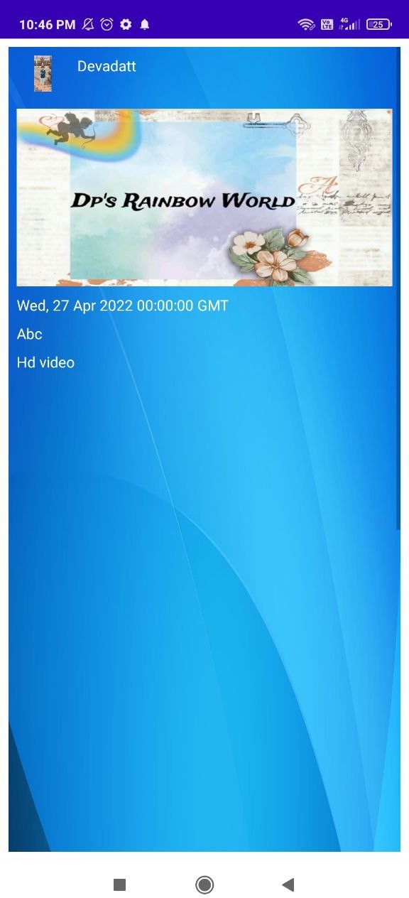
USER MODULE
Figure: view tutorials

Slide 33
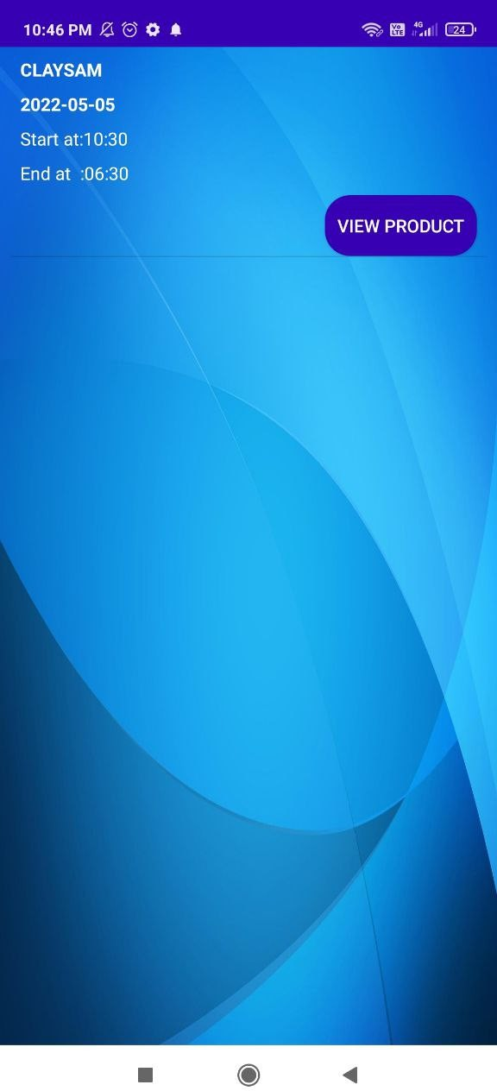
USER MODULE
Figure: view exhibitions

Slide 34
USER MODULE
Figure: home page

Slide 35
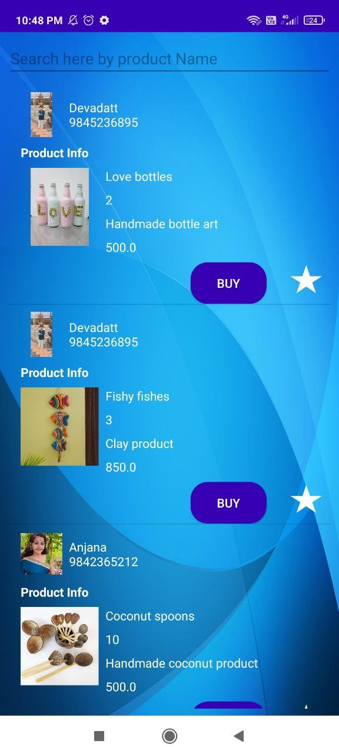
USER MODULE
Figure: view all products

Slide 36
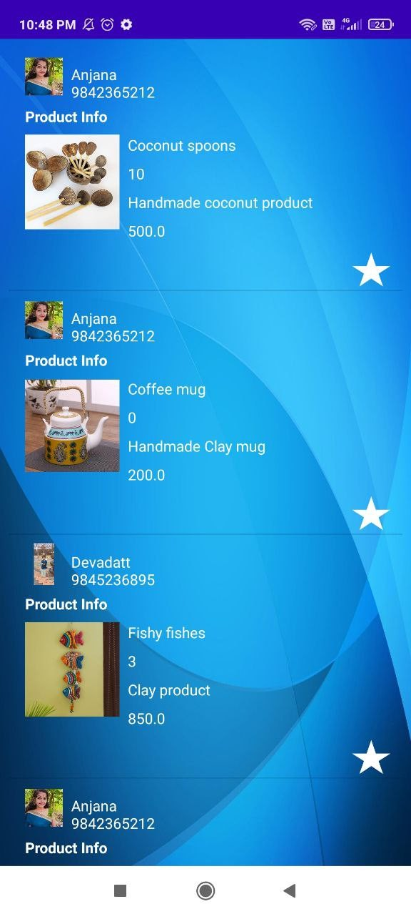
USER MODULE
Figure: view purchase history

Slide 37
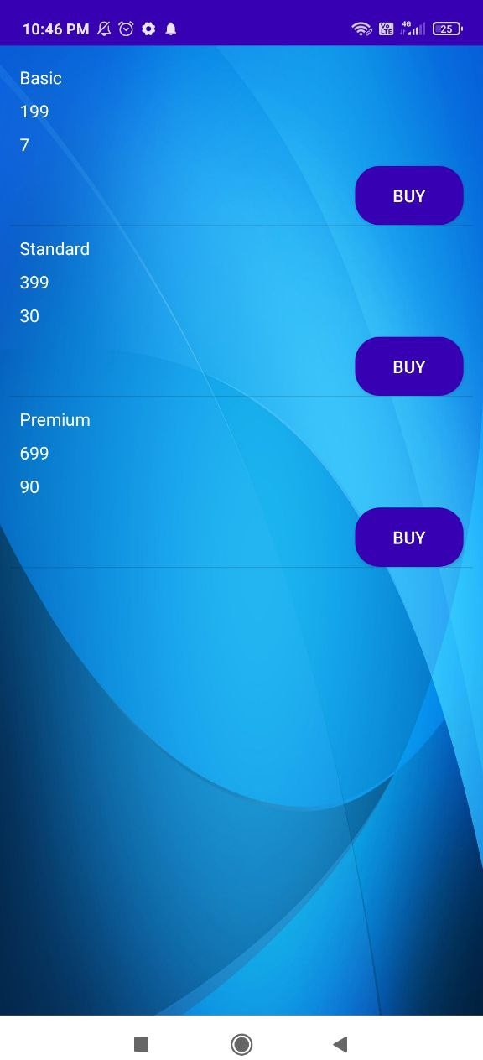
USER MODULE
Figure: view packages

Slide 38
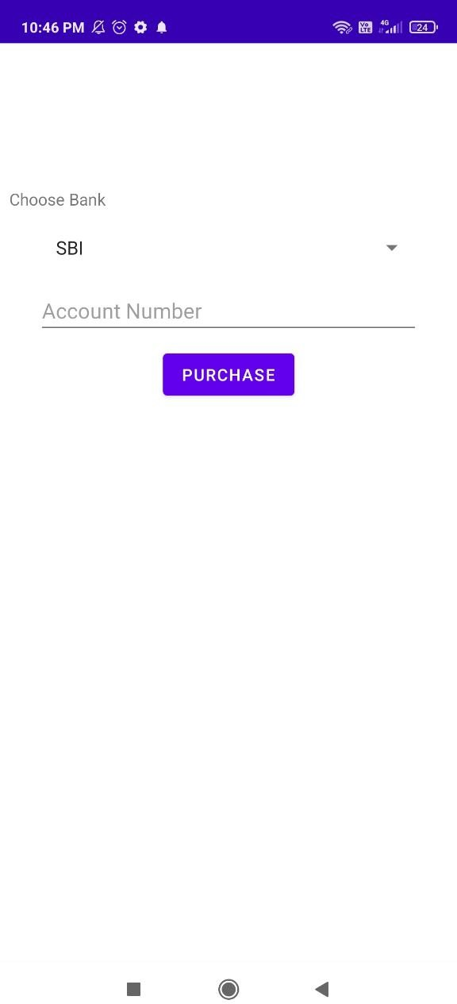
USER MODULE
Figure: payment method

Slide 39
SCOPE FOR FUTURE ENHANCEMENT
In the future, we can implement facilities like Live Delivery tracking using GPS facilities Introduce delivery
Introduce Rewards coin programs for customers Order now and pay later options
Online chat and video call
SCOPE FOR FUTURE ENHANCEMENT

Slide 40
THANK YOU
THANKS
SCOPE FOR FUTURE ENHANCEMENT

