Slide 1
LINEAR POWER SUPPLY
Group No. - 05

Slide 2
Basic Idea
Stepped down source
(230 V rms-15 V rms)
Short circuit protection
Regulator circuit
Current divider circuit
Feedback circuit
Output
(Voltage 10V
Current 5A)
Over voltage protection
Foldback Current circuit

Slide 3
SCHEMATIC DIAGRAMS

Slide 4
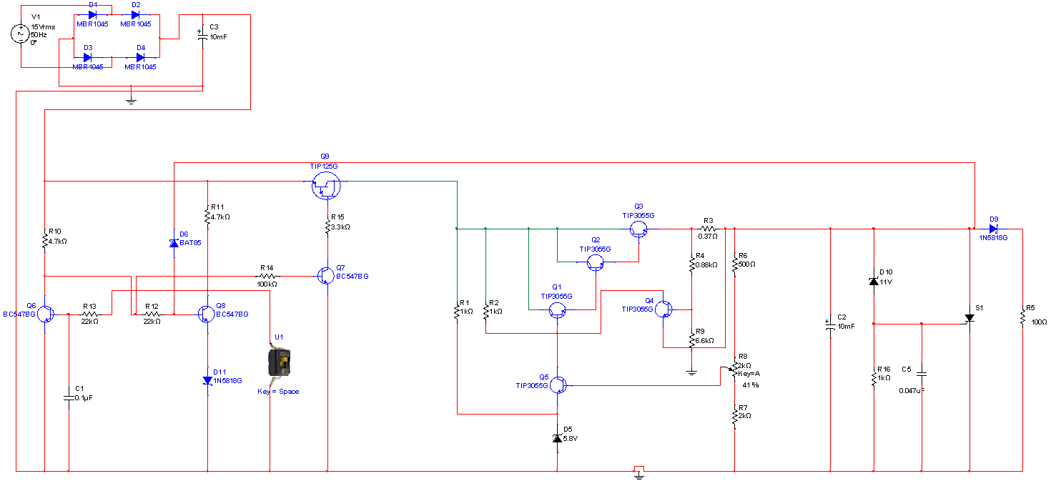
MAIN REGULATION CIRCUIT

Slide 5
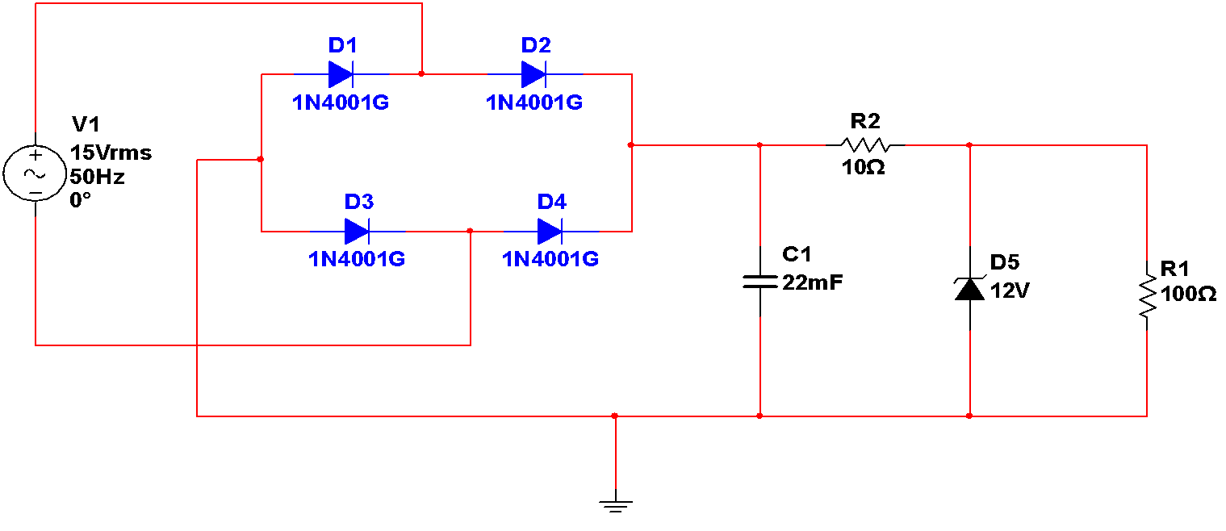
FAN REGULATION CIRCUIT

Slide 6
CIRCUIT EXPLANATION

Slide 7
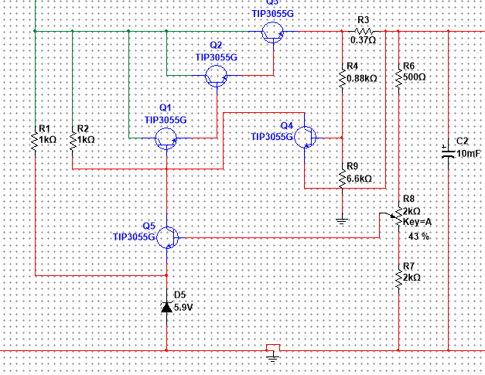
Main regulation parts
Regulator
Current divider
Feedback
Foldback Current
VBE(Q4)= K IL R5 + (K – 1) Vout
K= (R9 / R4+ R9)

Slide 8
Feedback circuit Calculations
V_{BE(Q5)} + V_{(D5)} = R₇ / (R₇ + R₆) * V_{out}
V_{out} = (1 + R₆/R₇) (V_{BE(Q5)} + V_{(D5)} ) 01
V_{out} =10v V_{(D5)} =5.9v V_{BE(Q5)} =0.7v
From 01, R₇ ≈2 R₆
Foldback current limiting circuit calculations
V_{B(Q4)} = V_{out +} V_{BE(Q4)} 01 K = R₉ / R₉ + R₄
V_{B(Q4)} = (V_{out} + R₃ I_{L} )K 02
So, V_{out +} V_{BE(Q4)} = (V_{out} + R₃ I_{L} )K
V_{out} =10v I_{Lmax}=5.5A V_{BE(Q4)} =0.7v & choose R₃ =0.37Ohm
By substituting values, K = 0.889
So, R₉≈8 R_{4.}

Slide 9
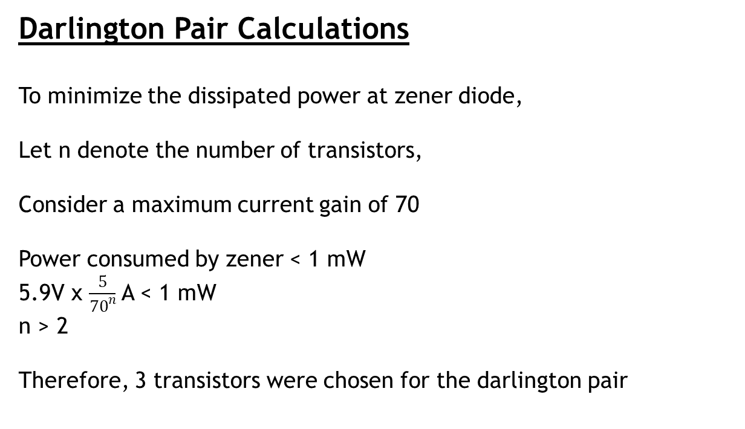

Slide 10
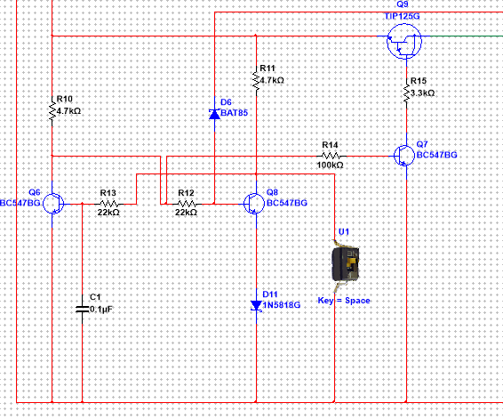
Circuit Protections
Short Circuit Protection

Slide 11
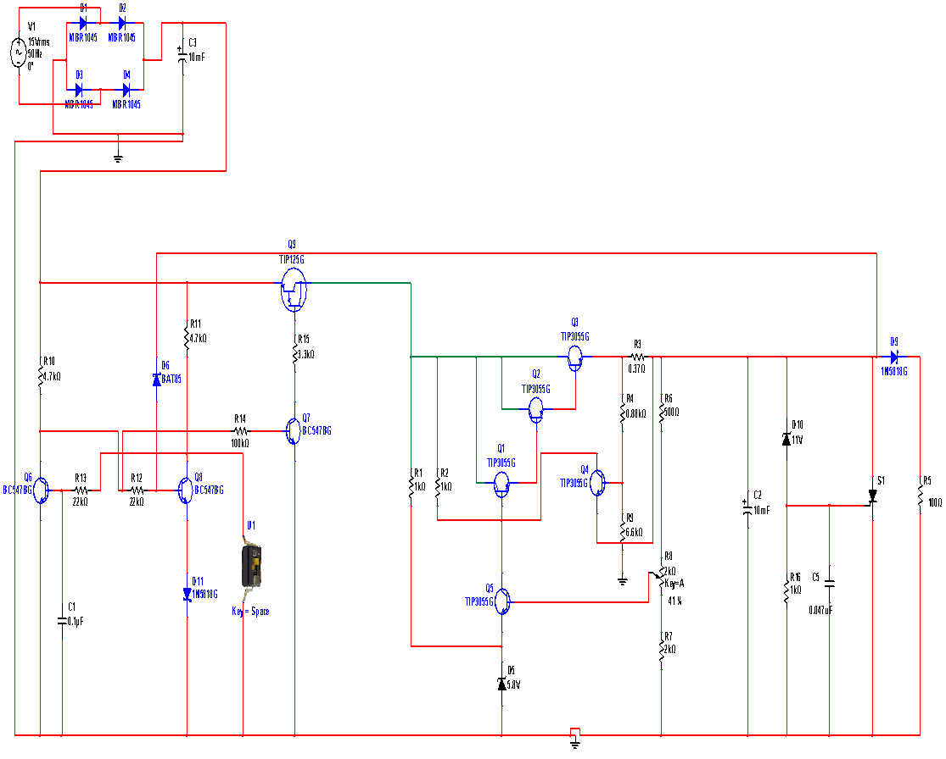
Over Voltage Protection
Over Load Protection

Slide 12
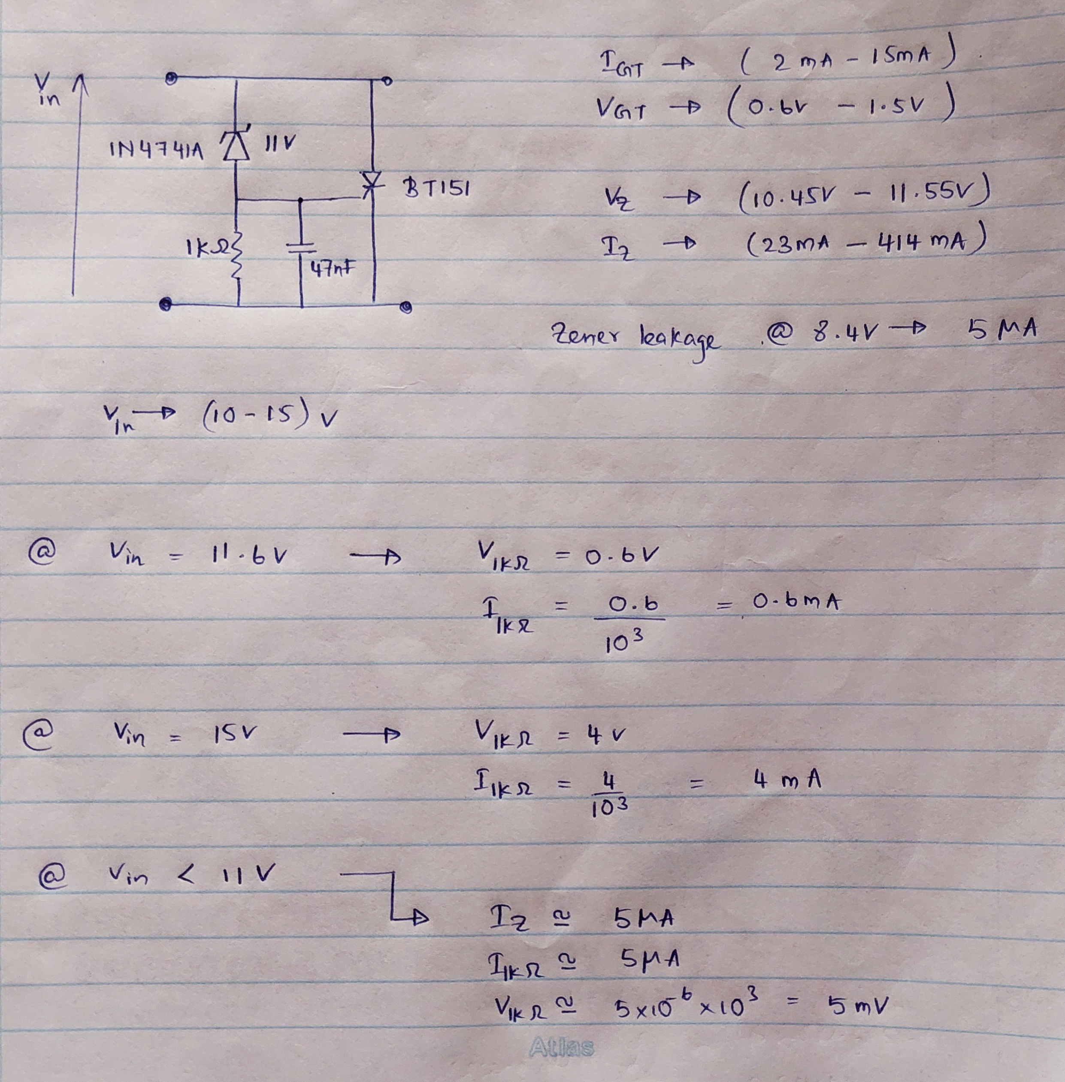
Over Voltage Protection circuit calculation

Slide 13
SIMULATION RESULTS

Slide 14
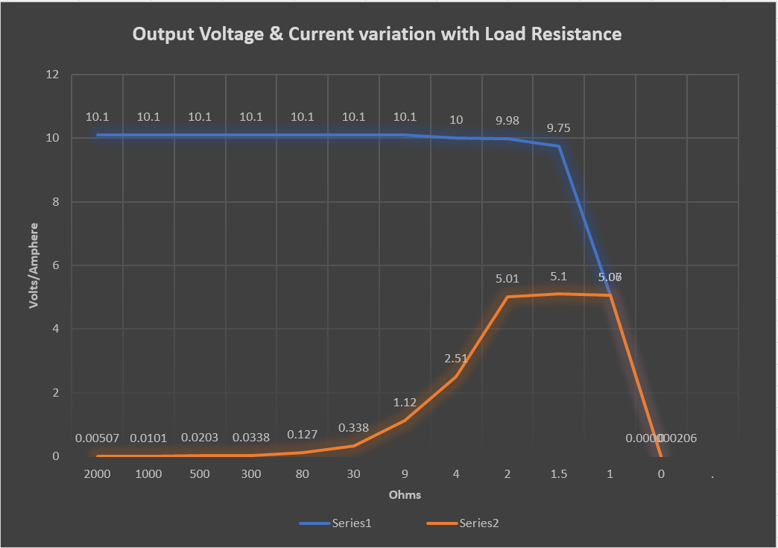

Slide 15
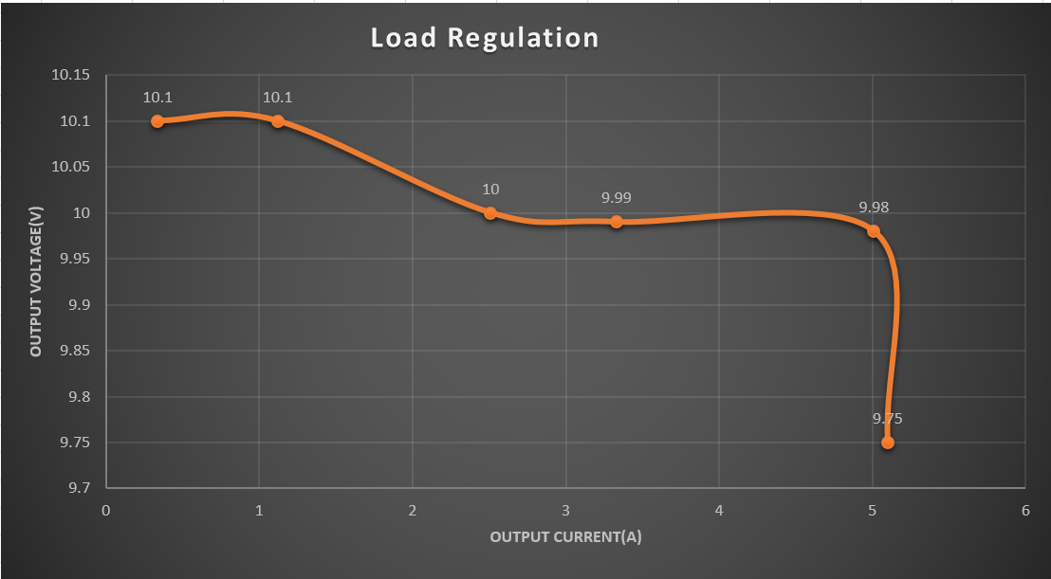

Slide 16
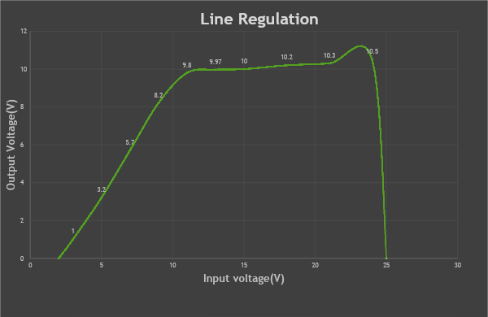

Slide 17
Accuracy
Accuracy = output voltage at maximum current/required output voltage
= 9.79/10 * 100%
= 97.9%

Slide 18
Breadboard Implementation
Load Resistance (ohms) | Output voltage (V)
2000 | 10.2
1000 | 10.1
500 | 10.1
100 | 9.7
50 | 9
30 | 8.1
10 | 7.3
5 | 6.9
2 | 6.5
When output current increase for small load resistance, the voltage loses from the bred board and jumper wires increases. So that output voltage dropped from a huge amount.

Slide 19
COMPLETION PLAN

Slide 20
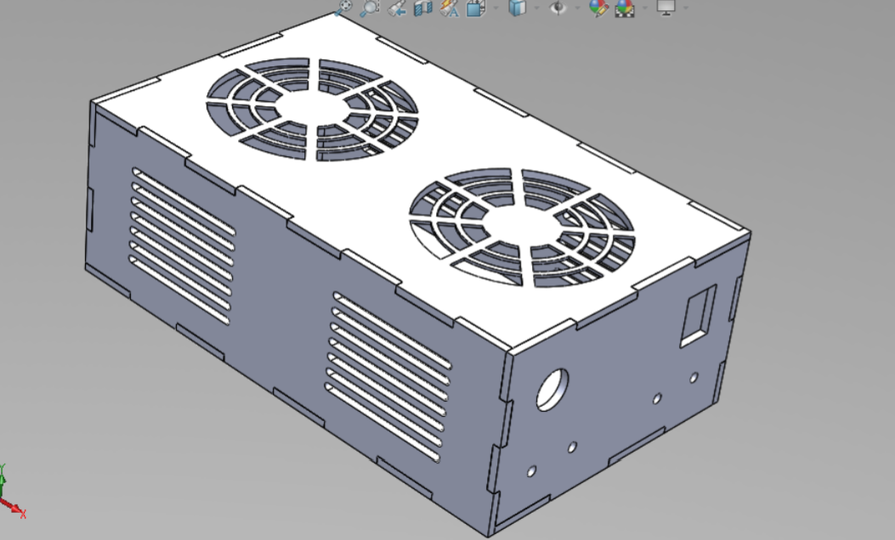
ENCLOSURE DESIGN

Slide 21
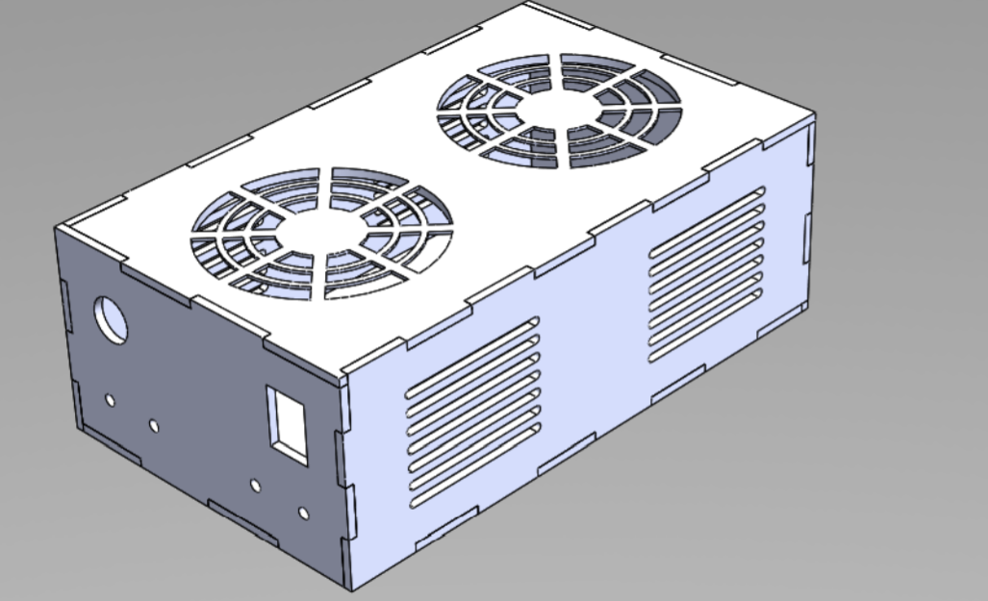

Slide 22
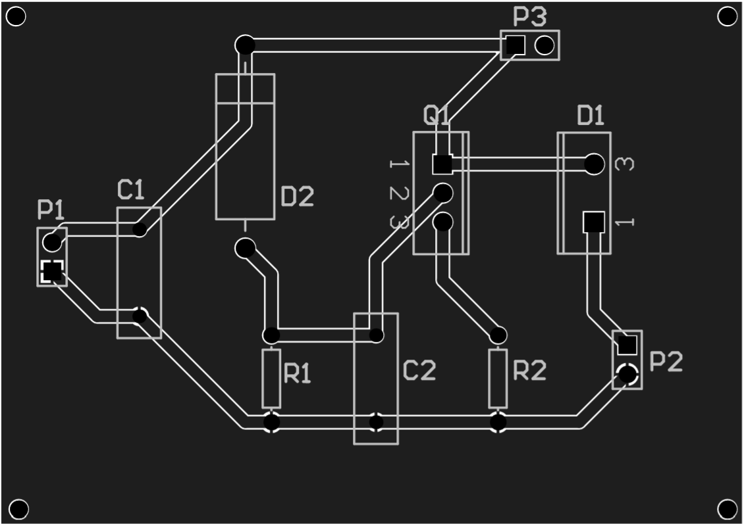
PCB DESIGN

Slide 23
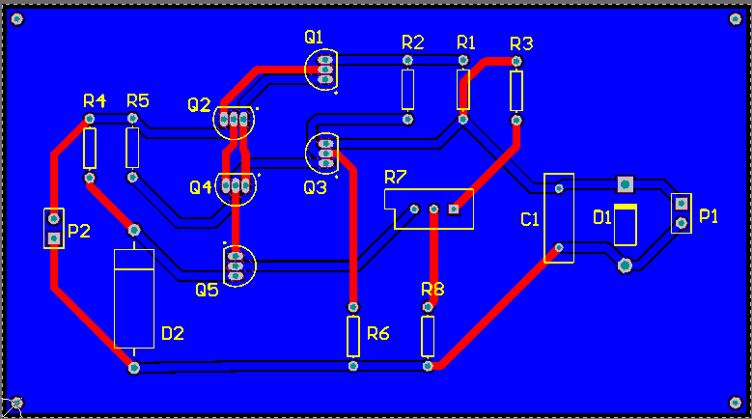

Slide 24
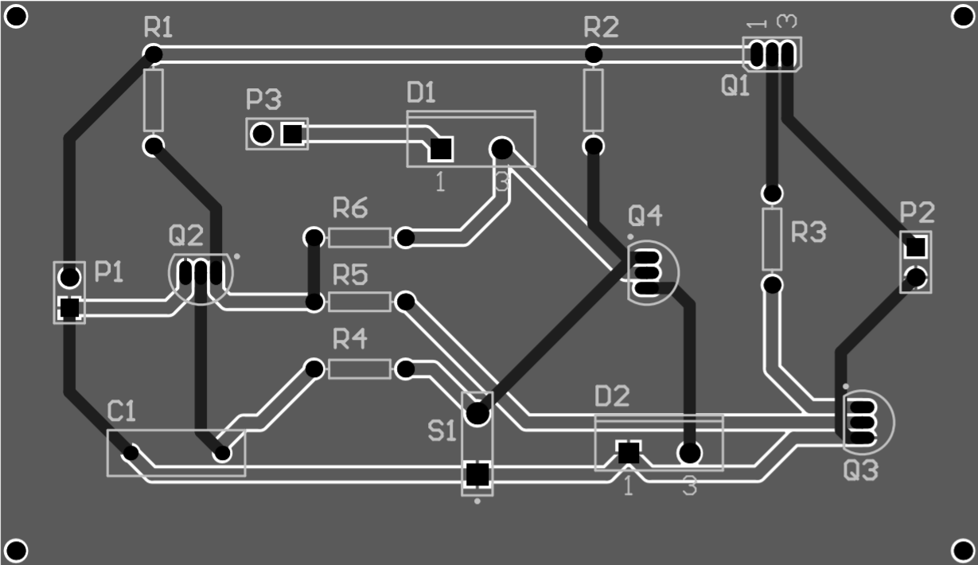

Slide 25
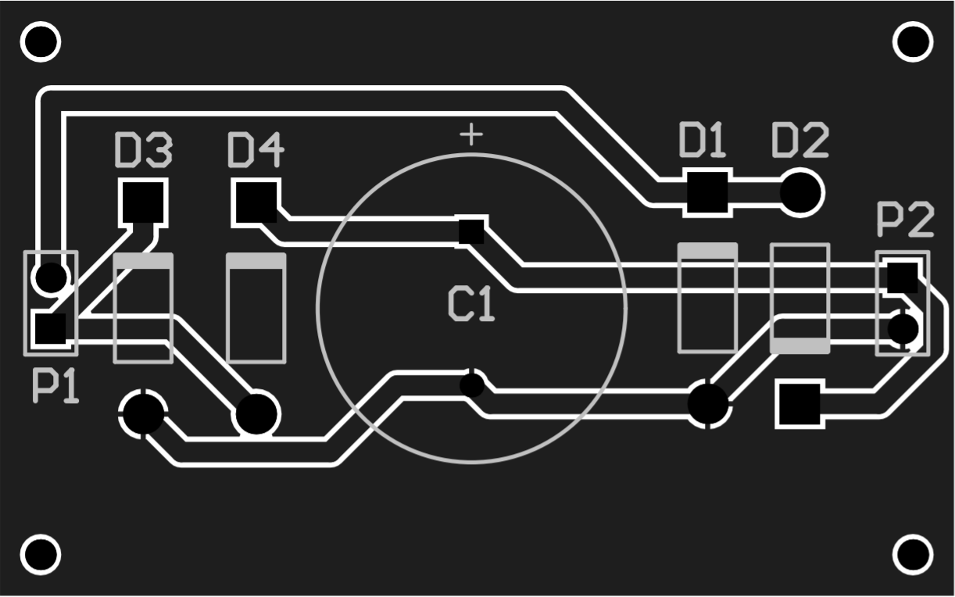

Slide 26
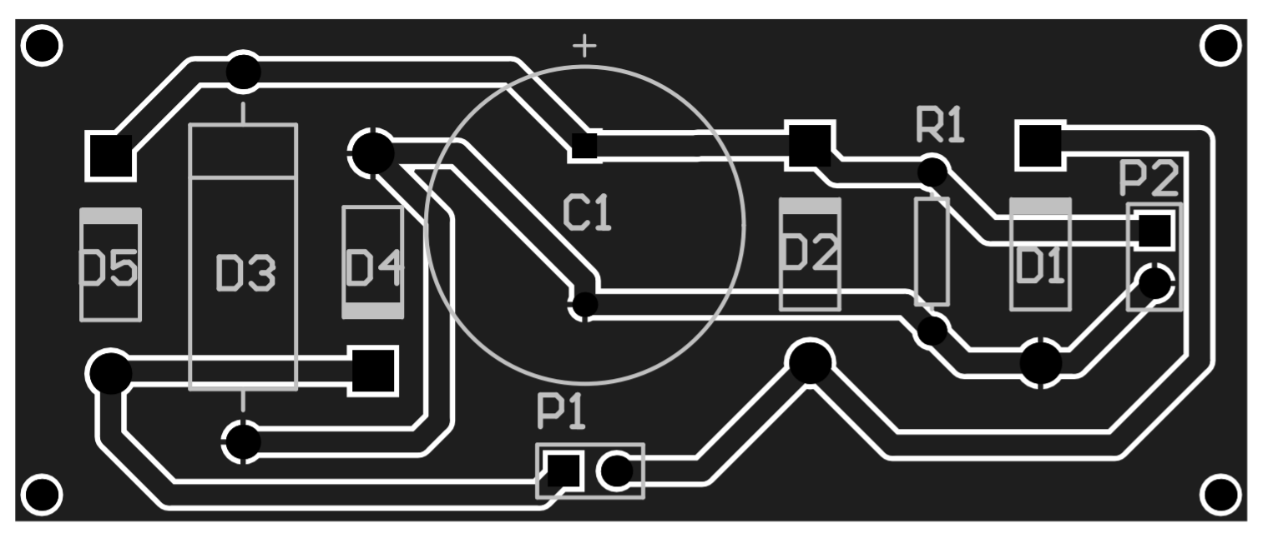

Slide 27
THANK YOU !!

