Slide 1
Blinkit Grocery
Dashboard Analysis
POWER BI PROJECT
Data Cleaning · DAX Measures · 3-Page Interactive Dashboard

Slide 2
AGENDA
What This Deck Covers
1
Objective & business questions
5
Chart Specifications
What the dashboard is designed to explain
Which chart, which fields, which question it answers
2
Dataset Overview
6
3-Page Dashboard Layout
8523 rows, 12-column
Overview · Product Analysis · Outlet Performance
3
Data Cleaning
7
Key Insights & Recommendations
Power Query steps to fix nulls, duplicates & inconsistent text
Practical follow-up analysis
4
DAX Measures
Reusable calculations that power every visual
Blinkit Grocery Dashboard | Power BI Project
2

Slide 3
SECTION 1
Objective & Business Question
Objective
!
Headline Insight
Build a 3-page Power BI dashboard on Blinkit data to understand sales performance across item types, fat content, outlet locations, outlet sizes and outlet types.
Total Sales
1.20M
Key Business Questions
1
Which item types have higher average sales?
Fruits and vegetables item have the highest sale and Supermarket Type 1 has the high sales share
2
How is total sales split by item fat content?
3
Which outlet types contribute the most sales?
4
How do outlet location tiers compare?
Blinkit Grocery Dashboard | Power BI Project
3

Slide 4
SECTION 2
Dataset Overview
BlinkIt Grocery Data.xlsx 8523 rows × 12 columns
Column | Data Type | Description
Item Fat Content | Text | Regular or Low fat content
Item Identifier | Text | Unique Identifier
Item Type | Text | Item category
Outlet Establishment Year | Whole Number | Year of establishment
Outlet Identifier | Text | Identification number for outlet
Outlet location Type | Text | Location category tier1/tier2/tier3
Outlet Size | Text | High/Medium/Small
Outlet Type | Text | Grocery store/Supermarket - Type1/Type2/Type3
Item Visibility | Decimal Number | Items visibility
Item Weight | Decimal Number | Weight of item
Sales | Decimal Number | Sales Amount
Rating | Whole Number | Rating
Raw Data Snapshot
8523
total rows
10
Count of outlets
1559
Count of item identifiers
4
Outlet types
Blinkit Grocery Dashboard | Power BI Project
4

Slide 5
SECTION 3
Data Cleaning in Power Query
Query steps applied, in order, inside Power Query Editor before loading to the data model:
01
Check data types
05
Reconcile totals
Sales and item weight should be numeric; ratings and identifiers should use suitable types.
Confirm total sales and outlet/item counts against the source data after cleaning.
02
Check missing values
06
Document transformations
Review blanks in Item Type, Item Fat Content, Outlet Type, Outlet Size and location fields.
Keep the cleaning steps repeatable so refreshes use the same logic.
03
Check duplicates
07
Close & Load to Model
Validate whether item/outlet rows are repeated intentionally before removing any records.
Loaded the cleaned table into the Power BI data model for measures and visuals.
04
Validate category labels
Standardize fat content, outlet type, outlet size and location tier labels.
Blinkit Grocery Dashboard | Power BI Project
5

Slide 6
SECTION 4
DAX Measures
Added in Report view (Modeling > New Measure) — calculated on the fly in the current filter context, used by every chart & KPI card.
fx
Total Sale
SUM('BlinkIT Grocery Data'[Sales])
fx
Average Sale
AVERAGE('BlinkIT Grocery Data'[Sales])
fx
Average Rating
AVERAGE('BlinkIT Grocery Data'[Rating])
Blinkit Grocery Dashboard | Power BI Project
6

Slide 7
SECTION 5
Chart Specifications
Each visual is scoped to one clear question — mapped to the dashboard page it appears on.
Page | Visual/Fields Used | Question It Answers
Overview | KPI cards: Total Sale, Average Sales, Average Rating | What is the overall performance snapshot?
Overview | Sales by Item Fat Content | How does sales contribution differ by fat content?
Overview | Total Sale by Item Type | Which item types contribute to sales?
Overview | Total Sale by Outlet Establishment Year | How does sales vary by outlet establishment year?
Overview | Fat content / outlet location tier comparison | How do sales and average sales differ across location tiers?
Product Analysis | Average Sales by Item Type | Which item types have higher average sales?
Product Analysis | Total Sale by Item Type and Item Fat Content | How does fat content contribute within each item type?
Outlet Performance | Total Sale by Outlet Size / Outlet Type | Which outlet sizes and outlet types contribute most?
Outlet Performance | Average Rating by Outlet Type | Which payment method is used most often?
Blinkit Grocery Dashboard | Power BI Project
7

Slide 8
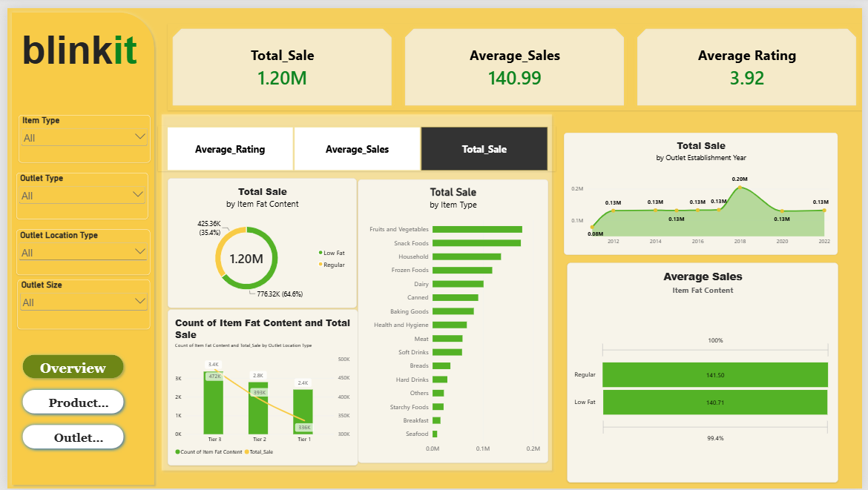

Slide 9
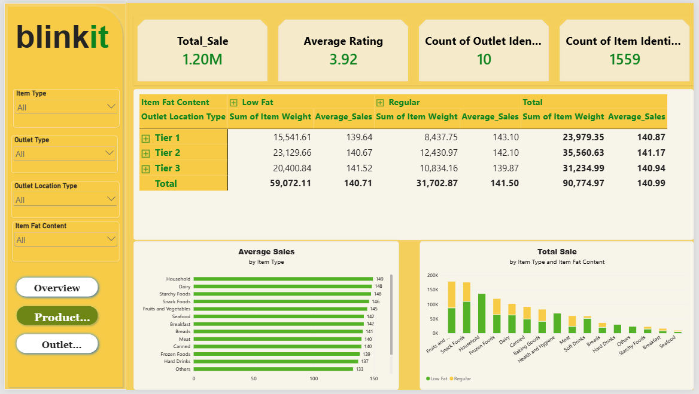

Slide 10
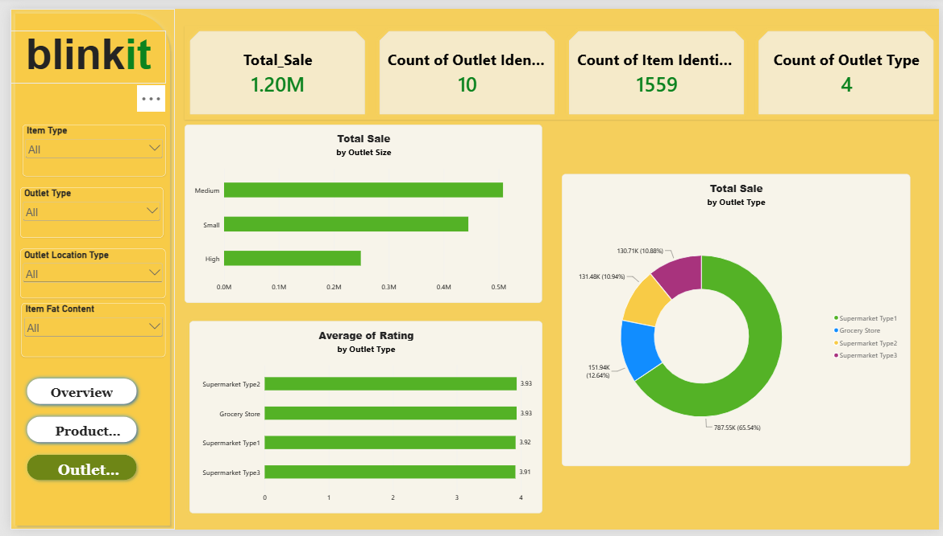

Slide 11
SECTION 7
Key Insights
1
Low Fat items dominate the sales split
3
Average sales are similar across location tiers
Low Fat accounts for 776.32K (64.6%) compared with 425.36K (35.4%) for Regular. This is a sales mix result, not proof that customers prefer Low Fat without unit/order context.
The displayed averages are 140.87 (Tier 1), 141.17 (Tier 2) and 140.94 (Tier 3), so the differences are small.
4
Ratings sit between 3.91 and 3.93. The dashboard shows little separation in average rating across the four outlet types.
Average rating is consistent by outlet type
2
At 787.55K (65.54%), Type1 contributes far more sales than each other outlet type in the displayed report.
Supermarket Type1 is the main sales contributor
5
Item-type average sales vary more than tier averages
Household is highest at 149 and Others lowest at 133, while tier-level averages cluster around 141.
Blinkit Grocery Dashboard | Power BI Project
11

Slide 12
CONCLUSION
From Dashboard Findings to Next Steps
Project checklist
Recommendations
8523-row source CSV
Compare sales with item counts or units sold before concluding that a category is more popular.
Break down Supermarket Type1 sales by outlet size, location tier and establishment year to understand what drives its lead.
Review outlet-establishment-year values and outlet counts together to avoid interpreting outlet age as a causal factor.
Use slicers to check whether fat-content and item-type patterns remain consistent across outlet types and locations.
Validate all KPI values after adding measures and calculated columns; reconcile totals to the supplied dashboard.
Cleaned Power Query model
Displayed values interpreted
3 DAX measures
Source model still needs validation
Blinkit Grocery Dashboard | Power BI Project

