Slide 1
EMPLOYEE TRAINING EFFECTIVENESS
A Power BI Dashboard Project — Build Guide & Insights
Dataset: 5,000 employee training records • 10 columns • CSV & XLSX

Slide 2
01 · OBJECTIVE
Why This Dashboard Exists
1
2
3
4
Measure training ROI
Spot completion gaps
Guide L&D investment
Demonstrate BI skills
Track how much employee skill scores improve after training, relative to program cost.
Identify which departments, regions, or programs have low completion or high drop-off.
Show leadership which programs deliver the strongest learning gains and satisfaction.
Show end-to-end capability: data modeling, DAX, calculated columns, and storytelling.
Business question: “Are our training programs actually improving employee performance, and is the spend justified?”
Training Effectiveness Dashboard | Power BI Project Walkthrough
2

Slide 3
02 · DATASET
Dataset Overview — 10 Columns, 5,000 Rows
Column | Type | Description
EmployeeID | Text | Unique employee identifier (EMP10001–EMP15000)
Department | Text | Sales, IT, HR, Finance, Operations, Marketing, Support, R&D
Region | Text | North, South, East, West, Central
TrainingProgram | Text | One of 10 training courses offered
EnrollmentDate | Date | Date employee enrolled (2024–2025)
CompletionStatus | Text | Completed / In Progress / Dropped
PreTrainingScore | Number | Assessment score before training (0–100)
PostTrainingScore | Number | Score after training (blank if not completed)
TrainingCost_INR | Number | Cost of training per employee (₹)
SatisfactionRating | Number | Post-training feedback score (1–5)
QUICK FACTS
5,000
Total records
10
Data columns
8
Departments
5
Regions
10
Training programs
24 mo
Date range (2024–25)
Training Effectiveness Dashboard | Power BI Project Walkthrough
3

Slide 4
03 · BUILD PROCESS
6 Steps to Build the Dashboard in Power BI
1
Get & Clean Data
2
Model the Data
3
Add Calculated Columns
Import the CSV/XLSX via Get Data. Fix data types (dates as Date, scores/cost as Decimal). Handle blanks in PostTrainingScore in Power Query.
Keep a single flat table, or split into Fact_Training + Dim tables. Build a Date table and mark it as the official Date table.
Create row-level fields for filtering/grouping: Score Improvement, Enrollment Month, Outcome Flag, Cost Bucket.
4
Write DAX Measures
5
Design the Report Page
6
Test, Format & Publish
Build reusable measures: Completion Rate %, Avg Score Improvement, Avg Satisfaction, Total Cost, Cost per Completion.
Add KPI cards, bar/column charts, a matrix, and slicers. Apply a consistent theme and clear titles.
Check slicer interactions, format numbers/currency, add tooltips, test mobile layout, then publish.
Training Effectiveness Dashboard | Power BI Project Walkthrough
4

Slide 5
04 · DATA MODELING
Calculated Columns
Row-level columns added in Power BI to enable grouping, filtering, and conditional formatting.
Score Improvement
Score Improvement =
IF(ISBLANK('Training'[PostTrainingScore]), BLANK(),
'Training'[PostTrainingScore] - 'Training'[PreTrainingScore])
Drives the improvement histogram & top-programs ranking.
Enrollment Month
Enrollment Month =
FORMAT('Training'[EnrollmentDate], "MMM YYYY")
Powers the monthly enrollment trend line & slicer.
Outcome Flag
Outcome Flag =
SWITCH('Training'[CompletionStatus],
"Completed","On Track","Dropped","At Risk","In Progress")
Simplifies status into a 3-tier label for KPI icons/colors.
Cost Bucket
Cost Bucket =
IF('Training'[TrainingCost_INR]<200,"Low",
IF('Training'[TrainingCost_INR]<400,"Medium","High"))
Groups spend into bands for the cost-distribution chart.
Training Effectiveness Dashboard | Power BI Project Walkthrough
5

Slide 6
04 · DATA MODELING
Core DAX Measures
Measures aggregate across whatever filters/slicers are applied — used directly on KPI cards and charts.
Completion Rate %
Avg Score Improvement
Completion Rate % =
Completion Rates% = DIVIDE([Completed Employees],[Total Employees])
Where Total Employees = DISTINCTCOUNT(training_effectiveness_data[EmployeeID])
Completed Employees = CALCULATE(DISTINCTCOUNT(training_effectiveness_data[EmployeeID]),training_effectiveness_data[CompletionStatus]="Completed")
AVERAGE(training_effectiveness_data[Score Improvement])
Avg Satisfaction
Total Training Cost
Avg Satisfaction = AVERAGE('training_effectiveness_data'[SatisfactionRating])
Total Training Cost = SUM('training_effectiveness_data'[TrainingCost_INR])
Cost per Completion
Drop-off Rate %
Cost per Completion = DIVIDE([Total Training Cost],[Completed Employees])
Drop-Off-Rate% = DIVIDE(CALCULATE([Total Employees],training_effectiveness_data[CompletionStatus]="Dropped"),[Total Employees])
Training Effectiveness Dashboard | Power BI Project Walkthrough
6

Slide 7
05 · REPORT DESIGN
Chart & Visual Specifications
Visual | Type | Fields Used | Purpose
KPI Cards | Card | Completion Rate %, Total Employees, Avg Satisfaction, Total Cost | At-a-glance headline metrics
Enrollment Trend | Line chart | Enrollment Month (X) vs Count of EmployeeID (Y) | Track enrollment volume over time
Completion by Dept | Funnel Chart | Department (Y) vs Completion Rate % (X) | Compare departments' completion
Improvement by Program | Funnel chart | TrainingProgram (X) vs Avg Score Improvement (Y) | Rank programs by learning gain
Cost vs Improvement | Scatter chart | TrainingCost_INR (X), Score Improvement (Y), Program (legend) | Spot cost-effective programs
Status Breakdown | Donut chart | CompletionStatus, Count of EmployeeID | Show Completed/In Progress/Dropped mix
Detail Matrix | Matrix/Table | Department, Region, Program, all key measures | Drill-down for analysts
Filters | Slicers | Region, Department, Training Program, Completion Status,EnrollmentDate (range) | Let users filter the whole page
Training Effectiveness Dashboard | Power BI Project Walkthrough
7

Slide 8
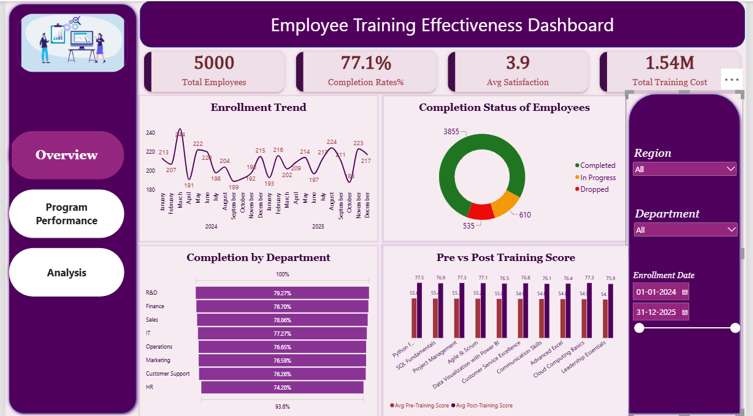

Slide 9
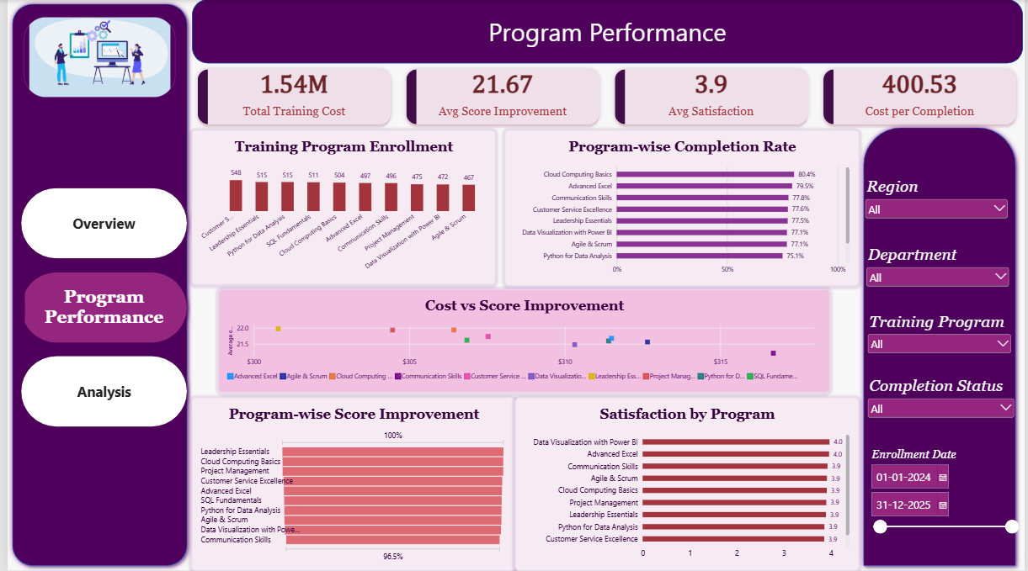

Slide 10
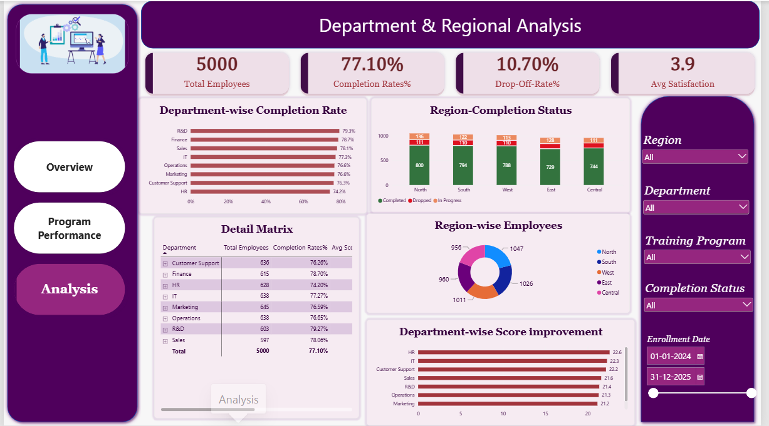

Slide 11
06 · ANALYSIS
Data Findings & Insights
Based on the 5,000-row generated dataset (illustrates the kind of storytelling this dashboard supports).
77.1%
+21.67 pts
3.9 / 5
1.54M
Overall completion rate
Avg score improvement (completed)
Avg satisfaction (completed)
Total training spend
1
Leadership Essentials and Cloud Computing Basics produced the highest average score gains (~22 pts), while Communication Skills trailed slightly (~21.2 pts) — gains are fairly even across programs.
R&D and Finance have the highest completion rates (~79%), while HR is lowest (~74%) — a possible signal to review HR scheduling or workload conflicts.
2
Employees who dropped out rated satisfaction far lower on average (2.65/5) than those who completed (4.07/5), reinforcing that early engagement drives both completion and sentiment.
3
Customer Service Excellence, Leadership Essentials, and Python for Data Analysis are the top 3 programs by enrollment (500+ each), indicating strong demand to plan capacity around.
4
Training Effectiveness Dashboard | Power BI Project Walkthrough
9

Slide 12
SUMMARY & TAKEAWAYS
What This Project Demonstrates
End-to-end workflow: raw data → Power Query cleanup → data model → DAX → visual storytelling.
Hands-on use of calculated columns vs. measures, and when to use each.
Business framing: every chart ties back to a real L&D decision (completion, cost, satisfaction).
Result: training completion is strong (77%) and effective (+21.7 avg pts), but HR completion and early drop-off satisfaction are clear areas to act on.
Resume line: “Built an end-to-end Power BI dashboard analyzing training effectiveness across 5,000 employee records — designed calculated columns and DAX measures to track completion rate, score improvement, and training ROI.”
Training Effectiveness Dashboard | Power BI Project Walkthrough
10

