Slide 1

SKILL DEVELOPMENT PROJECT
Project name: Library Management System
Submitted by :
Anjana .V
12322576

Slide 2
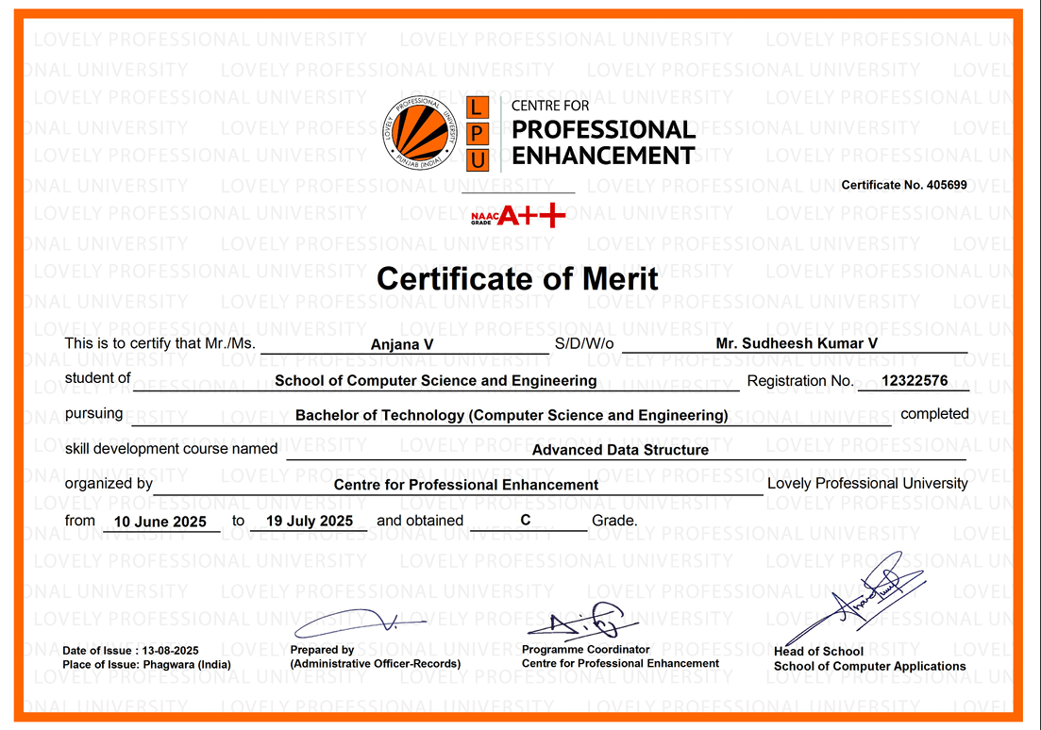
CERTIFICATE

Slide 3
Objectives of the Project
To simplify and automate library management tasks.
Maintain accurate records of books and borrowers.
Track popular books and borrowing frequency.

Slide 4
Features Implemented
Add/Search books
Borrow and return functionality
Maintain borrower history
Display most popular books
Track availability and copies
FIFO-based return system

Slide 5
Importance in Real World
Manual library systems are time consuming and error-prone.
A digital library management system ensures:
Efficiency : Quick search and updated.
Accuracy : Reduce human errors.
Scalability : Can manage large datasets.
Transparency: Track all transactions clearly.

Slide 6
Tools & Technologies used
Backend: C++ with STL
Frontend: HTML, CSS
Editor: Visual Studio Code
Execution: Terminal / Command Prompt
Browser: For frontend interface

Slide 7
Data Structures Used
Unorderded_Map : To store and access books by ID
Fast retrieval by book ID [O(1)]
Queue : Manage book returns(FIFO).
Perfect for handling return order
Priority Queue : Track most borrowed books.
Identifies top borrowed books efficiently.
Map : Sorting list of Authors and books.
Keep keys ordered automatically

Slide 8
Conclusion
The project demonstrates how data structures form the backbone
of efficient software.
It shows practical application of STL in real-world systems.

