Slide 1
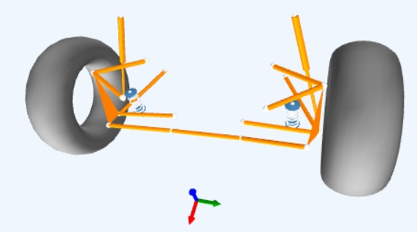
STATE SPACE ANALYSIS OF ACTIVE SUSPENSION SYSTEM​
GROUP NO 10:​
Anjaneyadora Adapa (234103406)
T Lhingminchong Haokip (234103441)
Vikas Kumar (234103442)

Slide 2
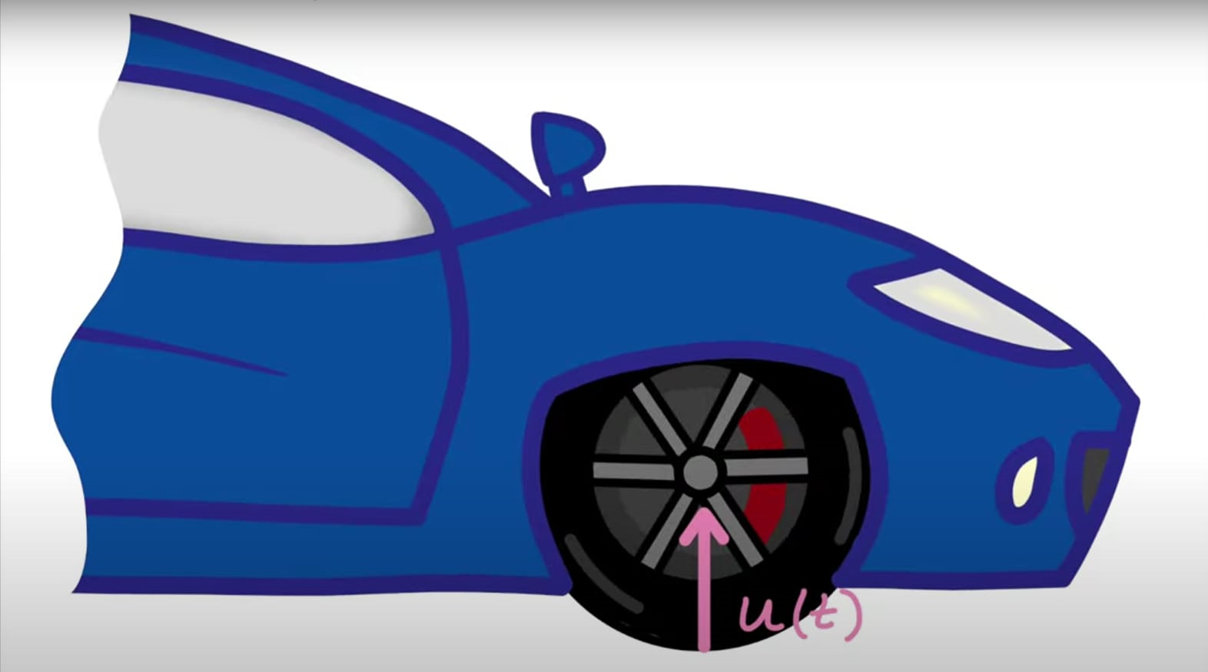
OVERVIEW
Objective
Physical systems​
Suspension systems
Modeling​(block diagram)
Diffenretial equations​
State space​
Matlab​
script
Results

Slide 3
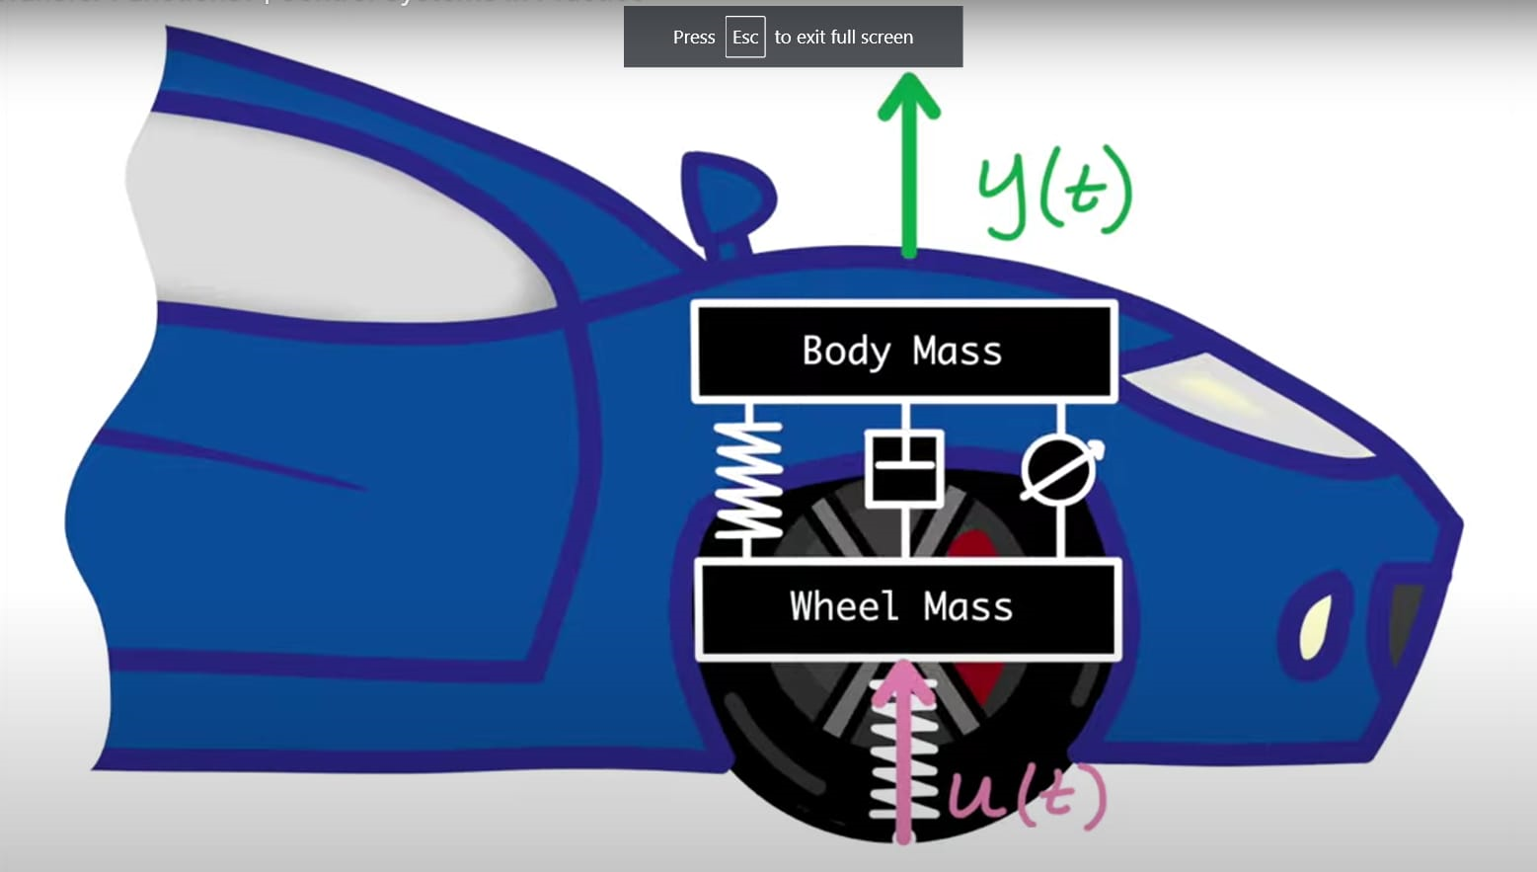
OBJECTIVE
To isolate the car body from
road disturbances​
Broad classification of suspension systems:​
PASSIVE: conventional method by utilizing a spring and a damper​
SEMI-ACTIVE: this has a controllable damper​
ACTIVE: has an actuator in parallel with the damper and the spring

Slide 4
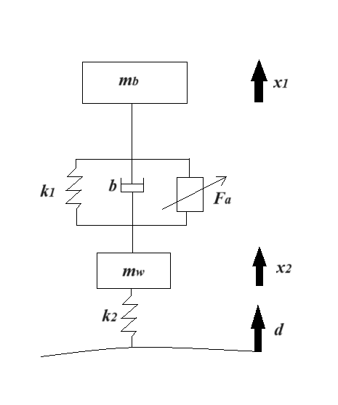
MASS-SPRING DAMPER SYSTEM
Systems ​
Two masses: m_{b} (body mass), m_{w}(wheel mass)​
Two springs​
One damper​
One actuator​
The two masses are connected with
a spring factor, k₁ (N/m),
a damper with a damping factor, b(Ns/m), and
has a hydraulic actuator with force , F_{a}(N)​
Stiffness of tire: k₂ (N/m)

Slide 5
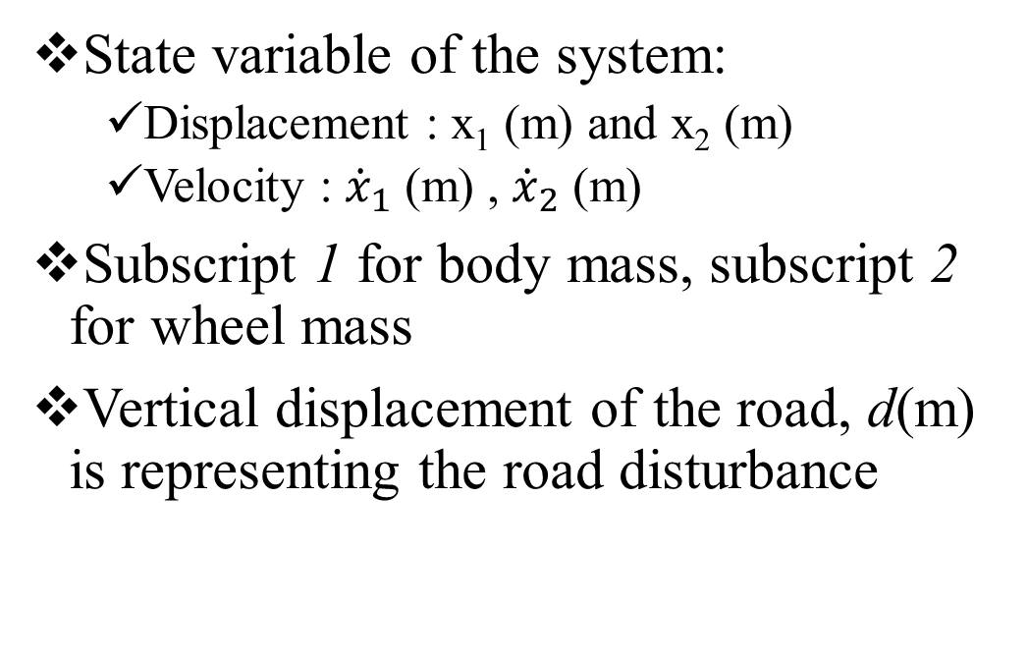
MASS-SPRING DAMPER SYSTEM
State variable of the system:​
Displacement : x₁ (m) and x₂ (m)​
Velocity : ${\dot{x}}_{1}$ (m) , ${\dot{x}}_{2}$ (m) ​
Subscript 1 for body mass, subscript 2 for wheel mass​
Vertical displacement of the road, d(m) is representing the road disturbance

Slide 6
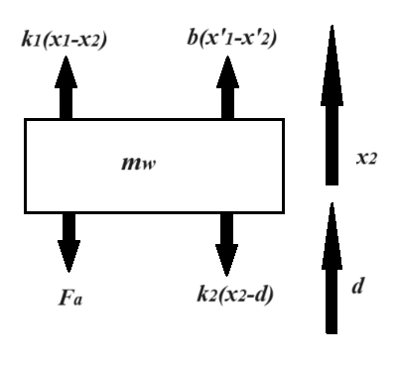
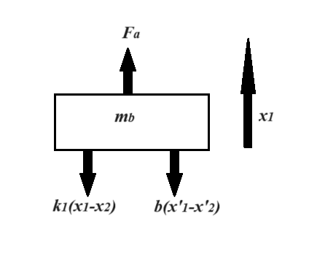
BLOCK DIAGRAM AND FBD OF EACH MASSES
Fig: FBD of wheel mass
Fig: FBD of body mass
Fig: Block diagram of the suspension system

Slide 7
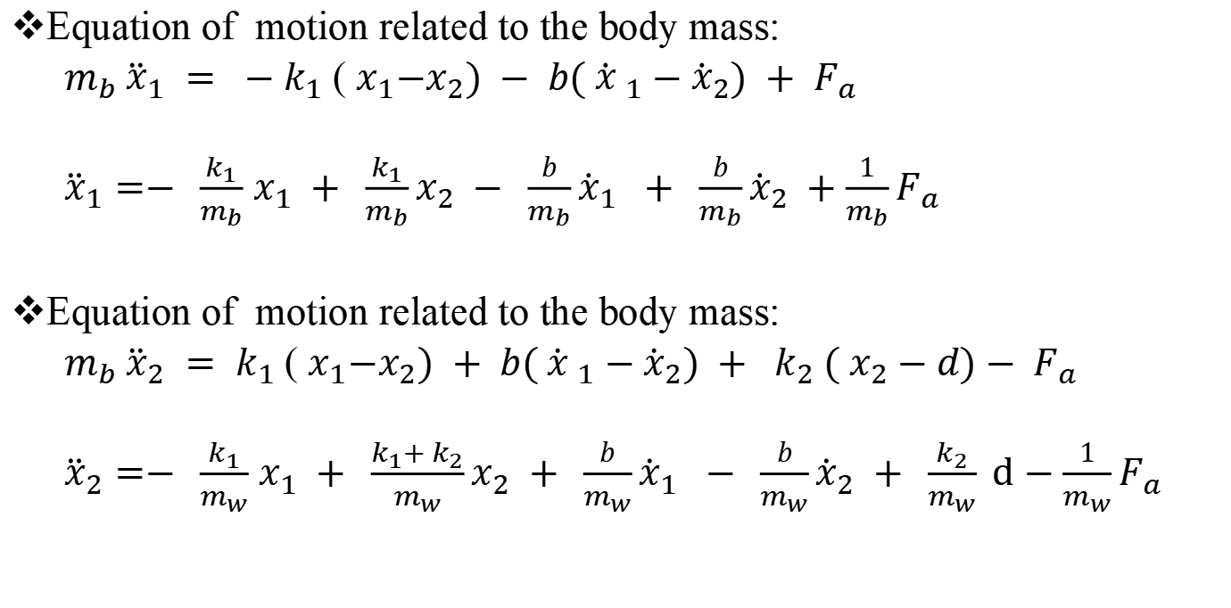
EQUATION OF MOTION
Equation of motion related to the body mass:
$m_{b} {\ddot{x}}_{1} = −k_{1}$( $x_{1}{−x}_{2}) − b( {\dot{x} }_{1}−{\dot{x}}_{2}) + F_{a}$
${\ddot{x}}_{1}=− \frac{k_{1}}{m_{b}}$ $x_{1} + \frac{k_{1}}{m_{b}}x_{2} − \frac{b}{m_{b}}{\dot{x}}_{1} + \frac{b}{m_{b}}{\dot{x}}_{2} +\frac{1}{m_{b}}F_{a}$
Equation of motion related to the body mass:
$m_{b} {\ddot{x}}_{2} = k_{1}$( $x_{1}{−x}_{2}) + b( {\dot{x} }_{1}−{\dot{x}}_{2}) + k_{2} ( x_{2}−d)− F_{a}$
${\ddot{x}}_{2}=− \frac{k_{1}}{m_{w}}$ $x_{1} + \frac{k_{1}+ k_{2}}{m_{w}}x_{2} + \frac{b}{m_{w}}{\dot{x}}_{1} − \frac{b}{m_{w}}{\dot{x}}_{2} + \frac{k_{2}}{m_{w}} d−\frac{1}{m_{w}}F_{a}$

Slide 8
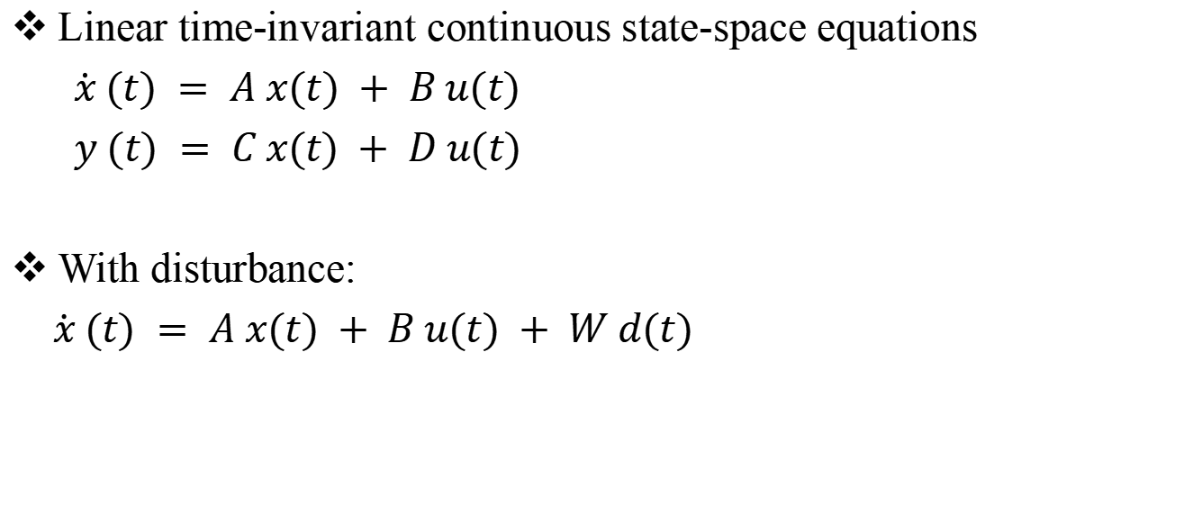
STATE SPACE MODEL
Linear time-invariant continuous state-space equations
$\dot{x} (t) = A x(t) + B u(t)$
$y (t) = C x(t) + D u(t)$
With disturbance:
$\dot{x} (t) = A x(t) + B u(t) + W d(t)$

Slide 9
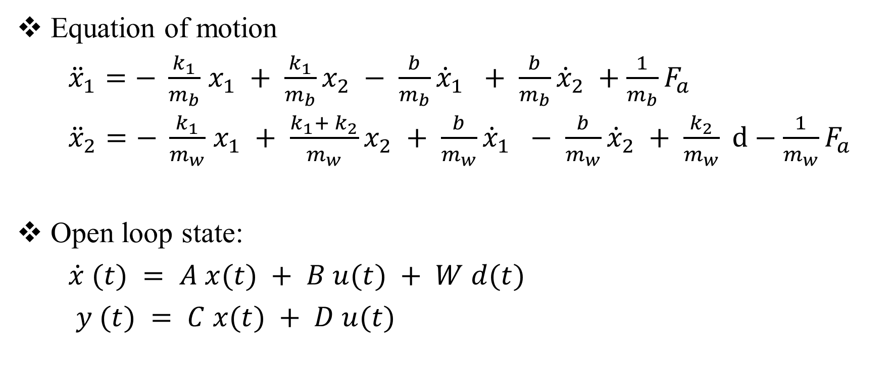
STATE SPACE MODEL
Equation of motion
${\ddot{x}}_{1}=− \frac{k_{1}}{m_{b}}$ $x_{1} + \frac{k_{1}}{m_{b}}x_{2} − \frac{b}{m_{b}}{\dot{x}}_{1} + \frac{b}{m_{b}}{\dot{x}}_{2} +\frac{1}{m_{b}}F_{a}$
${\ddot{x}}_{2}=− \frac{k_{1}}{m_{w}}$ $x_{1} + \frac{k_{1}+ k_{2}}{m_{w}}x_{2} + \frac{b}{m_{w}}{\dot{x}}_{1} − \frac{b}{m_{w}}{\dot{x}}_{2} + \frac{k_{2}}{m_{w}} d−\frac{1}{m_{w}}F_{a}$
Open loop state:
$\dot{x} (t) = A x(t) + B u(t) + W d(t)$
$y (t) = C x(t) + D u(t)$

Slide 10
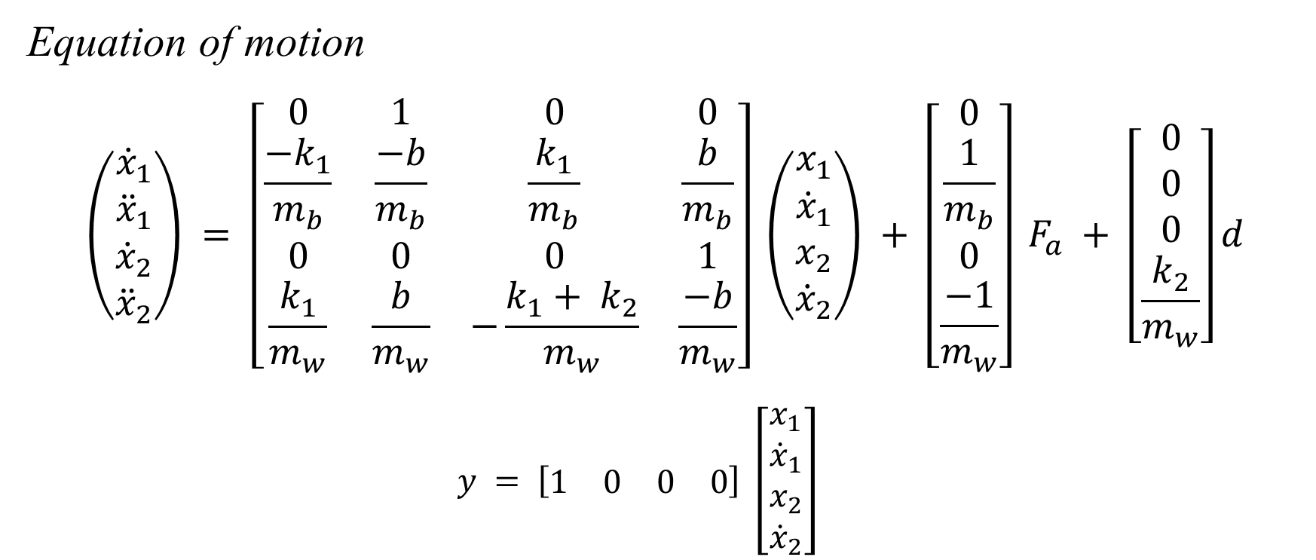
STATE SPACE MODEL
Equation of motion
$$\left(\begin{matrix}{\dot{x}}_{1} \\ {\ddot{x}}_{1} \\ {\dot{x}}_{2} \\ {\ddot{x}}_{2}\end{matrix}\right) = \left[\begin{matrix}0 & 1 & 0 & 0 \\ \frac{−k_{1}}{m_{b}} & \frac{−b}{m_{b}} & \frac{k_{1}}{m_{b}} & \frac{b}{m_{b}} \\ 0 & 0 & 0 & 1 \\ \frac{k_{1}}{m_{w}} & \frac{b}{m_{w}} & −\frac{k_{1}+ k_{2}}{m_{w}} & \frac{−b}{m_{w}}\end{matrix}\right] \left(\begin{matrix}x_{1} \\ {\dot{x}}_{1} \\ x_{2} \\ {\dot{x}}_{2}\end{matrix}\right) + \left[\begin{matrix}0 \\ \frac{1}{m_{b}} \\ 0 \\ \frac{−1}{m_{w}}\end{matrix}\right] F_{a} + \left[\begin{matrix}0 \\ 0 \\ 0 \\ \frac{k_{2}}{m_{w}}\end{matrix}\right]d$$
$$y = \left[\begin{matrix}1 & 0 & 0 & 0\end{matrix}\right] \left[\begin{matrix}x_{1} \\ {\dot{x}}_{1} \\ x_{2} \\ {\dot{x}}_{2}\end{matrix}\right]$$

Slide 11
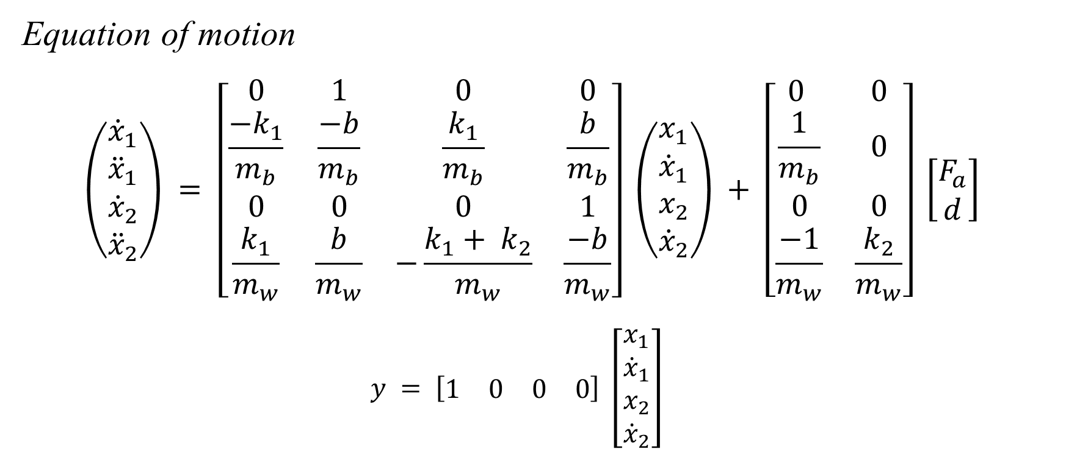
STATE SPACE MODEL
Equation of motion
$$\left(\begin{matrix}{\dot{x}}_{1} \\ {\ddot{x}}_{1} \\ {\dot{x}}_{2} \\ {\ddot{x}}_{2}\end{matrix}\right) = \left[\begin{matrix}0 & 1 & 0 & 0 \\ \frac{−k_{1}}{m_{b}} & \frac{−b}{m_{b}} & \frac{k_{1}}{m_{b}} & \frac{b}{m_{b}} \\ 0 & 0 & 0 & 1 \\ \frac{k_{1}}{m_{w}} & \frac{b}{m_{w}} & −\frac{k_{1}+ k_{2}}{m_{w}} & \frac{−b}{m_{w}}\end{matrix}\right] \left(\begin{matrix}x_{1} \\ {\dot{x}}_{1} \\ x_{2} \\ {\dot{x}}_{2}\end{matrix}\right) + \left[\begin{matrix}0 & 0 \\ \frac{1}{m_{b}} & 0 \\ 0 & 0 \\ \frac{−1}{m_{w}} & \frac{k_{2}}{m_{w}}\end{matrix}\right] \left[\begin{matrix}F_{a} \\ d\end{matrix}\right]$$
$$y = \left[\begin{matrix}1 & 0 & 0 & 0\end{matrix}\right] \left[\begin{matrix}x_{1} \\ {\dot{x}}_{1} \\ x_{2} \\ {\dot{x}}_{2}\end{matrix}\right]$$

Slide 12
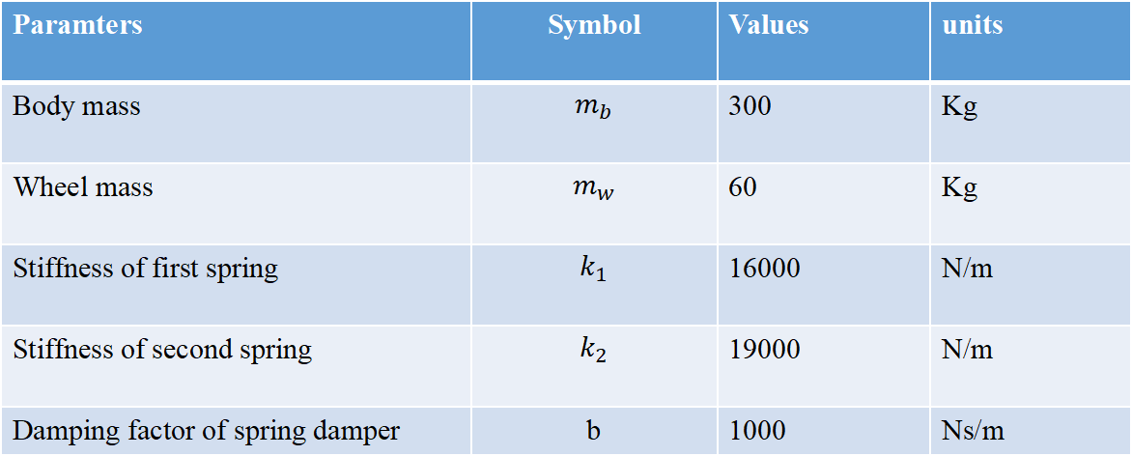
SIMULATION USING MATLAB
Systems parameters:
Paramters | Symbol | Values | units
Body mass | $$m_{b}$$ | 300 | Kg
Wheel mass | $$m_{w}$$ | 60 | Kg
Stiffness of first spring | $$k_{1}$$ | 16000 | N/m
Stiffness of second spring | $$k_{2}$$ | 19000 | N/m
Damping factor of spring damper | b | 1000 | Ns/m

Slide 13
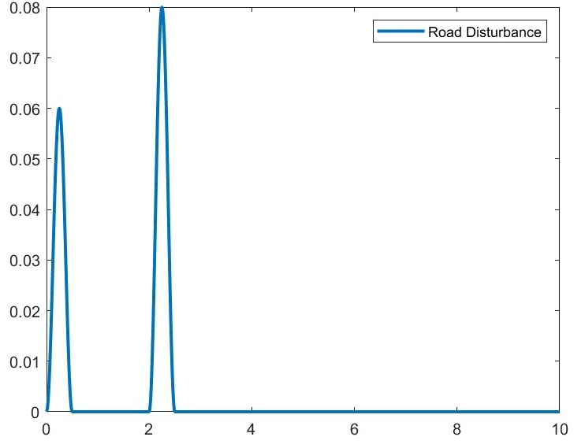
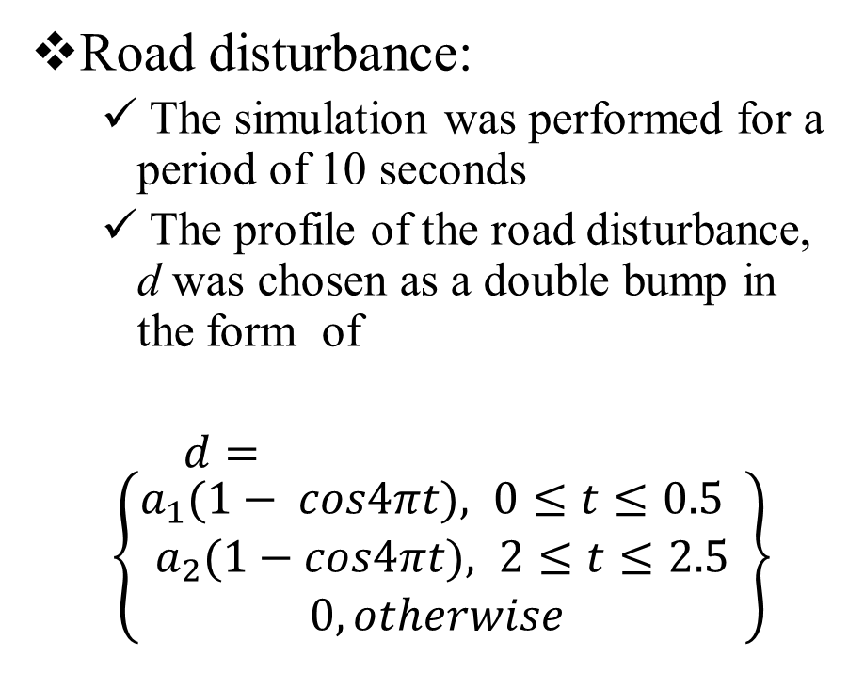
SIMULATION USING MATLAB
Road disturbance:
The simulation was performed for a period of 10 seconds
The profile of the road disturbance, d was chosen as a double bump in the form of
$d= \left\{\begin{aligned}a_{1}(1− cos4πt), 0≤t≤0.5 \\ a_{2}(1−cos4πt), 2≤t≤2.5 \\ 0, otherwise \end{aligned}\right\}$
Fig: Road disturbaance

Slide 14
MATLAB SCRIPT
%MATLAB Code
%State Space Analysis Of Active Suspension System.
clc
close all
clear all
t = 10; %Simulation Time
si = 0.01; %Sub-interval
%Simulation Of Road Disturbance
x = 0;
a1 = 0.03; %Constant
a2 = 0.04; %Constant
for i = 0:si:t
x = x+1;
if i<0.5
ud(x) = a1*(1-cos(4*pi*i));
elseif i>2 && i<2.5
ud(x) = a2*(1-cos(4*pi*i));
else
ud(x) = 0;
end
end
i = 0:si:t;
plot(i,ud,'LineWidth',2)
legend('Road Disturbance')
xlabel('Time(sec)'),ylabel('Displacemnt(m)')

Slide 15
MATLAB SCRIPT
%Simulation System Parameters
mb = 300;
mw = 60;
k1 = 16000;
k2 = 190000;
c = 1000;
%State Space Matrices
A = [0 1 0 0; -(k1/mb) -(c/mb) (k1/mb) (c/mb); 0 0 0 1; (k1/mw) (c/mw) -(k1+k2)/mw -(c/mw)];
B = [0 0; (1/mb) 0; 0 0; -(1/mw) (k2/mw)];
C = [1 0 0 0];
D = [0 0];
sys_ss = ss(A,B,C,D)
%Simulation
tsim = 0:si:t;
uc = zeros(size(tsim));
u = [uc;ud];
x0 = [0,0,0,0];
y = lsim(sys_ss, u, tsim, x0);
i = 0:si:t;
plot(i,y,'c',i,ud,'k:','LineWidth',2)
legend('System Response','Road Disturbance')
xlabel('Time(sec)'),ylabel('Dispalcement(m)')
title('Car Body Mass')

Slide 16
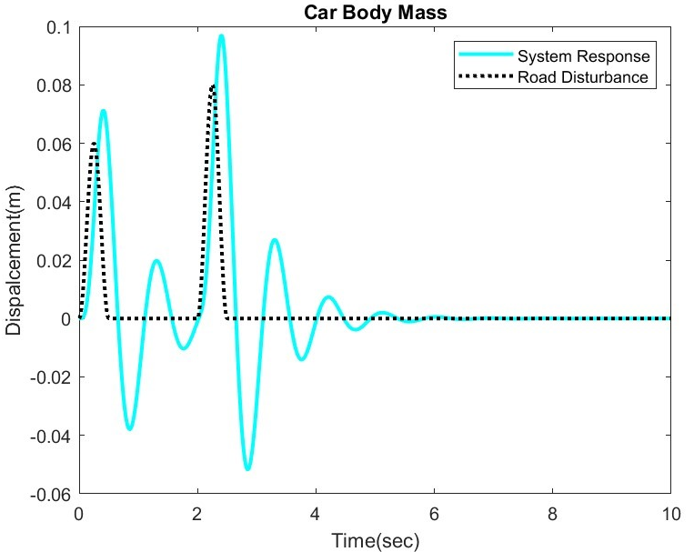
RESULTS
Fig: Road disturbaance
Fig: Car Body response

Slide 17
CONCLUSION
MATLAB code was written to show the car(system) response due to road disturbance
Black line: Road disturbance
Blue line: System response
The graph shows the behaviour of car when it encounters a bump

Slide 18
REFERENCES
[1] Roumy, J-G., Boulet, B. and Dionne, D. (2004) `Active control of vibrations transmitted through a car suspension', Int. J. Vehicle Autonomous Systems, Vol. 2, Nos. 3/4, pp.236-254.
[2] S. Ikenaga, F. L. Lewis, J. Campos and L. Davis (2000) ‘Active Suspension Control of Ground Vehicle based on a Full-Vehicle Model’, Proceedings of the American Control Conference Chicago, Illinois June 2000
[3] Ajit G. Mohite*, Anirban C. Mitra (2017) ‘Development of Linear and Non-linear Vehicle Suspension Model’, ICMPC 2017

Slide 19
THANKYOU

