Slide 1

E-Commerce Sales Insight Report
Transforming raw e-commerce data into actionable business intelligence
through integrated Python, SQL, and Excel analytics.

Slide 2
The Challenge
Data Complexity Limiting Growth
E-commerce businesses generate massive volumes of sales data, but inconsistent, unstructured, and duplicated information makes analysis nearly impossible. Companies struggle to track performance, identify trends, and understand customer behavior—missing critical growth opportunities.
31,048 Rows
Raw data processed
This project addresses the challenge using a Kaggle/GitHub dataset with a complete analytics workflow integrating Python, SQL, and Excel to transform chaos into clarity.
3 Tools
Python, SQL, Excel

Slide 3

Dashboard Requirements
01
02
KPIs
Visualizations
Total Revenue, Orders, Units Sold, Average Order Value, Average Quantity Per Order
Orders/Sales by Month, Top 5 States, Sales by Gender, Orders by Age/Gender, Order Status, Channel Distribution
03
Interactive Filters
Month, Channel, Product Category slicers for dynamic exploration

Slide 4
Methodology & Tools
Data Cleaning
Data Analysis
Visualization
Python (Pandas, NumPy) removed duplicates, corrected inconsistencies, and standardized formats
SQL functions (GROUP BY, ORDER BY, subqueries) analyzed sales performance and trends
Excel dashboards with Power Query, Power Pivot, charts, KPIs, and interactive slicers

Slide 5
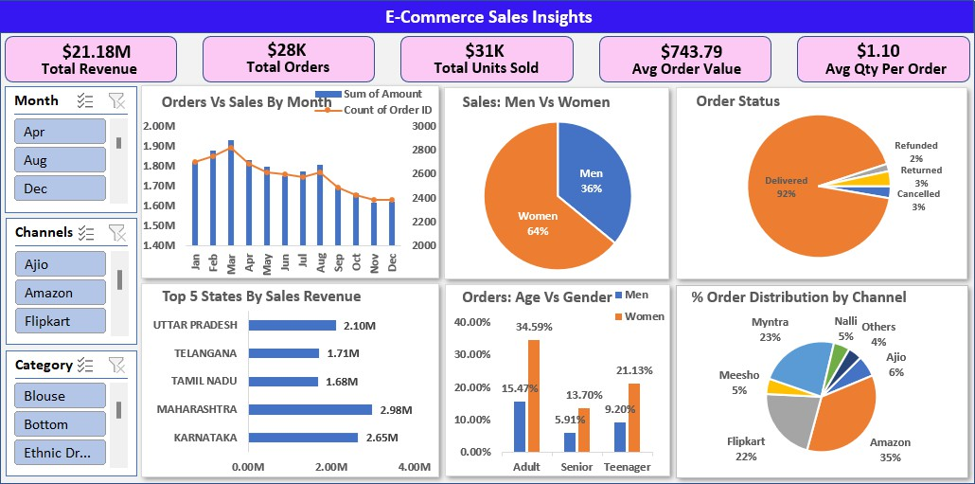
The Dashboard Solution
A consolidated analytical hub providing stakeholders with both high-level orientation and granular control— transforming complex data into clear visualizations for strategic decision- making.

Slide 6
Business Performance at a Glance
$21.18M
Total Revenue
$28K
Total Orders
$31K
Units Sold
$743.79
Avg Order Value
Strong sales performance
High customer demand
Robust transaction volume
Profitable transactions
1.10
Avg Qty Per Order
Multi-item purchases

Slide 7
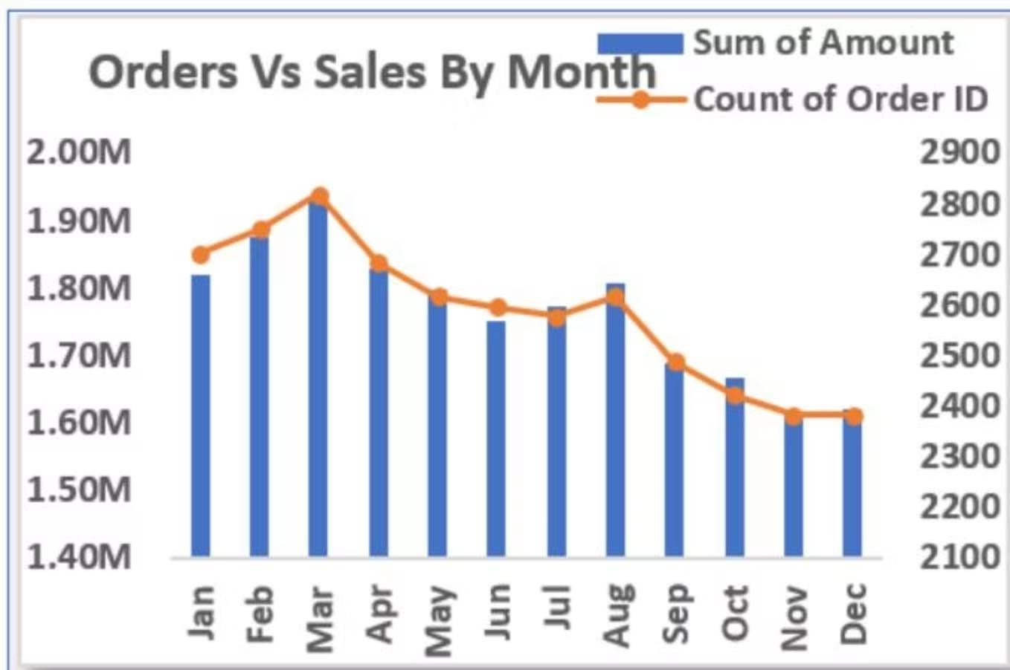
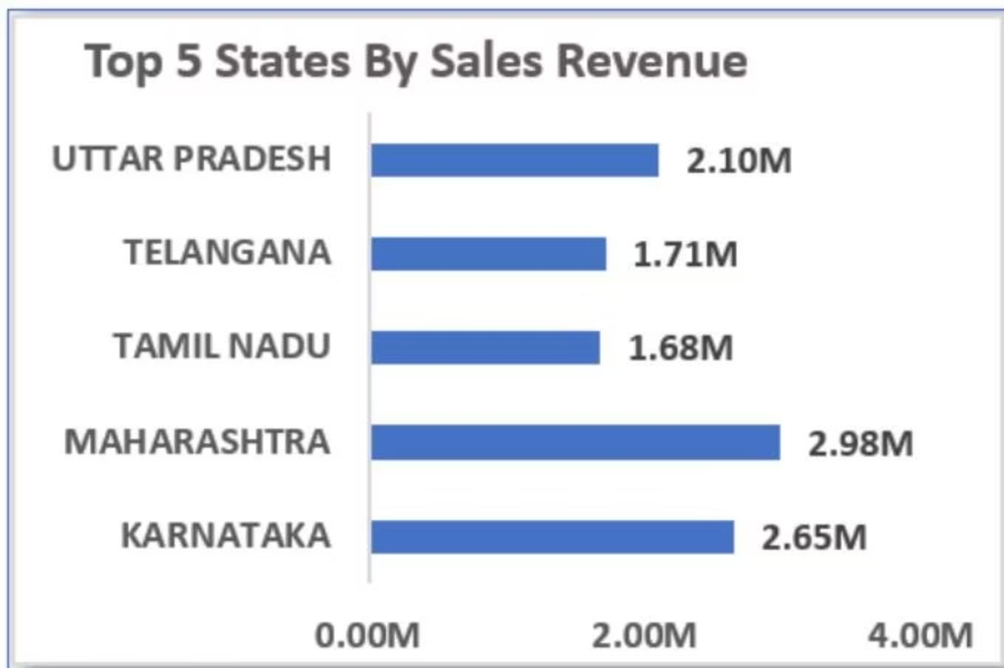
Sales Trends & Geographic Performance
Seasonal Sales Pattern
Top Markets
Sales peaked in March at $1.95M, then declined 16.9% to December,
revealing strong seasonality requiring Q2-Q4 strategies.
Maharashtra ($2.98M) and Karnataka ($2.65M) dominate with over
50% of top-state sales combined.

Slide 8


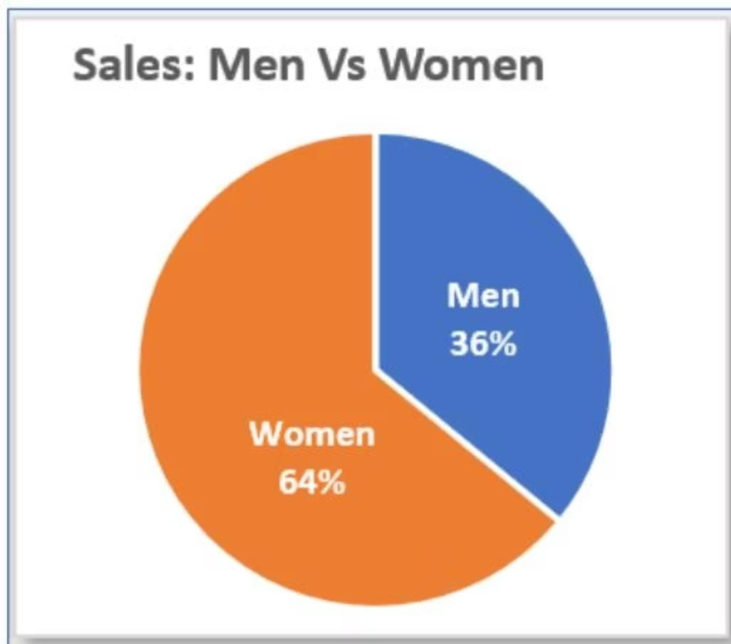
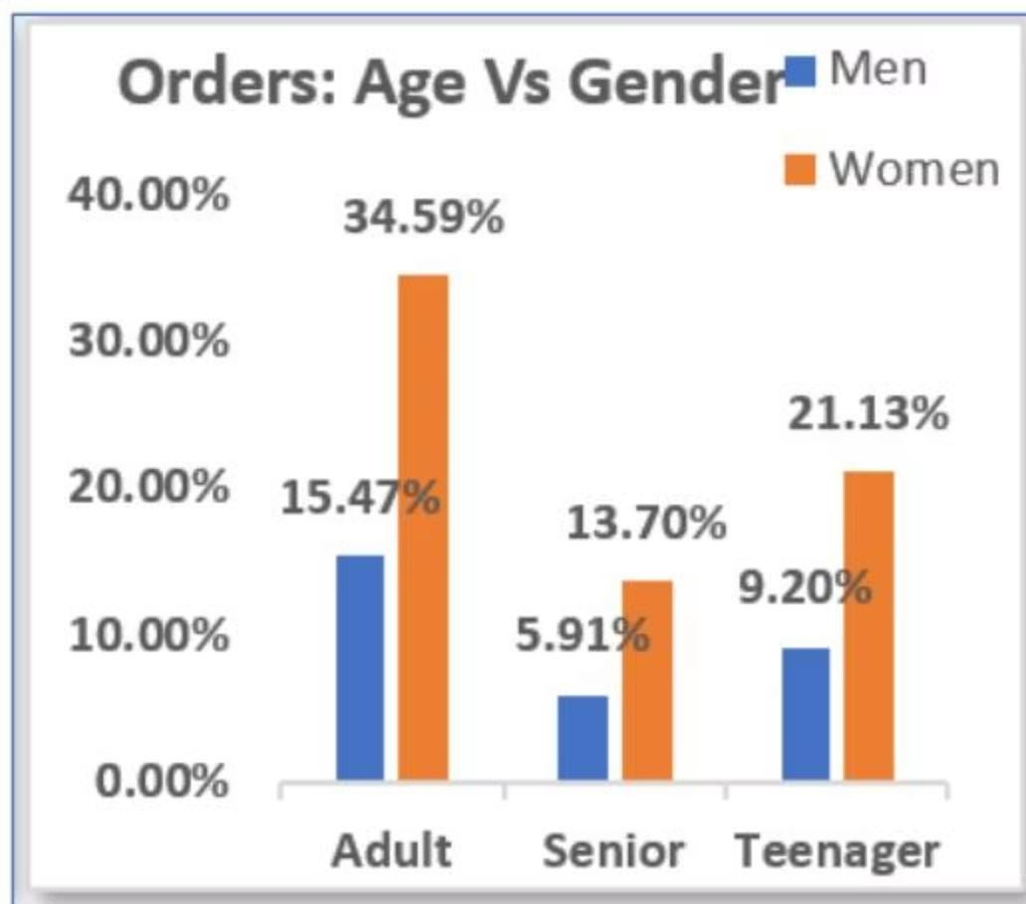
Customer Demographics Drive Strategy
Women Lead Sales
Adult Women Core
Teen Opportunity
64% of total sales from female customers—the dominant buying force
34% of orders from adult women, establishing them as the primary market segment
21% from teenage women—a strong secondary segment for growth

Slide 9
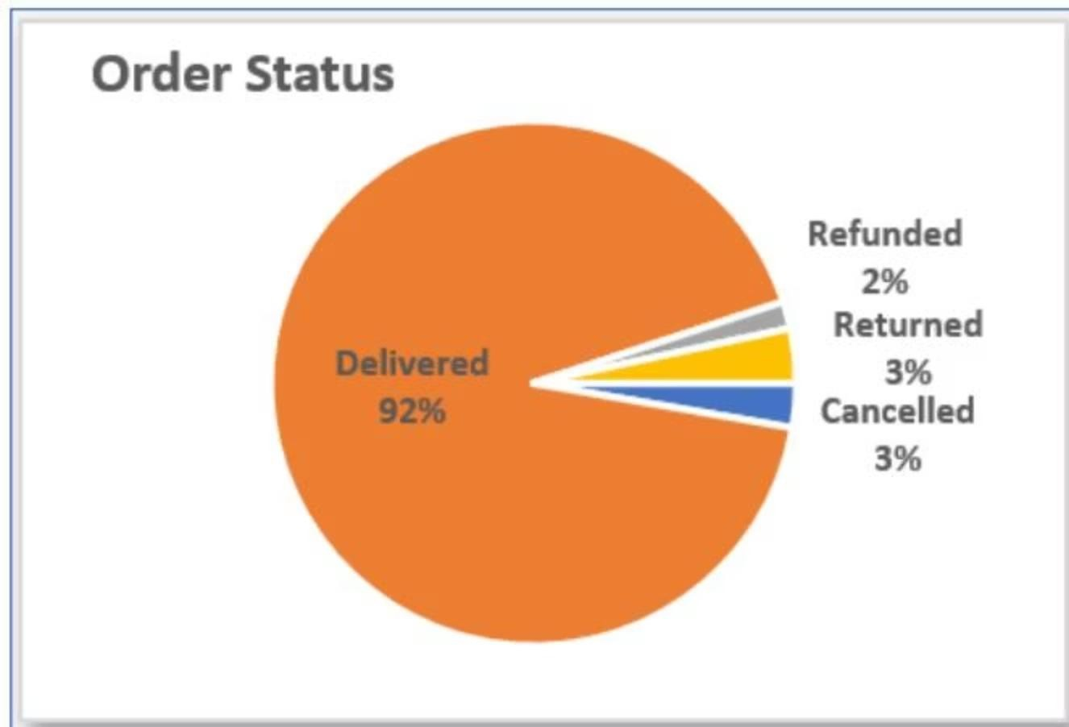
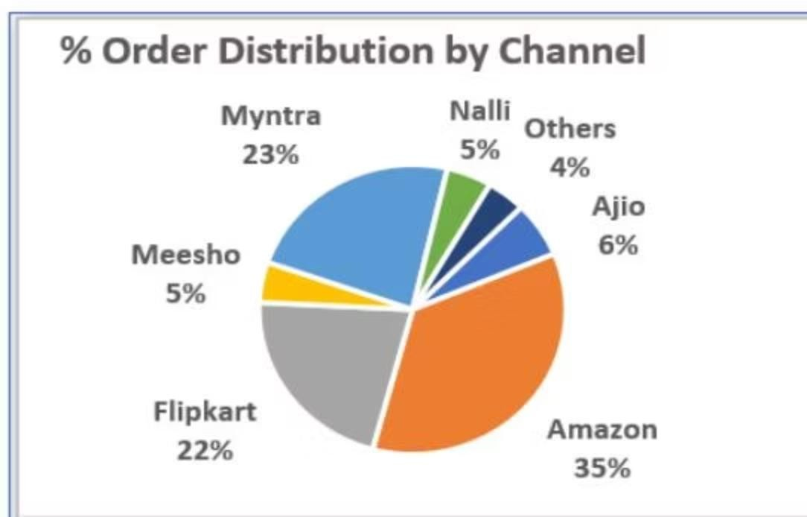
Operational Excellence & Channel Performance
Fulfillment Efficiency
Channel Distribution
92% of orders are successfully delivered, showing a highly reliable fulfillment process with very few issues.
Cancellations, returns, and refunds together make up only 8%, indicating high customer satisfaction and accurate product expectations.
Amazon (35%), Myntra (23%), and Flipkart (22%) together generate 80% of total orders, highlighting their dominance.
The remaining 20% from niche platforms presents potential for strategic partnerships and growth.

Slide 10

Strategic Recommendations
Combat Seasonality
Focus Core Segment
Expand Strategically
Implement targeted Q2-Q4 promotions
to stabilize revenue fluctuations
Target women aged 30-39 in Maharashtra, Karnataka, Uttar Pradesh with focused campaigns on Amazon, Flipkart, Myntra
Boost male engagement, strengthen niche platform partnerships, and expand in high-potential states
Conclusion: Strong seasonal trends, dominant female customer base, and geographic concentration present clear opportunities. Targeted marketing and regional expansion will sustain and enhance business performance.

