Slide 1
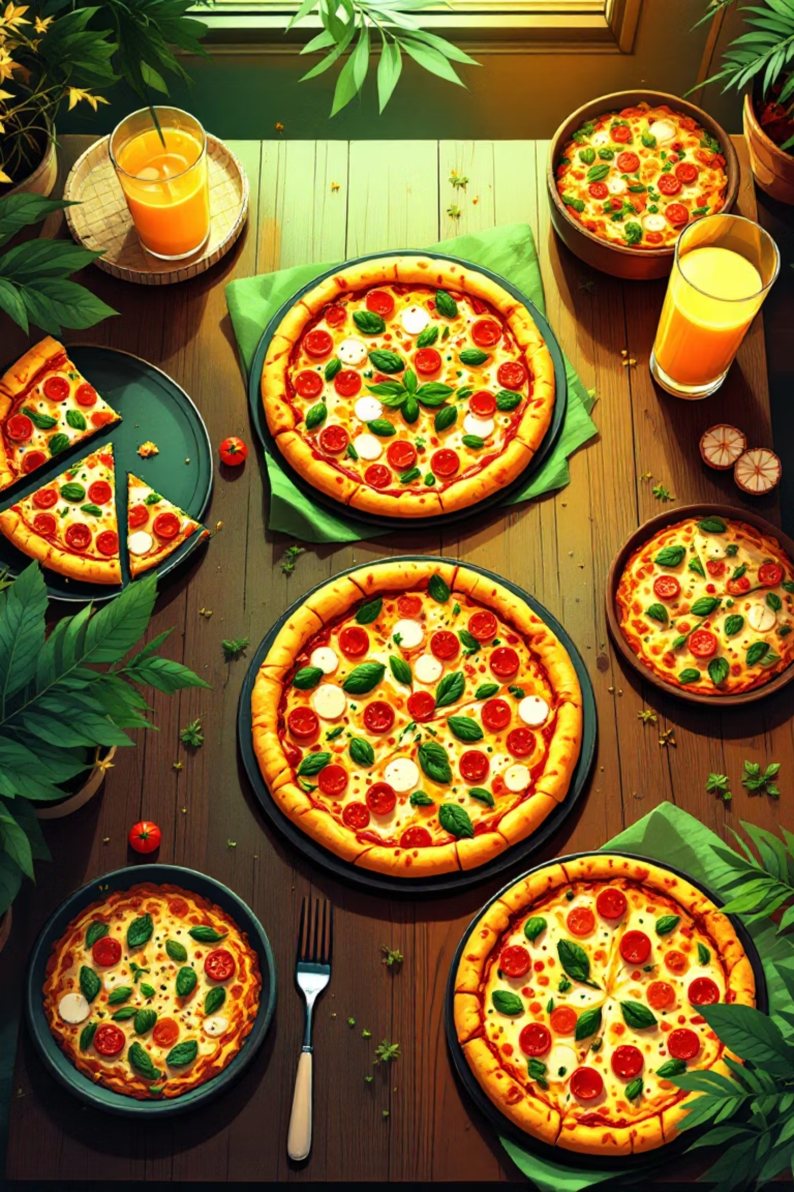
Pizza Sales Analysis Report
Comprehensive analysis of pizza sales performance, customer preferences, and revenue trends to drive menu optimization and strategic growth.

Slide 2

Project Overview
Analysis Scope
Strategic Goals
Evaluation of pizza varieties examining sales trends, revenue patterns, and customer preferences across 48,620 orders.
Support menu optimization, marketing strategies, and revenue growth through actionable insights.
High-demand and low-demand identification
Data-driven decision making
Performance benchmarking
Average order value analysis
Customer behavior patterns
Sales efficiency metrics

Slide 3
Key Performance Indicators
$817K
$38
50K
21K
Total Revenue
Average Order Value
Total Pizzas Sold
Total Orders
$2.3
Pizzas Per Order

Slide 4
Methodology & Tools
01
02
03
Data Collection
Data Cleaning
SQL Analysis
Gathered comprehensive pizza sales dataset from GitHub containing 48,620 rows across 12 key variables including orders, products, and sales information.
Removed duplicates, corrected inconsistencies, standardized formats, and created calculated fields to ensure data quality.
Applied aggregate functions (SUM, COUNT, AVG) with GROUP BY and ORDER BY to generate KPIs and analyze sales trends.
04
05
Power BI Visualization
Insights & Reporting
Designed interactive dashboards using KPI cards, charts, and DAX measures for comprehensive insights.
Highlighted sales patterns, identified top and bottom performers, and developed actionable recommendations.

Slide 5
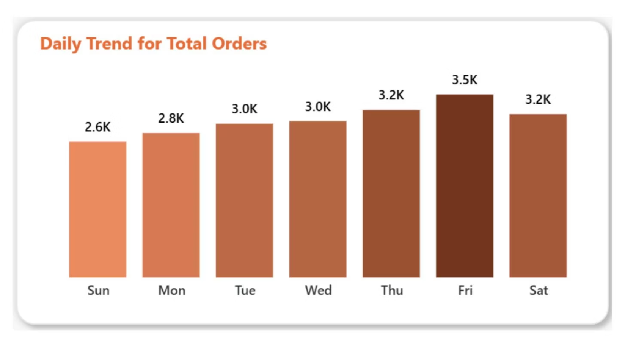
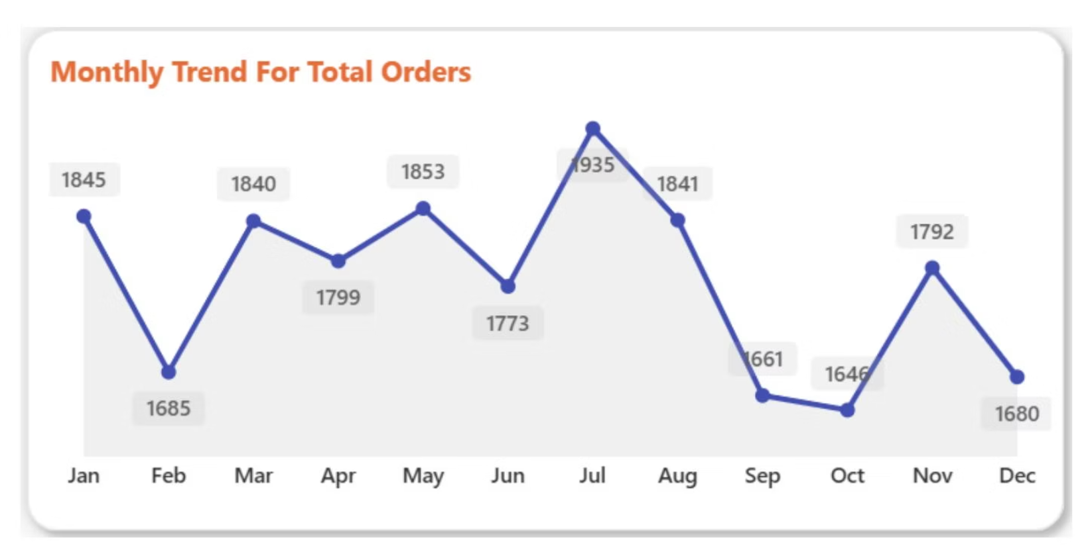
Weekly & Monthly Trends
Weekend Dominance
Seasonal Patterns
January (1,850) and July (1,940) are peak months due to New Year gatherings and summer vacations. September shows sharp decline.
Fridays (3.2K) and Saturdays (3.5K) show highest order volumes, indicating strong weekend dining preference—perfect for targeted promotions.

Slide 6
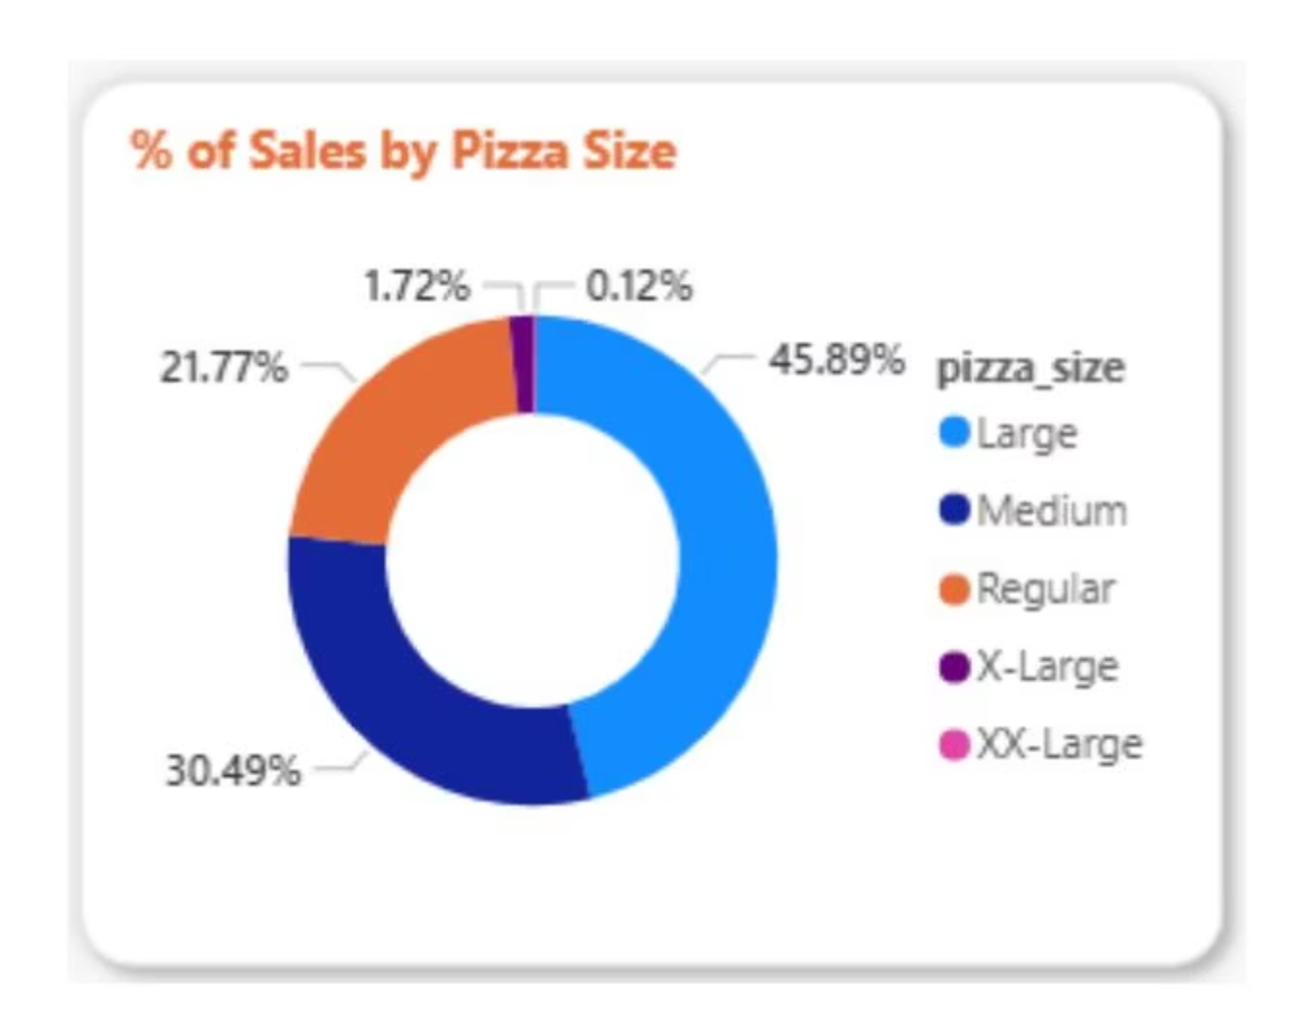
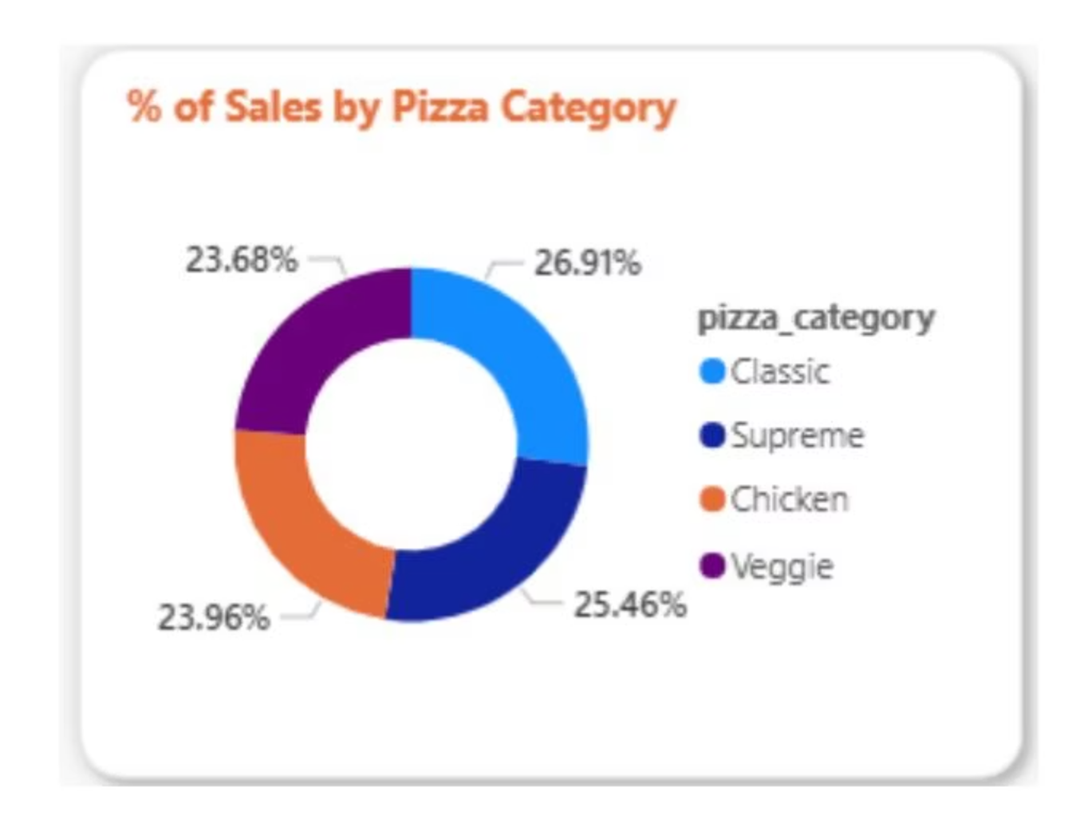



Size & Category Distribution
46%
30%
27%
Large Pizzas
Medium Pizzas
Classic Category
Dominate sales due to better value for groups and families
Second most popular size choice
Leads all categories with familiar flavors and broad appeal

Slide 7
Top Revenue Performers
Thai Chicken
$43K revenue
Premium toppings and popular flavor combinations drive strong performance
Barbecue Chicken
$43K revenue
Tied for top spot with broad customer appeal
California Chicken
$41K revenue
Strong third place performance
Classic Deluxe
$38K revenue
Highest volume seller with 2.5K units

Slide 8
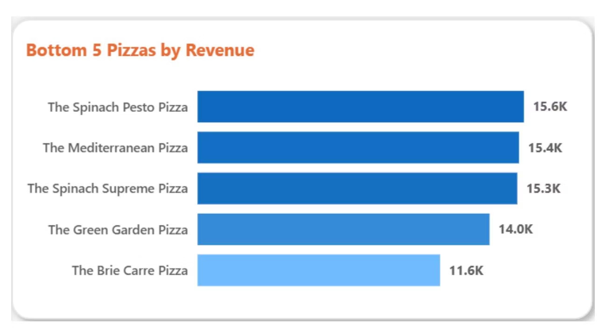
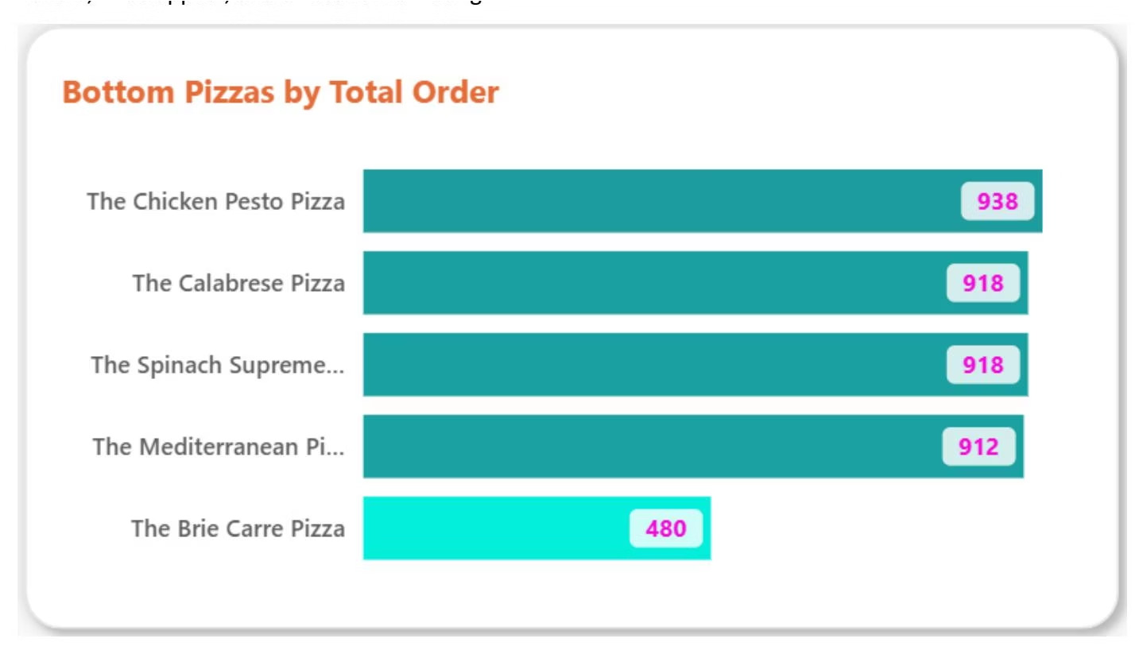

Underperforming Products
Key Finding: Low revenues suggest limited customer appeal, possibly due to vegetarian focus, niche flavors, or lack of promotion compared to popular meat-based options.

Slide 9
Strategic Insights
Revenue Concentration
Volume Leader
Size Preference
Classic Deluxe Pizza records highest units sold at 2.5K, outselling all competitors in volume despite lower per-unit pricing.
Large pizzas represent 46% of all sales—nearly half—indicating strong family and group ordering patterns with upselling opportunities.
Top five pizzas drive majority of revenue—Thai Chicken and Barbecue Chicken are critical premium performers generating $43K each.
Weekend Peak
Seasonal Decline
Fridays and Saturdays account for majority of orders (3.2K-3.5K), with January and July showing peak monthly volumes.
September experiences sharp sales drop, presenting opportunity for targeted off-season promotional campaigns.

Slide 10





Actionable Recommendations
Focus Marketing on Top 5
Prioritize promotional efforts on Thai Chicken, Barbecue Chicken, California Chicken, Classic Deluxe, and Spicy Italian to maximize ROI.
Create Premium Bundles
Upsell high-revenue pizzas through value-added combos with sides and beverages, especially targeting Large size preference.
Optimize Weekend Campaigns
Launch special Friday-Saturday promotions and strategically plan inventory and staffing for January and July demand surges.
Address September Slump
Implement targeted promotions like "Back to Work" campaigns, discounts, or new flavor launches to mitigate seasonal decline.
Review Underperformers
Evaluate Brie Carre and bottom performers for menu repositioning, revamping, or removal to optimize overall profitability.

