Slide 1


Slide 2


The Auction Game

Slide 3
About The Game
There will be 15 Cricket players with there base value and ratings.
Each team will have 15000 Balance Points(BP) initially using which they will buy player’s in auction rounds.
No Prior knowledge or interest in cricket is required ,everyone can play .
We might have used any thing except Cricket but since everyone is familiar with cricket we have used them.
Player ratings are indicated below them
You can make any size of team like 3, 4 , 5 etc.

Slide 4
Rules Of Game
There are 15 Players and there will be 15 rounds of auction.
Winner team will be decided on the basis of total sum of ratings of players in there respective teams.
Bid should be in multiples of 100.
Each team's captain bid will be considered final.
In case of a tie team which spend lesser BP will be winner.
P.S: Ratings of Players are on the basis of there current rankings.

Slide 5
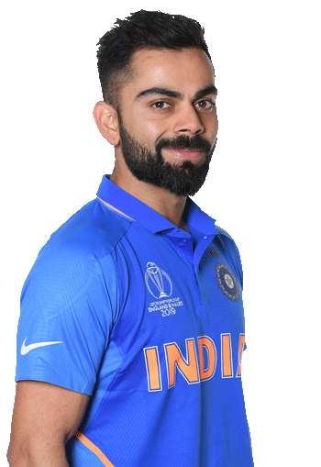
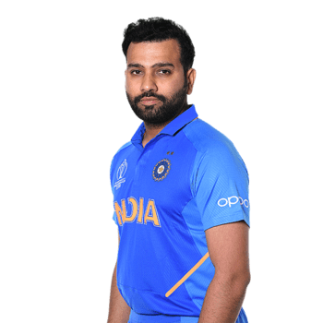





Batsmen
13
12
11
10
9
8
7

Slide 6
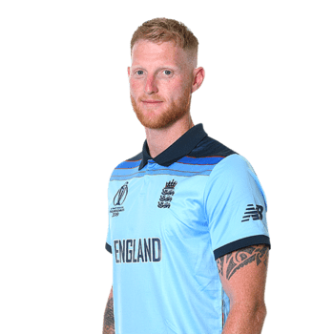


All-rounder's
11
10
9

Slide 7




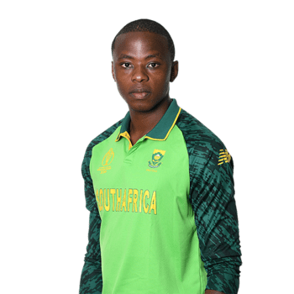
Bowlers
12
11
10
9
8

Slide 8
BONUS
If a team manages to get at least
3 Batsmen
1 All Rounder
2 Bowlers
That team will be awarded 10 Bonus Points.

Slide 9
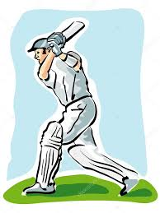
BATSMEN

Slide 10
Rating : 13
Virat Kohli
Base Value : 1300

Slide 11
Rating : 12
Rohit Sharma
Base Point : 1200

Slide 12
Rating : 11
Ross Taylor
Base Point : 1100

Slide 13
Rating : 10
David Warner
Base Point : 1000

Slide 14
Rating : 09
Kane Williamson
Base Point : 900

Slide 15
Rating : 08
Faf Du Plessis
Base Point : 800

Slide 16
Rating : 07
Joe Root
Base Point : 700

Slide 17

ALL ROUNDER’S

Slide 18
Rating : 11
Mohammad Nabi
Base Point : 1100

Slide 19
Rating : 10
Ben Stokes
Base Point : 1000

Slide 20

Rating : 09
Collin De Grandhomme
Base Point : 900

Slide 21

BOWLERS

Slide 22
Rating : 12
Trent Boult
Base Point : 1200

Slide 23
Rating : 11
Jaspreet Bumrah
Base Point : 1100

Slide 24
Rating : 10
Mujeeb Ur Rahman
Base Point : 1000

Slide 25
Rating : 09
Pat Cummins
Base Point : 900

Slide 26
Rating : 08
Kagiso Rabada
Base Point : 800

