Slide 1


Slide 2
Contents
Projects Done/Contributed-
Demo Project.
Themis.
Key Lessons Learned.
Experience and Learnings

Slide 4
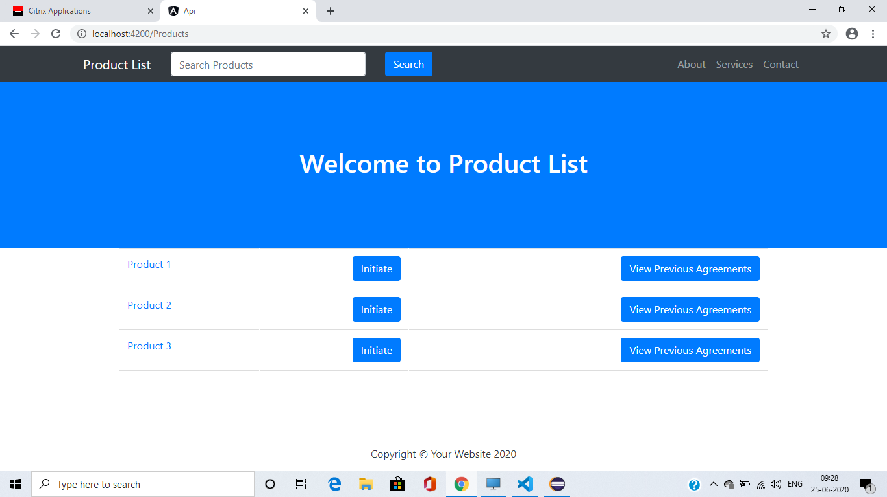

Slide 5
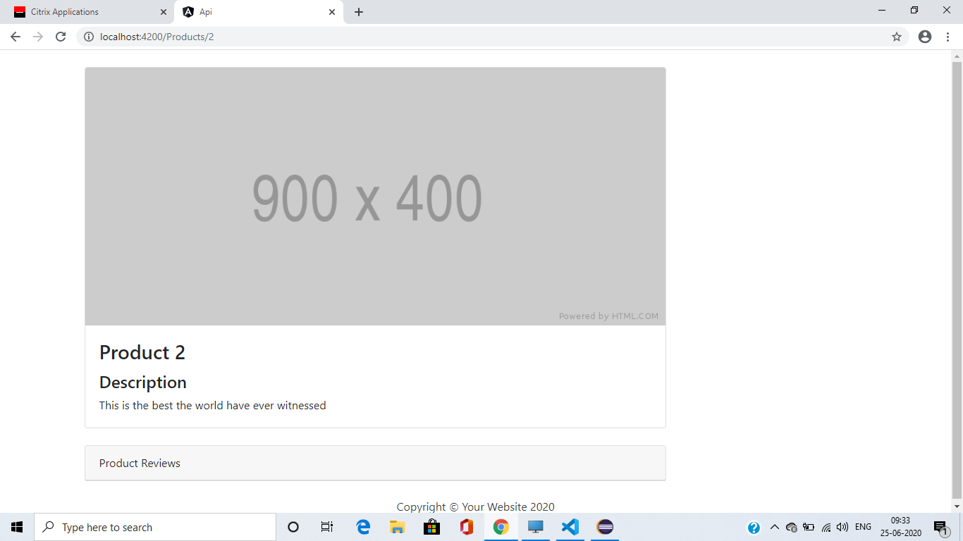

Slide 6
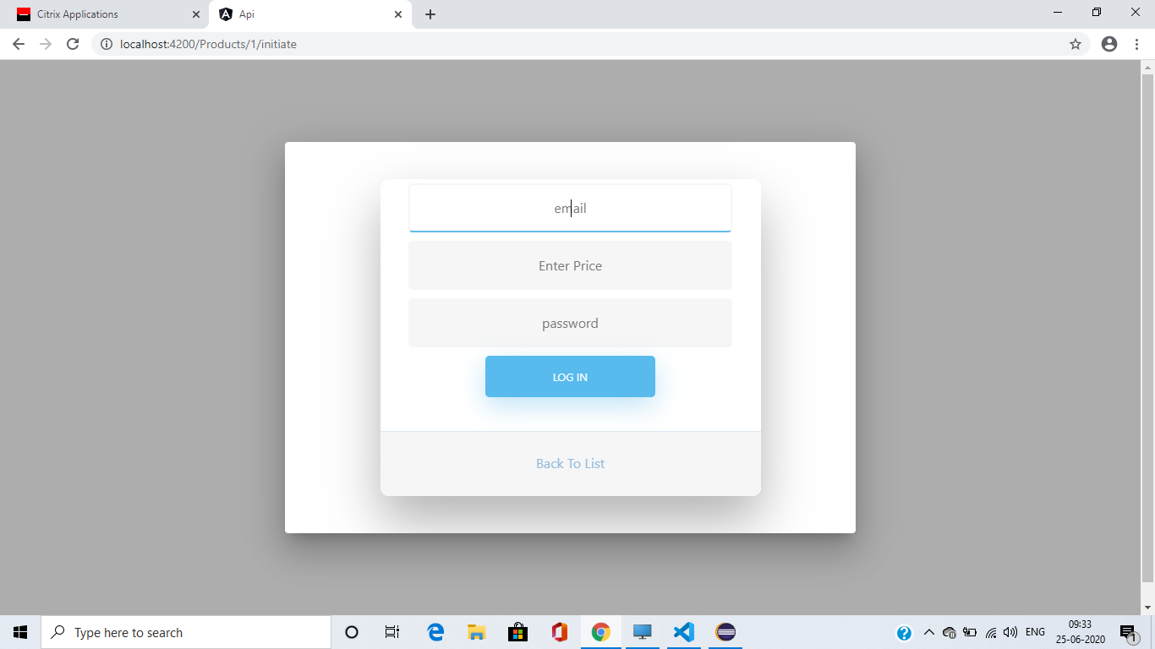

Slide 7
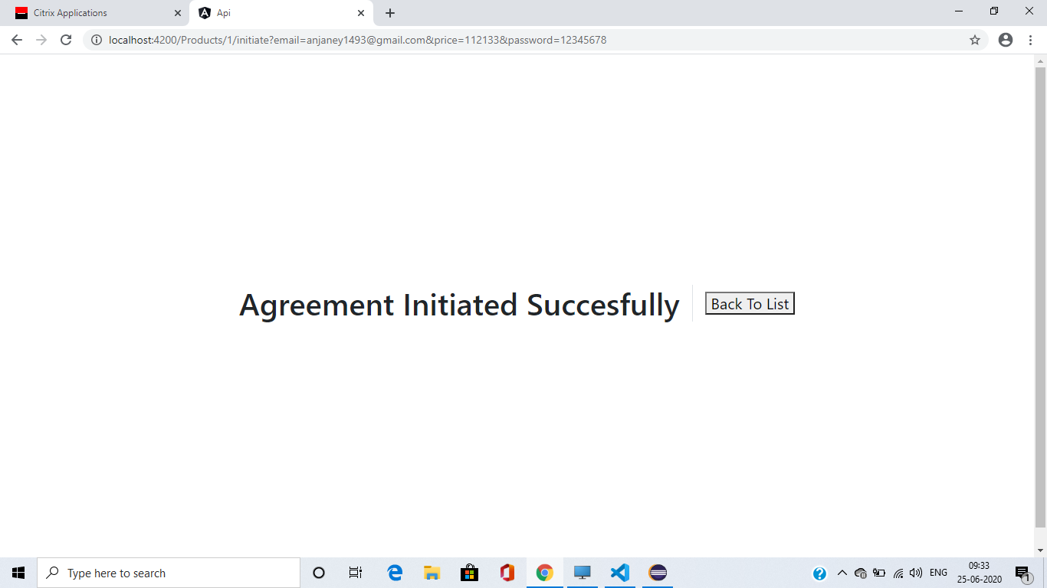

Slide 8
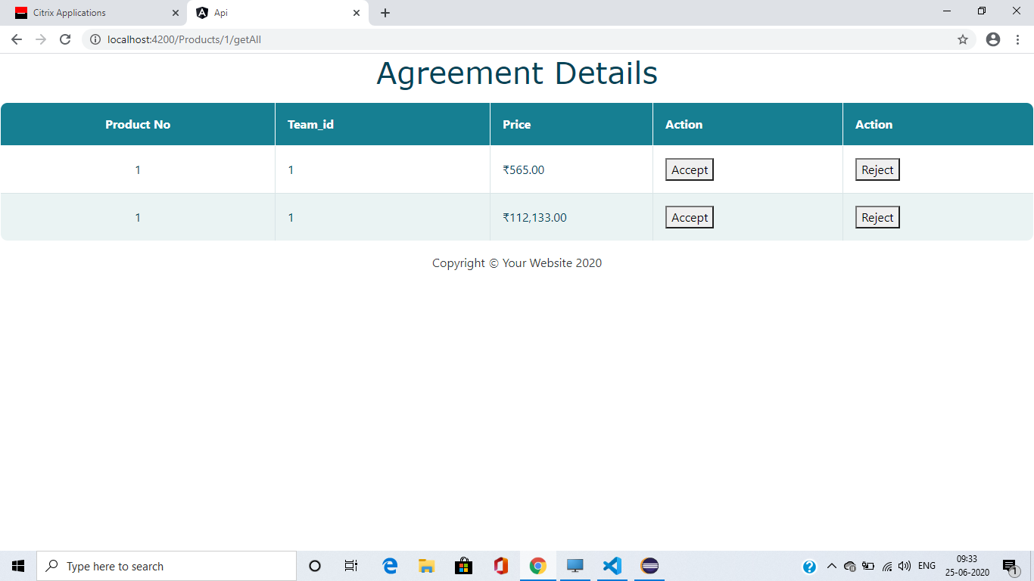

Slide 9
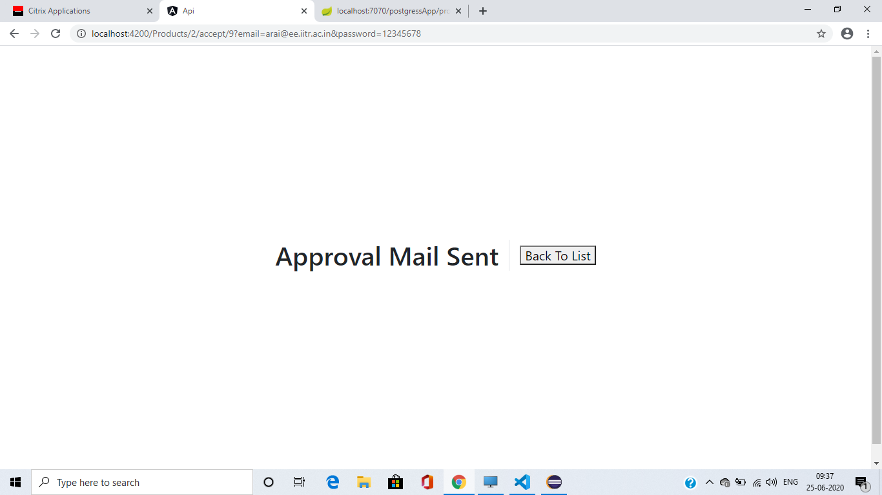

Slide 10
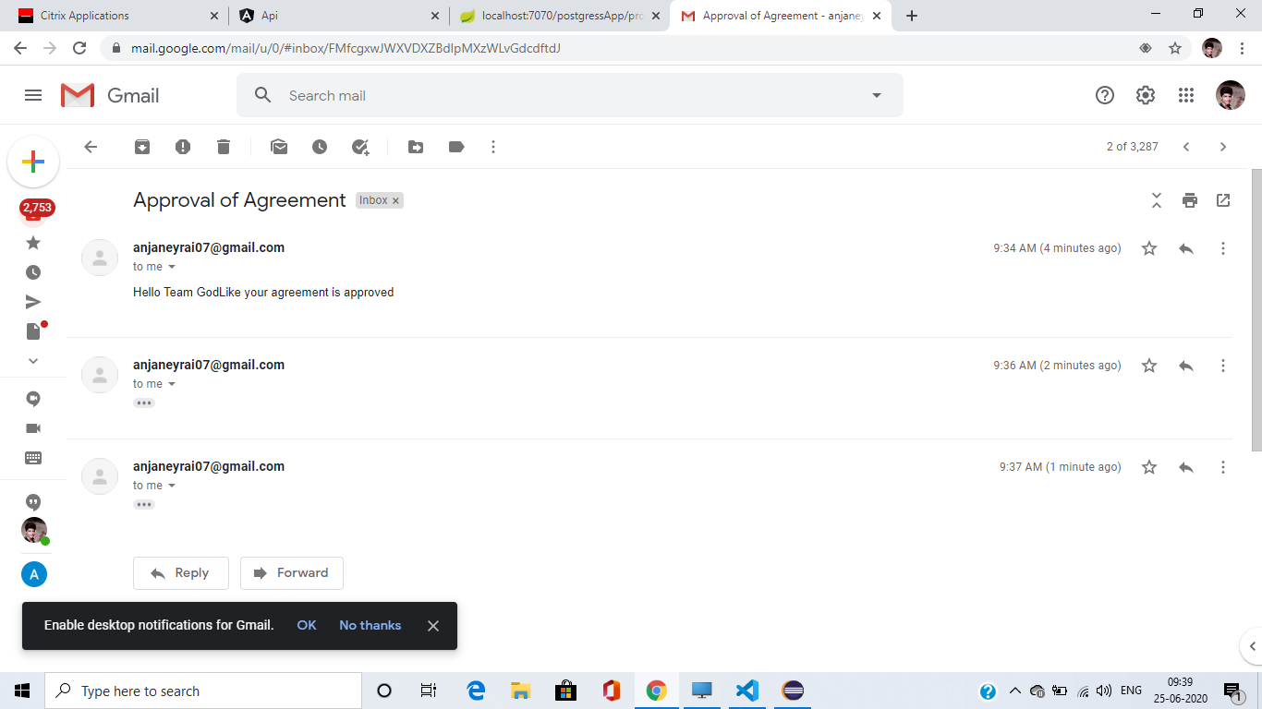

Slide 11
Themis
Completed Fund ,Legal and Team components in Themis.

Slide 12



Key Lessons Learned:
Working with Java
Spring Framework.
Working with Angular.
Working with Databases(PostgreSQL ,SQL Developer etc).
Basics of Grails.

