Slide 1

Review –Text Analysis
April 11, 2021

Slide 2

INTRODUCTION
A Hotel room dataset consists in reviews written by customers . This is an interesting dataset to analyze because we can match customers and interests with the reviews , it involves text understanding and scoring and ranking of results, and everything else we need to deliver the right thing to the customers in terms of their choice of rooms and service.
we are analyzing a dataset where user response is captured and analyzing those comments (text analysis). Understanding customer’s review in text form can help the hotel owners to make decisions and improve their services. Through my analysis the companies can identify and classify opinions towards their service. The booking can be more accurately and increase the crowd and the business.

Slide 3

The data will be acquired from Kaggle(https://www.Kaggle.com/ and will contain 38932 rows and 5 columns which is considered as the feature variable. Feature variables will be as below: User_Id Description Browser_used Device_used Is_Response

Slide 4
Target variable
All the feature variables are not important to an analysis on as we are analyzing the user reviews which is in the form of text. Target the right review and make predictions around their responses is the project moto. Hence Is_Response is the target variable.

Slide 5
Steps to be Followed
To Clean the data doing Exploratory Data Analysis(EDA)
Data Pre-Processing
Removing Stop words
Lemmatization and Stemming
TF-IDF Algorithm which provides the score of each word based on their occurence.More the score , more the occurrence.
Train the LDA Model
Sentiment Analysis

Slide 6
DATA WRANGLING
The Original Dataset is written into a file called train.csv, which is being used to do data analysis. My dataset is composed of text data. This task will be managed by using various Python Libraries.
Most important task is to load the datafile into a data frame and we can identify the number of data it has using df.head().
Is_Response column will be our target variable , analyzing which we will get to the know the response. And whether a review is a positive or negative.
Cleaning the dataset if it has any null value as they should be avoided in order to have a clean dataset.

Slide 7

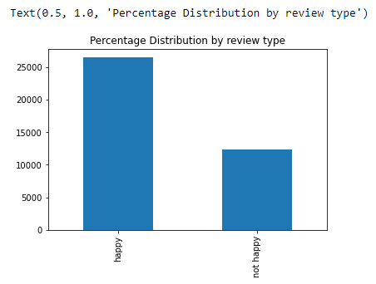
Happy Vs Unhappy Customers It is clear than most customers are happy by looking at the count

Slide 8

Text Cleaning Is_Response has many unwanted texts Which needs to be cleaned up to have a proper understanding about the user’s opinion

Slide 9
As and when we proceed with the text cleaning, we get more cleaner texts which makes more sense now.
Next level of cleaning will have stop words removal
Data Pre-processing
We will perform the following steps: Tokenization: Split the text into sentences and the sentences into words. Lowercase the words and remove punctuation. Words that have fewer than 3 characters are removed. All stop words are removed.
Words are lemmatized — words in third person are changed to first person and verbs in past and future tenses are changed into present.
Words are stemmed — words are reduced to their root form and can easily be identified about the user’ review.

Slide 10
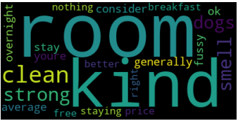
Now we will use TF-IDF vectorizer which will find out the score based on the occurrence of any word being used in the text. More the score , more the occurrence of the word in the review sentences which will directly impact the review score. Now if we create a word cloud with the words occurred in the review text form it will look like below.

Slide 11
LDA- Topic Modelling
Latent Dirichlet Allocation assumes that documents are composed of words that help determine the topics and maps documents to a list of topics by assigning each word in the document to different topics.
The number of words in the document are determined.
A topic mixture for the document over a fixed set of topics is chosen.
A topic is selected based on the document's multinomial distribution.

Slide 12
Sentiment Analysis using TextBlob Text Blob is a python library for Natural Language Processing (NLP). Text Blob actively used Natural Language Toolkit (NLTK) to achieve its tasks. NLTK is a library which gives an easy access to a lot of lexical resources and allows users to work with categorization, classification and many other tasks. Text Blob is a simple library which supports complex analysis and operations on textual data.
TextBlob returns polarity and subjectivity of a sentence. Polarity lies between [-1,1], -1 defines a negative sentiment and 1 defines a positive sentiment. Negation words reverse the polarity. TextBlob has semantic labels that help with fine-grained analysis. For example — emoticons, exclamation mark, emojis, etc. Subjectivity lies between [0,1].
Subjectivity quantifies the amount of personal opinion and factual information contained in the text. The higher subjectivity means that the text contains personal opinion rather than information

Slide 13
Thank You☺

