Slide 1
Waste-x
A modern e-Commerce/online retailer platform

Slide 2
Agenda
What is Waste-X?
Who is the client?
A deep dive into an e-Commerce domain
Important components of e-Commerce domain
Why e-Commerce over offline?
Why does the client need the Waste-X platform?
Why does the client need the Waste-X platform as a B2B platform?
Target audience
Modules
Process/Workflow
Tech stack
Architecture

Slide 3
What is Waste-X?
Waste-X is a modern e-commerce platform and online retailer offering a variety of food raw materials at affordable prices.
It is a custom e-Commerce solution tailored for one of our client (Berkshire Foods & Co.) and the overall business model is B2B.

Slide 4
Who is the client?
Berkshire Foods & Co.
Berkshire Foods & Co. is a food ingredient manufacturer in the USA specializing in the production of raw materials such as grains, spices, oils, flavors, additives, and other ingredients used in food production.

Slide 5
A deep dive into an e-Commerce domain
e-Commerce, or electronic commerce, is simply the act of buying and selling goods or services over the Internet. Instead of going to a physical store, customers can go online, browse items on a website or an app, and purchase them using their computer or smartphone.
e-Commerce in the food ingredient manufacturing sector refers to using an online platform to sell raw food ingredients directly to either businesses (B2B e-commerce) or consumers (B2C e-commerce).
e-Commerce is popular because it's convenient, often allows for lower prices, and customers can shop from anywhere at any time.

Slide 6
B2C (Business to consumer): Although less common than B2B, some food ingredient manufacturers also sell directly to consumers. This can be particularly prevalent with specialty or high-value ingredients, such as organic spices, health-oriented additives like protein powders, or specialty flours.
B2B (Business to Business): In the B2B model, food ingredient manufacturers sell large quantities of ingredients to other businesses, such as food processors, restaurants, bakeries, and other manufacturers. These transactions are typically handled through specialized e-commerce platforms(such as Waste-X) or via a dedicated section of the manufacturer’s website.

Slide 7
IMPORTANT COMPONENTS OF e-commerce
Product Catalog: A comprehensive and well-organized product catalog is essential. It should include detailed descriptions, images, pricing, and any relevant information about each food ingredient offered by the manufacturer.
Shopping Cart and Checkout: Implement a user-friendly shopping cart system that allows customers to easily add items to their cart and proceed to checkout. The checkout process should be simple, secure, and support various payment methods.
Customer Accounts: Provide customers with the option to create accounts on your e-commerce platform. This allows for easier order tracking, personalized recommendations, and a smoother overall shopping experience.

Slide 8
Inventory Management: Implement robust inventory management functionality to track stock levels, manage replenishment, and prevent overselling. Real-time inventory updates ensure that customers are aware of product availability.
Order Management: Streamline order processing with an efficient order management system. This should include order tracking, status updates, and the ability to manage returns and refunds seamlessly.
Shipping and Logistics Integration: Integrate with shipping carriers to provide accurate shipping rates, delivery options, and order tracking. Seamless integration with logistics partners ensures timely delivery of food ingredients to customers.

Slide 9
Customer Support: Offer multiple channels for customer support, such as live chat, email, or phone, to address inquiries, resolve issues, and provide assistance throughout the shopping process.

Slide 10
Why e-commerce over offline?
Broader Market Access: e-Commerce platforms allow manufacturers to reach a global audience, overcoming geographical limitations inherent in offline sales. This is particularly advantageous for specialized products that may have a niche market.
Data Analytics: e-Commerce enables the collection and analysis of customer data, which can be used to tailor marketing strategies, optimize inventory, and improve product offerings based on real-time feedback and behavior patterns.
24/7 Availability: e-Commerce stores can operate around the clock, offering customers the flexibility to place orders at any time, which is not possible with traditional offline channels.

Slide 11
Enhanced Product Visibility: Through e-commerce, food ingredient manufacturers can showcase their entire product range in detailed catalogs with high-quality images and extensive product information. This visibility can help new and existing customers discover the full breadth of offerings, something that might be limited in a traditional sales setting.
Cross-Selling and Up-Selling: Online platforms enable effective cross-selling and up-selling by suggesting related products or premium options at the point of sale. For example, if a customer is buying a bulk spice, the website might suggest purchasing a complementary seasoning or a higher-grade version of the same spice.

Slide 12
Streamlined Sales Processes: E-commerce automates much of the sales process, from order taking to billing and shipping. This automation reduces the potential for human error and frees up resources to focus on product development and customer service.

Slide 13
Why does the client need the Waste-X platform?
To reduce wastage of raw materials due to expiration dates: Generally, the expiration dates of food raw materials tend to be relatively shorter compared to other types of products. This is because food raw materials, such as grains, spices, and oils, flavors, additives and other ingredients may have a limited shelf life due to factors such as moisture content, exposure to air, and susceptibility to spoilage.
By using the provided solution, the client can sell those raw materials at cheaper rates as their shelf life approaches expiration. So that they can reduce the wastage of raw materials to some extent.
Although they have proper inventory management, planning and forecasting but still they want to reduce the wastage as much as possible.

Slide 14
Drive growth in the company's revenue: Before implementing the solution, the overall business was operating offline. By transitioning the business online with the provided solution, they can attract many new B2B customers, including large, mid-sized, and small B2B customers. By using the provided solution, the company's revenue will increase and it also helps them build a solid B2B customer base.

Slide 15
Why does the client need the Waste-X platform as a B2B platform?
Larger Order Sizes: B2B customers, such as food producers, bakeries, and restaurants, typically purchase ingredients in bulk quantities. This results in larger transactions, providing greater revenue per sale compared to individual consumer sales.
Lower Marketing Costs: Marketing directly to businesses can be less expensive on a per-customer basis than targeting individual consumers, as B2B sales often rely more on relationship-building (which included trust and loyalty).
Streamlined Logistics: Shipping large, bulk orders to a few business customers is often more logistically efficient and cost-effective than distributing smaller packages to many individual consumers.

Slide 16
Long-term Partnerships: B2B relationships often evolve into long-term partnerships. Businesses tend to reorder regularly if they're satisfied with the product quality and customer service, leading to a more reliable revenue stream.
Choosing B2B over B2C in food ingredient manufacturing essentially revolves around leveraging larger, more stable sales, cultivating long-term relationships, and focusing expertise on a specific client base, which can lead to greater overall business efficiency and profitability.

Slide 17
Target audience
Large-sized, Mid-sized and Small-sized food production companies (such as food processors, restaurants, bakeries, and other manufacturers)
Wholesalers/Distributors
Retailers

Slide 18
Modules
Supply service
Marketplace service

Slide 19
PROCESS/WORKFLOW

Slide 20
Tech stack
Backend Technologies: Java, Spring Boot, Microservices, GRPC, GraphQL, API Integrations
Frontend Technologies: React, Tailwind CSS
Database: Cockroach DB
VCS: GitHub
Project management tool: Notion
Project methodology: Agile
Deployment: GitHub Actions (CI/CD), Docker, Kubernetes, Argo CD, AWS
Monitoring: Grafana (Loki)

Slide 21
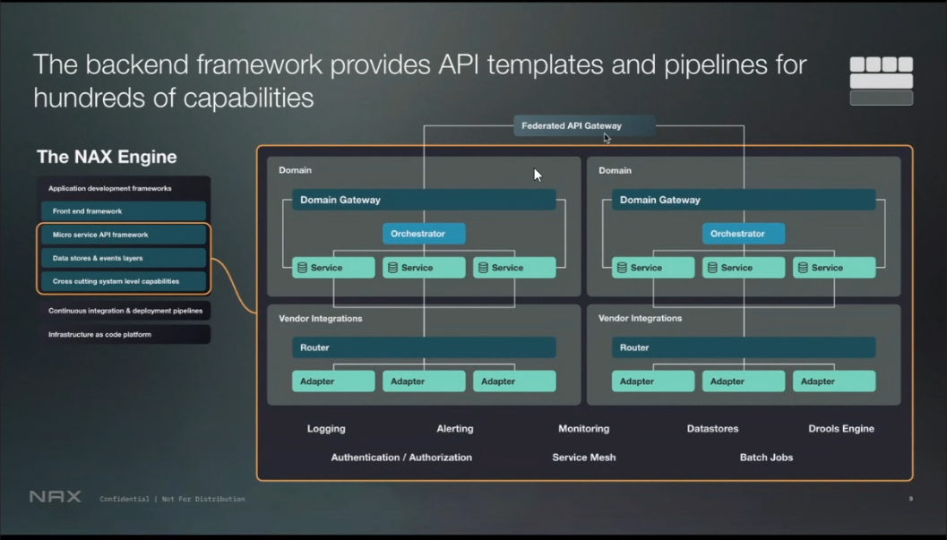
Architecture

