Slide 1
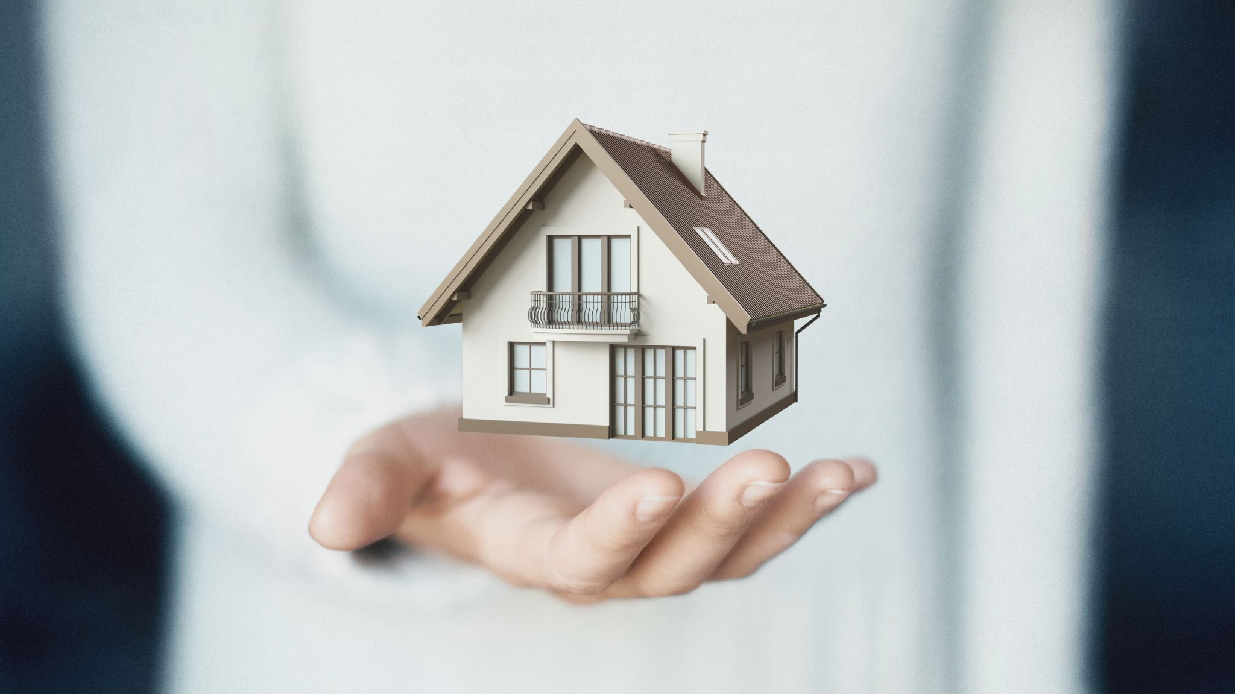
Smart Home Energy Management System
Presented By Sri Anjhanee K

Slide 2
What is a SHME?
A Smart Home Energy Management System is a software solution that:
  Monitors energy consumption of home appliances
  Allows users to control devices remotely
  Tracks real-time and historical energy usage
  Automates device operations using schedules
  Helps reduce electricity bills and power wastage
Why This System Is Needed
  Increasing electricity costs
  Lack of visibility into device-level consumption
  Manual control leads to energy waste

Slide 3
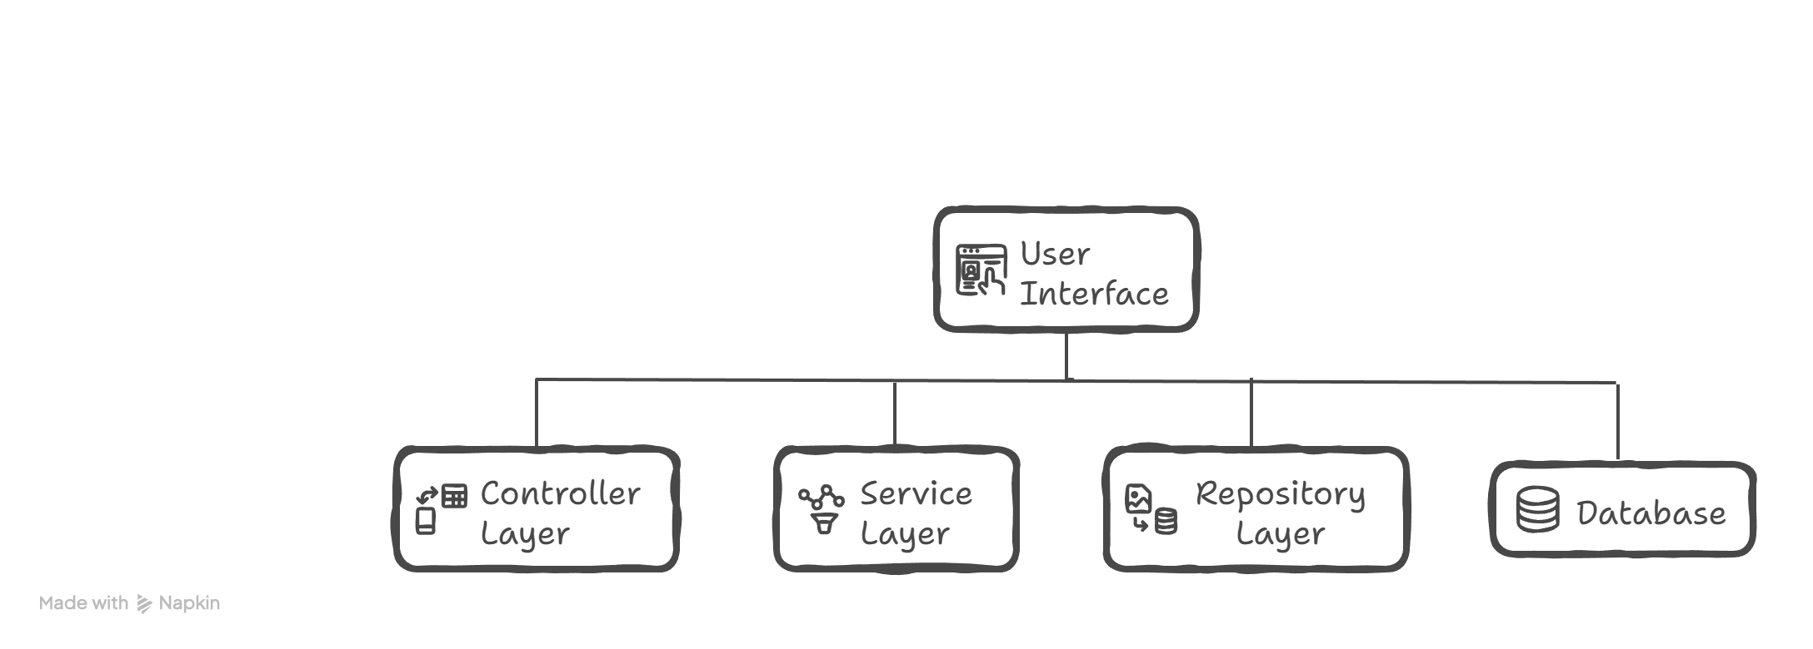
SYSTEM ARCHITECTURE
MODULE OVERVIEW
Modules | Name | Responsibility
Module1 | Authentication | User login & security
Module2 | Smart Device Management | Device control
Module3 | Real-Time Energy Tracking | Energy data
Module4 | Analytics Dashboard | Usage insights
Module5 | Scheduling & Automation | Auto control

Slide 4
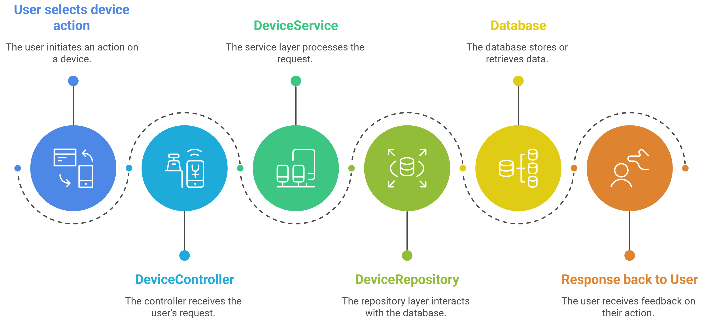
SMART DEVICE MANAGEMENT (MODULE 2)
Main Functionalities :
Add new smart devices
Store device details
Turn devices ON or OFF
Update device status
Track power usage per device

Slide 5
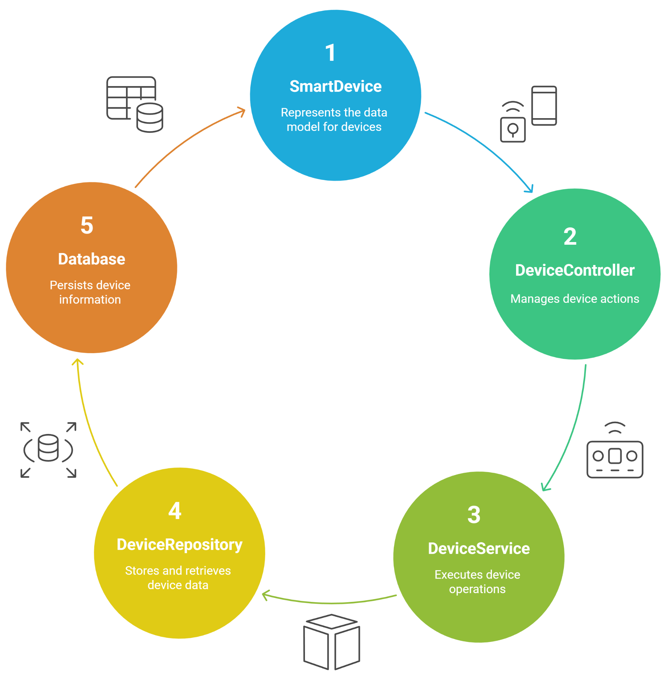
CLASS STRUCTURE IN SMART DEVICE MANAGEMENT

Slide 6
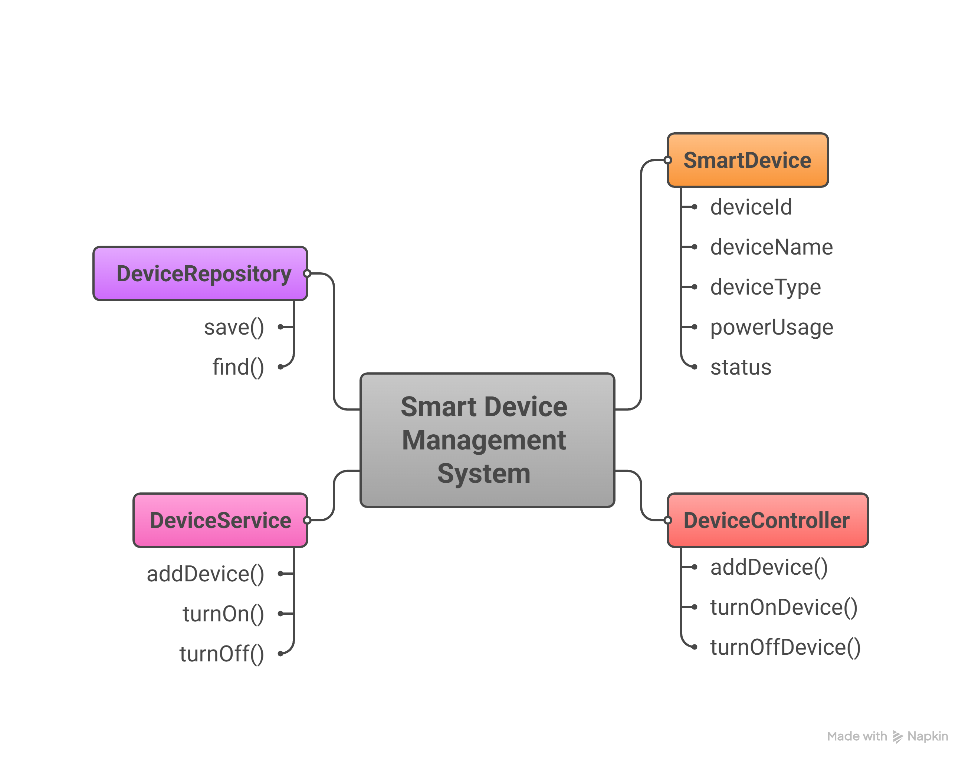
DETAILED CLASS DESIGN – MODULE 2

Slide 7
DATABASE SCHEMA
Field Name | Data Description
device_id | Primary Key
device_name | Name of device
device_type | Type of appliance
power_usage | Energy consumed
status | ON / OFF

Slide 8
Thank you !

