Slide 1
Module 3: Real-Time Energy Monitoring & Alerts
Continuously monitors energy usage of active devices
Calculates device-wise and total home consumption
Detects risky energy patterns (warning/critical)
Generates alerts before overload or bill spikes
Stores energy logs for analytics and reporting

Slide 2
Problem Statement
Multiple appliances run simultaneously (AC, fan, fridge, washing machine)
Users realize excess consumption only after receiving the electricity bill
No early warning system in traditional homes
Risks caused by high usage:
Sudden power overload
Device damage / heating issues
Increased electricity bills
Emergency situations without awareness

Slide 3
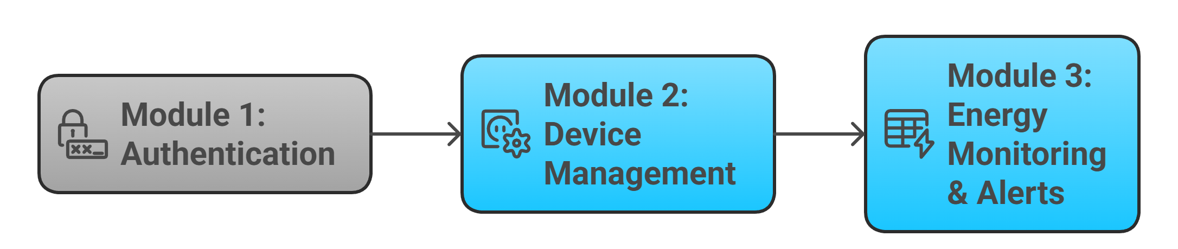
Integration with Module 1 & Module 2
Module 1 (Authentication): verifies user identity and access
Module 2 (Device Management): provides device status and power details
Module 3 (Energy Alerts):
reads active device list
tracks usage
generates safety alerts

Slide 4
Purpose and Objectives
Purpose:
Provide awareness and safety
Prevent overload and reduce energy wastage
Support smarter energy decisions
Objectives:
Track energy usage in real time
Compare usage with safe threshold limits
Generate alerts (Normal / Warning / Critical)
Store historical logs for future analysis

Slide 5
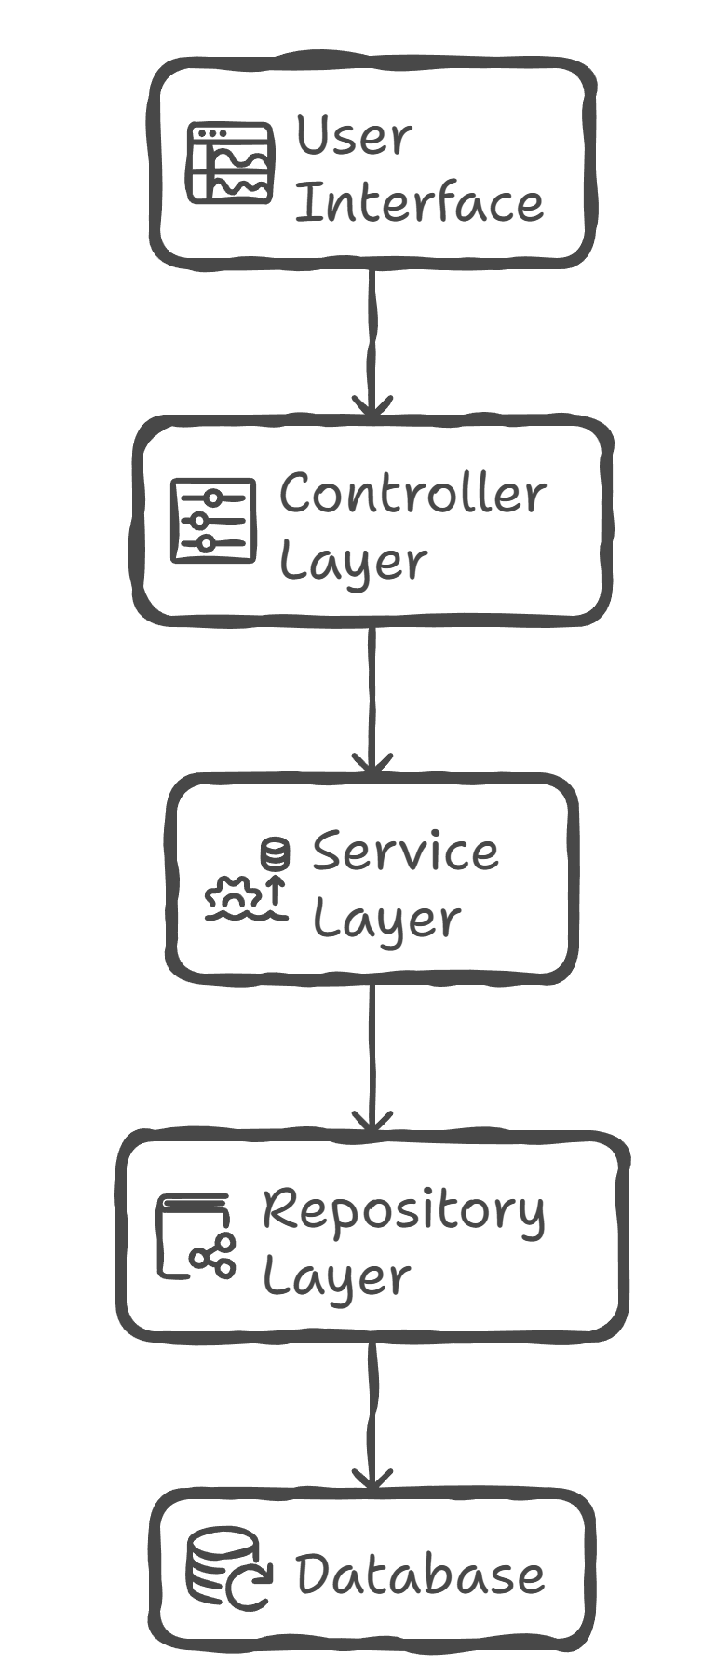
Architecture of Energy Monitoring Module
Controller Layer
Receives monitoring requests from UI
Service Layer
Calculates energy consumption
Decides alert level
Repository Layer
Stores and retrieves energy usage records
Model Layer
Structured representation of energy logs

Slide 6
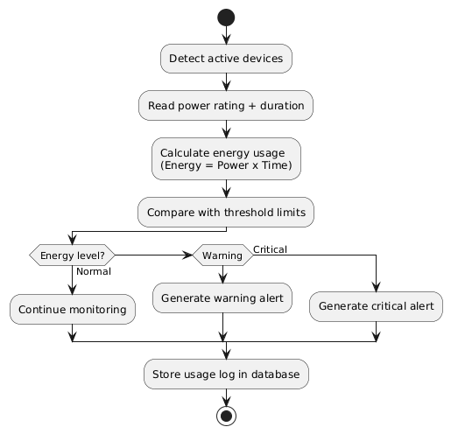
Activity Diagram

Slide 7
Classes in Energy Monitoring Module
1) EnergyUsage (Model)
deviceId, energyUsed, time
2) EnergyController
recordEnergy(data)
viewEnergy(deviceId)
3) EnergyService
saveEnergy(data)
getEnergy(deviceId)
threshold comparison logic
4) EnergyRepository
save(data)
find(deviceId)

Slide 8
Database Schema – Energy Usage Log
Column | Purpose
usage_id (PK) | unique record id
device_id (FK) | device reference
energy_used | calculated usage value
time | timestamp

Slide 9
Thank you

