Slide 1
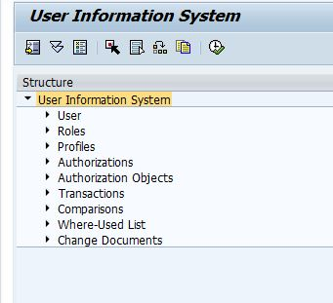
THE SUIM INITIAL SCREEN

