Slide 1

RoboManiax Edutech Pvt. Ltd. (REPL™)
LEARN | INNOVATE | EARN

Slide 2
Why to get trained from REPL?
Professionally designed syllabus.
Theoretical as well as Practical Knowledge.
Every day a new practical.
Time to time Practical Assignments.
Revision Time & Query Sessions.
Development of an innovative project at the end.
Certification with E-verification option.
LAST BUT NOT THE LEAST, each student will be provided with a login ID and password for accessing our student forum for absolutely free!

Slide 3
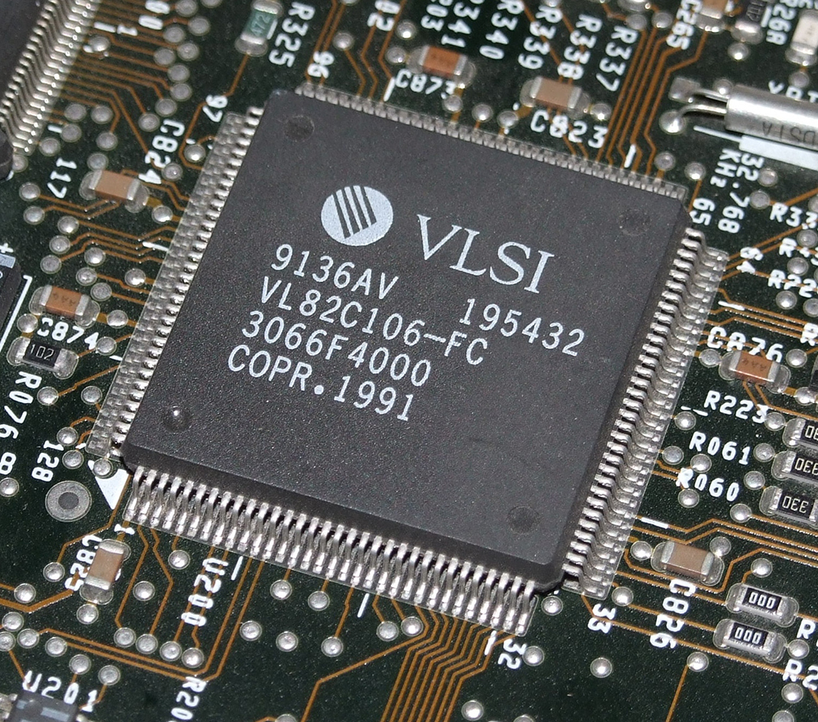
VLSI Design

Slide 4
Embedded system and it’s evolution
ERA DATE COMPLEXITY
(number of logic blocks per chip)
Single transistor 1959 less than 1
Unit logic 1960 1
Multi-function 1962 2 - 4
Complex function 1964 5 - 20
Medium Scale Integration 1967 20 - 200
Large Scale Integration 1972 200 - 2000
Very Large Scale Integration 1978 2000 - 20000
Ultra Large Scale Integration 1989 20000 - ? (ULSI)

Slide 5
VLSI and it’s importance
Very-large-scale integration (VLSI) is the process of creating an integrated circuit (IC) by combining thousands of transistors into a single chip.
The microprocessor is a VLSI device.
An electronic circuit might consist of a CPU, ROM, RAM and other glue logic. VLSI lets IC designers add all of these into one chip.

Slide 6
VLSI course outline
INRTODUCTION
Evolution
Y- chart
Y- chart domain
Design Hierarchy
DIGITAL VLSI SYSTEM DESIGN
Introduction to Digital System IC Design
Number System and Boolean logic
Logic gates, functions & library
Optimization techniques for logic functions
Designing combinational circuits
Analysis and Synthesis of combinational circuits
Designing synchronous sequential circuits
Analysis and Synthesis of sequential circuits like Flip-Flops, registers, counters and memory

Slide 7
VLSI course outline
VERILOG HDL
Hierarchical Modeling Concepts
Basic Concepts
Modules and Ports
Gate-Level Modeling
Dataflow Modeling
Behavioral Modeling
Useful Modeling Techniques
BASICS OF TESTBENCHES
Design Testing Concepts
Test Bench Generation
Simulation & Verification using Test Benches

Slide 8
VLSI course outline
PROJECT IN VERILOG
Project Study
Design & Implementation using Mentor Graphics ModelSim simulation tools
Presentation
Document submission
Evaluation of Project 2/5
FPGA BASICS
FPGA Kit Introduction
Block RAM
FPGA Kit interfacing and configuration
Switch Interfacing
1) Combinational sequential
2) Seven Segment Display

Slide 9
Most important topic- Y chart
The Gajski-Kuhn chart (or Y diagram) depicts the different perspectives in VLSI hardware design. Mostly, it is used for the development of integrated circuits. Daniel Gajskiand Robert Kuhn developed it in 1983. In 1985, Robert Walker and Donald Thomas refined it.
The only 5 levels of VLSI design:
System Level
Algorithmic Level
Register transfer Level
Logical Level
Circuit Level

Slide 10
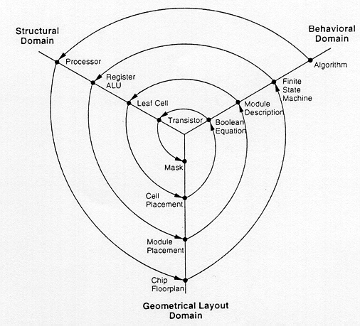
Most important topic- Y chart (contd.)

Slide 11
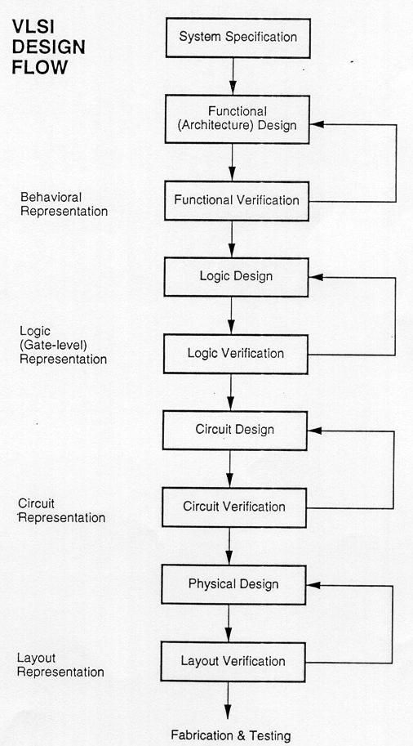
Most important topic- Y chart (contd.)
The Y-chart consists of three major
domains, namely:
Behavioural domain,
Structural domain,
Geometrical layout domain.

Slide 12
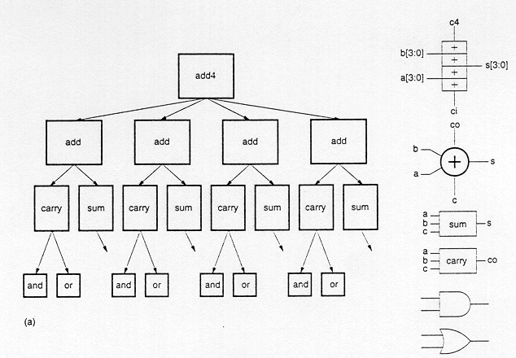
VLSI Design Hierarchy

Slide 13
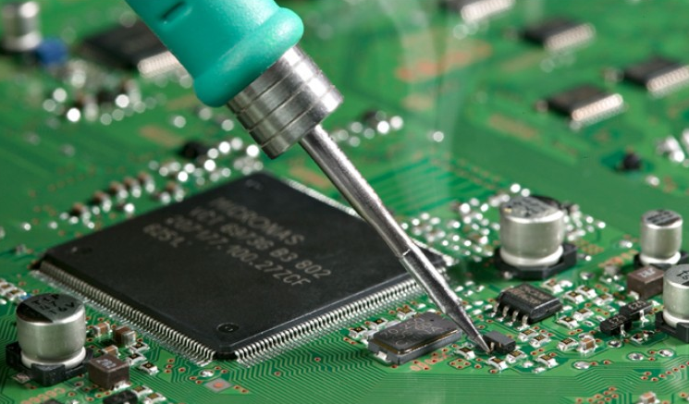
PCB Design & Fabrication

Slide 14
PCB and it’s importance
Very important for all electronic gadgets, which are used either for domestic use, or for industrial purpose.
The PCB designs can be created both manually and automatically.
With the increase in demand, the number of PCB services is on the rise.
A few among those listed on top are the OrCAD PCB design, the Altium PCB design, the Eagle PCB design & ExpressPCB design.

Slide 15
Advantages
LOW ELECTRONIC NOISE
EASE IN DIAGNOSTICS AND REPAIR
COMPACT SIZE
IMMUNITY TO MOVEMENT

Slide 16
Free PCB design Software
PCBWeb Designer
ZenitPCB
Osmond PCB
TinyCAD
BSch3V
ExpressPCB
Kicad
gEDA
Fritzing
ExpressSCH

Slide 17
Paid PCB design Software
OrCAD PCB design
Altium PCB design
Eagle PCB design
Proteus
DesignSpark PCB
EasyEDA
DipTrace
UpVerter
Circuit Maker

Slide 18
Our Course Outline
Types of PCB
Single Layer PCB
Double Layer PCB
Multi Layer PCB
Overview of PCB technologies and its use
Types of component technologies
Through hole component
SMD’s(Surface Mount Technology )
Overview of Manual routing technology
The CAD system as a substitute for manual routing and how to judge CAD systems.
General rules for design of PCBs and design factors

Slide 19
Our Course Outline (contd.)
Introduction to Software
Basics of Circuit designing
Introduction to Symbols
Part reference (Reference Designators)
Schematic Diagram
Layout Design file creation
How to assign footprints to a symbol ?
Conversion of Design file to layout
Selecting of Pads and drill size
Enhanced routing technology

Slide 20
Our Course Outline (contd.)
Soldering Methods
Safety Precautions
Different Methods of Soldering
LED Design Patterns
Use of Flux in soldering
Soldering Iron Precautions
Solder and Solder Materials Precautions
Checking for errors and de-soldering techniques
Getting PCB ready for etching
Etching the PCB
Checking for errors
Cleaning the PCB
Finalizing PCB and Studying the circuit
Drilling and Soldering methods of PCB

Slide 21
Job Prospective
A career in embedded systems is one of the most favourable career options available.
The embedded industry offers tremendous job fortuity countrywide.
If you plan to enter into this field, you need not worry about the respective job prospects.
Embedded systems engineers can find jobs in companies that build embedded systems for the armed forces of a country.
Embedded systems are also used in chemotherapy, diagnostic equipment pacemakers, ventilators, etc.
Online freelancing PCB designers are also favoured worldwide.

Slide 22
Further education / higher studies
Embedded is also the very correct choice to move with for post graduation (masters).
With a Master in Embedded systems you are well prepared for a career in industry or research.
People with command in technical education, combined with knowledge and skills in, design and development of embedded systems are in great demand on the labor market.

Slide 23
Entrepreneurship
India is to emerge as the embedded systems hub it will have to eagerly address the needs of the market.
It is very obvious that academics education needs to be assembling for this. Thus need to focus on job-oriented courses.
Education and vocational training are the sources for this. One can open its own organization for this purpose.
Small cottage industries and organizations are also relevant option in this field.
Equipments as car, fans, air conditioners, washing machines will always resides in use, as the scope for entrepreneurship will lie there. ‘Always’.

Slide 24
Thank You
For sharing your time with us!

