Slide 1
Existing management practices & business culture
Major Problems of business in Nepal
Exploring Existing Management Practices and Business Culture in Nepal

Slide 2
Agenda
1
Introduction to Management Practices and Business Culture in Nepal
2
Defining Management Practices in Nepalese Context
3
Understanding Business Culture in Nepal
4
Analysis of the Current State of Business in Nepal
5
Major Challenges Facing Businesses in Nepal
6
Cultural Barriers to Business Success
7
Impact of Globalization on Local Business Practices
8
Case Studies: Successful Management Practices in Nepal
9
Innovations in Business Management
10
Future Outlook: Opportunities and Risks
11
Strategies for Improving Business Practices in Nepal
12
Conclusion: Key Takeaways and Future Directions

Slide 3




Introduction to Management Practices and Business Culture in Nepal
Overview, Importance, Objectives, Context
Overview of Management Practices
Management practices in Nepal encompass a blend of traditional methods and modern approaches, reflecting the country's cultural diversity and economic landscape.
Cultural Significance
Understanding these practices is crucial for effective leadership and fostering workplace harmony in Nepal's unique socio-cultural context.
Objectives of Study
This study aims to uncover the intricacies of current management practices and how they shape business culture in Nepal.
Contextual Relevance
The analysis of management practices in Nepal is pivotal to enhancing efficiency and sustaining growth within local businesses.
Notes:
The examination of management practices and business culture in Nepal is essential for comprehending the specific dynamics that define the country's economy. As we delve into this analysis, we will explore how historical, cultural, and economic factors converge to create a distinctive management landscape. By doing so, we can better appreciate the importance of adapting management styles to align with Nepal's diverse values and traditions, ultimately aiming to enhance organizational performance.

Slide 4

Defining Management Practices in Nepalese Context
Key Characteristics, Traditional Approaches, Modern Adaptations
Key Characteristics: Nepalese management practices emphasize collaboration, employee engagement, and respect for hierarchy, mirroring the country's collectivist cultural values.
Traditional Approaches: Historically, family-owned businesses have dominated Nepal's economic landscape, valuing personal relationships and long-term commitment over transactional interactions.
Modern Adaptations: Recent trends show a shift towards more formalized business structures, integrating global standards and practices to enhance competitiveness.
Locus of Decision-Making: Decision-making is often centralized in Nepalese firms, which may limit innovation but also ensures stable governance in a traditionally hierarchical framework.
Photo by Al Jeffery on Unsplash
Notes:
As we define management practices within the Nepalese context, it is crucial to recognize how historical, social, and economic factors shape these practices. Traditional approaches often focus on familial ties and collective decision-making, underscoring a culture of trust and relationship-building. However, as globalization influences local businesses, there is a notable adaptation towards modern management approaches, integrating operational efficiencies and structured methodologies. Emphasizing both traditional frameworks and modern adaptations can enhance internal coherence and drive economic progress.

Slide 5

Understanding Business Culture in Nepal
Values, Norms, Communication Styles, Hierarchical Structures
Core Values: Key values in Nepalese business culture include trust, loyalty, and cooperation, often deeply rooted in religious and ethical beliefs.
Norms of Interaction: Social norms dictate that formalities and respect for seniority play a crucial role in business interactions and negotiations.
Communication Styles: Indirect communication is prevalent, with emphasis on nonverbal cues and contextual understanding, which can sometimes be misinterpreted by outsiders.
Hierarchical Structures: Nepalese businesses often operate within clearly defined hierarchical structures, where respect for authority is paramount and decision-making tends to be top-down.
Photo by Sebastian Pena Lambarri on Unsplash
Notes:
Understanding the intricate elements of Nepalese business culture is vital for effective engagement and collaboration. Values such as trust and loyalty are essential for building lasting business relationships and facilitating negotiations. Furthermore, communication styles in Nepal can be nuanced, often relying on indirect cues and nonverbal expressions, which may pose challenges, especially for foreign entities. Recognizing these cultural aspects equips businesses with the tools necessary to navigate the local landscape more effectively.

Slide 6
Analysis of the Current State of Business in Nepal
Market Landscape, Key Industries, Economic Indicators
Market Landscape
Nepal's market is characterized by a vibrant mix of traditional sectors like agriculture and modern industries including tourism and textiles.
Key Industries
Critical industries such as agriculture, tourism, and remittances form the backbone of the economy, influencing policy and development.
Economic Indicators
Insights into GDP growth, unemployment rates, and inflation provide a comprehensive overview of Nepal's economic health and business viability.
Investment Climate
A growing interest from foreign investors marks a shift in the economic landscape, although numerous barriers still impact decision-making.
Notes:
Analyzing the current state of business in Nepal reveals a complex market landscape where traditional practices collide with modern demands. Various sectors play pivotal roles in the economy, particularly agriculture and tourism, while remittances contribute significantly to GDP. Understanding economic indicators is essential as they provide critical insight into the business climate, highlighting emerging opportunities and existing challenges. The growing interest from international investors signals a shift, yet barriers such as bureaucratic inefficiencies must be addressed to foster sustainable economic growth.

Slide 7




Major Challenges Facing Businesses in Nepal
Political Instability, Infrastructure Issues, Regulatory Environment
Political Instability
Frequent governmental changes and policy shifts create an unpredictable business environment that discourages long-term investment.
Infrastructure Issues
Inadequate transport and communication infrastructures hinder business operations and supply chain efficiencies.
Regulatory Environment
Complex regulatory frameworks and cumbersome bureaucratic processes create significant challenges for business compliance and growth.
Access to Finance
Limited access to financing options for small and medium enterprises constrains innovation and expansion capabilities.
Notes:
The landscape for businesses in Nepal is fraught with significant challenges that can impede growth and sustainability. Political instability often leads to an erratic regulatory environment, complicating operational decision-making for businesses. Additionally, persistent infrastructure deficiencies hinder logistics and communications, ultimately affecting operational efficiency. Furthermore, the regulatory environment is complex and often opaque, creating barriers for compliance and growth, particularly for small and medium enterprises that represent a substantial portion of Nepal's economy.

Slide 8




Cultural Barriers to Business Success
Socio-Cultural Factors, Resistance to Change, Relationship Building
Socio-Cultural Factors
Societal norms and expectations dictate business practices, influencing decision-making and operational methods in Nepal.
Resistance to Change
Cultural adherence to traditional practices can create resistance against new methodologies or innovative practices.
Importance of Relationships
Building personal relationships is essential for doing business, often superseding formal agreements and contracts.
Networking Challenges
Limited networking opportunities can restrict the exchange of ideas and collaboration among businesses, impeding growth.
Notes:
Culture plays a crucial role in shaping business practices and outcomes within Nepal. Socio-cultural factors significantly influence how decisions are made and how businesses interact, often prioritizing relationships over formal processes. This emphasis on personal connections can pose challenges for the adoption of innovative practices and methodologies. Moreover, resistance to change is common, as organizations often cling to traditional methods. Navigating these cultural barriers requires a nuanced understanding of local dynamics and a focus on relationship-building to foster a conducive environment for success.

Slide 9



Impact of Globalization on Local Business Practices
Cultural Exchange, Market Influence, Adaptation Challenges
Cultural Exchange
Globalization facilitates the exchange of ideas and practices, enriching Nepalese business culture while introducing new challenges.
Market Influence
The influx of foreign competition impacts local enterprises and changes consumer expectations and behaviors.
Adaptation Challenges
Businesses face difficulties in adapting to globalization, balancing traditional values while integrating modern practices.
Skill Development
Globalization necessitates skill development programs to prepare the workforce for emerging business practices and technologies.
Notes:
The influence of globalization on local business practices in Nepal is multifaceted, presenting both opportunities and challenges. While cultural exchange enriches the business environment and introduces fresh perspectives, it can also disrupt traditional practices and consumer expectations. Local businesses must navigate competitive pressures while striving to maintain their cultural integrity. Adaptation to new practices is often fraught with challenges, necessitating a strategic approach to skill development to empower the workforce in this evolving paradigm.

Slide 10


Case Studies: Successful Management Practices in Nepal
Best Practices, Lessons Learned, Sustainability Factors
Best Practices Highlighted
Case studies reveal practical applications of successful management practices tailored to local contexts and challenges.
Lessons Learned
Learning from both successful and unsuccessful endeavors can provide valuable insights for future business strategies.
Notes:
Examining case studies of successful management practices in Nepal offers valuable insights into how businesses can thrive in challenging environments. These studies highlight innovative solutions grounded in local contexts, illustrating a commitment to sustainability and community engagement. By analyzing both successes and failures, businesses can glean lessons that inform their strategic direction and enhance their operational effectiveness, ultimately contributing to a more resilient economic landscape.

Slide 11

Innovations in Business Management
Technology Adoption, Digital Transformation, New Business Models
Technology Adoption: The integration of technology into traditional business practices is revolutionizing operations, improving efficiency and competitiveness.
Digital Transformation: Businesses are rethinking their approaches to customer engagement, leveraging digital channels for enhanced interaction and service delivery.
Emerging Business Models: New business models, rooted in collaboration and sustainability, are gaining traction, reshaping the business landscape in Nepal.
Cultural Adaptation: Innovations must respect and integrate Nepal’s cultural values to ensure acceptance and success in the local market.
Photo by Luke Chesser on Unsplash
Notes:
Innovation is at the forefront of business management practices in Nepal as companies embrace technology and digital transformation. The integration of new technologies into traditional practices enhances operational efficiencies and drives competitiveness. Moreover, emerging business models focusing on sustainability and collaboration hint at a paradigm shift in how businesses operate. However, successful innovation requires a sensitive approach that respects and adapts to Nepal’s rich cultural heritage while delivering tangible value to consumers.

Slide 12
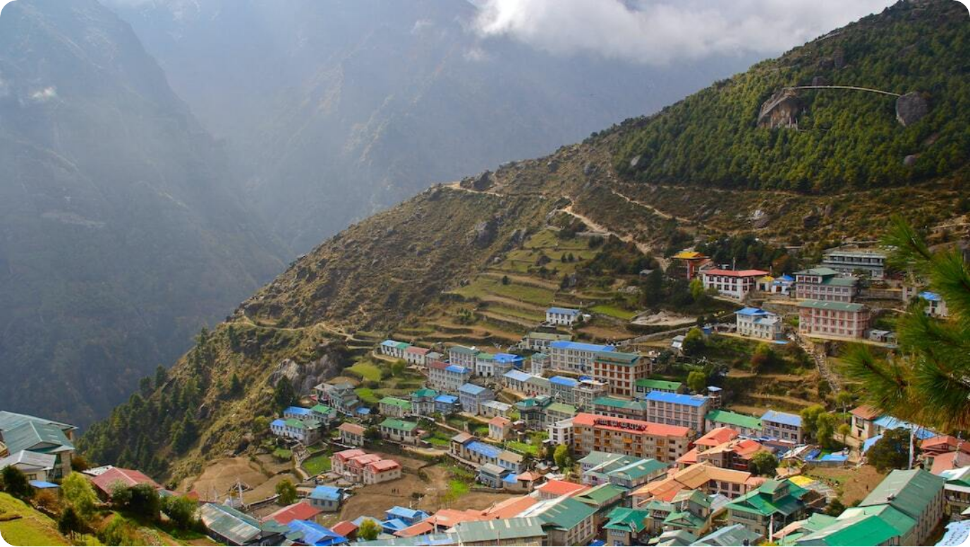
Future Outlook: Opportunities and Risks
Emerging Trends, Potential Growth Areas, Risk Management Strategies
Emerging Trends: Trends like e-commerce growth and sustainable practices present significant opportunities for innovation and expansion in the Nepalese market.
Potential Growth Areas: Sectoral growth opportunities exist beyond traditional areas, including renewable energy, technology, and sustainable tourism.
Risk Management Strategies: Robust risk management frameworks are essential to navigate both local and global uncertainties and to foster resilience.
Strategic Partnerships: Collaborations between local businesses and global entities can enhance resource sharing and innovation capabilities.
Photo by Kalle Kortelainen on Unsplash
Notes:
Looking ahead, the future of business in Nepal is marked by both challenges and opportunities. Emerging trends such as e-commerce and sustainable practices are laying the groundwork for new avenues for growth. Key sectors present substantial expansion potential, particularly in tech and renewable energy. As businesses navigate these landscapes, they must also prioritize risk management and leverage strategic partnerships to bolster resilience and adaptability in an ever-changing environment.

Slide 13

Strategies for Improving Business Practices in Nepal
Actionable Recommendations, Capacity Building, Stakeholder Engagement
Actionable Recommendations: Developing clear business frameworks and guidelines can facilitate smoother operations and compliance with regulatory requirements.
Capacity Building: Investing in training and skill development programs is vital to prepare the workforce for evolving business demands.
Stakeholder Engagement: Engaging with stakeholders fosters collaboration and partnership, essential for driving collective growth and addressing common challenges.
Policy Advocacy: Active participation in policy advocacy can help create a more enabling environment for businesses to flourish.
Photo by Sameer Shyantan on Unsplash
Notes:
To bolster the business landscape in Nepal, actionable strategies must be implemented. Clear recommendations and frameworks can ease operational complexities and ensure compliance. Capacity building through targeted training programs is crucial to equip the workforce with the necessary skills. Furthermore, engaging stakeholders and fostering strategic partnerships cultivates an environment for collective growth, while active participation in policy advocacy strengthens the overall regulatory framework for businesses, paving the way for a more conducive business environment.

Slide 14


Conclusion: Key Takeaways and Future Directions
Summary, Final Insights, Call to Action
Summary of Key Insights
The interplay between management practices and cultural values significantly shapes business outcomes in Nepal.
Future Directions
Adopting innovative practices aligned with cultural context is key to fostering sustainable business growth.
Call to Action
Engagement from all stakeholders is required to drive change and improve business practices across various sectors.
Notes:
In summary, the intricate relations between management practices and business culture in Nepal embody unique challenges and opportunities. Moving forward, it is essential for businesses to align their practices with local cultural values and trends for sustainable growth. The role of all stakeholders is critical in this endeavor; collaboration will be fundamental to not only improve business practices but to promote resilience and adaptability in the face of rapid change. A collective commitment to innovation and cultural sensitivity will pave the way for a robust economic future.

