Slide 1
A 50-m/320-Gb/s DWDM FSO Communication With Afocal Scheme
Anjitha M
EC 7 B
Roll No: 14
Guided By,
Remya S
A. P in ECE

Slide 2
Contents
Introduction
Free Space Optics
DWDM and Afocal Scheme
Experimental Setup
Experimental Results
Challenges
Inferences
Conclusion
References

Slide 3
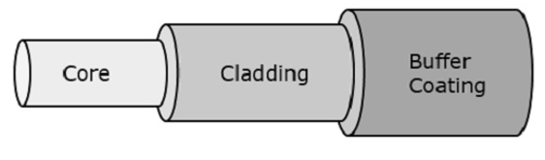
Introduction
Optical Communication
OFC
Fig 1: Parts of an Optical Fiber Cable
Notes:
1. communication at a distance using light to carry information. It can be performed visually or by using electronic
devices.
2. An optical communication system uses a transmitter, which encodes a message into
an optical signal, a channel, which carries the signal to its destination, and a receiver, which
reproduces the message from the received optical signal
3. most common type of channel for optical communications.
4. consists of an inner glass core surrounded by a glass cladding which has a lower refractive index.
5. Digital signals are transmitted in the form of intensity-modulated light signal which is trapped in the glass core.
6. Light is launched into the fiber using a light source such as a Light Emitting Diode (LED) or Laser. It is detected on the other side using a photo detector such as a photo-transistor.

Slide 4
Introduction
Advantages:
Higher bandwidth
Reduced losses
Fiber optic cables provide high security
OFCs are immune to electromagnetic interference and electrical noise.
Disadvantages:
High installation cost
Large no. of repeaters
More protection needed
Notes:
Current optical fiber systems provide transmission rates from 45 Mb/s to 9.6 Gb/s using the single
wavelength transmission.

Slide 5
Free Space Optics (FSO)
Uses light propagating in free space for wireless data transmission.
Air, outer space, vacuum, or something similar.
Different from using solids such as OFC.
Useful where the physical connections are impractical due to high costs or other considerations.
Notes:
1.an optical communication technology that uses light propagating in free space for wireless data transmission for telecommunications or computer networking.
2.This contrasts with using solids such as optical fiber cable for data transmission.
3.impractical due to high costs or other considerations.
4.high directivity, which provides high power efficiency and isolation from other interferences, unlicensed bandwidth, easy installation, and the promise of multi-gigabit mobile applications by using flexibility through free-space links.
5. high bandwidth, low cost implementation in a non-licensed spectrum, relatively low power consumption, immunity and security compared with RF technologies

Slide 6
Why FSO?
Ease of deployment.
License-free long-range operation (in contrast with radio communication).
High bit rates.
Low bit error rates.
Immunity to electromagnetic interference.
Increased security when working with narrow beam(s).
Notes:
Disadvantages:
Fog (10 to 100 dB/km attenuation).
Beam dispersion.
Atmospheric absorption.
Rain.
Snow.
Terrestrial scintillation.
Interference from background light sources (including the sun).
Shadowing.
Pointing stability in wind.
Pollution / smog.
These factors cause an attenuated receiver signal and lead to higher bit error rate (BER).
Eye safe: limited laser power density. Laser classes 1, 1M, 1550nm wavelength
Laser class 1 is classified as eye-safe under all operating conditions.
Laser class 1M is classified as safe for viewing directly with the naked eye, provided no optical instruments are used.

Slide 7
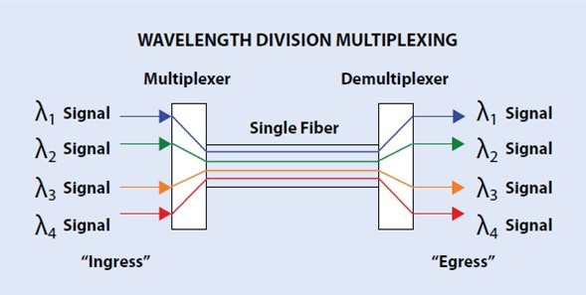
DWDM
WDM
DWDM
Fig 2: WDM Operating Principle
Notes:
WDM: multiplexes a number of optical carrier signals onto a single optical fiber by using different wavelengths (i.e., colors) of laser light.
enables bidirectional communications over one strand of fiber, as well as multiplication of capacity. (several signals can be transmitted in an optical waveguide at differing wavelengths.)
uses a multiplexer at the transmitter to join the several signals together, and a demultiplexer at the receiver to split them apart.
Normal WDM (sometimes called BWDM) uses the two normal wavelengths 1310 and 1550 on one fiber. Coarse WDM provides up to 16 channels across multiple transmission windows of silica fibers. Dense wavelength division multiplexing (DWDM) uses the C-Band (1530 nm-1565 nm) transmission window but with denser channel spacing.
DWDM: optical signals multiplexed within the 1550 nm band so as to leverage the capabilities (and cost) of erbium doped fiber amplifiers (EDFAs)

Slide 8
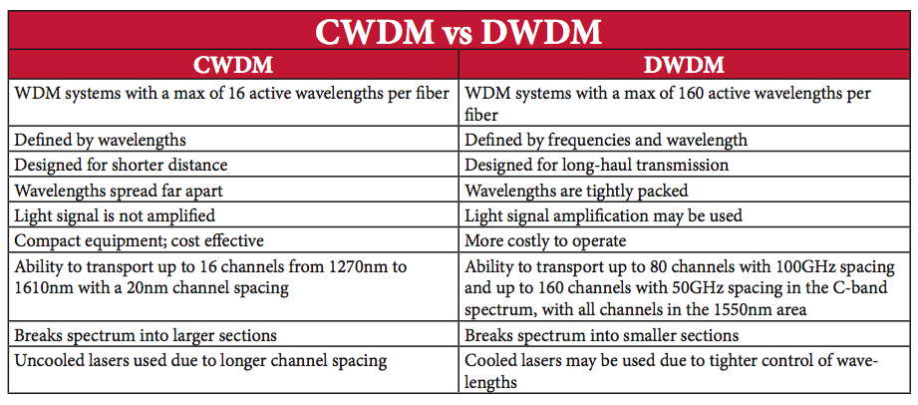
CWDM and DWDM
Notes:
CWDM: fewer than eight active wavelengths per fiber.
defined by wavelengths
for short-range communications, so it employs wide-range frequencies with wavelengths spread far apart.
DWDM: more no of wavelengths.
defined in terms of frequencies.
tighter wavelength spacing fits more channels onto a single fiber
cost more to implement and operate.

Slide 9
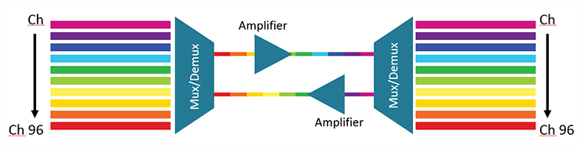
Why DWDM?
Fig 3: DWDM system
Increases the distances between network elements.
The fiber-optic amplifier.
Broad range of wavelengths.
Fewer regenerators.
Notes:
compared to repeater based s/ms
taking in and amplifying optical signals without converting them to electrical signals.
Less regenerators mean fewer interruptions and improved efficiency.
Cost effective to use DWDM to leverage capabilities of EDFA (1550 nm range)
Increased bandwidth
Effect of multiple virtual fibers
40 channels at 100 GHz spacing or 80 channels with 50 GHz spacing.
compared with repeater-based applications, increases the distances between network elements, a huge benefit for long-distance service providers looking to reduce their initial network investments significantly.
The fiber-optic amplifier component enables a service provider to save costs by taking in and amplifying optical signals without converting them to electrical signals. allows service providers to do it on a broad range of wavelengths.
Using fewer regenerators in long-distance networks results in fewer interruptions and improved efficiency.

Slide 10
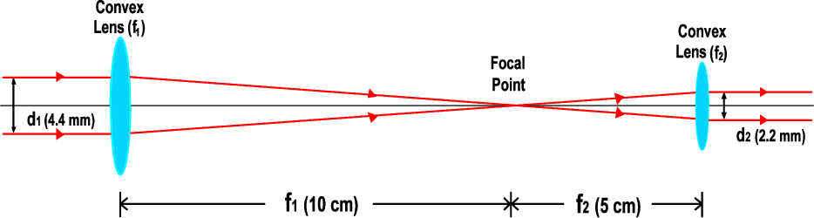
Afocal Scheme
Produces no net convergence or divergence of the beam.
d = f1+f2
Fig 4: Afocal Scheme, with two convex lenses ^{[1]}
Notes:
, i.e. has an infinite effective focal length. (theoretically)
Main function is to reduce the diameter of the beam.
transform a collimated optical beam with a large diameter of 4.4 mm (d1) into another collimated optical beam with a small diameter of 2.2 mm (d2).
operated nearby the receiving site: pre
operated nearby the middle position: in line

Slide 11
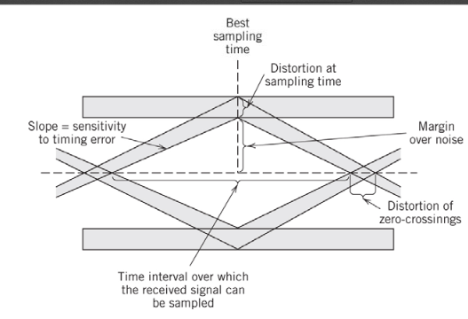
Bit Error Rate (BER)
BER: the number of bit errors per unit time.
The bit error ratio
Fig 5: Interpretation of eye diagram
Notes:
Bit error ratio
Eye pattern: pattern displayed on the screen of a cathode ray oscilloscope (CRO); used as a tool for evaluating the effects of inter symbol interference (ISI).

Slide 12
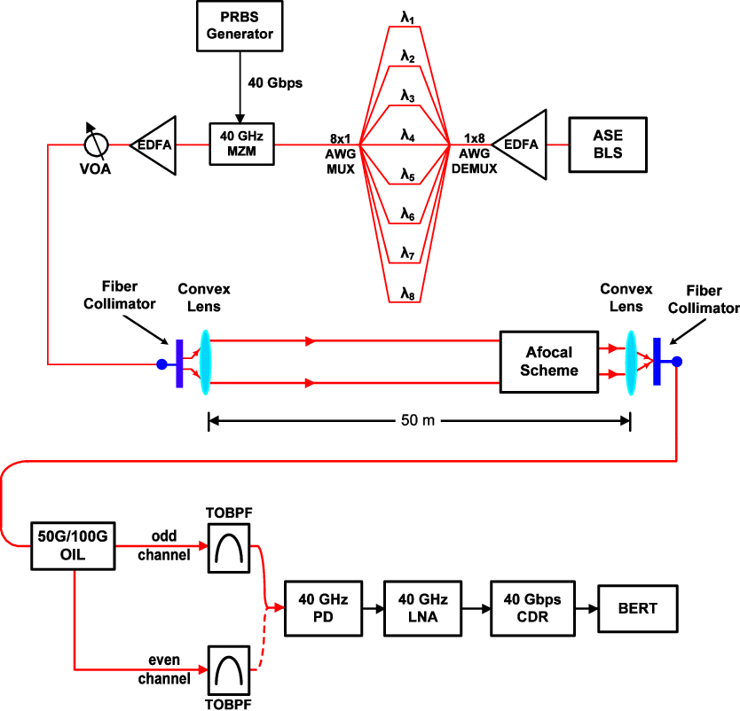
Experimental Setup
BPF
RESULT
Fig 6: Experimental configuration of the proposed 50-m/320-Gb/s DWDM FSO communication ^{[1]}
Notes:
Explain briefly, come back after explaining elements
The output of the amplied spontaneous emission (ASE) broadband light source (BLS) is amplied by an erbium-doped ber amplier (EDFA) and eciently split into eight opti-
cal channels by a 1 x 8 arrayed waveguide grating (AWG) demultiplexer (DEMUX) with a channel spacing of 0.4 nm (50 GHz). Eight wavelengths from the AWG DEMUX output are multiplexed into a 40-GHz Mach{ Zehnder modulator (MZM) by a 8 x 1 AWG multiplexer (MUX). The MZM is modulated by a 40-Gbps pseudorandom binary sequence (PRBS) generated by a PRBS generator. It means that the same PRBS sequence is transmitted over all eight channels.
A collimator is a device that narrows a beam of particles or waves. To narrow means to cause the directions of motion to become more aligned in a specific direction i.e., make collimated light or parallel rays.
a single-mode optical fiber (SMF) is an optical fiber designed to carry light only directly down the fiber - the transverse mode. Modes define the way the wave travels through space, i.e. how the wave is distributed in space. Waves can have the same mode but have different frequencies. This is the case in single-mode fibers, where we can have waves with different frequencies, but of the same mode, which means that they are distributed in space in the same way, and that gives us a single ray of light.
Fiber collimator connected to SMF: operating wavelength range of 1050–1620 nm, a fiber-to-lens distance of 7.5 mm, and a focal length of
7.5 mm.
FC to convex lens to free space to afocal scheme to convex lens to FC.
40 Ghz photo diode : conert optical s/g into electrical, with a responsivity of 0.55 mA/mW (at
1550 nm)
The Spectral responsivity is a ratio of the generated photocurrent to incident light power, expressed in A/W
40-GHz LNA with a small signal gain of 20 dB (measured at
40 GHz) and a noise figure of around 2 dB.
LNA amplifies a very low-power signal without significantly degrading its signal-to-noise ratio. (whereas generally amplifiers amplify both s/g and noise
It is necessary for an LNA to amplify the data stream while adding as little noise and distortion as possible.
Noise figure 2 dB : helps determine the efficiency of a particular LNA.
low noise figure results in better signal reception
CDR and BERT:
the receiver needs to recover the clock in order to sample the data on serial lines because most of the high speed serial interfaces do not have any accompanying clock.
To recover the sampling clock, receiver needs a reference a clock of approximately same frequency. To generate the recovered clock, the receiver needs to phase align the reference clock to the transitions on the incoming data stream. This is called as Clock recovery.
Sampling of that incoming data signal with recovered clock to generate a bit stream is called as Data recovery. Together, this is called Clock Data Recovery, or CDR
CDR needed to recover data from incoming data stream in the absence of any accompanying clock signal, without any bit errors due to over/under sampling.
BERT: data transmitted – error if data noisy. High BER means degraded performance.

Slide 13
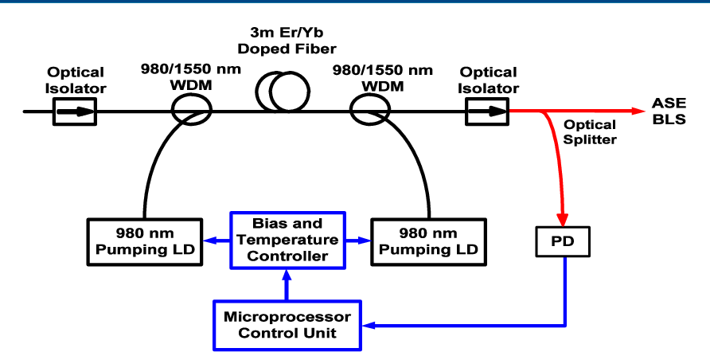
Amplified Spontaneous Emission (ASE) broadband light source (BLS)
Fig 7: Configuration of ASE BLS ^{[1]}
Notes:
1. Amplified spontaneous emission (ASE)} or superluminescence is light, produced by spontaneous emission, that has been optically amplified by the process of stimulated emission in a gain medium.
2.The gain medium (also called active laser medium or lasing medium) is the source of optical gain within a laser. The gain results from the stimulated emission of electronic or molecular transitions to a lower energy state from a higher energy state.
3.BLS is a light source with a broad bandwidth, which does not necessarily emit in the visible spectral region. Such sources can be superluminescent sources, e.g. superluminescent diodes, easy to tightly focus the output or to deliver it through an optical fiber, even a single-mode fiber.
composed of a bidirectional pumped EDFA with LDs at 980 nm. Two 980 nm pumping LDs with 180 mW pumping power are coupled into a 3-m Er/Yb doped fiber by two 980/1550 nm WDM couplers. Two optical isolators are used to prevent reflections which can degrade ASE BLS performance. Part of the laser output is utilized for optoelectronic feedback to enhance the performance of ASE BLS, and another part of the laser output is used for ASE BLS. A PD converts laser light into the electronic
signal to control the microprocessor control unit and the bias and temperature controller. The high power ASE cascaded with EDFA can be efficiently split into many optical channels by using a 1 x N AWG DEMUX.

Slide 14
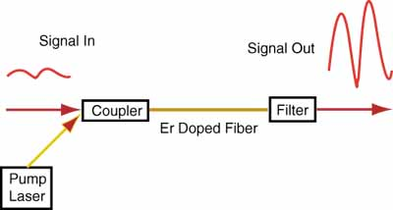
Erbium-Doped Fiber Amplier (EDFA)
Figure 8: EDFA
The core of a silica fiber is doped with trivalent erbium ions.
Efficiently pumped with a laser at a wavelength of 980 nm or 1,480 nm.
Exhibits gain in the 1,550 nm region.
Notes:
amplifies an optical signal directly, without the need to first convert it to an electrical signal.
used as optical repeaters in the long distance fiber-optic cables
glass fiber can absorb light at one frequency and emit light at another frequency.
An external semiconductor laser couples light into the fiber at infrared wavelengths of either 980 or 1480 nanometers.
This action excites the erbium atoms.
Additional optical signals at wavelengths between 1530 and 1620 nanometers enter the fiber and stimulate the excited erbium atoms to emit photons at the same wavelength as the incoming signal.

Slide 15
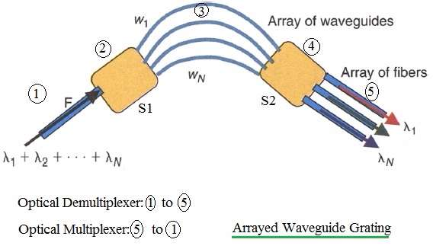
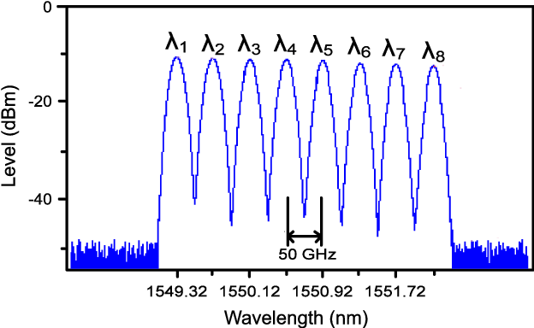
Arrayed Waveguide Grating (AWG) MUX and DEMUX
Fig 9: Operation of AWG
Fig 10: Optical Spectrum of the 8 wavelengths ^{[1]}
Notes:
Optical mux, multiplex various WDM channels into one fiber cable.
also used as optical de-multiplexers
Explain function of AWG as DEMUX
Fiber containing all wavelength enter the input cavity, called s1, move through free space and splits into 8 arrayed waveguides. This will travel to reach s2 via different length waveguides and phase delay is introduced proportional to wavelength.
Output cavity connected to multiple fibers. Each will receive a waveguide of unique wavelength and maximum amplitude

Slide 16
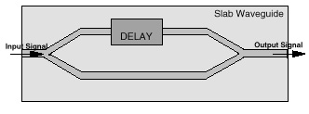
Mach-Zehnder modulator (MZM) and Variable Optical Attenuator (VOA)
Used for controlling the amplitude of an optical wave.
VOA is a device that can incrementally adjust the power of the optical signal passing through it.
Fig 11: MZM
<- BACK
Notes:
MZI : similar structure to MZM, device used to determine the relative phase shift variations between two collimated beams derived by splitting light from a single source.
Performs amplitude modulation
If a voltage is applied across one of the arms, a phase shift is induced for the wave passing through that arm. When the two arms are recombined, the phase difference between the two waves is converted to an amplitude modulation.
VOA: The power reduction is done by such means as absorption, reflection, diffusion, scattering, deflection, diffraction, and dispersion
work by absorbing the light, like sunglasses absorb extra light energy.
They typically have a working wavelength range in which they absorb all light energy equally.
They should not reflect the light or scatter the light in an air gap, since that could cause unwanted back reflection in the fiber system.

Slide 17
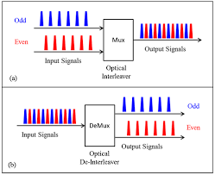
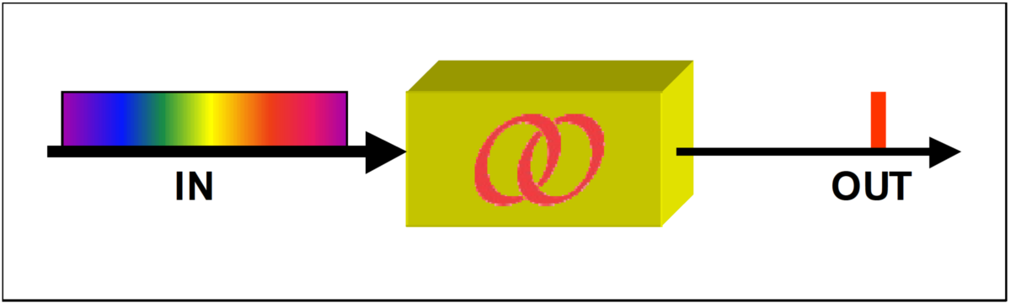
Optical Interleaver (OIL) and TOBPF
Fig 12: An Optical Interleaver
Fig 13: Tunable Optical Band Pass Filter
←BACK
Notes:
OIL: 3-port passive fiber-optic device that is used to combine two sets of dense wavelength-division multiplexing (DWDM) channels (odd and even channels) into a composite signal stream in an interleaving way.
OIL takes two multiplexed signals with 100 GHz spacing and interleaves them, creating a denser DWDM signal with channels spaced 50 GHz apart.
Reverse: de-interleaver – used here (50 G/100G)
TOBPF: Pass required frequency according to tuning. 3 dB bandwidth .32 nm

Slide 18
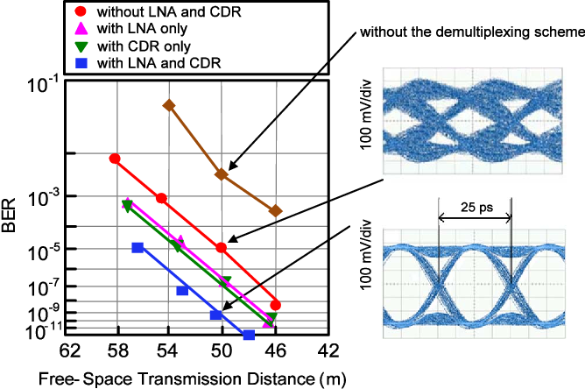
Experimental Results
Fig 14: The measured BER curves of DWDM FSO communications at a data stream of 40 Gbps ^{[1]}
Fig 15: The measured BER curves at 40 Gbps with LNA and CDR employed. ^{[1]}
Notes:
Fig 1: The measured BER curves of DWDM FSO communications at a data stream of 40 Gbps.
At a free-space transmission distance of 50 m, as LNA and CDR are
not employed, the BER is approximately 10⁻⁵.
as LNA and CDR are employed simultaneously, the BER reaches around 10⁻⁹
When one of the BER scheme removed, performance degrades.
Eye diagrams: w/o BER scheme – not clear. Amplitude and phase fluctuations
With BER, clear.
Removing DEMUX scheme ( no OIL and TOBPF): degradation due to crosstalk and interference from other wavelength.
Fig 2: over different tramn distances. As dist inc, BER inc as well. For distances greater than 50 m, BER more than 10⁻⁹
Longer distance, less rxd power. Can be improved by afocal scheme, EDFA of higher o/p power.

Slide 19
Inferences
Both of the LNA and CDR play important roles for BER improvement.
Demultiplexing scheme must reject adjacent channels.
The free-space transmission distance extended by:
The optimization of the afocal scheme
The employment of an EDFA with higher optical output power.

Slide 20
Challenges
The simplification of the BLS.
The function of the demultiplexing scheme.
As the free-space transmission distance increases, the noise increases.
Notes:
BLS mention superluminescent diode, spectrum slicing
Demux scheme: is to distinguish each optical wavelength without crosstalk and channel interference. It is a great challenge in closely spaced optical wavelengths.
3. resulting in the decrement of OSNR value and the degradation of BER performance.

Slide 21
Conclusion
A promising and rapidly progressing research avenue in modern optics.
A DWDM FSO communication that adopts afocal scheme and DWDM technology.
The free-space transmission distance and transmission rate are greatly increased by afocal scheme and DWDM technology.
A total transmission rate of 320 Gbps is successfully delivered over a 50-m free-space link.
Experimentally demonstrated with low BER operation and clear eye diagram.
The findings demonstrated provide the advantages of optical wireless links for long transmission distance and high transmission rate.

Slide 22
References
[1] W. S. Tsai et al., “A 50-m/320-Gb/s DWDM FSO Communication With Afocal Scheme”, IEEE Photon. J., vol. 8, no. 3, June 2016, Art. No. 2555618.
[2] W. S. Tsai et al., “A 20-m/40-Gb/s 1550-nm DFB LD-based FSO link," IEEE Photon. J., vol. 7, no. 6, Dec. 2015, Art. no. 7905907.
[3] H. Henniger and O. Wilfert, “An introduction to free-space optical communications,” Radioen., vol. 19, no. 2, pp. 203–212, Jun. 2010.
[4] W. S. Tsai et al., “A 50 m/40 Gbps 680-nm VCSEL-based FSO communication," IEEE Photon. J., vol. 8, no. 2, Apr. 2016, Art. no. 7903008.
[5] J. Yu et al., “DWDM optical millimeter-wave generation for radio-over-fiber using an optical phase modulator and an optical interleaver," IEEE Photon. Technol. Lett., vol. 18, no. 13, pp. 1418 - 1420, Jul. 2006.
[6] H. H. Lu et al., “Bidirectional fiber-wireless and fiber-VLLC transmission system based on an OEO-based BLS and a RSOA," Opt. Lett., vol. 41, no. 3, pp. 476 - 479, Feb. 2016.
[7] G. A. Alphonse, D. B. Gilbert, M. G. Harvey, and M. Ettenberg, “High-power superluminescent diodes," IEEE J. Quantum Electron., vol. 24, no. 12, pp. 2454 - 2457, Dec. 1988.

Slide 23
THANK YOU

