Slide 1
Cloud IAM

Slide 2
IAM
Identity and Access Management

Slide 3
Layers of principals
Applications
Identites: Application Users, Applications Administrators
Operating Systems
Identites: Developer, System Engineers
Amazon Web Services
Identies: Developers, Solution Architects ,Testers

Slide 4
AWS principals
Account Owner ID (Root account)
Access to all susbscribed services
Access to billing
Access to console and APIs
Access to customer Support
AWS Identity and Access Management(IAM)
Access to specific services
Access to console and APIs
Access to Customer Support(Bussiness and Support)

Slide 5
AWS IAM
IAM Users
IAM Groups
IAM Roles
Policies

Slide 6
Policy Type
Identity Based Policies
Resource based Policies
Access Control Lists

Slide 7
Identity Based Policies
Containes permissions that specifies what actions that identity can perform on which resources and under what conditions.
Attached to a identity

Slide 8
Resource Based Policies
Contains permissions that specifies what actions a specified principal can perform on what resource under what conditions
Attached to a resource

Slide 9
Access Control Lists
Manage Access to buckets and objects
Contains a grantee and permissions

Slide 10
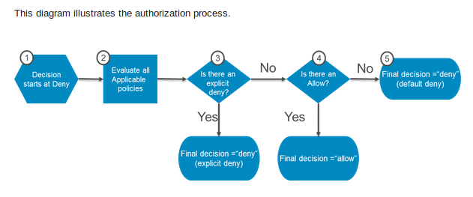
Policy Evaluation Logic

Slide 11
Identity Based Policy
Resource Permissions
Access Control Lists
Resource Based Policy

Slide 12
AWS Boundary Types
Organization Service Control Policy
Permission Boundary

Slide 13
Service Control Policy
Allows you to control which AWS service APIs are accessible
List of APIs that are allowed (Whitelisit)
List of APIs that are blocked(BlackList)
Local Admin can not override SCPs
Effective permissionson IAM user/role is intersection of SCP and IAM permissions

Slide 14
Defined by developer
IAM Permissions
Effective Permissions
Organization SCP
Defined by Admin

Slide 15
Permission Boundary
Permission to create users and roles
Preventing privilege escalation
Avoid broad permissions
User or role can do only actions allowed by both the attached identity based policies and the permissions boundary

Slide 16
Defined by developer
IAM Permissions
Effective Permissions
Permission Boundary
Defined by Admin

