Slide 1
Cloud Computing

Slide 2
Why?
Scalability Problem
Lage Scale data
High performance data
Rapid change in requirements
Cost

Slide 3
Introduction
NIST defines "cloud computing is a model for enabling ubiquitous, convenient, on-demand network access to a shared pool of configurable computing resources (e.g., networks, servers, storage, applications and services) that can be rapidly provisioned and released with minimal management effort or service provider interaction."
NIST(National Institute of Standards and Technology)

Slide 4
Introduction
Cloud computing enables on demand network access
Share computing resources
Require minimal effort
High Level abstraction of compution resources
Cost Effective
Pay as you go model
Provides services over network
Services:Storage,Computing resource,Software

Slide 5
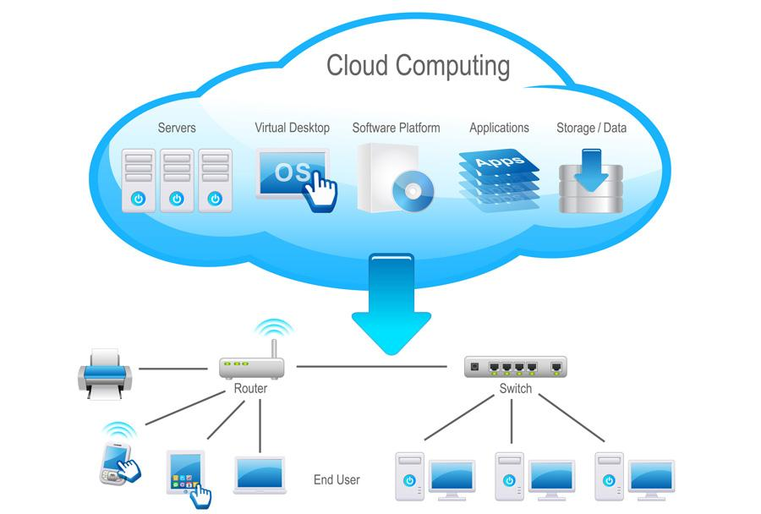
Source: https://nodetx.com/cloud-provisioning/

Slide 6
Services and models are working behind the scene making the cloud computing possible

Slide 7
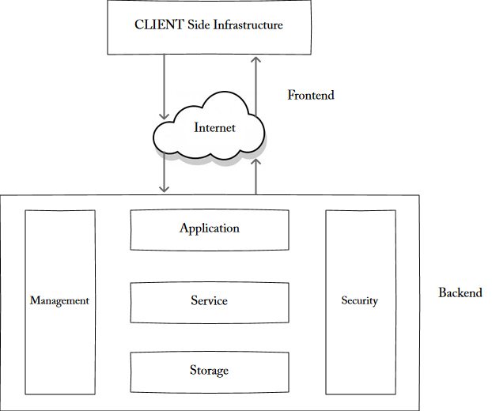
Cloud Architecture
Source: https://www.w3schools.in/

Slide 8
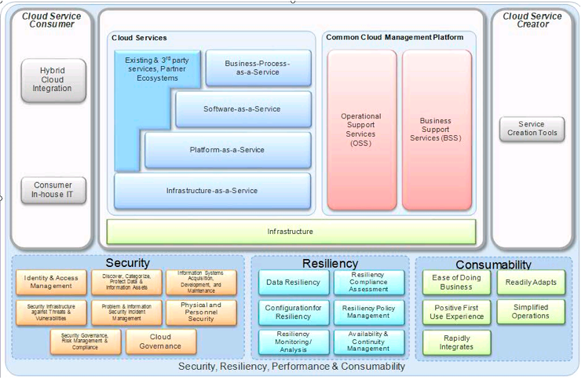
IBM reference Architecture

Slide 9
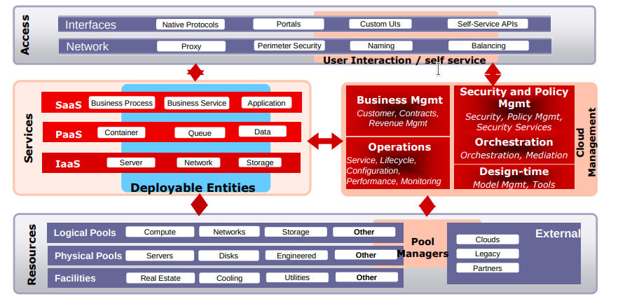
Oracle Cloud Architecture

Slide 10
Characteristics
Broad network access
Rapid elasiticty
Measured service
On-demand self service
Resource pooling

Slide 11
Deployment Models
Public Cloud
Private Cloud
Hybrid Cloud: Mix of both public and private cloud. Critical services available through private cloud. And general services available through public cloud.
Community Cloud: Services available to group of organization

Slide 12
Public Cloud
Services available to general public such as computing resource, such as hardware (OS, CPU, memory, storage) or software (application server, database) on a subscription basis.

Slide 13
Private cloud
Services available to certain set of people
A private cloud is typically infrastructure used by a single organization
Such infrastructure may be managed by the organization itself to support various user groups, or it could be managed by a service provider that takes care of it either on-site or off-site.
Private clouds are more expensive than public clouds

Slide 14
Hybrid Cloud
An organization makes use of interconnected private and public cloud infrastructure. Many organizations make use of this model when they need to scale up their IT infrastructure rapidly, such as when leveraging public clouds to supplement the capacity available within a private cloud.
An online retailer needs more computing resources to run its Web applications during the holiday season it may attain those resources via public clouds.

Slide 15
Community cloud
This deployment model supports multiple organizations sharing computing resources that are part of a community
Such as NPO(Non-profit organizations),Universities for research

Slide 16
Service Models
Software as a Service(SaaS)
Infrastructure as a Service(IaaS)
Platform as a Service(PaaS)

Slide 17
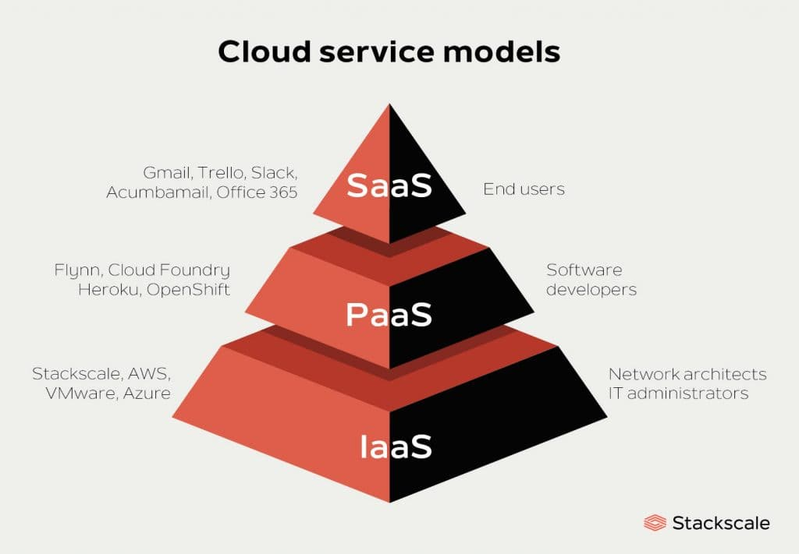
Source: https://www.stackscale.com/

Slide 18
SaaS
Allows to use software applications software applications as a service to end users.
Remotely as a web based service
Sometimes pay as you go
Sometimes subscription
Highly scalabale Infrastructure

Slide 19
IaaS
Deliver technology infrastructure as on demand service
Provides access to physical machine, virtual machine, virtual storage, etc.
Pay as you go

Slide 20
PaaS
PaaS provides runtime enviroment for applications, development and deployment tools etc.
Generally application must be developed with platform in mind
Highly Scalable
Pay as you go
Subscription based

Slide 21
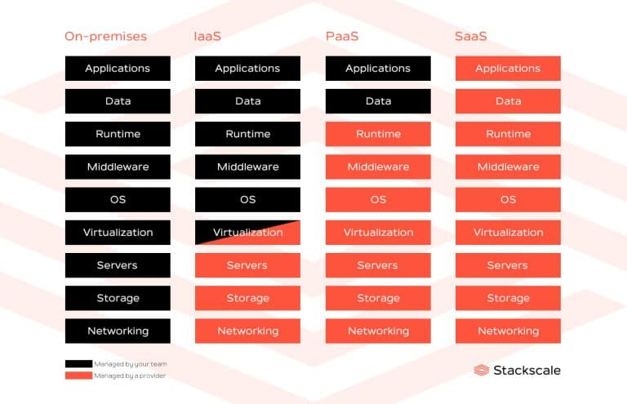
Source: https://www.stackscale.com/

Slide 22
Virtualization
Virtualization enables users to disjoint operating systems from the underlying hardware
Users can run multiple operating systems such as Windows, Linux, on a single physical machine at the same time.
Such operating systems are known as guest OS
Virtualization allows cloud providers to deliver users along with existing physical computer hardware.

Slide 23
Over an existing operating system & hardware, we generally create a virtual machine that and above it, we run other operating systems or applications. This is called Hardware Virtualization.
This virtual environment is managed by firmware, which is termed as a hypervisor.

Slide 24
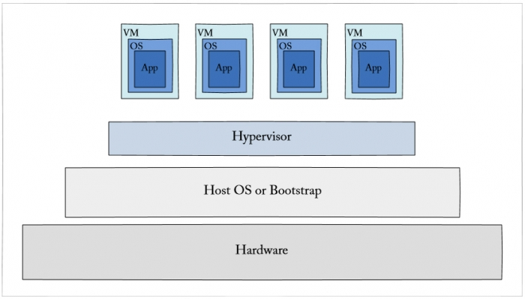
Source: https://www.w3schools.in/

Slide 25
Hyperviser
Virtual Machine
Container

