Slide 1
Container

Slide 2
Introduction
Virtualization of application not hardware
Runs over OS
Very Lightweight than virtual machine
New Instance starts in milliseconds
Don’t need to assign to CPU,memory,storage and network
Small package

Slide 3
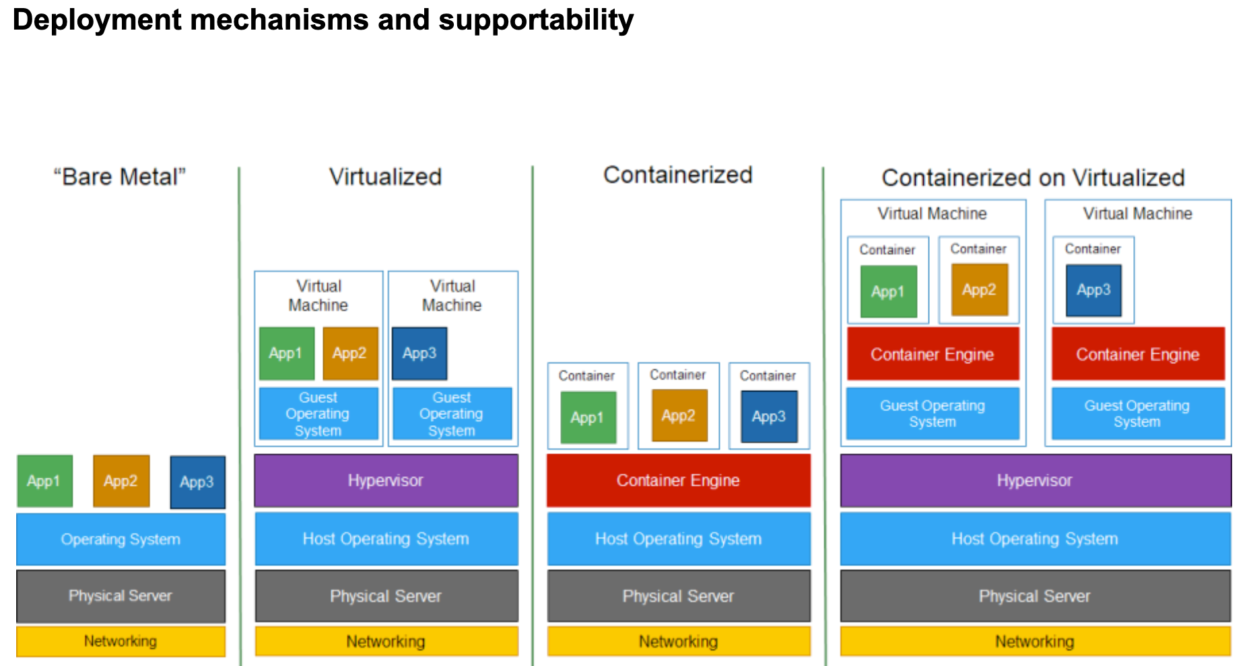

Slide 4
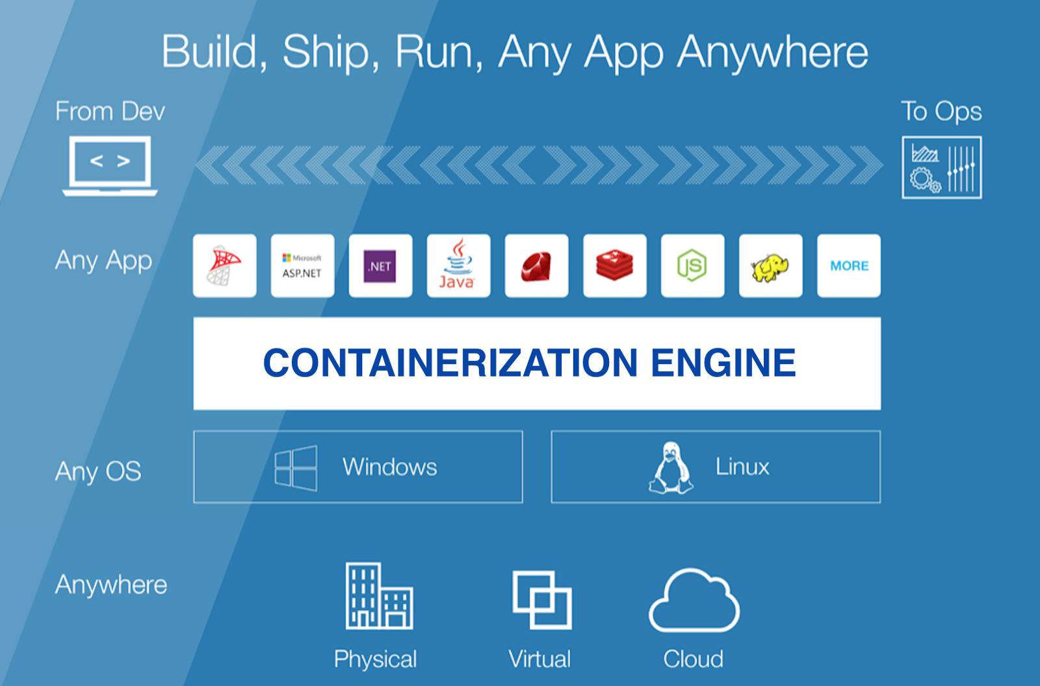

Slide 5
Why?
Performace
Scaling
Licensing cost
Shift to devops
Fast exploration and deployment

Slide 6
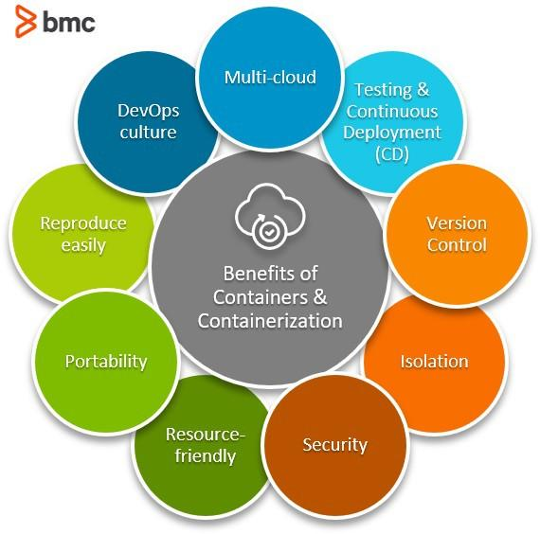
Source: https://www.bmc.com/

Slide 7
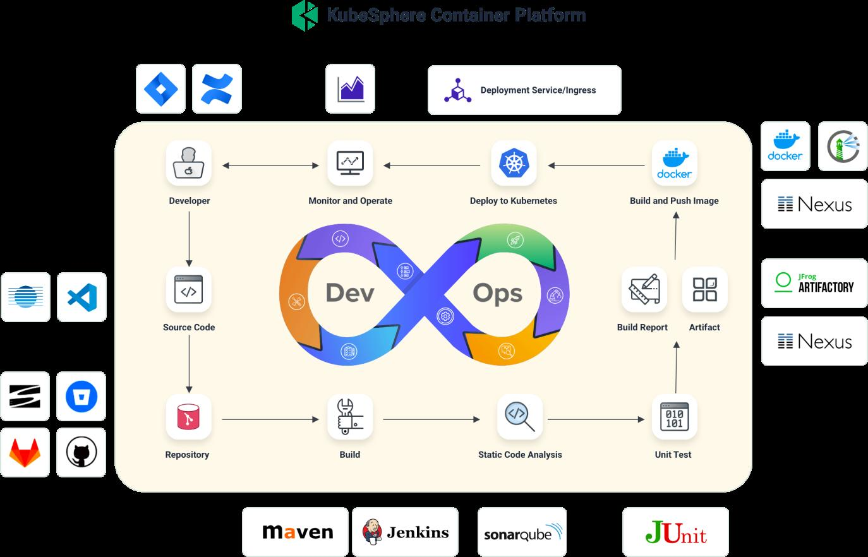
Source: https://kubesphere.io/

Slide 8
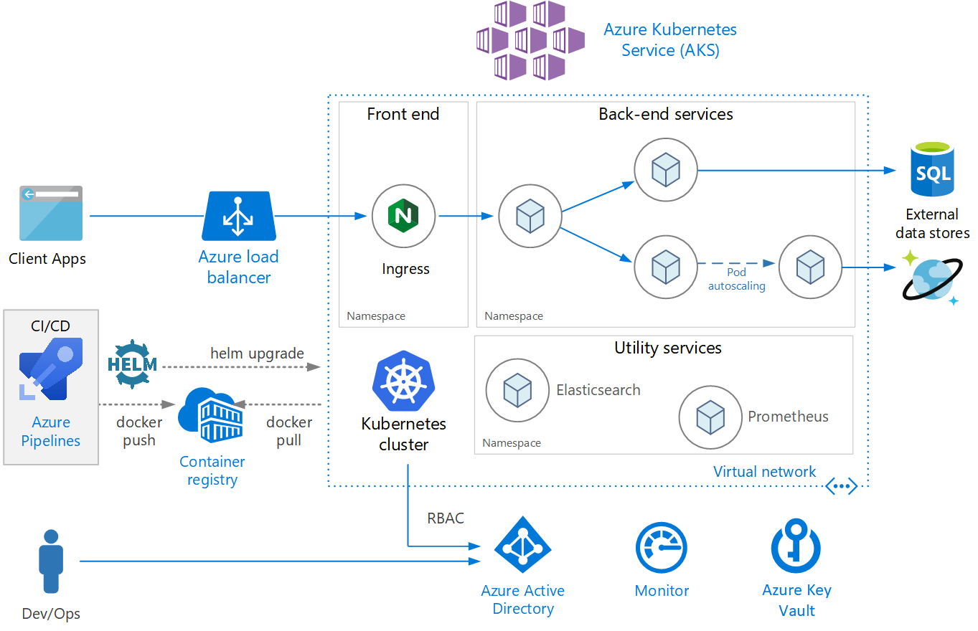
Source: https://www.altoros.com/

Slide 9
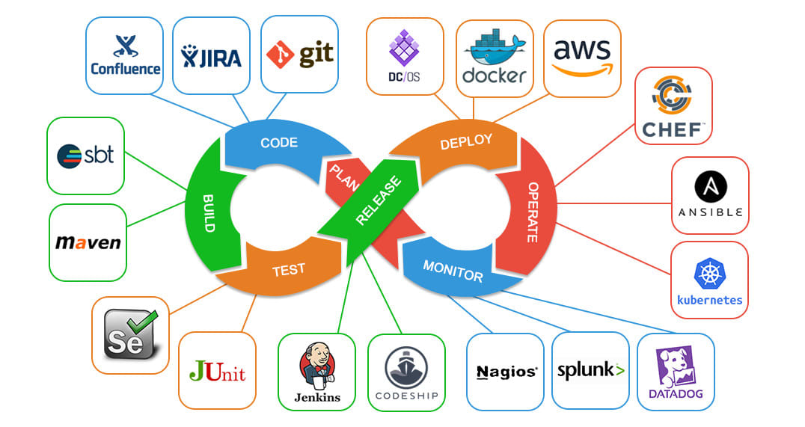
Source: https://www.altoros.com/

Slide 10
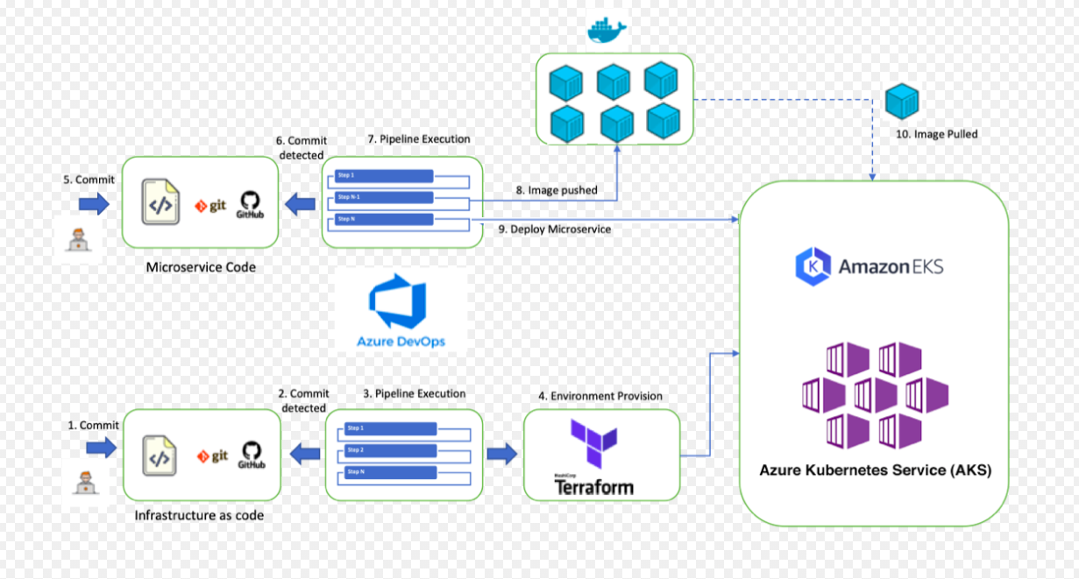

Slide 11
Docker
Docker engine
Docker Hub
Docker Trusted registry
Docker Compose

Slide 12
Docker engine
Docker Daemon
Docker background service
Build Image
Manage and Run container
Docker CLI : Command tool to interact with docker

Slide 13
Docker Hub
It is a collection of repository of container image
Free for public image
Charges for private image
Automated builds
Pull images from docker hub

Slide 14
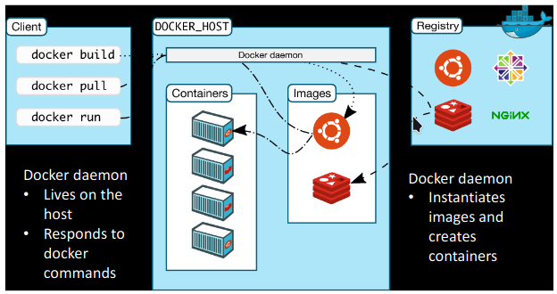

Slide 15
Image is instantiated form of container
Container image is structured in terms of layers
Mechanism
Find base image
Load new software
Commit base image and new software to form a new image
New image can become base image for other software
Developers shares image

Slide 16
When an image is updated, only update new layers
Unchanged layers do not need to be updated
That’s why update is faster

Slide 17
Own process space
Own network interface
Might have its seperate /sbin/init
Share kernel with host
No emulation like virtual machine

Slide 18
Isolation with namespace
user
ipc
net
mnt
pid
uts

Slide 19
Let’s start
Pull Ubuntu
docker pull ubuntu
Downloads image from docker hub
Containes bare copy of ubuntu
List images on machine
docker images
Run a image
docker run -i -t ubuntu
It’ll start a container
You can run commands here

Slide 20
Get list of all containers running and exited
docker ps -a
Commit image
docker commit container_name name

