Slide 1
Tuples
Like a list, tuples are iterable arrays of objects
Tuples are immutable – once created, unchangeable
To add or remove items, you must redeclare
Example uses of tuples
County Names
Land Use Codes
Ordered set of functions

Slide 2
Tuples and sequences
lists, strings, tuples: examples of sequence type
tuple = values separated by commas
>>> t = 123, 543, 'bar'
>>> t[0]
123
>>> t
(123, 543, 'bar')

Slide 3
Tuples
Tuples may be nested
>>> u = t, (1,2)
>>> u
((123, 542, 'bar'), (1,2))
kind of like structs, but no element names:
(x,y) coordinates
database records
like strings, immutable → can't assign to individual items

Slide 4
Tuples
Empty tuples: ()
>>> empty = ()
>>> len(empty)
0
one item → trailing comma
>>> singleton = 'foo',

Slide 5
Dictionaries
Dictionaries are sets of key & value pairs
Allows you to identify values by a descriptive name instead of order in a list
Keys are unordered unless explicitly sorted
Keys are unique:
var[‘item’] = “apple”
var[‘item’] = “banana”
print var[‘item’] prints just banana

Slide 6
x = var.get("model")
Print Keys:
for x in var:
print(x)
Print Values:
for x in var:
print(var[x])
Print Values:
for x in var.values():
print(x)
Print both key-value:
for x, y in var.items():
print(x, y)
Remove value
var.pop("model")
var.popitem() #last item
del thisdict["model"]
del var

Slide 7
Empty Dictionary
var.clear()
Copy Dictionary
d = var.copy()
d = dict(var)
Create Dictionary
d=dict(name=’sid’,state=’MH’)

Slide 8
Reference Sementics
Assignment manipulates references
x = y does not make a copy of y
x = y makes x reference the object y references
Very useful; but beware!
Example:
>>> a = [1, 2, 3]
>>> b = a
>>> a.append(4)
>>> print b
[1, 2, 3, 4]

Slide 9
Changing a Shared List
a
1
2
3
a = [1, 2, 3]
a
1
2
3
b = a
b
a
1
2
3
a.append(4)
4
b

Slide 10
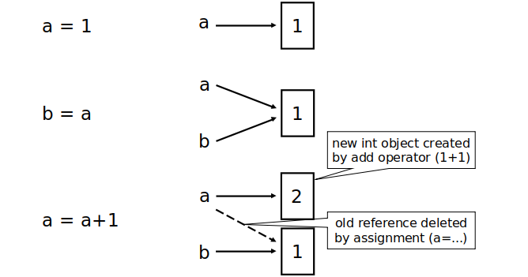
Changing an Integer

Slide 11
Operators
Python Airthmatic Operators
+,-,/,*,%,**,//
Assignment operators
=,+= and so on
Comparison Operators
==,!=,<,>,>=,<=
Logical Operators
and,or,not

Slide 12
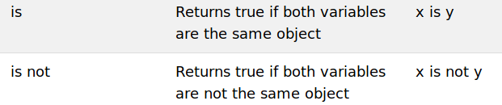
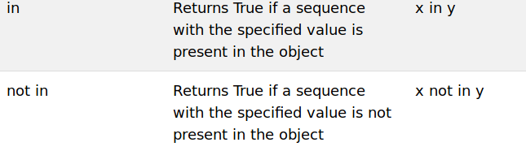
Identity Operator
Membership Operator

Slide 13
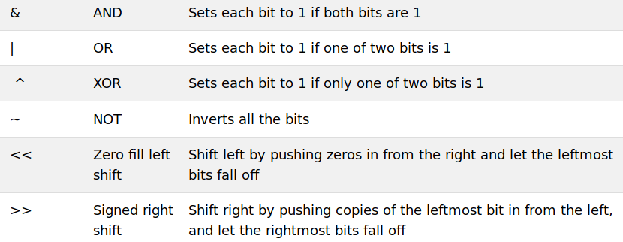
Bitwise Operator

Slide 14
Defining functions
def fib(n):
"""Print a Fibonacci series up to n."""
a, b = 0, 1
while b < n:
print b,
a, b = b, a+b
>>> fib(2000)
First line is docstring
first look for variables in local, then global
need global to assign global variables

Slide 15
Functions: default argument values
def ask_ok(prompt, retries=4, complaint='Yes or no, please!'):
while 1:
ok = raw_input(prompt)
if ok in ('y', 'ye', 'yes'): return 1
if ok in ('n', 'no'): return 0
retries = retries - 1
if retries < 0: raise IOError, 'refusenik error'
print complaint
>>> ask_ok('Really?')

Slide 16
Keyword arguments
last arguments can be given as keywords
def parrot(voltage, state='a stiff', action='voom', type='Norwegian blue'):
print "-- This parrot wouldn't", action,
print "if you put", voltage, "Volts through it."
print "Lovely plumage, the ", type
print "-- It's", state, "!"
parrot(1000)
parrot(action='VOOOM', voltage=100000)

