Slide 1
Git

Slide 2
Two Types
Source Control
Version Control

Slide 3
Source Control
Source control refers to tracking and managing changes to code. This ensures that developers are always working on the right version of source code.
Source control is specific to source code. Version control also covers large binary files and digital assets.
Source control management (SCM) refers to tools that help you keep track of your code with a complete history of changes.
Source control is specific to tracking changes in source code. And a source code management tool (SCM) tracks changes to a source code repository.

Slide 4
Why?
Maintains a single source of truth for development teams
Facilitate collaboration and accelerates release velocity
Allows multiple developers to work on the same codebase.
Commit and merge code without conflicts.
Developers can even make edits to shared code, without unknowingly overwriting each other’s work.

Slide 5
Source Control tools
Git
Subversion
Clearcase
Mercurial

Slide 6
Version Control
Version control allows you to manage changes to files over time and store these modifications in a database.
Version control is a component of software configuration management.
These systems are critical to ensure everyone has access to the latest code.
Helps teams collaborate around the world.
Accelerates product delivery.
Source Control is subset of Version Control

Slide 7
Tools
Git
SVN
ClearCase
Mercurial
TFS

Slide 8
Git Version Control
Git version control is open source. It's a distributed free version control software. In fact, Git version control is one of the most popular options. It's open source, so anyone can use it.

Slide 9
History
Created by Linus Torvalds,creator of Linux, in 2005
Designed for Linux kernel

Slide 10
Install
• Git website: http://git-scm.com/
sudo apt-get install git-all
Sudo dnf install git-all

Slide 11
Two Types of VCS(Version Control System)
Centralized VCS
Distributed VCS

Slide 12
Centralized VCS
A central server repository (repo) holds the "official copy" of the code
You make "checkouts" of it to your local copy
When you're done, you "check in" back to the server

Slide 13
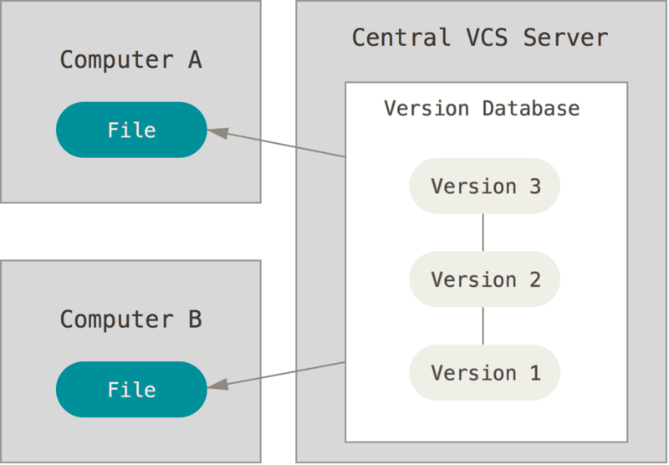
Source: https://git-scm.com

Slide 14
Distributed VCS
You "clone" it and "pull" changes from it
Your local repo is a complete copy of everything on the remote server
Local repo keeps version history
You can "push" changes back to server

Slide 15
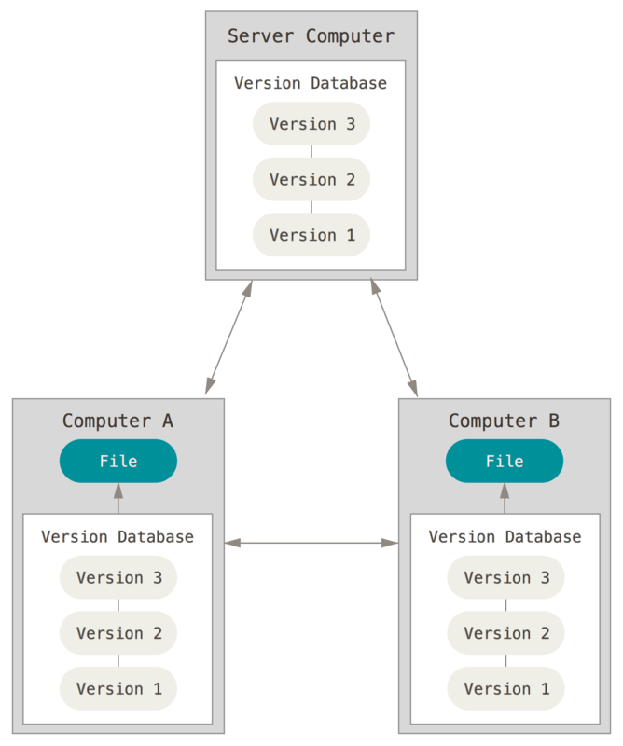
Source: https://git-scm.com

Slide 16
A command line version control program
Uses checksums to ensure data integrity
Cross-platform
No need to connect to central server
It Can work without internet connection

Slide 17
Git tracks changes, not versions
No single failure point
Developers can work independently and merge their work later

Slide 18
Repository
Contain folders and files, images, videos, spreadsheets, etc.
Anything your project needs
“origin" is a shorthand name for the remote repository that a project was originally cloned from.

Slide 19
Git
Snapshots, Not Differences
The major difference between Git and any other VCS (Subversion and friends included) is the way Git thinks about its data.
other systems store information as a list of file-based changes.
store as a set of files and the changes made to each file over time (Detla VCS)

Slide 20
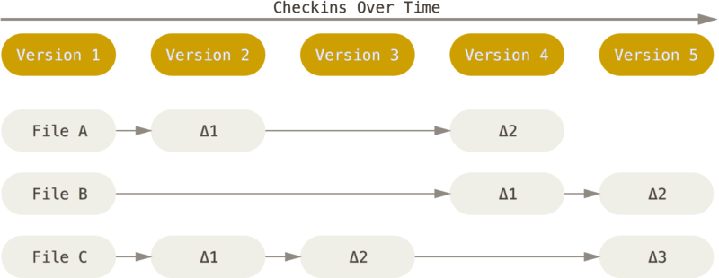
Other VCS
Source: https://git-scm.com

Slide 21
Its data more like a series of snapshots of a miniature filesystem.
It doesn’t store the file again, just a link to the previous identical file it has already stored.
Stream of snapshots

Slide 22
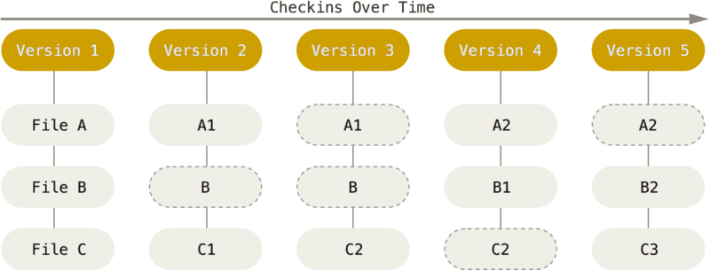
Git VCS
Source: https://git-scm.com

Slide 23
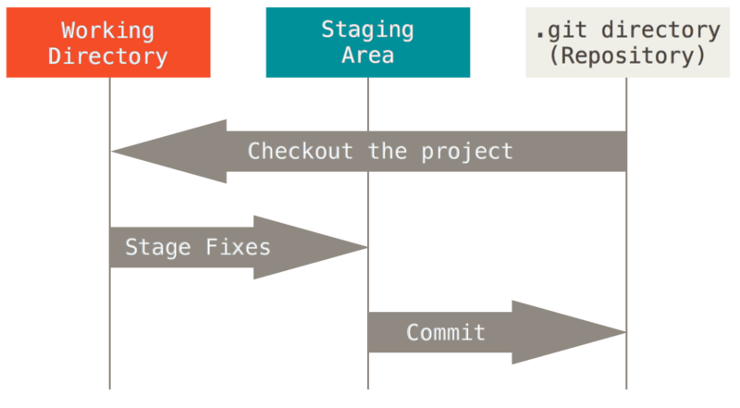
Three Tier Architecture
Source: https://git-scm.com

Slide 24
Modified - You have changed the file but have not committed it to your database yet.
Staged - You have marked a modified file in its current version to go into your next commit snapshot.
Committed - The data is safely stored in your local database.

Slide 25
Git Workflow
Modify files in your working tree.
Selectively stage just those changes you want to be part of your next commit, which adds only those changes to the staging area.
Commit, which takes the files as they are in the staging area and stores that snapshot permanently to your Git directory.

Slide 26
First Setup commands
git config --list –show-origin
git config --global user.name "John Doe"
git config --global user.email a@exp.com
git config --global core.editor code
git config –list
git config --global init.defaultBranch main
git config user.name

Slide 27
Project commands
Check Version
git --version
Initialize git in project
git init
Add changes to git
git add .
Commit Change
git commit -m “Message”
Git log
git log

Slide 28
When you commit , Staging the files computes a checksum
Git checksums each subdirectory and stores them as a tree object in the Git repository.
Git then creates a commit object that has the metadata and a pointer to the root project tree so it can re-create that snapshot when needed.
Stores that version of the file in the Git repository (Blobs) and adds that checksum to the staging area
Git then creates a commit object that has the metadata and a pointer to the root project tree so it can re-create that snapshot when needed.

Slide 29
Git repo have
blobs (each representing the contents of file)
tree that lists the contents of the directory and specifies which file names are stored as which blobs
commit with the pointer to that root tree and all the commit metadata.

Slide 30
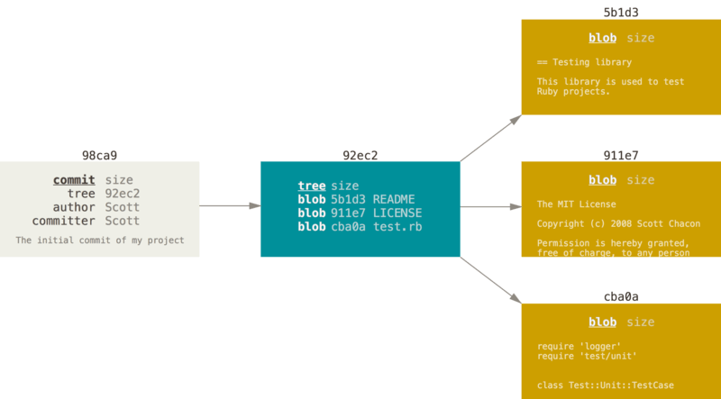
Source: https://git-scm.com

Slide 31
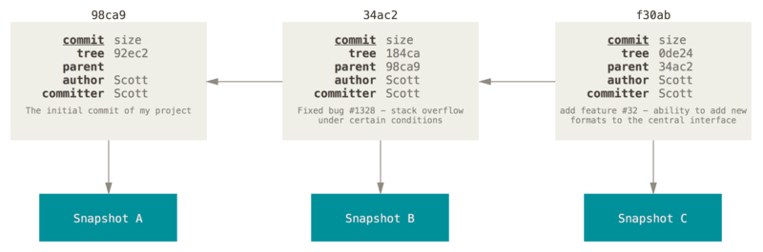
Snapshots
Source: https://git-scm.com

Slide 32
HEAD pointer
Points to a specific commit in repo
As new commits are made, the pointer changes
HEAD always points to the “head” of the currently checked-out branch in the repo
last state of repo (what was checked out initially)
HEAD points to parent of next commit (where writing the next commit takes place)

Slide 33
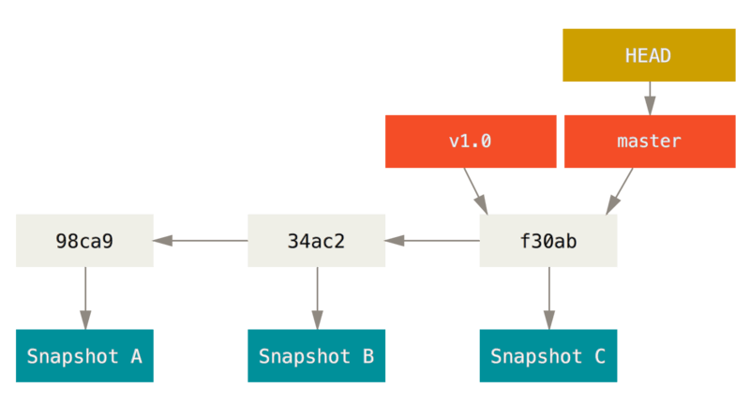
Source: https://git-scm.com

Slide 34
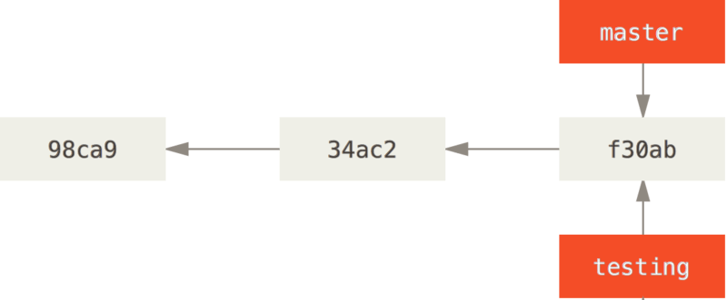
Branching
Creates a new pointer for you to move around
git branch testing
Source: https://git-scm.com

Slide 35
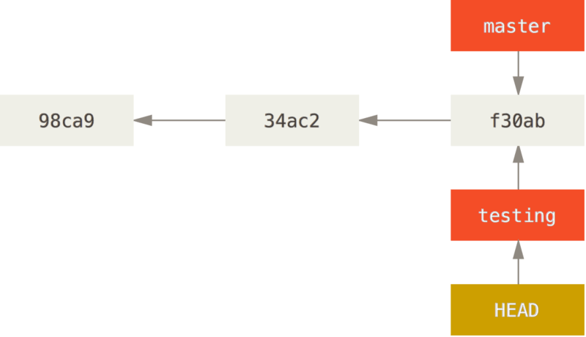
git log --oneline –decorate
Switch Branch
git checkout testing
Source: https://git-scm.com

Slide 36
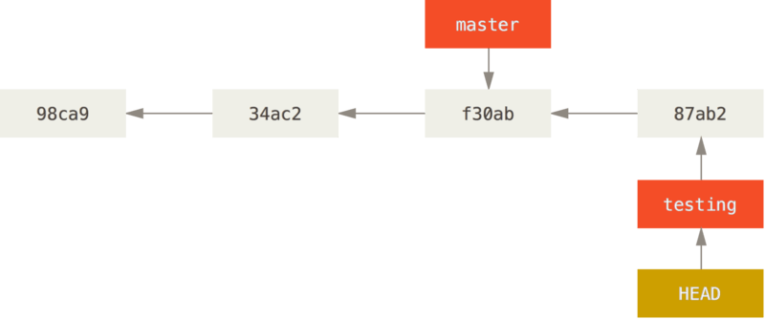
After new commit
git commit -a -m ‘Added function’
Source: https://git-scm.com

Slide 37
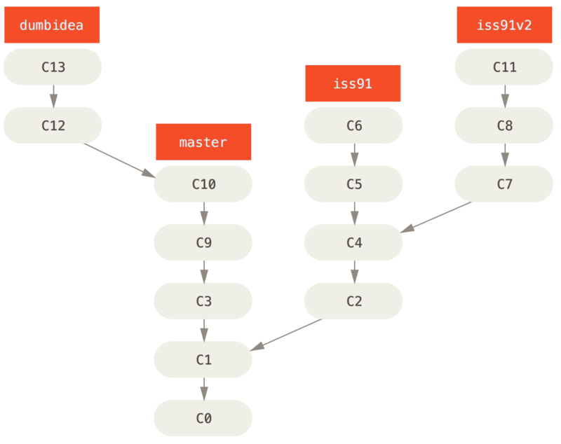
Source: https://git-scm.com

Slide 38
Remote Branch
git remote show <remote>
git ls-remote <remote>

Slide 39
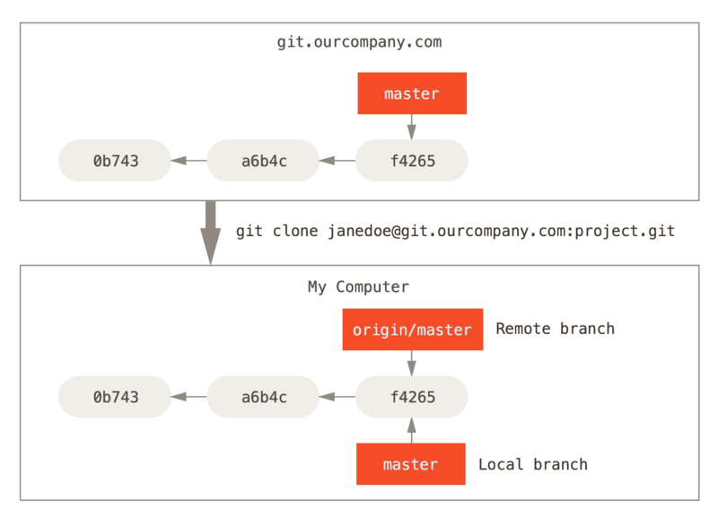

Slide 40
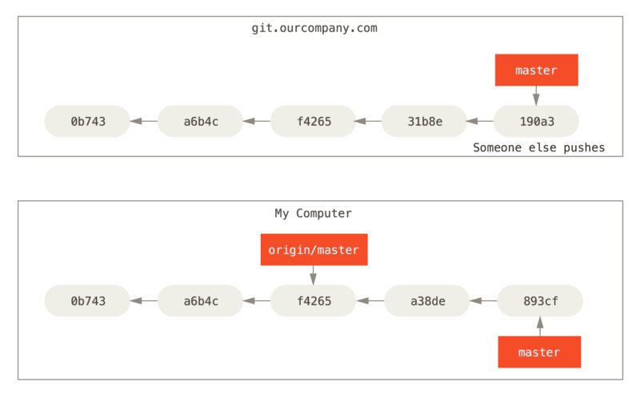

Slide 41
To synchronize your work with a given remote, you run a git fetch <remote>

Slide 42
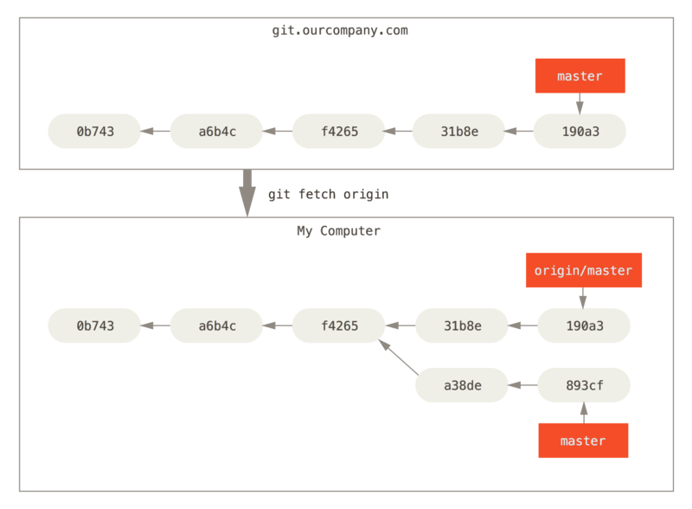

Slide 43
Push
git push origin fixissue
git push <remote> <branch>
Other team they can run below command to get fixissue
git fetch origin
To merge this work into your current working branch, you can run
git merge origin/fixissue
If you want your own fixissue branch that you can work on
git checkout -b serverfix origin/fixissue

Slide 44
Tracking
Checking out a local branch from a remote-tracking branch automatically creates what is called a “tracking branch” (and the branch it tracks is called an “upstream branch”)
Tracking branches are local branches that have a direct relationship to a remote branch.
If you’re on a tracking branch and type git pull,
When you clone a repository, it generally automatically creates a master branch that tracks origin/master.

Slide 45
git checkout --track origin/fixissue
git checkout fixissue
To set up a local branch with a different name than the remote branch
git checkout -b newbranch origin/fixissue
change the upstream branch you’re tracking
git branch -u origin/fixissue
Check all tracking branch
git branch -vv

Slide 46
Pulling
git fetch command will fetch all the changes on the server that you don’t have yet, it will not modify your working directory at all. It will simply get the data for you and let you merge it yourself.
git pull which is essentially a git fetch immediately followed by a git merge in most cases.
It’s better to simply use the fetch and merge commands explicitly as the magic of git pull can often be confusing

Slide 47
Delete Remote Branch
git push origin --delete fixissue
Basically all this does is remove the pointer from the server. The Git server will generally keep the data there for a while until a garbage collection runs,

Slide 48
Github
www.github.com
Login on website
Create repository

Slide 49
Workflow
Fork the project.
Create a topic branch from master.
Make some commits to improve the project.
Push this branch to your GitHub project.
Open a Pull Request on GitHub.
Discuss, and optionally continue committing.
The project owner merges or closes the Pull Request.
Sync the updated master back to your fork.

Slide 50
Forking
When you “fork” a project, GitHub will make a copy of the project that is entirely yours. It lives in your namespace, and you can push to it.
git clone url
Make change
Check changes
git diff --word-diff
Commit
Push to server
git push origin branch

