Slide 1
Cloud Security

Slide 2
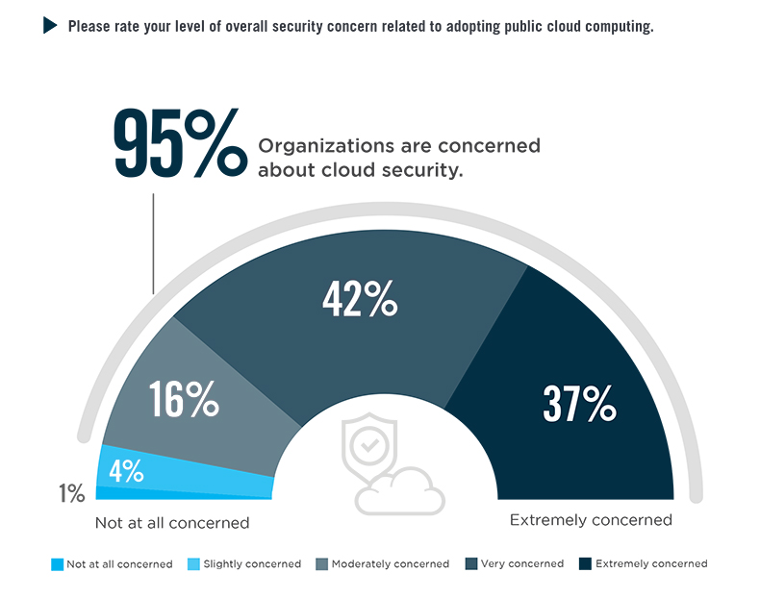
AWS Survey 2020

Slide 3
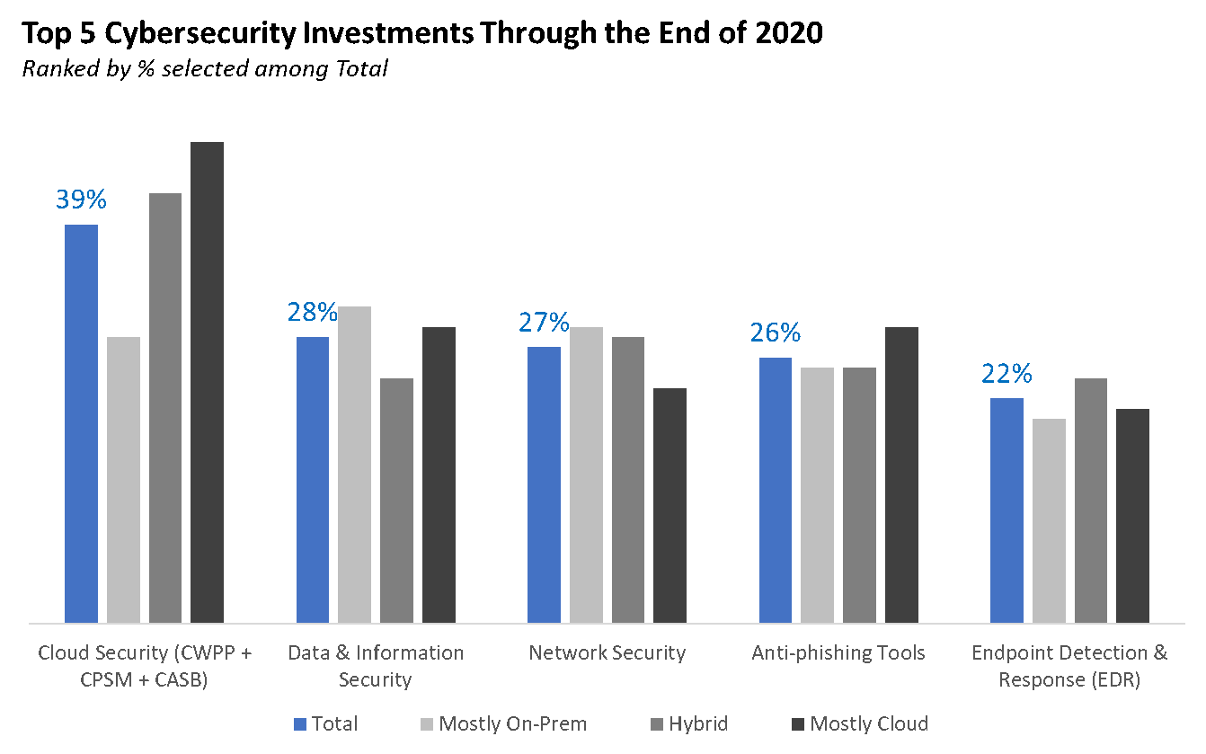

Slide 4
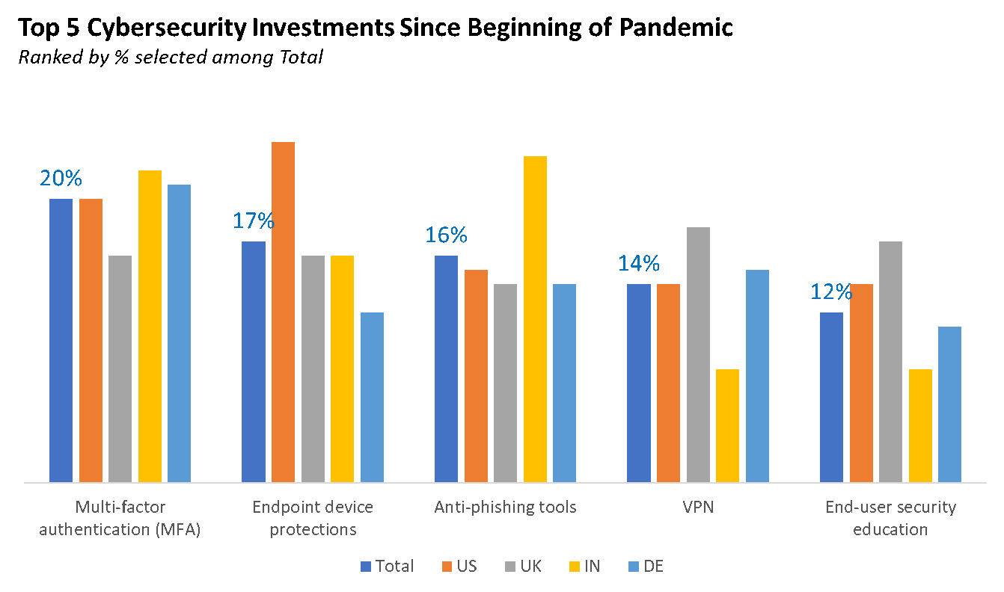

Slide 5
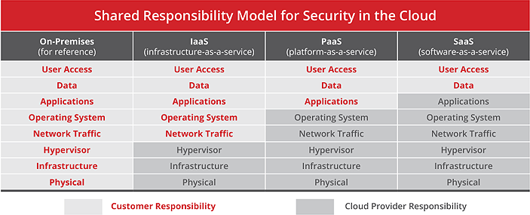
Shared Responsibility for Security in the cloud
https://www.mcafee.com/

Slide 6
According to Gartner, by 2021, 50% of enterprises will unknowingly and mistakenly have exposed some IaaS storage services, network segments, applications, or APIs directly to the public internet, up from 25% at YE18.
According to Gartner, through 2023, at least 99% of cloud security failures will be the customer’s fault.
Through 2024, workloads that leverage the programmability of cloud infrastructure to improve security protection will demonstrate improved compliance and at least 60% fewer security incidents than those in traditional data centers.

Slide 7
Challenges
Increased Attack Surface
Lack of Visibility and Tracking
Ever-Changing Workloads
DevOps, DevSecOps and Automation
Granular Privilege and Key Management
Complex Environments
Cloud Compliance and Governance
Embedded/Default Credentials & Secrets

Slide 8
Multitenancy
Malware & External Attackers
Insider Threats – Privileges

Slide 9
Robust Cloud Security
Granular, policy-based IAM and authentication controls across complex infrastructures
Zero-trust cloud network security controls across logically isolated networks and micro-segments
Enforcement of virtual server protection policies and processes such as change management and software updates
Safeguarding all applications (and especially cloud-native distributed apps) with a next-generation web application firewall

Slide 10
Enhanced data protection
Threat intelligence that detects and remediates known and unknown threats in real-time

Slide 11
Best Practices
Strategy & Policy
Network Segmentation
Identity and Access Management and Privileged Access Management
Discover and Onboard Cloud Instances and Assets
Password Control (Privileged and Non-Privileged Passwords)
Vulnerability Management
Encryption

Slide 12
Disaster Recovery
Monitoring, Alerting, and Reporting

Slide 13
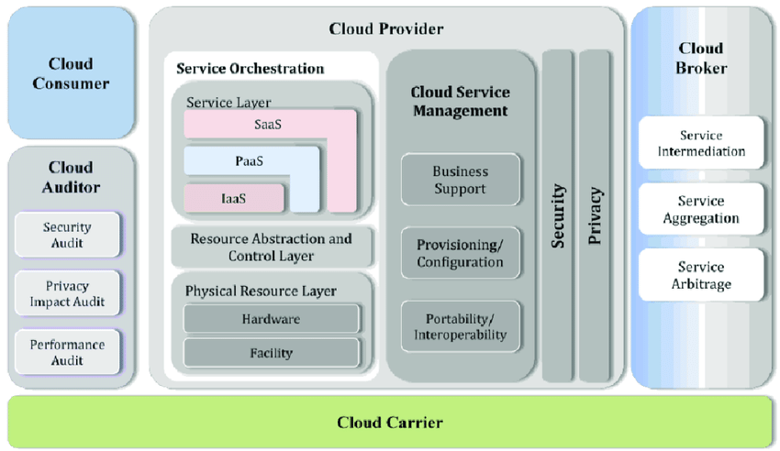
NIST Cloud reference model

