Slide 1
Impact of unverified news reports on stocks.
Adarsh Shrivastava (D21002)
Anjitha Merin Alex (D21005)
Kandarp Chaudhary (D21016)
Kurumaddali Saketh (D21020)
Sahil Gupta (D21030)

Slide 2
Common ground:
From the corridors of Lutyens to the gullies of rural India, NEWS exert a significant impact on daily happenings. As the fourth pillar of democracy, publishing houses both print and electronic, do need to exhibit transparency, credibility and accountability.
Hypothesis:
Due to an unverified article flashed as the headlines on India’s largest circulated business daily, Economic Times (ET) on 14th June 2021, the shares of six listed companies of Adani group fell by about 10% to 20%.

Slide 3
Steps:
1. Collect the ET articles responsible for sudden plunge in Adani shares.
2. Collect the daily performance data of 6 listed companies of Adani Group from Bombay Stock Exchange (BSE).
https://www.bseindia.com/markets/equity/EQReports/StockPrcHistori.html?flag=0
3. Filter the datasets to the time period of interest and develop a detailed understanding of the data at hand.
4. Decide upon the right visuals and tools to be deployed to prove the Hypothesis. In this case study, we used Tableau as our platform for analysis through which we plotted Line Chart and a Candle Stick chart.
5. Map the happenings of real life in form of articles published, to the consequent responses in the market with the help of visuals depicted.

Slide 4
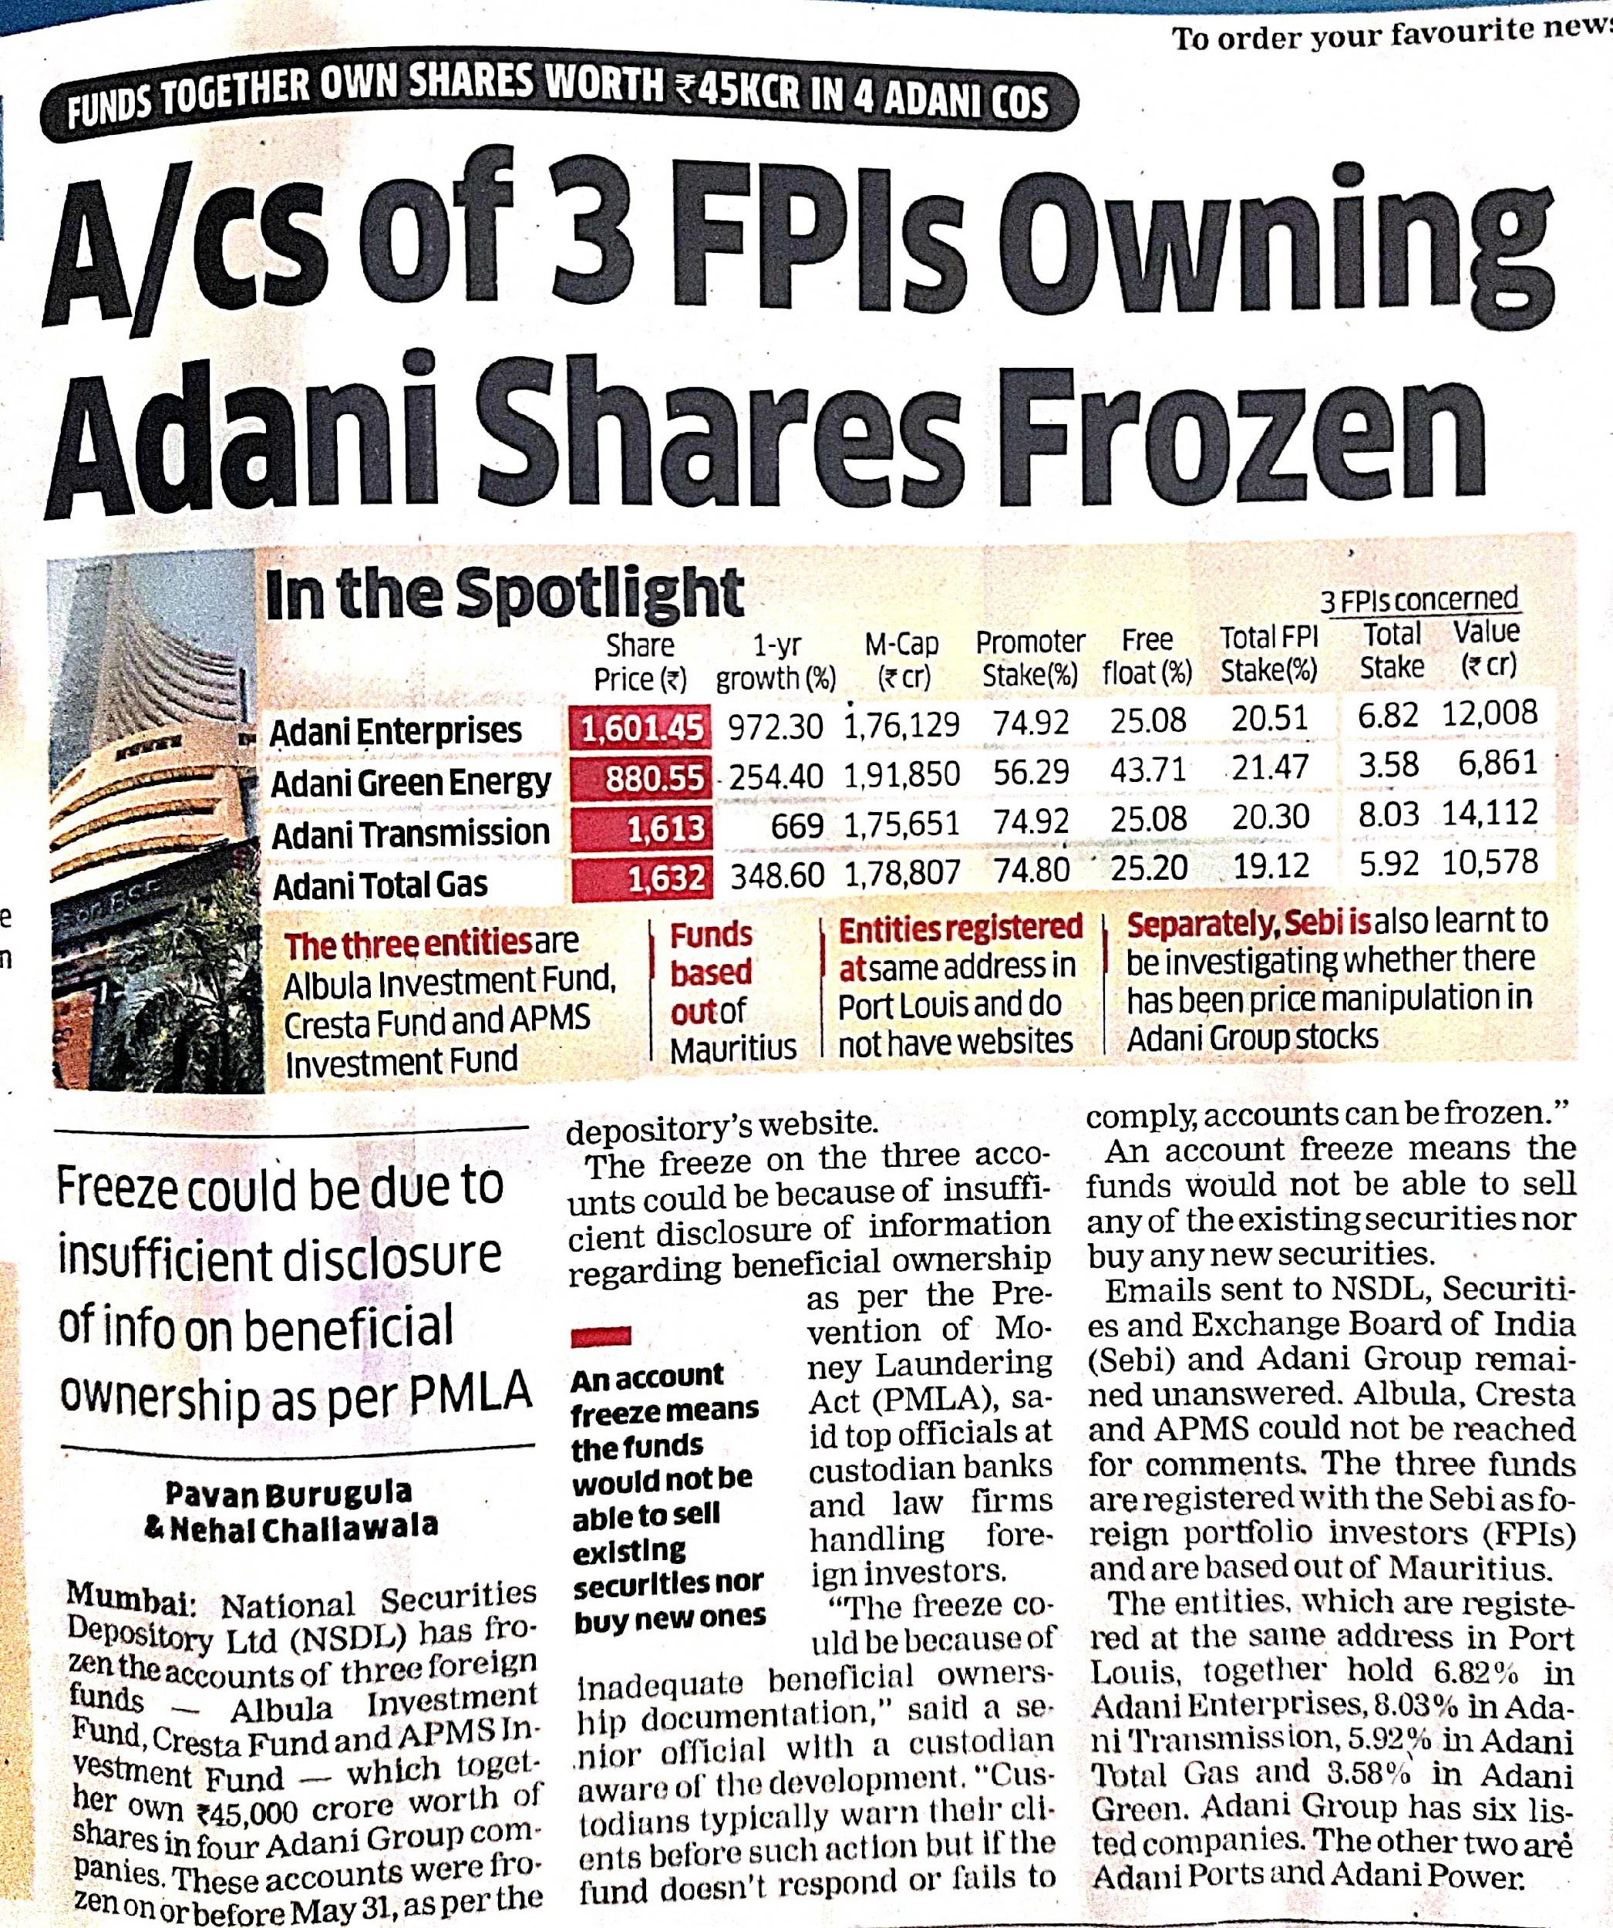
The Cause:

Slide 5
Following the negative news, shares of Adani Group companies hit lower circuits on Monday.
1. Adani Enterprises plummeted 20 per cent to Rs. 1,281.20
2. Adani Ports fell 19 per cent to Rs. 681.50.
3. Adani Green Energy shed 5 per cent to Rs. 1,165.35
4. Adani Power shed 5 per cent to Rs. 140.90
5. Adani Total Gas shed 5 per cent to Rs.1,544.55
6. Adani Transmission shed 5 per cent to Rs. 1,517.25
CFO’s explanation which termed the news report as “blatantly erroneous” couldn’t heal the adversely affected market sentiments and it proved to be too little too late.

Slide 6
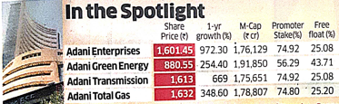
Adani Group founder Gautam Adani has become the second wealthiest person in Asia after the recent surge in group stocks. The industrial magnate's wealth has increased to $77 billion, registering a spike of $43.2 billion in 2021 till June 11, 2021. Adani is the 14th richest man on the planet. Among the Adani Group companies, shares of Adani Total Gas were up sone 335 per cent in 2021 till June 11. Adani Transmission soared 264 per cent and Adani Enterprises 235 per cent. Adani Power was 200 per cent, followed by Adani Ports (74 per cent) and Adani Green (17 per cent).

Slide 7
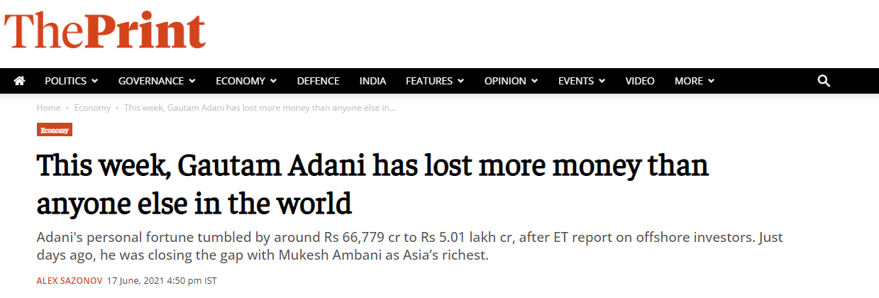
The Impact:
While days ago he was closing the gap with India’s richest man, Adani lost more money this week than anyone else in the world, with his personal fortune tumbling by about $9 billion to $67.6 billion, according to the Bloomberg Billionaires Index based on Wednesday closing prices.

Slide 8
After falling 0.4-8.5% on Monday, the day of the Economic Times report, Adani group stocks fell between 7.7%-23% in the first four days this week, wiping out nearly a quarter of the gains in the year preceding this week.

Slide 9
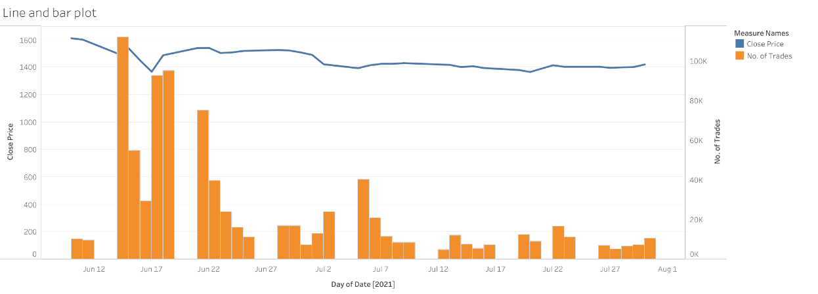
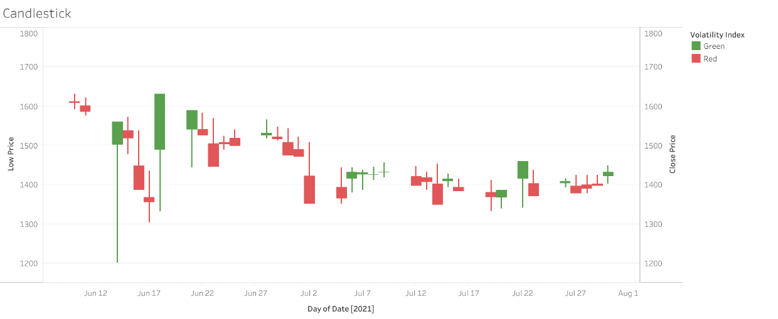
Adani Enterprises:
https://public.tableau.com/app/profile/adarsh.shrivastava/viz/AdaniEnterprises/Candlestick?publish=yes

Slide 10
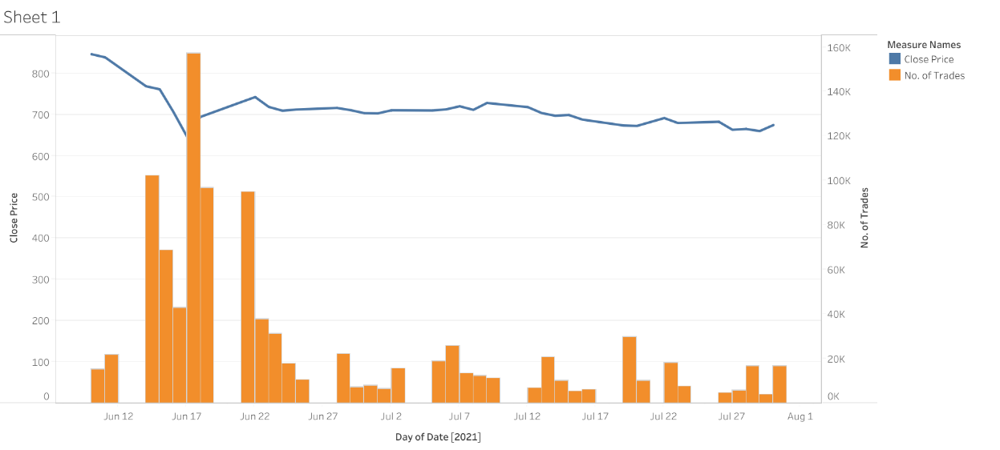
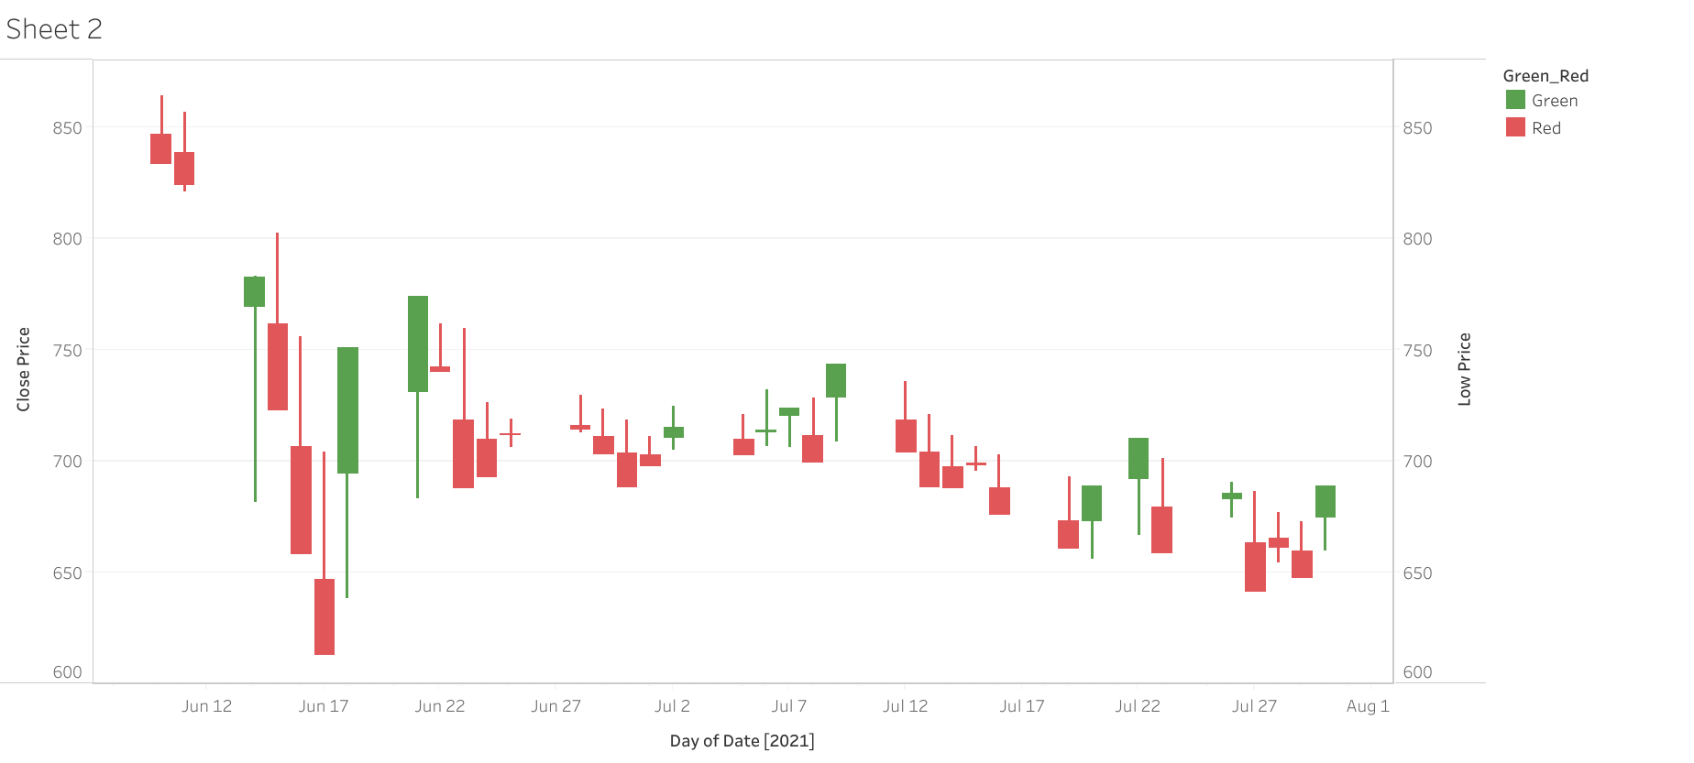
Adani Ports:
https://public.tableau.com/app/profile/kandarp4619/viz/AdaniPortsandSEZ/Sheet1?publish=yes

Slide 11
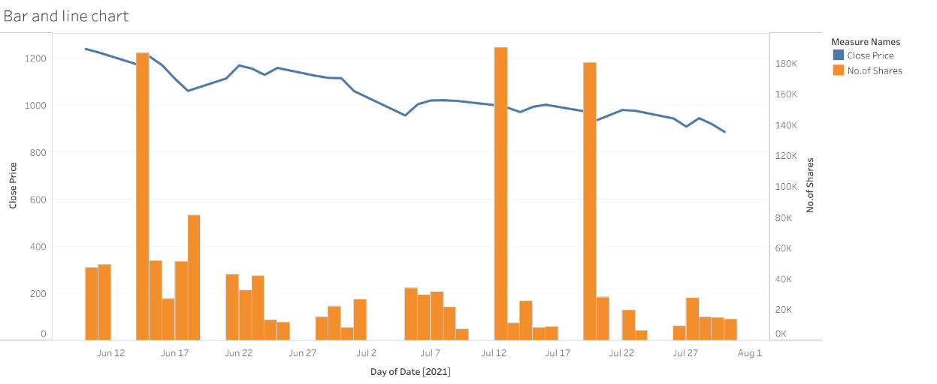
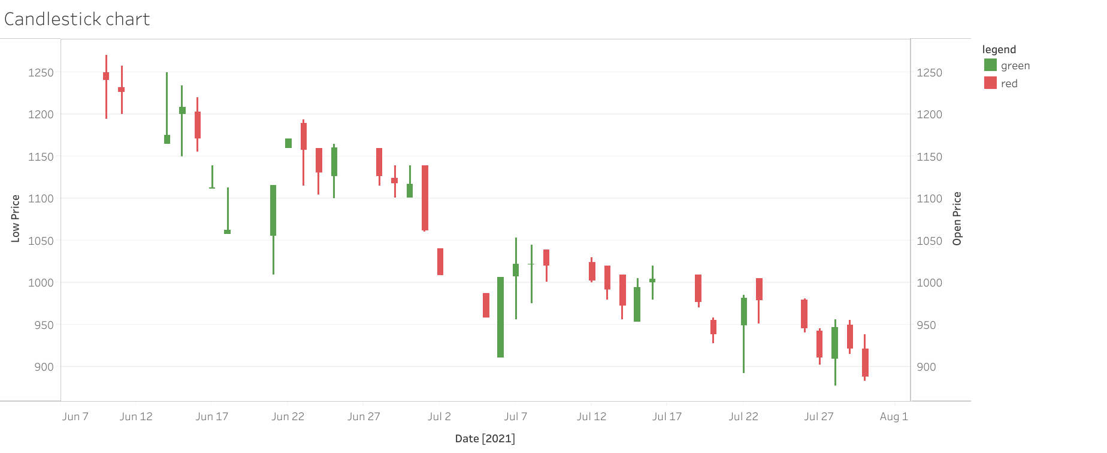
Adani Green Energy:
https://public.tableau.com/app/profile/anjitha4228/viz/AdaniGreenEnergy/BarandAreachart?publish=yes

Slide 12
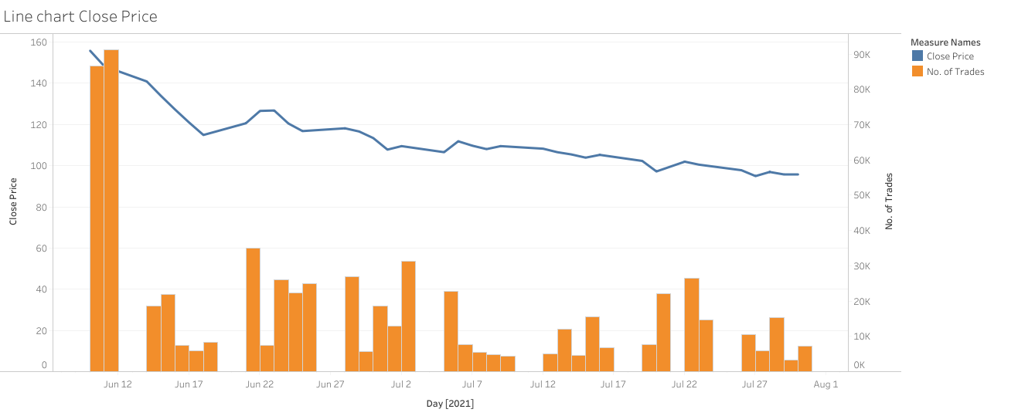
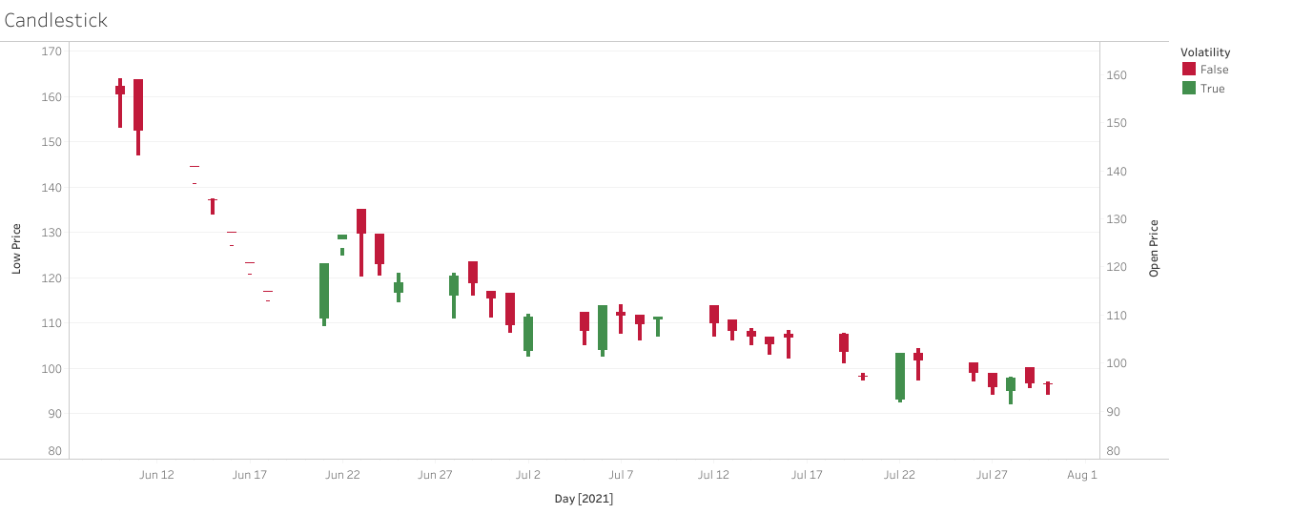
Adani Power:
https://public.tableau.com/app/profile/k.saketh/viz/AdaniPower/Candlestick

Slide 13
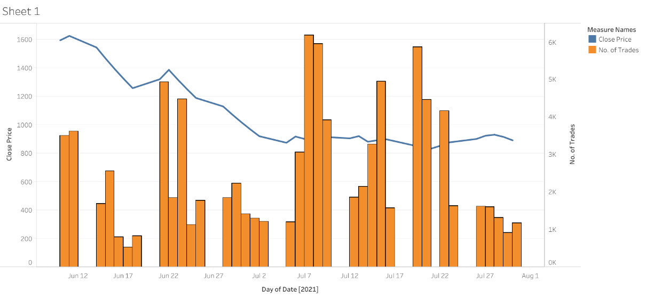
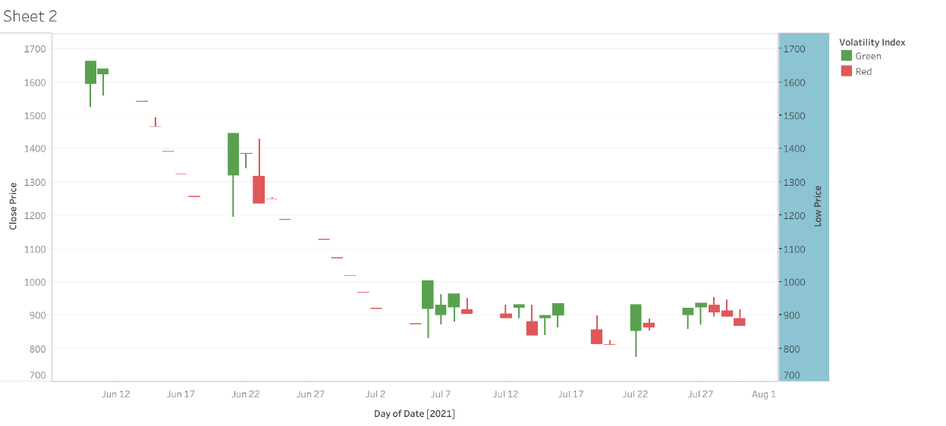
Adani Total Gas:
https://public.tableau.com/app/profile/sahil.gupta3251/viz/AdaniTotalGas/Sheet2?publish=yes

Slide 14
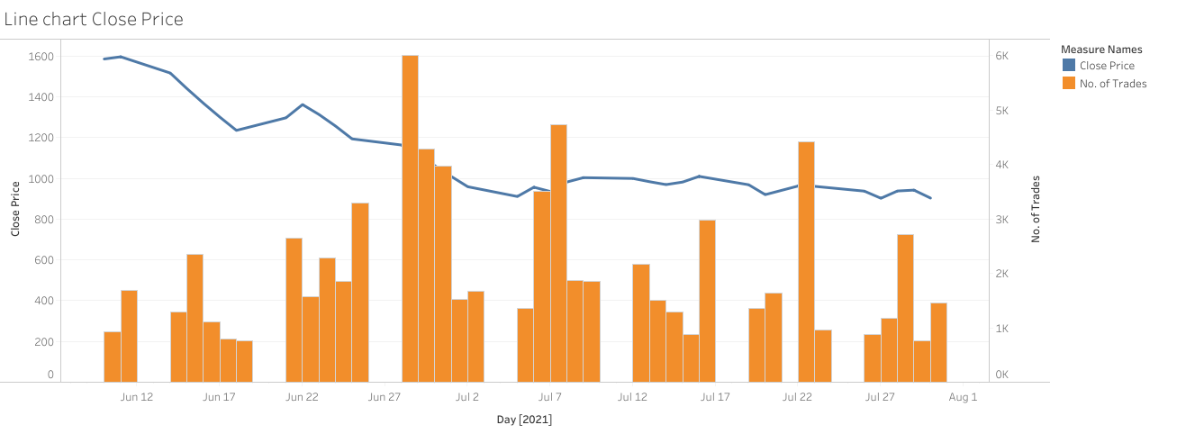
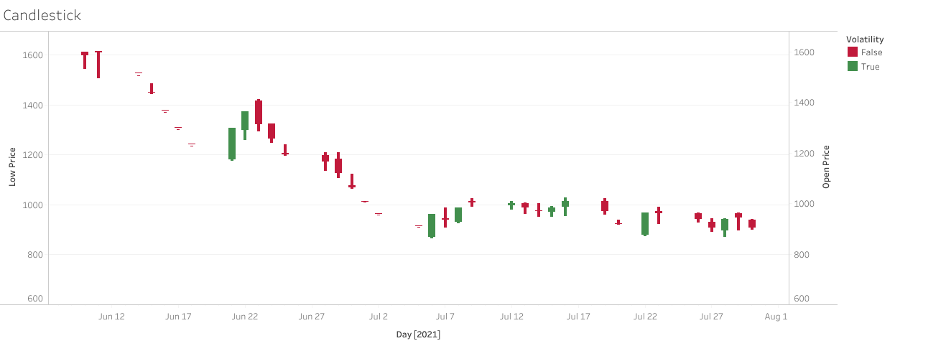
Adani Transmission:
https://public.tableau.com/app/profile/k.saketh/viz/AdaniTransmission/Candlestick

Slide 15
Conclusion:
As is depicted in the visuals, ET articles has beaten the Adani group neck and crop so much so that the clarifications from SEBI and CFO were barely taken note of. The points made as part of our Hypothesis are thus logically and factually verified with the data available.
Historically it has always been tough to strike a distinction between news reports that are verified and unverified.
In a domain as dynamic as Stock markets, where every worldly event either casts a doom or a spell on the already heavily volatile and vulnerable market sentiments, it is important to bring in certain degrees of regulation on the news being reported.

Slide 16
References:
https://economictimes.indiatimes.com/markets/stocks/news/a/cs-of-3-fpis-owning-adani-shares-frozen/articleshow/83496483.cms
Follow up articles on ET -------->
1. https://economictimes.indiatimes.com/markets/stocks/news/adani-group-stocks-shed-up-to-20-after-nsdl-freezes-3-fpi-accounts/articleshow/83501981.cms
2. https://economictimes.indiatimes.com/markets/stocks/news/confusion-over-adani-fpi-a/cs-freeze-cfo-offers-an-explanation/articleshow/83567590.cms
Article by Reuters about this ------->
https://www.reuters.com/world/india/adani-group-stocks-lose-more-ground-despite-rejecting-report-investors-2021-06-16/

Slide 17
THANK YOU!!!

