Slide 1
Card Matching Game
?
7
7
?
A 4×4 memory game in 8086 Assembly
COAL Project
Presented by Anjlee Kumari
Roll No: 25-BSCS-06
Notes:
Good morning everyone. My project is a Card Matching Game, written completely in 8086 assembly language and run on the EMU8086 emulator. In the next few minutes I will explain the game, how it works, and the concepts from COAL that I used.

Slide 2



Introduction & Objective
Objectives
What is it?
A memory game on a 4×4 grid. Flip two cards at a time and find all matching pairs before attempts run out.
Build a complete, playable game
Apply 8086 concepts in a real program
Why assembly?
It gives hands-on practice with registers, memory, and direct control of screen and keyboard.
Handle keyboard input and screen output
Notes:
The game is simple: sixteen face-down cards, eight hidden pairs. The player flips two cards and tries to find all pairs. I chose assembly to practise low-level programming. My objectives were to build a complete working game, apply 8086 concepts, and handle keyboard input and screen output.

Slide 3
Game Rules & Controls
4×4
8
12
board
pairs to find
attempts allowed
↑ ↓ ← →
ENTER
R
ESC
Move cursor
Select card
Restart
Exit
Win: all 8 pairs found. Game over: 12 attempts used.
Notes:
The board is four by four with eight pairs. The player has twelve attempts; one attempt means flipping two cards. Controls: arrow keys move the cursor, Enter selects a card, R restarts and Escape exits. Find all eight pairs to win; use up twelve attempts and the game is over.

Slide 4
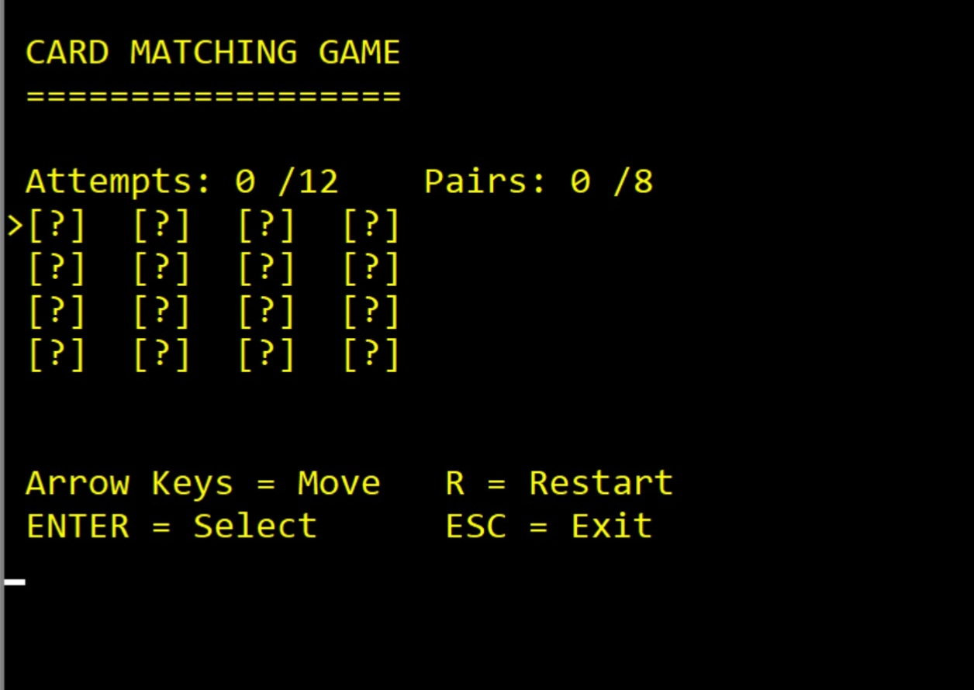
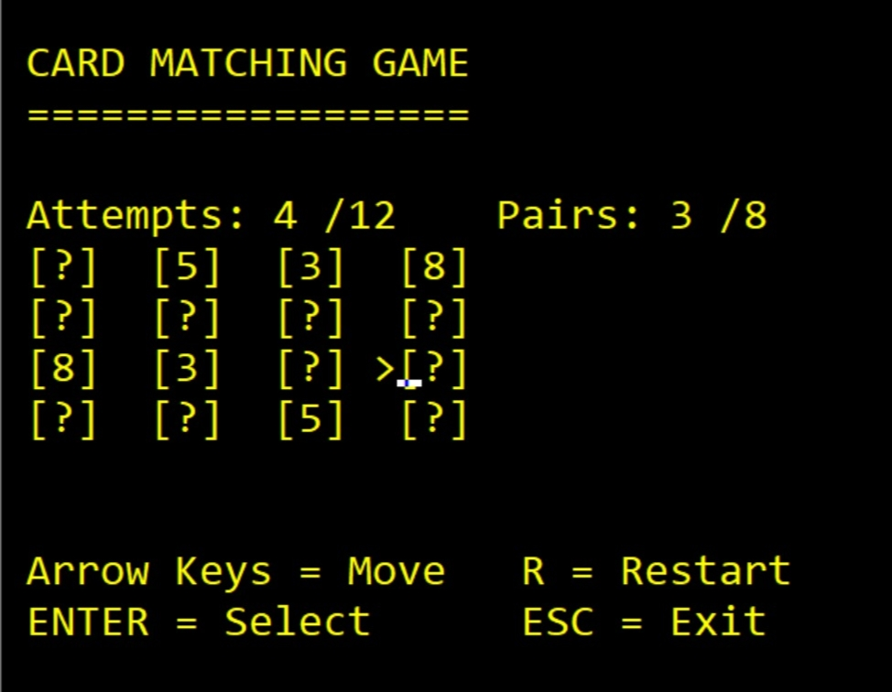
Game in Action
Start screen: all cards face down
Mid-game: 4 attempts, 3 pairs found
Notes:
These are screenshots from the running game in EMU8086. On the left is the start screen with all sixteen cards face down and the cursor on the first card. On the right is a game in progress: four attempts used and three pairs already found, and the matched cards stay open.

Slide 5



Tools & Technology
8086 Assembly
EMU8086
DOS INT 21h
BIOS INT 10h / 16h
Low-level code using registers and memory
Write, assemble, run and debug the program
Print characters and strings on screen
Set cursor position and read key presses
Program type: .COM file (org 100h)
Notes:
I wrote the program in 8086 assembly and ran it in EMU8086. For output I used DOS interrupt 21h to print characters and strings. BIOS interrupt 10h sets the cursor position and interrupt 16h reads the keyboard, including arrow keys. The program is a .COM file starting at org 100h.

Slide 6
Program Design
Data (variables)
Main procedures
board / matched
initGame
reset all values
16 card values and match flags
drawScreen
draw full screen once
curRow / curCol
cursor position
updateCursor
move the > marker
firstCard / secondCard
selectCard
flip and compare
current picks
checkMatch
compare, mark pairs
attempts / pairs
score counters
winGame/loseGame
end screens
Notes:
The program has two parts. First, the data: the board holds sixteen card values, a matched array stores which cards are already paired, and there are variables for the cursor, the two selected cards, and the attempts and pairs counters. Second, the procedures: initGame resets everything, drawScreen draws once, updateCursor moves the marker, selectCard handles Enter, and checkMatch compares the two cards. Finally, win and lose screens.

Slide 7





Key COAL Concepts Used
Arrays & Indexing
Arithmetic
Interrupts
index = row × 4 + column
MUL and DIV find positions and digits
INT 21h, 10h and 16h for I/O
Procedures
Jumps & Flags
Smart Screen Updates
CALL and RET keep code modular
CMP with JE, JNE, JB drives the logic
Only changed cards are redrawn
Notes:
These are the main COAL concepts in the project. Arrays: the board is a one-dimensional array and I find a card with row times four plus column. MUL and DIV do this arithmetic. Interrupts handle all input and output. Procedures keep the code organised. Compare and jump instructions control the game logic. And I redraw only the cards that change, which stops the screen from flickering.

Slide 8
Game Flow
(1)
Init & draw screen
(2)
Wait for key
Arrows move the cursor
(3)
ENTER: flip 1st card
(
(4)
ENTER: flip 2nd card
Attempts + 1
Otherwise
back to step 2
(7)
8 pairs: Win
12 attempts: Game over
(6)
Match: stays open, pairs + 1
No match: flips back
(5)
Compare both cards
Notes:
This is the flow of the game. The program initialises and draws the screen once, then waits for a key. Arrow keys only move the cursor. When the player presses Enter twice, two cards are flipped and the attempt counter increases. The program compares them: a match stays open and the pair count goes up, otherwise the cards flip back. Then it checks for a win with eight pairs or game over at twelve attempts, and otherwise returns to waiting for a key.

Slide 9
Challenges & Conclusion
Challenges
Conclusion
Screen flicker: redraw only what changes
Cursor tracking: restore position after updates
Short delay so both cards can be seen
A fully playable game in pure assembly
Practised arrays, interrupts and procedures
Next: random shuffle and a timer
Notes:
The main challenges were avoiding screen flicker, keeping track of the cursor position, and giving the player a moment to see both cards. In conclusion, I built a fully playable memory game entirely in 8086 assembly and practised arrays, interrupts, and procedures. In future it could include a random shuffle and a timer.

Slide 10
Thank You
7
8
8
7
All 8 pairs found. Game complete!
Card Matching Game | COAL Project
Notes:
Thank you for listening.

