Slide 1
INTRODUCING MY SELF

Slide 2



About
Me
Hobbies
Goals
Personal
Information
Education
Swot Analysis
Contact Info

Slide 3
Personal Information
My name is Anjali Purohit.
Basically, I am from Jamnagar but currently living in Ahmedabad.

Slide 4
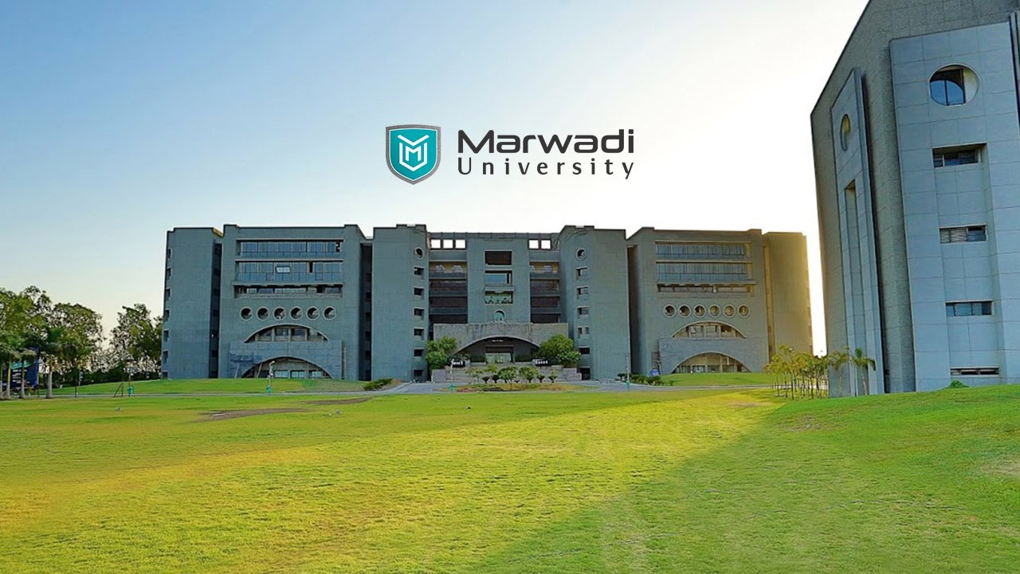
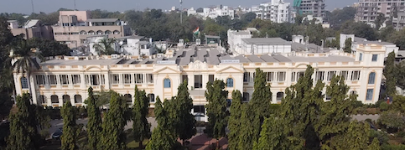
Education Information
I have done my post graduation in the stream of organic chemistry from Marwadi University, Rajkot.
I have done my dissertation work entitled “Design and synthesis of polymeric materials for the removal and remediation for toxic pollutants" is a piece of original work at Central Salt and Marine Chemical Research Institute (CSIR - CSMCRI), Bhavnagar.

Slide 5
Hobbies
Likes
Cooking For New Dishes Like Fast-Foods.
I Like To Play a Garba (Folk Dance).
Listening Romantic And 90’s Songs.
Watch Movies Like Comedy And Action.

Slide 6
Dis-likes
People who lie and fake
Those People who don’t respect me
Compare with others

Slide 7
Strengths
Quick Learner
Pro-Active
Creativity
Honest

Slide 8
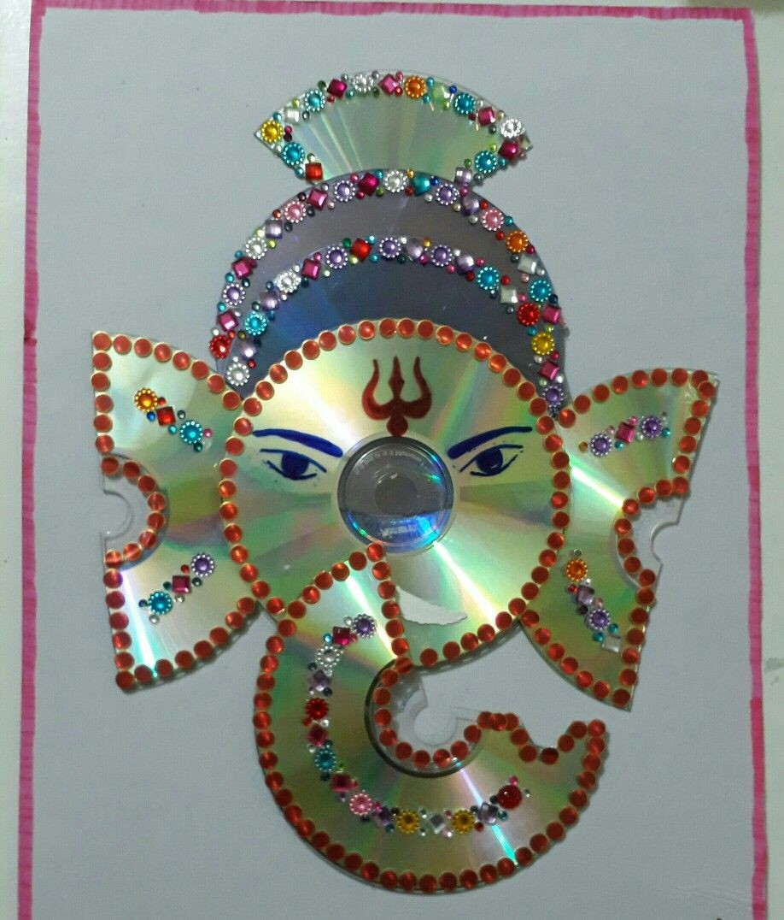
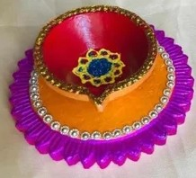
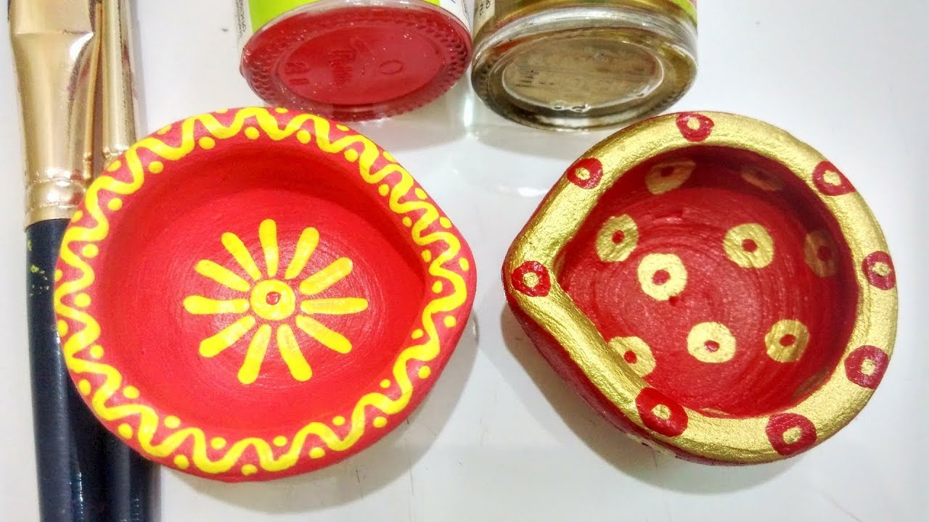
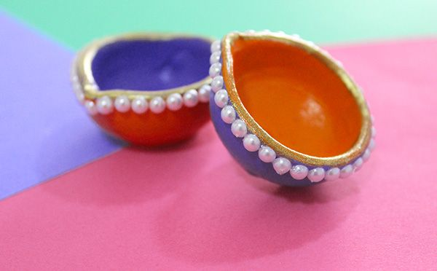
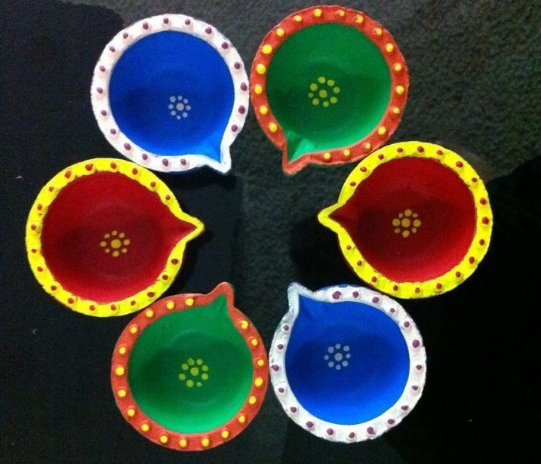

Slide 9
WEAKNESS
Public Speaking
Straight Forward
Impatient
Over-Thinking

Slide 10
Goals
Short-Term Goal
To achieve good position in a reputed company.
Long-Term Goal
I want to be a developer in future.
Travelling the entire world.

Slide 11
Thank You

