Slide 1



SmartSell
W H E N I N D O U B T S H O P I T O U T

Slide 2
01
02
03
Problem 1
Many customers engage in window shopping without making a purchase.
Problem 2
66% people spend money on products that don't cater their needs.
Problem 3
Cluttered products can make users confusing.

Slide 3

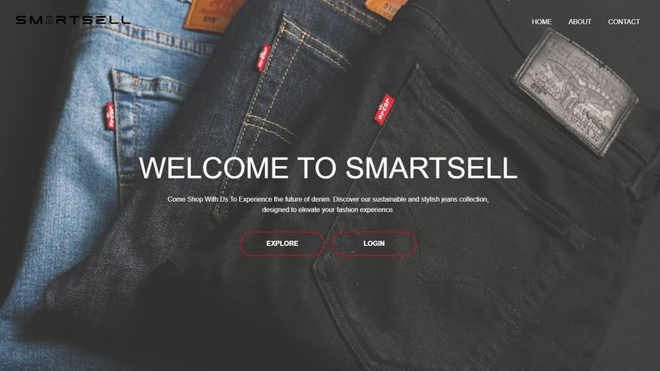
Solution
Smartsell is an online shopping application that is curated to cater the denim needs of customers.

Slide 4
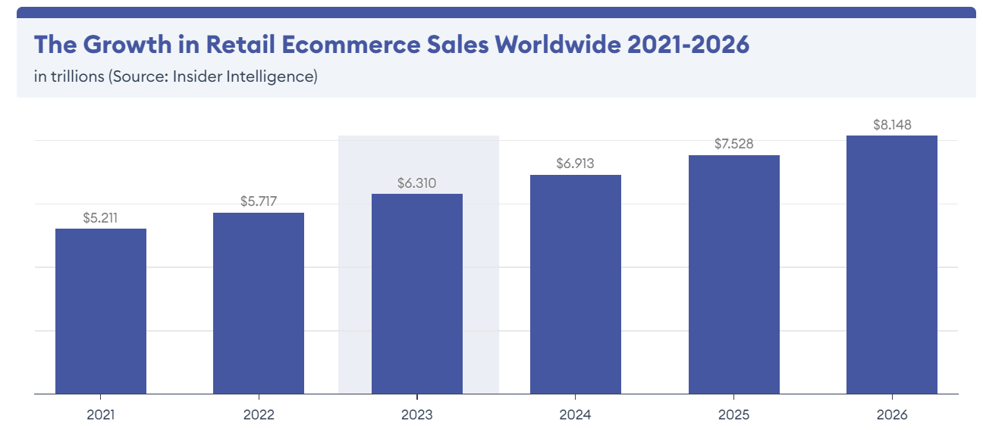

Slide 5
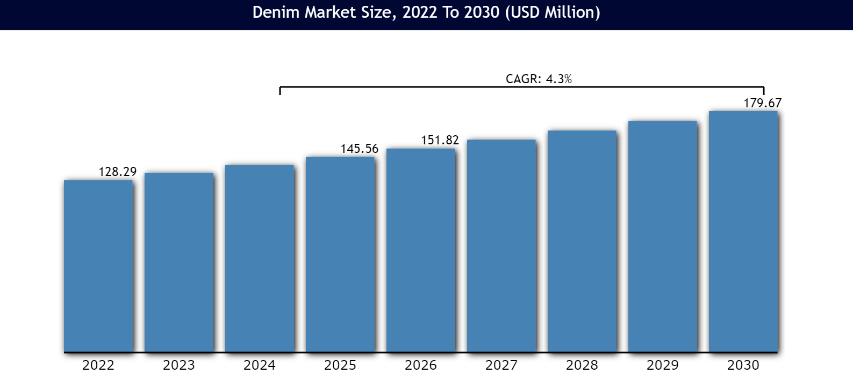
Denim Trends

Slide 6
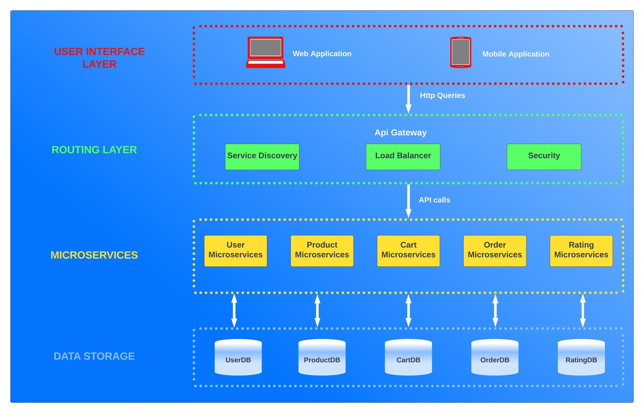
Project Structure

Slide 7
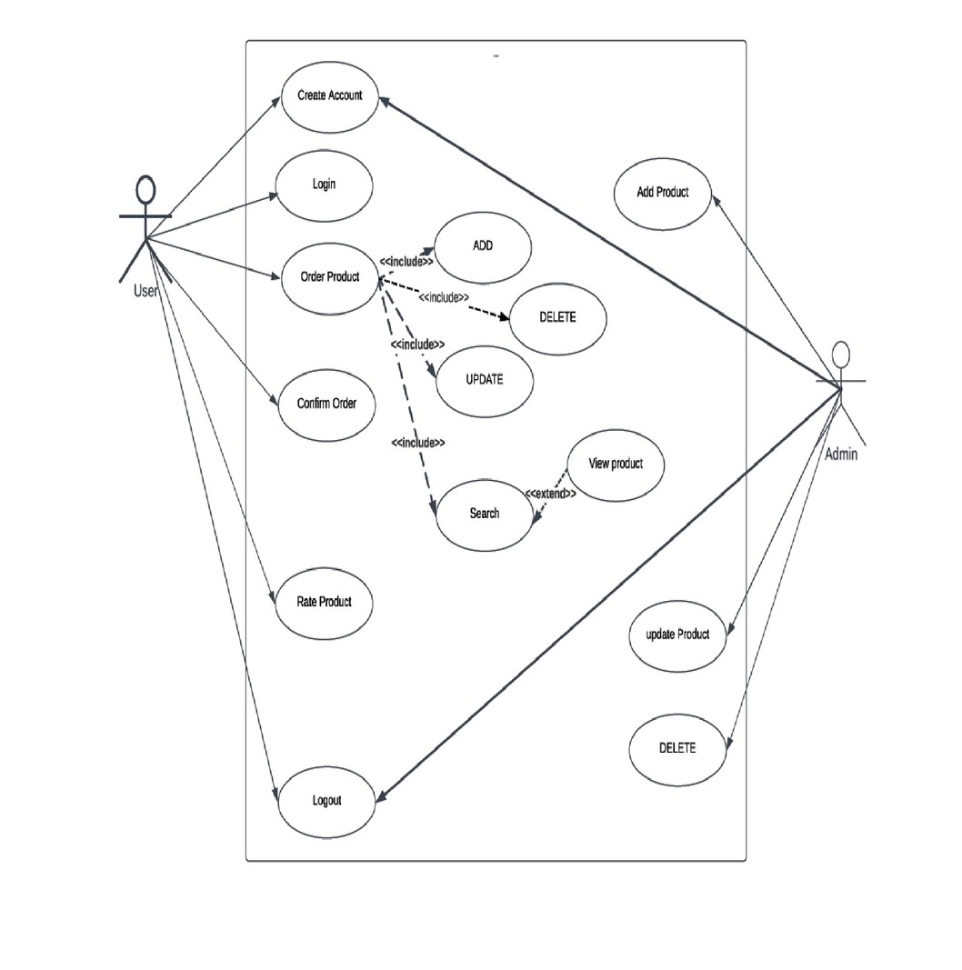
UseCase Diagram

Slide 8
Future Scope
Can be scaled to become a online thrift store
Can be integrated to become live store.
Can be integrated with AR/VR.

Slide 9

Thank You

