Slide 1

Comprehensive Analysis of Refrigerator Pricing

Slide 2
ABOUT US
Krishnaveni Nenavath Sai Preethi
B.Tech in ECE B.Tech in CSE
Batch.no: 325 Batch.no:325
Kunaboyina Anjali
B.Tech in ECE
Batch.no: 325

Slide 3
OBJECTIVE OF THE PROJECT
The goal of this “Comprehensive Analysis of Refrigerator Pricing” is to unlock the secrets of Refrigerator Pricing, revealing how factors like Brand, Capacity, Freeze Type, Star Rating ,Compressor Type and Warranty period influencing product pricing.

Slide 4
PROBLEM STATEMENT
The dataset reveals how various features, such as brand, capacity, energy efficiency (star rating), and refrigeration type, influence refrigerator prices.
It highlights consumer preferences, market trends, and product differentiation, providing insights into the pricing dynamics and key factors driving value in the refrigerator market.

Slide 5
DATA COLLECTION
Data was gathered from Flipkart Website using web scraping techniques, focusing on various attributes related to refrigerator pricing.
The dataset contains 9 columns and 1368 data points, offering a comprehensive foundation for analysis of pricing trends and feature relationships.
Numerical Columns: Prices, Capacity, Star Rating, Product Warranty, Compressor Warranty.
Categorical Columns: Brands, FreezType, No_of_Doors, Compressor Type.

Slide 6
DATA CLEANING
Removal of Price Symbols: The currency symbols were removed from the price column to ensure accurate numerical analysis.
Handling Missing Star Ratings: Null values in the star rating column were removed to maintain data integrity and consistency.
Price Data Type Conversion: The price column’s data type was converted from object to int64 for precise numerical analysis.
Star Rating Data Type Conversion: The star rating column was converted from float to int64 for improved clarity and easier interpretation of the data.

Slide 7
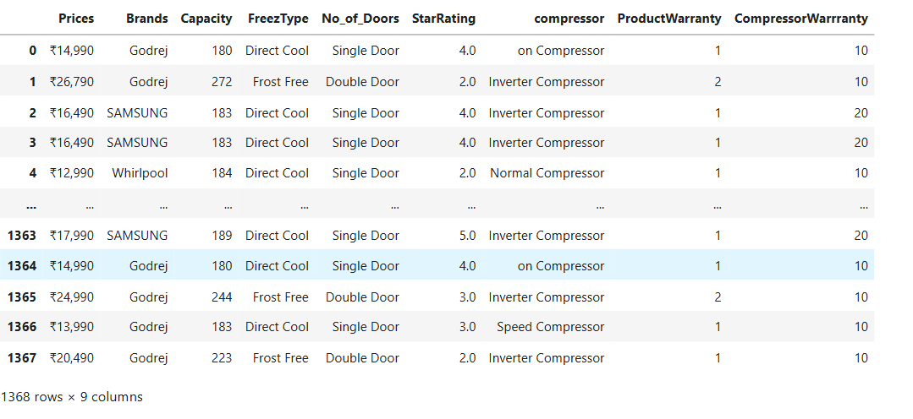

Before Data Cleaning

Slide 8
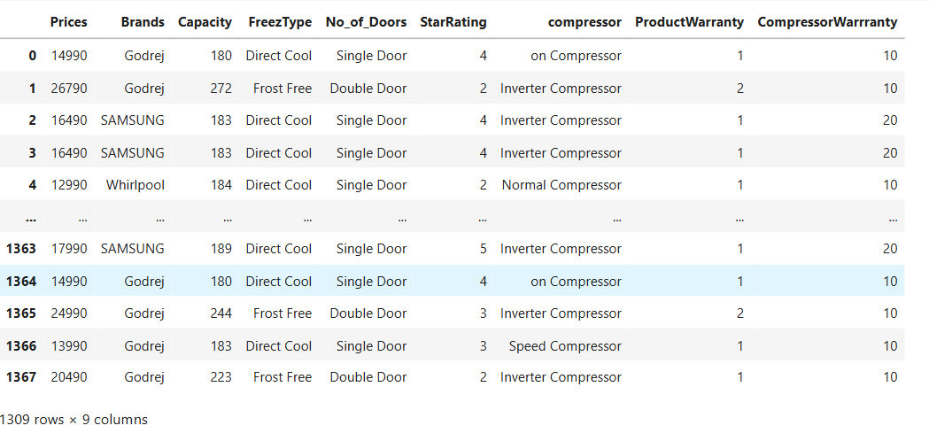
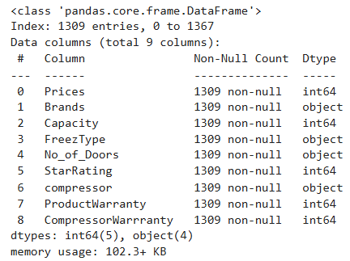
After Data Cleaning

Slide 9
DATA ANALYSIS
Data analysis is the process of cleaning, transforming, and interpreting data to uncover useful patterns, trends, or insights. It helps in making informed decisions by understanding the underlying story within the data.
Data Analysis Steps:
Data Collection: Scraped refrigerator data from Flipkart.
Data Cleaning: Removed symbols, handled nulls, and adjusted data types.
Univariate Analysis: Explored single variables using charts (e.g., pie, histogram).
Bivariate Analysis: Examined relationships (e.g., price vs. capacity) using scatter and bar plots.
Insights Extraction: Identified factors like brand and efficiency impacting pricing.

Slide 10
UNIVARIATE ANALYSIS
Univariate analysis is the simplest form of statistical analysis, focusing on the examination of one variable at a time. It helps summarize and understand the basic features of a dataset by analyzing the distribution, central tendency and dispersion of a single variable.
Univariate analysis can be applied on :
Numerical Data : Numeric values like Price, Capacity.
Categorical Data: Non-Numeric values like Brand, FreezType, etc.
Count Plot, Pie Chart and Histogram are used for Univariate distribution.

Slide 11
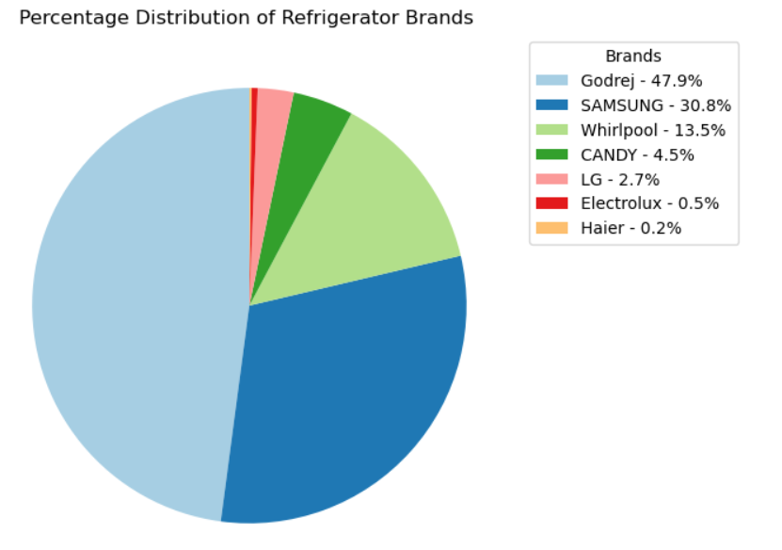
Percentage Distribution of Refrigerator Brands
From the pie chart, we can conclude that Godrej has the highest share of refrigerators (47.9%), followed by Samsung (30.8%), while brands like Haier and Electrolux have the smallest shares.

Slide 12
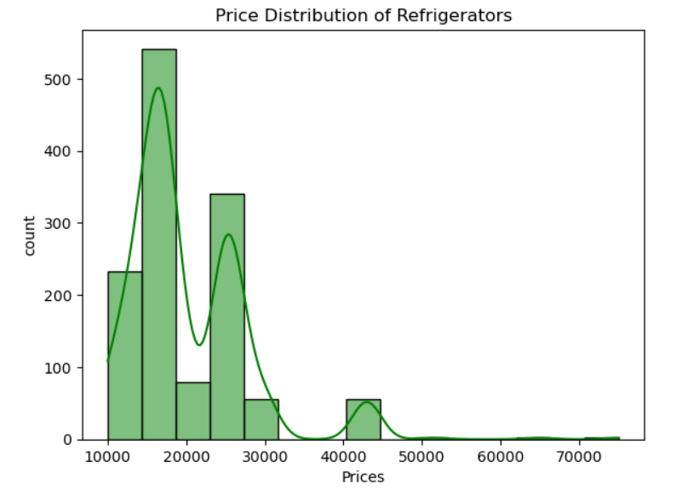
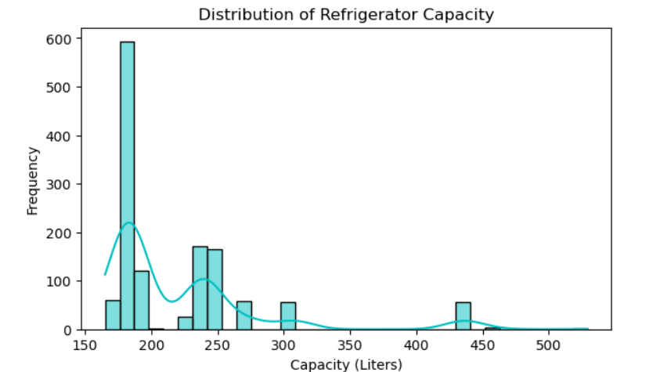
Price and Capacity Distribution of Refrigerators
From the plots, we can conclude that most refrigerators are priced between ₹10,000–₹30,000 and have a capacity of 200–250 liters, indicating a preference for mid-range, medium-capacity refrigerators in the market.

Slide 13
BIVARIATE ANALYSIS
Bivariate analysis is a statistical method for analyzing the relationship between two variables. It helps identify patterns, relationships, and correlations, providing insights into how one variable affects or is associated with another.
Types of Bivariate Distribution:
Numerical Vs Numerical : Includes 2 numerical columns .Plots supporting this distribution are: Scatter Plot.
Numerical Vs Categorical : Includes one numerical and one categorical columns , Plots supporting this distribution are: Count Plot, Box Plot, Stacked Bar Plot.

Slide 14
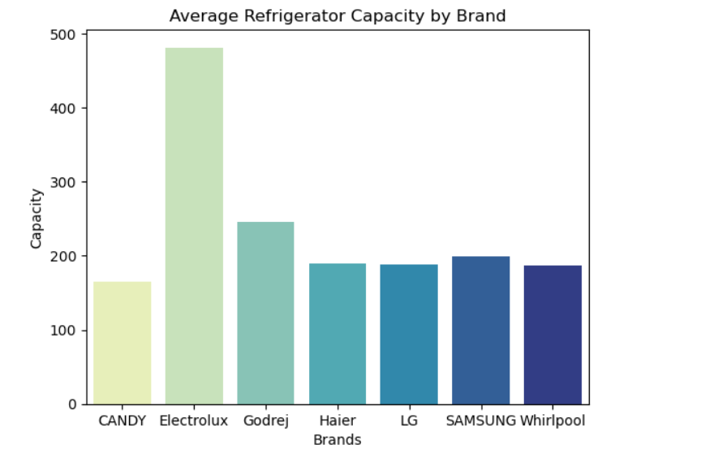
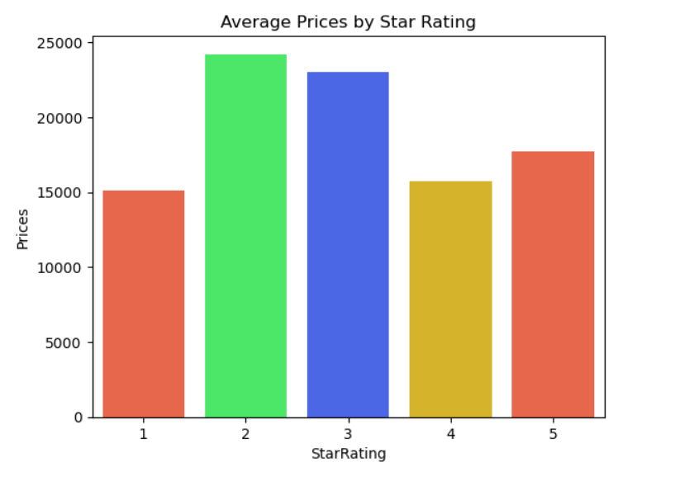
Comparison of Average Refrigerator Capacity by Brand and Prices by Star Rating
j
Electrolux offers the highest average capacity, and 2-star refrigerators have the highest average price despite lower energy efficiency.

Slide 15
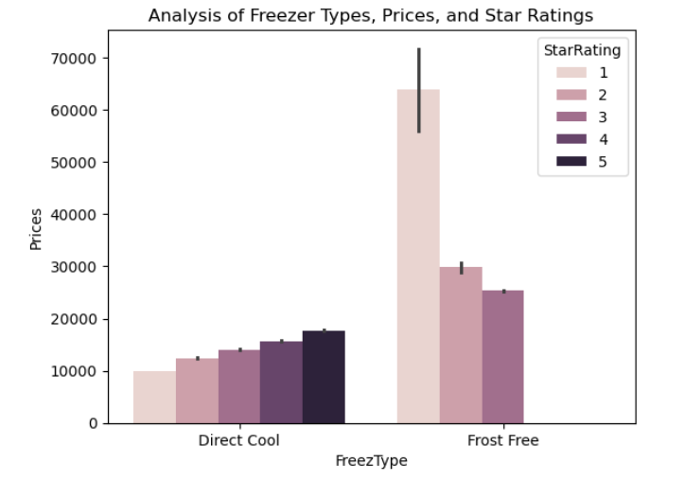
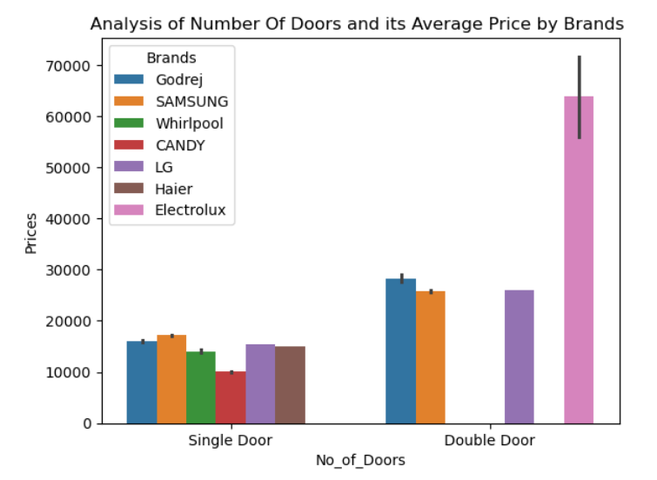
Analyzing Refrigerator Prices by Freeze Type and No_of_Doors
The price of a refrigerator is influenced by freeze type, star rating, number of doors, and Brand.
Frost Free and Double Door models are premium segments, while Direct Cool and Single Door models are more budget-friendly.

Slide 16
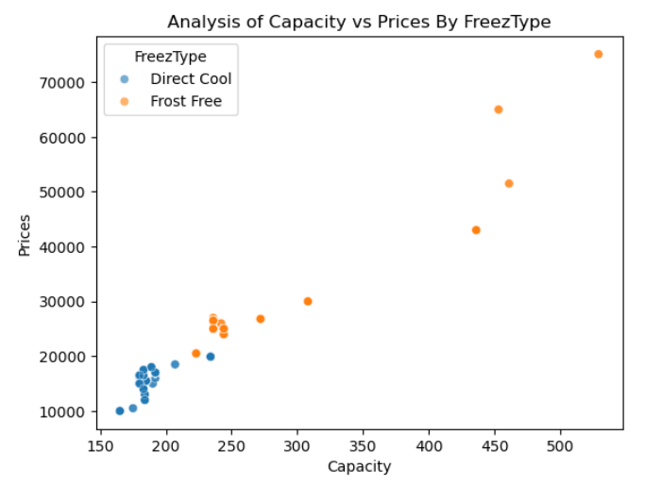
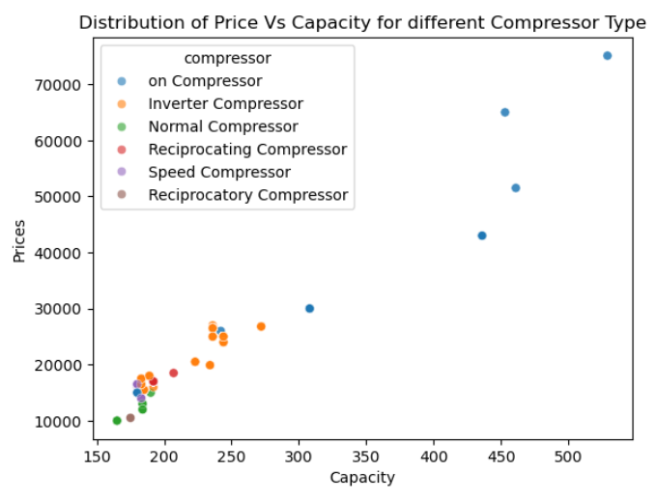
Price vs Capacity: Insights by Freeze Type and Compressor Type
As Capacity increases, Frost Free refrigerators show a steeper price growth compared to Direct Cool refrigerators.
On Compressors and other advanced compressor types are associated with higher Capacity and higher-priced refrigerators.

Slide 17
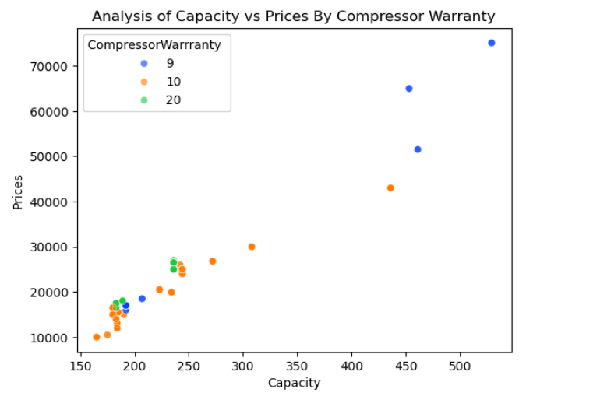
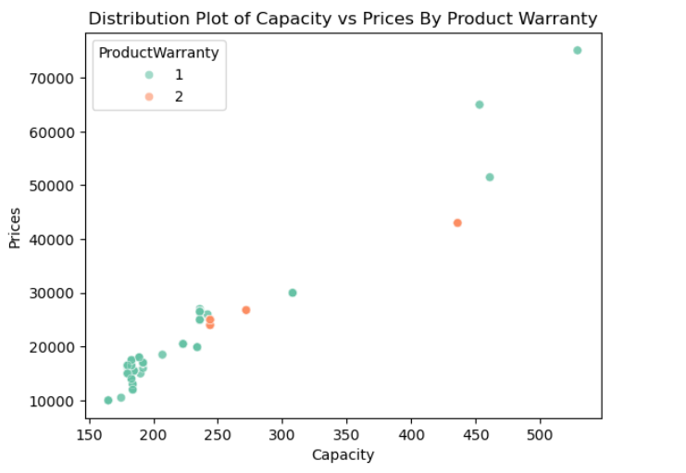
Impact of Warranty Periods on Refrigerator Prices and Capacities
Longer compressor warranties (e.g., 20 years) are generally associated with lower-capacity refrigerators, while shorter warranties (e.g., 9 years) are seen in premium, high-capacity models.
Higher product warranties are often associated with premium refrigerators, while standard warranties (1 year) dominate budget-friendly models.

Slide 18
CONCLUSION
The analysis reveals that several key features significantly affect refrigerator prices.
Brand: Recognized brands tend to command higher prices due to perceived quality and reliability.
Capacity: Larger capacity models generally have higher prices, reflecting increased functionality.
Star Rating: Higher energy efficiency ratings correlate with higher prices, indicating consumer willingness to pay for energy savings.
Compressor Type: Different compressor types also show varying impacts on pricing, with advanced technologies often priced at a premium.
Warranty Period: Longer warranty periods can justify higher prices as they enhance consumer confidence in product durability.

Slide 19
KEY BUSINESS QUESTIONS
Which brands offer the longest product warranty for single-door refrigerators ?
Brands like Samsung and LG often provide longer product warranties (2-3 years) for single-door refrigerators, reflecting their confidence in product durability.
If I have ₹15,000 and want a single-door refrigerator, which brand should I choose?
Based on our analysis, refrigerators in this price range and category are typically offered by brands like Whirlpool or Godrej. These brands provide reliable single-door models within budget.
Can I get a higher star-rated (energy-efficient) refrigerator under ₹20,000?
While it depends on the brand and capacity, 3-star or 4-star-rated refrigerators from brands like Godrej or Whirlpool are more likely to be found in this price range.

Slide 20

THANK YOU

