Slide 1
Sales Performance Report
"Analysis of Sales Trends and Influences.“
Prepared by: Anju Chauhan

Slide 2
Report Objectives:
Bullet points:
Analyze overall sales trends.
Examine the impact of holidays and weekends.
Explore the influence of external factors (e.g., CPI, temperature).
Compare performance across stores and departments.

Slide 3
Dataset Overview.
Time Period: 2010–2012
Data Size:
Total Records: Number of rows in the dataset.
Number of Columns (Features): Variables included.
Key Metrics:
Weekly_Sales: The target variable representing weekly sales in dollars.
IsHoliday: Boolean variable indicating if the date is a holiday.
CPI (Consumer Price Index): Measures average change in prices over time.
Fuel_Price: Price of fuel at the time.
Temperature: Weather temperature on the day.
Store and Department IDs: Used to identify performance by location and department.

Slide 4
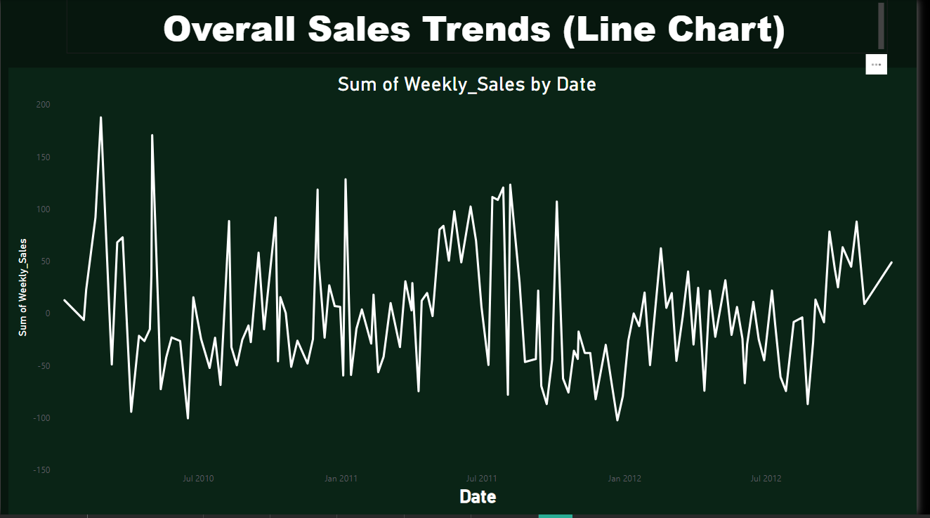
Analysis and Insights Slides
Overall Sales Trends:
"Sales peaks occur during holidays."
"Overall growth observed year over year."

Slide 5
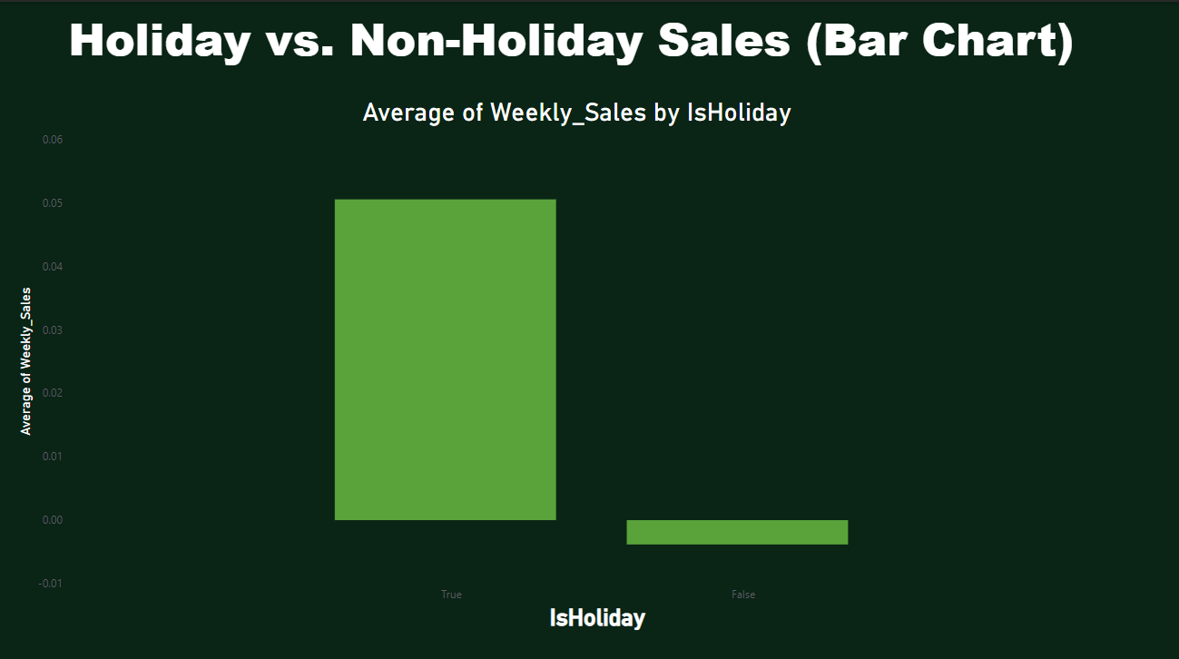
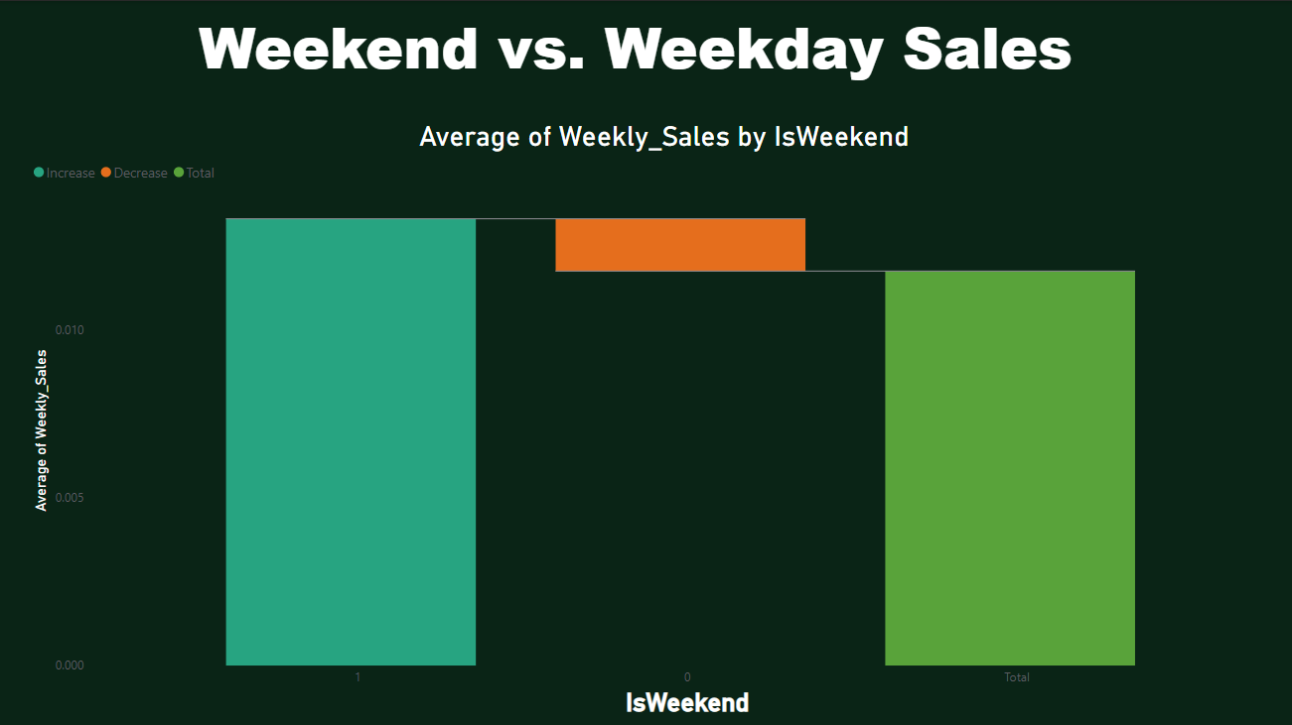
Impact of Holidays and Weekends
"Holidays boost sales by X%."
"Weekend sales are consistently higher."

Slide 6
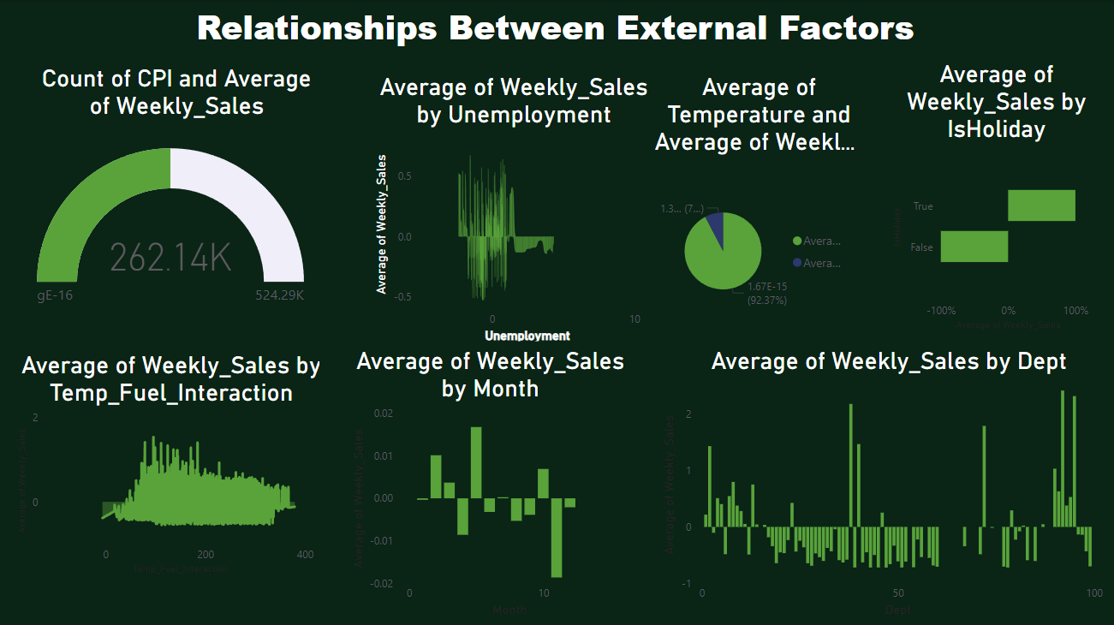
External Factors and Sales
"Moderate positive correlation with CPI."
"Slight decline in sales during extreme temperatures.“

Slide 7
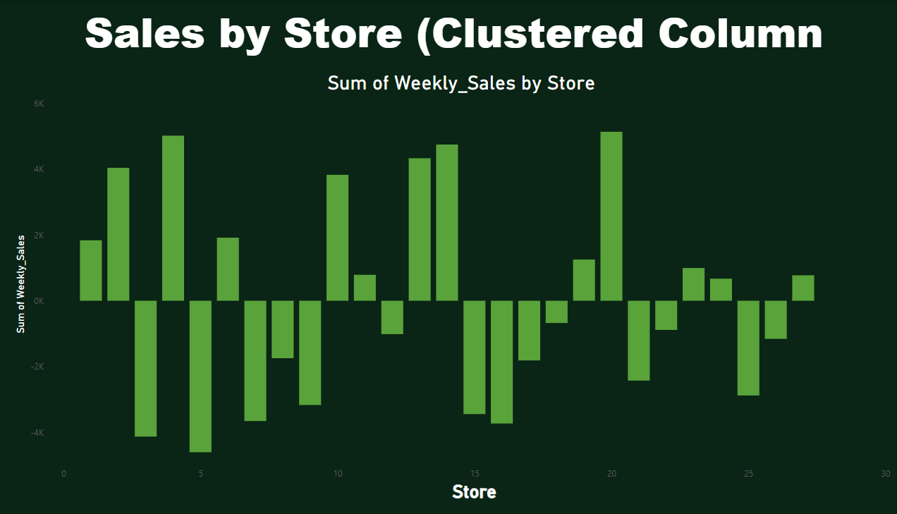
Sales by store Performance
"Store 3 has the highest total sales."

Slide 8
"Conclusion"
"Sales are significantly influenced by holidays and weekends.“
"External factperformance metricsors like CPI moderately impact sales."
"Store 3 lead."

Slide 9
THANK YOU Made by - Anju Chauhan

