Slide 1
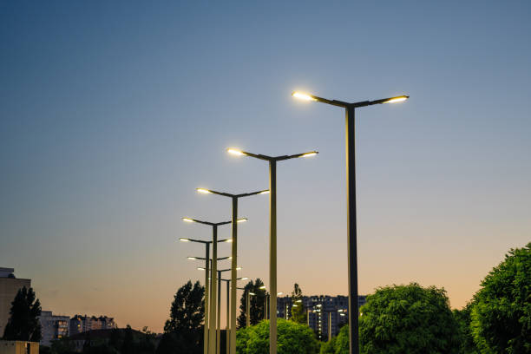
Smart Street Light Management System
Energy-efficient and Automated Lighting Solution
Team Members:
Anju : 2022BEC0020
Charitha : 2022BEC0032
Thanmaye : 2022BEC0037
Chitransh : 2022BEC0023

Slide 2
Let’s get to Numbers
Assuming each streetlight consumes 100 W of energy and operates for 12 hours every night (from 6 PM to 6 AM), it uses approximately 1.2 kWh of electricity per day. In a town with 500 streetlights, the total energy consumption amounts to 600 kWh per day.
At an average electricity rate of ₹10 per kWh in India, the daily cost comes to ₹6,000.
However, studies show that only 30% of the lights are actually needed at any given time, which means 70% of the energy is wasted — that’s 420 kWh wasted per day.
In just one month, this adds up to over 12,000 kWh of wasted energy — enough to power 400+ homes for a day.
Our smart streetlight system can reduce this wastage by up to 70%, making cities both smarter and more energy-efficient.

Slide 3
What is Smart Street Light Management System?
Imagine walking down a quiet street at midnight — all lights blazing with no one in sight. What it does : Wastes energy and unnecessary cost.
Now picture this: As you approach, the lights turn on, then switch off behind you. That’s smart lighting — efficient, automated, and responsive.
Our project brings that concept to life using Wireless Sensor Networks with a budget-friendly design.

Slide 4
System Overview
IR Sensors detect motion and ambient light levels.
Communication via WiFi.
Additional web interface for monitoring.

Slide 5
Hardware Components
NodeMCU (ESP8266)
3 x IR Sensors (Infrared Obstacle Sensors)
3 x LEDs
Breadboard
Jumper Wires
Resistors

Slide 6
Implementation Steps
Working:
IR sensors detect movement → Automatically turn ON respective LEDs.
ESP8266 hosts a local web server to: View LED status and Manually control LEDs (ON/OFF)
Combines auto + manual control using flags.
Pin Configuration: IR1 (D5), IR2 (D6), IR3 (D7),LED1 (D1), LED2 (D2), LED3 (D3)
Tech Used: Arduino IDE C++ (ESP8266WiFi, ESP8266WebServer libraries) HTML for simple web interface

Slide 7
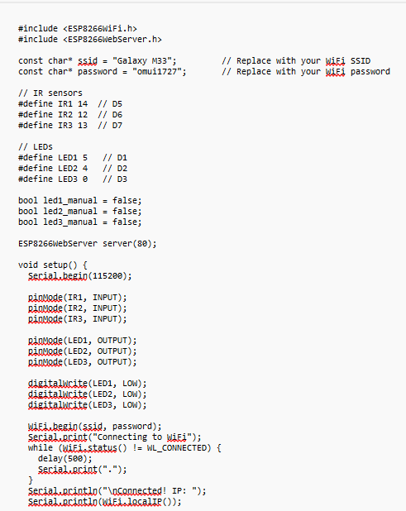

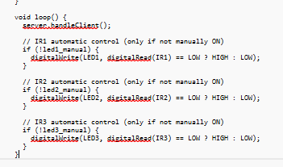
Code

Slide 8
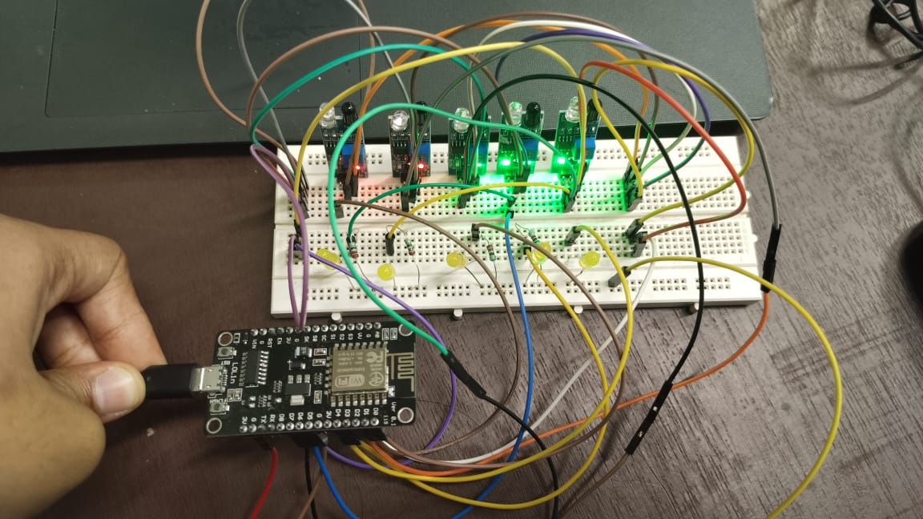
Prototype

Slide 9
Benefits
Energy Efficiency – LEDs automatically turn ON/OFF based on IR sensor input, saving electricity when no movement is detected.
Cost-Effective – Uses low-cost components like ESP8266, IR sensors, and basic LEDs—affordable for students and DIY projects.
Remote Control - You can manually control LEDs from any device via a web interface using WiFi—no physical switches needed.
Scalable Design – Easily expandable to more streets.

Slide 10
Future Enhancements
Add cloud integration for remote monitoring : Upload real-time data to the cloud to answer questions like Which streets are the most active at night and How much energy is saved in this month.
Implement AI-based object detection : Detect objects like dogs or trees which can lead to unnecessary triggers.
Develop mobile app interface : App for live status update, to detect faulty nodes and for manual override during emergency situations.
Emergency lighting mode : Integrate with disaster response system for lights to stay on even without motion during disasters.
Solar Panel Compatibility : Solar panels can be added to make the system fully sustainable.

