Slide 1
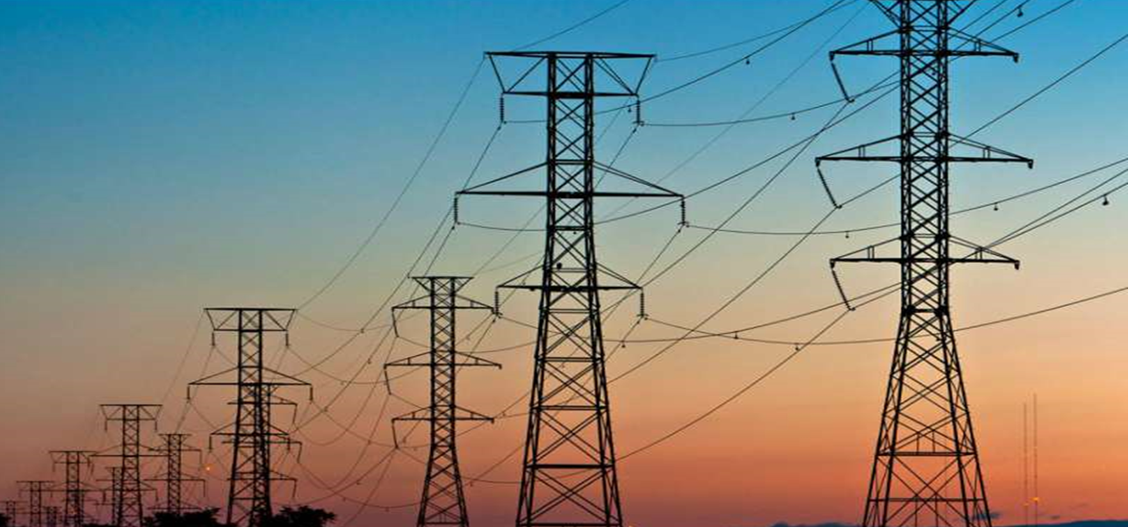
Energeia Group
Analysis, Forecasting and Strategy Development
- Anjum Banu Ismail

Slide 2
Analysis to be Carried out
PART 1
What Factors caused increase in prices in July2021?
What would be the future trend ?
What factors will increase / decrease the prices further ?
PART 2
Trends Observed
Develop Trading Strategies for 2021
Apply Trading Strategies for historic data

Slide 3
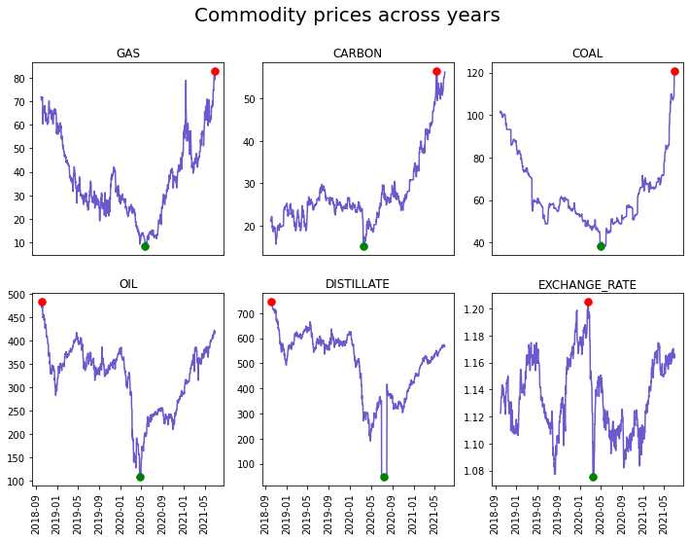
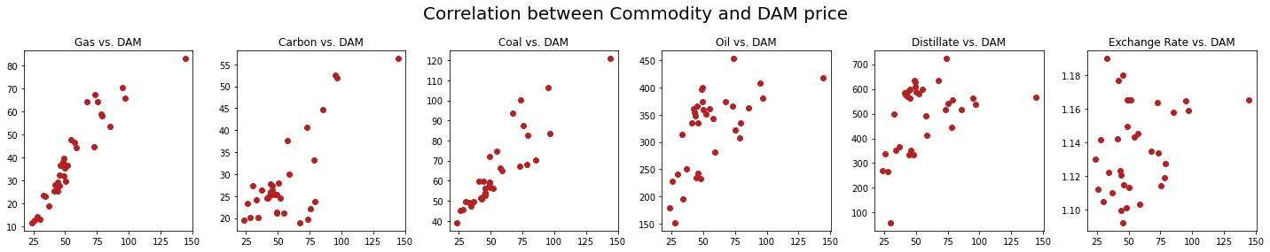
Part 1: Commodity prices and there trends in past 4 years
Commodities | Increased Price date | Max Price
Gas | 2021-06-30 | 82.8625
Carbon | 2021-05-14 | 56.49
Coal | 2021-06-30 | 120.75
Oil | 2018-10-03 | 483.224
Disttilate | 2018-10-04 | 744.75
Ezchange rate | 2020-02-19 | 1.205

Slide 4
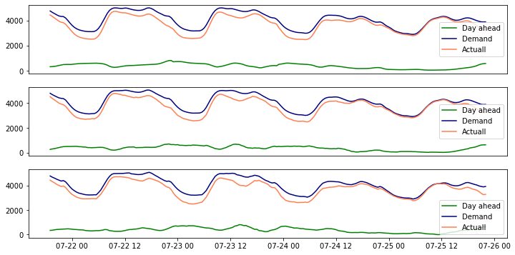
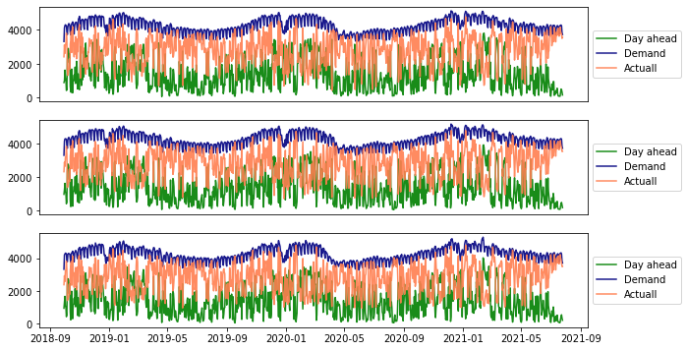
Part 1: Wind, Demand Trends and pattern
Day Pattern
Seasonal Pattern
Seasonal change observed in Wind and there is less Generation from Wind during Summers

Slide 5
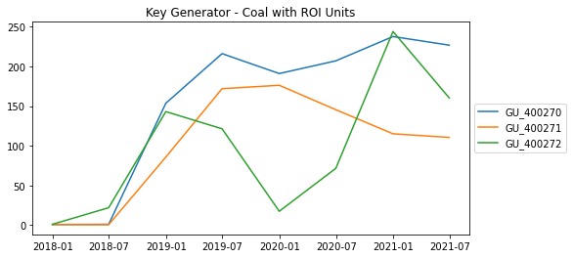
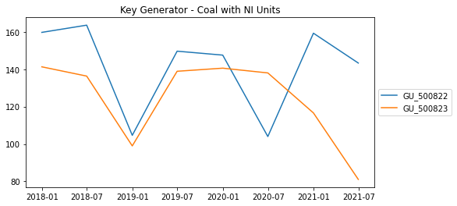
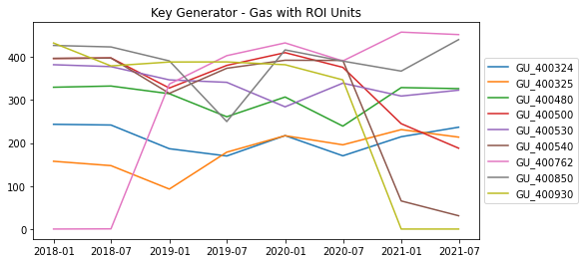
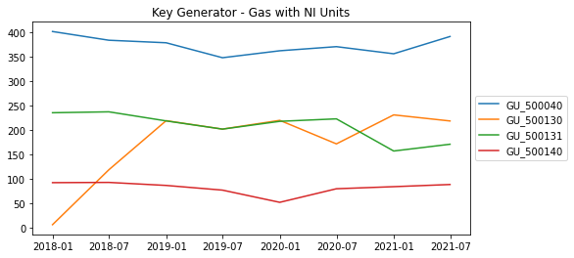
Part 1: Key Generators Availability and there price change
Price Change by Generators from June 2021 to July 2021
GU_400530 | 66.4 | 76.89
GU_400850 | 64.68 | 75.46
GU_400480 | 62.89 | 73.5
GU_400530 | 66.42 | 76.89
GU_400324 | 77 | 90
GU_400325 | 76 | 90
GU_400270 | 83.97 | 96.3
GU_500040 | 50 | 59
GU_500130 | 220 | 287.5
Fuel | Generator
Coal | GU_400270
Coal | GU_400271
Coal | GU_400272
Gas | GU_400324
Gas | GU_400325
Gas | GU_400480
Gas | GU_400500
Gas | GU_400530
Gas | GU_400540
Gas | GU_400762
Gas | GU_400850
Gas | GU_400930
Gas | GU_500040
Gas | GU_500130
Gas | GU_500131
Gas | GU_500140
Coal | GU_500822
Coal | GU_500823

Slide 6
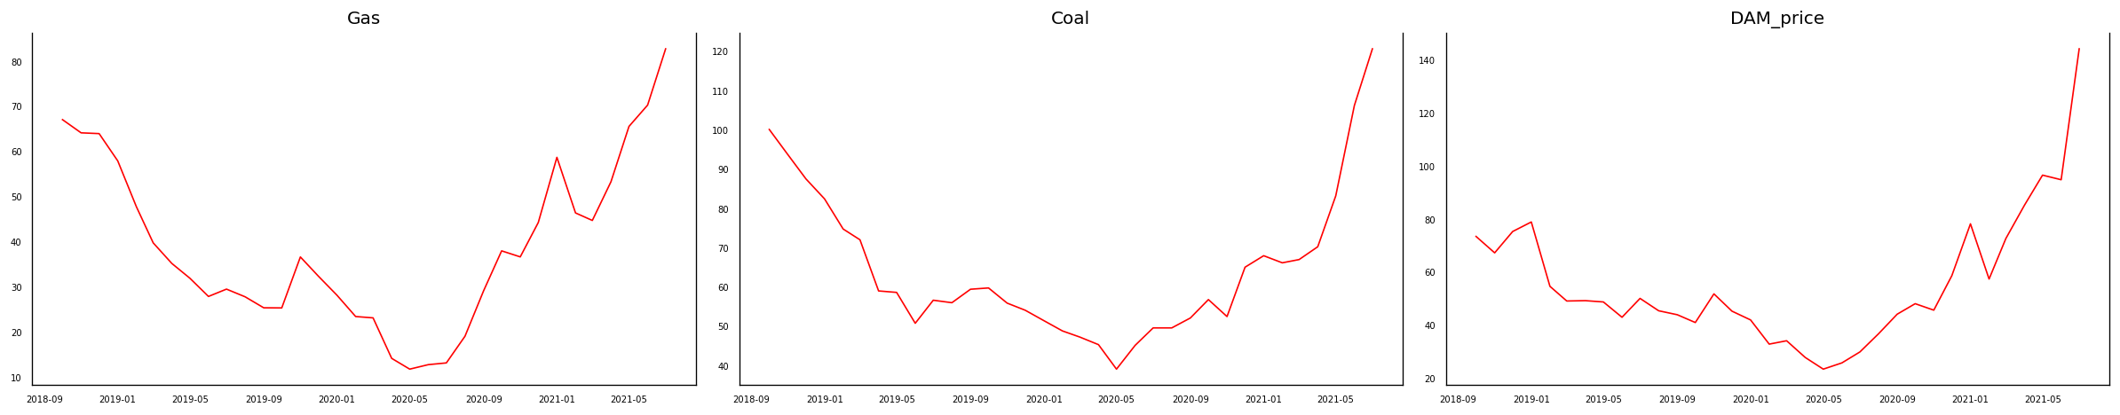
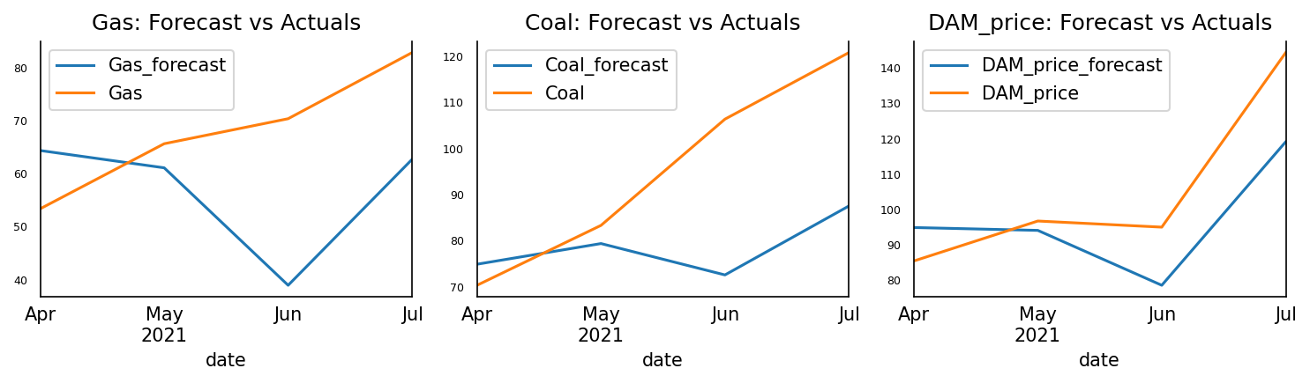
Part 1: Forecasting the Component resulting in price increase

Slide 7
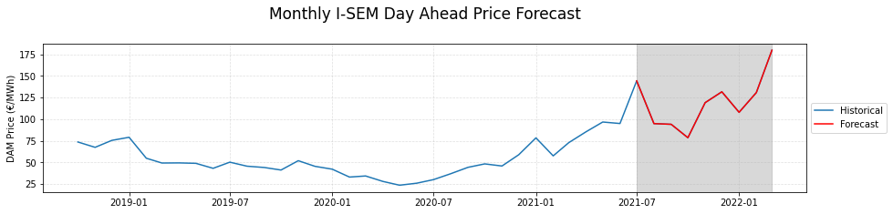
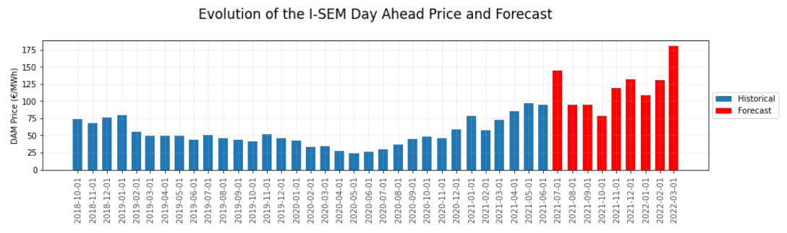
Part 1: Forecast of DAM for next 6 months

Slide 8
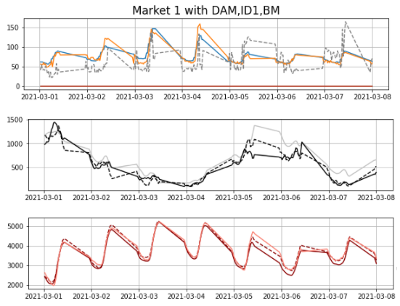
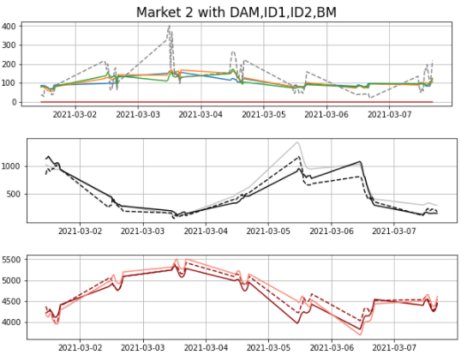
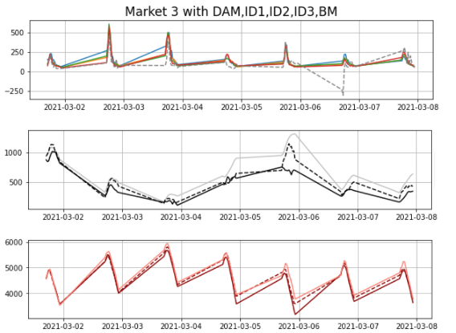



Part 2: Variations seen in different Market window in one week
Patterns were observed Monthly, and weekend Trends
The Trends varied in Winter and Summer months
Wind Demand and Net Demand are Negatively Correlated.

Slide 9
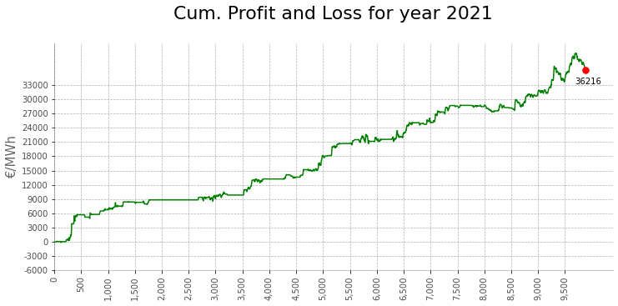
Part 2: Current Trading Strategies
Trade 1: (Short Trade)
Buy in DAM and Sell in BM when Output Wind < 1200 and Day net demand is > 1200
Trade 2: (Short Trade)
Buy in IDA1 and Sell in BM when Output Wind < 1200 and Day net demand is > 1200
Trade 3: (Long Trade)
Sell in IDA3 and Buy in DAM when Output Wind < 1200 and Day net demand is > 1200
Market and Auction | Winning Trades | Loss Trades | Max Win Trades | Max Loss Trades | Profit Gained
Trade 1 (5:30 PM) | 1083 | 1500 | 348.73 | -336.72 | 4459.83
Next Day Trade 2 (8:00 AM) | 1732 | 2061 | 1091.05 | -336.72 | 26007.92
Trade 3 (2:00 PM) | 2499 | 2460 | 398.56 | -136.55 | 36215.781

Slide 10
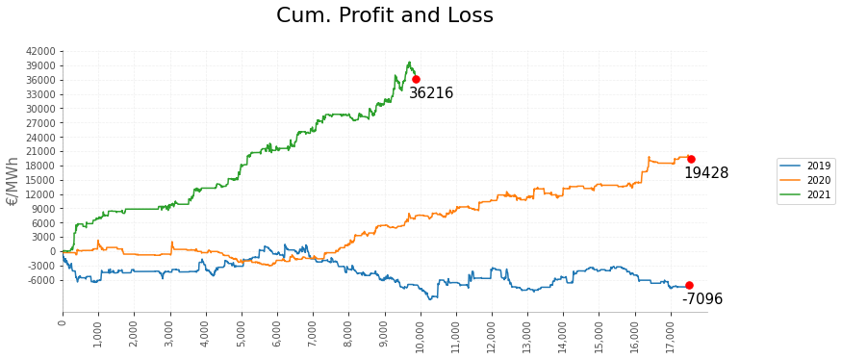
Part 2: Current strategy Impact on Historic data
Year | Total Trades | Total Available Trades | % of Trades | Winning Trades | Loss Trades | Winning Ratio | Loss Ratio | Average Win Trades | Average Loss Trades | Max Win Trades | Max Loss Trades
2019 | 7641 | 17520 | 43.61% | 2864 | 4777 | 37.48% | 62.52% | 33.69 | -21.69 | 368.853 | -311.05
2020 | 6566 | 17568 | 37.37% | 2915 | 3651 | 44.4% | 55.6% | 27.97 | -17.01 | 421.83 | -224.61
2021 | 4959 | 9888 | 50.15% | 2499 | 2460 | 50.39% | 49.61% | 43.05 | -29.01 | 1091.05 | -336.73

Slide 11

Thank you…

