Slide 1
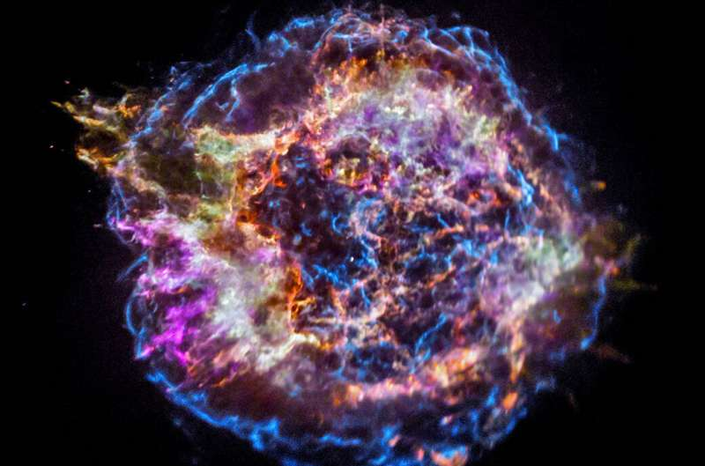
Classification of Astronomical light curves
Team
Adam Liffey
Akhil Abraham
Anjum Banu Ismail
Jiabin Wang

Slide 2
Presentation Summary
Part 1: Akhil
Part 2: Jiabin
Part 3: Adam
Part 4: Anjum
Introduction
Observations
Time Series Visualization
Feature Engineering (1)
Feature Engineering (2)
Clustering modeling Process
K means Clustering
Conclusions
Hierarchical clustering (K shape)
Other clustering model
Conclusions

Slide 3
Incorporation of clustering analysis to group various intensity light curves captured by 2 telescopes every night for period of 5 years (2016 – 2020)
Problem Statement
Clustering based on the given flux values with respect to its error and quality.
Grouping the objects into clusters by there shape.
Comments on model implementation

Slide 4
Clustering models used
K means Clustering: The Entire data is taken as one single time series and the grouping is performed based on flux, error and quality
Hierarchical Clustering: The Individual light curve data is used an object by the clusters are formed using shape extraction logic called k -Shape algorithm
Some of the Aspects that must be considered for Time series clustering
- Pre-processing of data, possibly changing the decision space. - Type of clustering (partitional, hierarchical, etc.). - Number of desired or expected clusters. - Choice of distance measure, along with its parameterization. - Choice of centroid function and its parameterization. This may also depend on the chosen distance.
- Evaluation of clustering results. - Computational cost, which depends not only on the size of the dataset, but also on the complexity of the aforementioned aspects

Slide 5
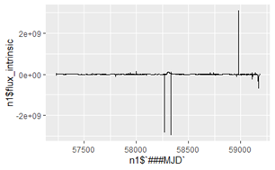
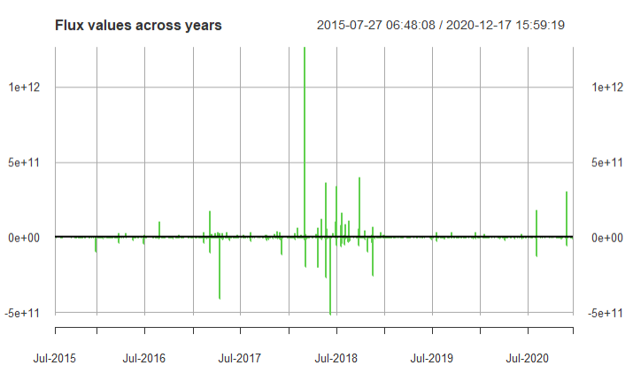
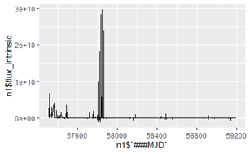
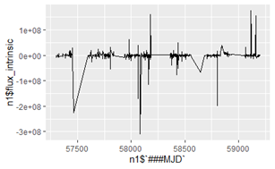
Time Series Visualization

Slide 6
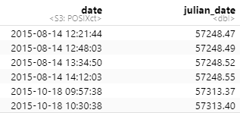
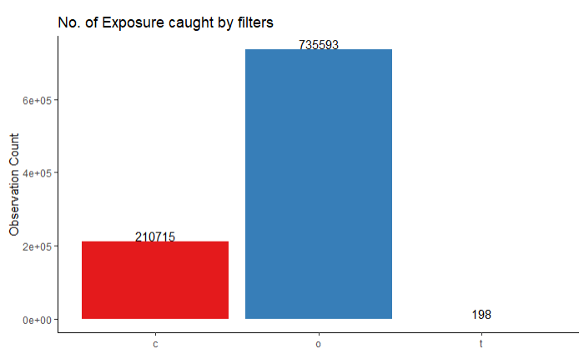
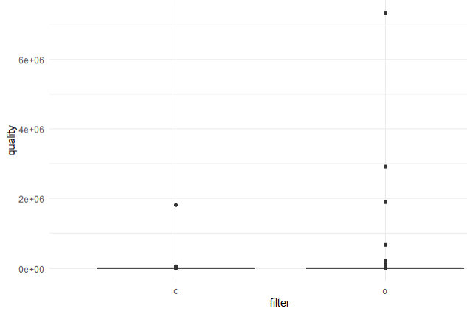
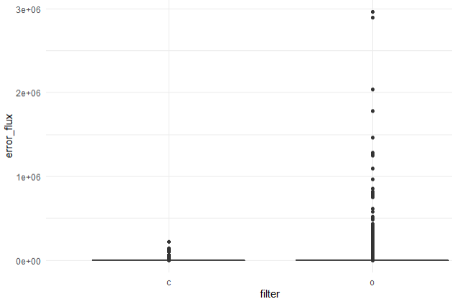
Feature Engineering (1)
Converting Modified Julian date to Calendar date for better understanding
Found entries with filter “t” and hence removed it
Removal of Outliers in the error and quality

Slide 7
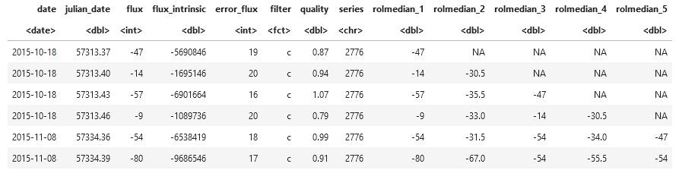
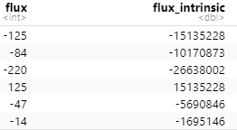
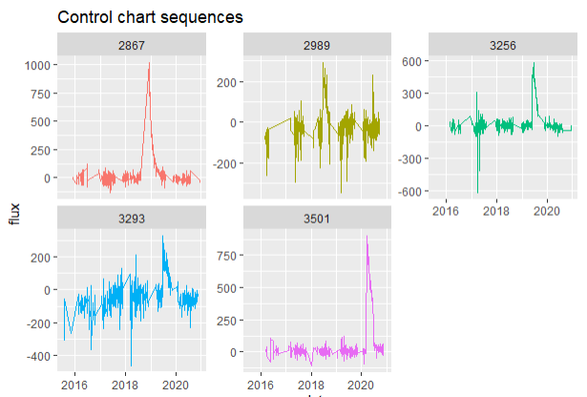
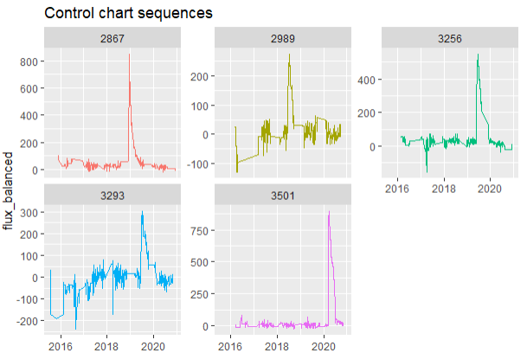
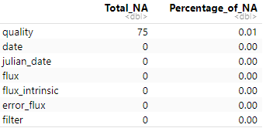
Feature Engineering (2)
Performing Rolling median on Flux
Removing the distance dependencies on flux by applying
Bringing the negative flux to base line 0
Removing the NA’s present within the quality (Chi) variable

Slide 8
K Means
Clustering

Slide 9
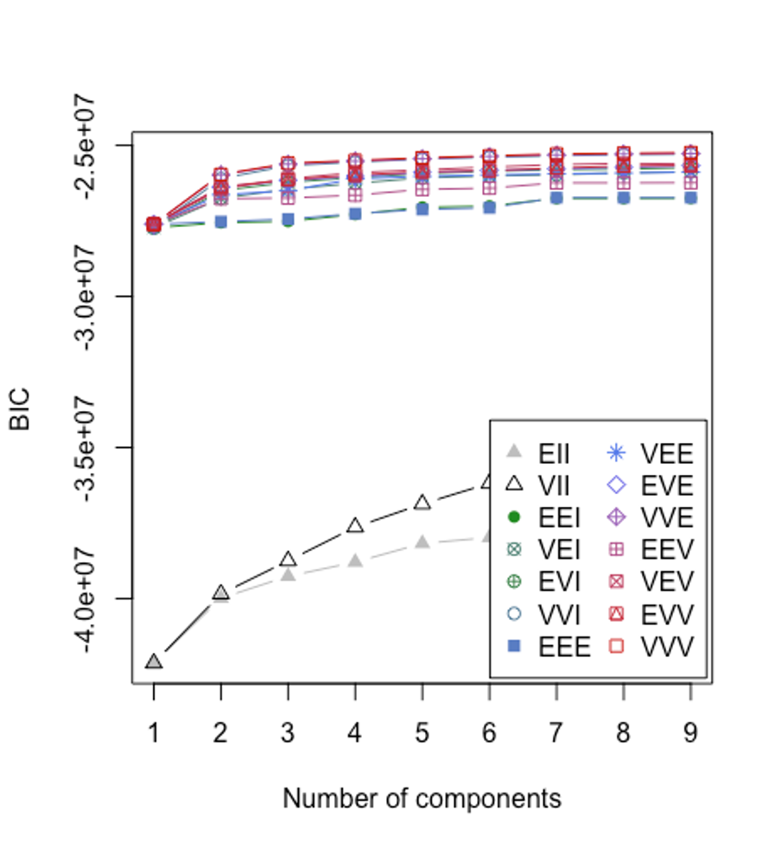
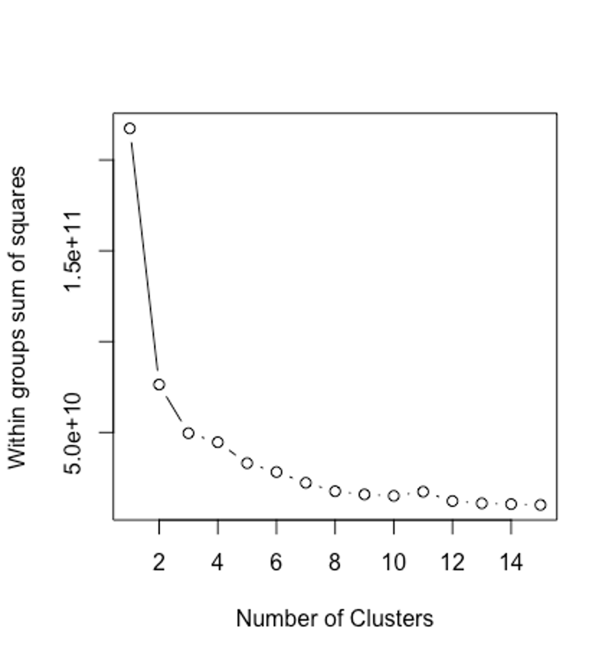
How to choose the number of clusters?

Slide 10
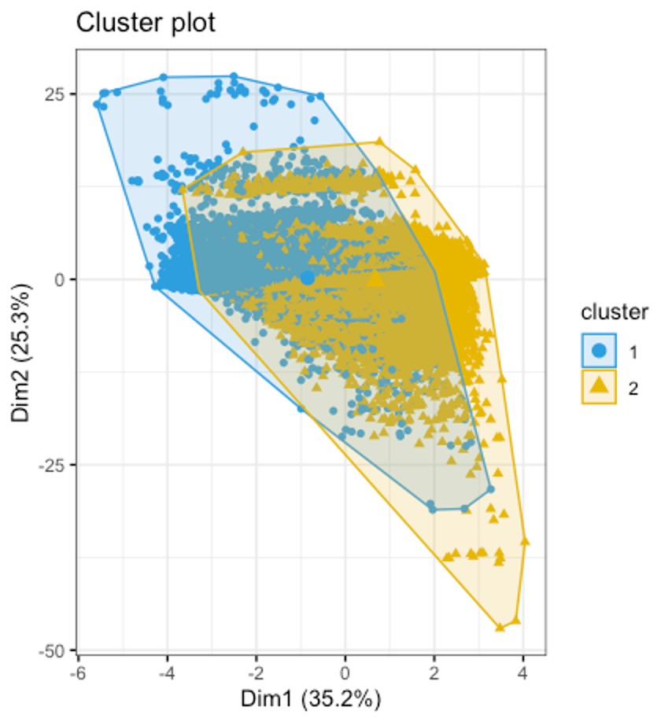
Cluster plot of data

Slide 11
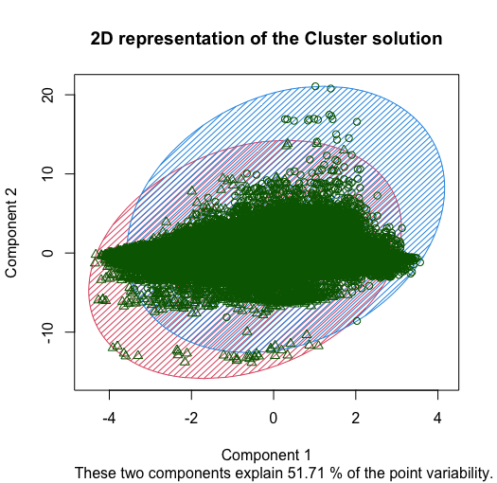
2D Representations on the clusters formed

Slide 12
Results from K mean
- 2 clusters of size 334,446 and 416,565
 | Cyan | Orange | Total
Cluster 1 | 88106 | 246,340 | 334,446
Cluster 2 | 87132 | 329,433 | 416,565
- Within cluster sum of squares by cluster: (between_SS / total_SS = 64.9 %)

Slide 13
Cluster Means
Cluster | Date (julian) | Error Flux | Quality | Flux
1 | 58776 | 17.9 | 1.3 | 5186
2 | 57905 | 23.9 | 1.26 | 5153

Slide 14
Time Series Clustering

Slide 15
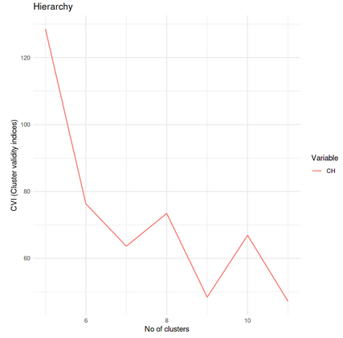
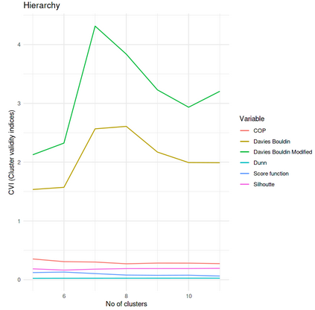
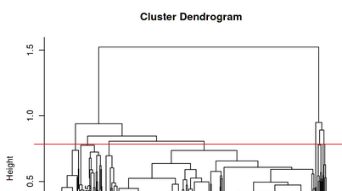
Hierarchical Clustering with shape extraction
Cluster | Count | Avg-distance
1 | 35 | 0.450608
2 | 329 | 0.182498
3 | 6 | 0.511242
4 | 22 | 0.199821
5 | 94 | 0.162627
6 | 8 | 0.329621
7 | 82 | 0.252921
8 | 69 | 0.422799

Slide 16
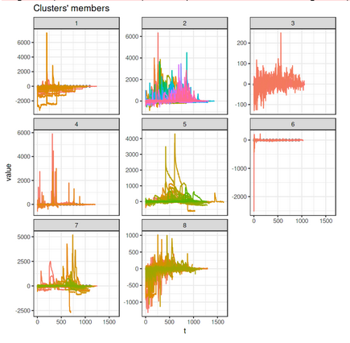
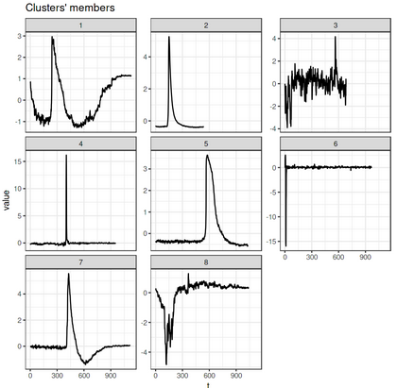
Clustering for filter “o”

Slide 17
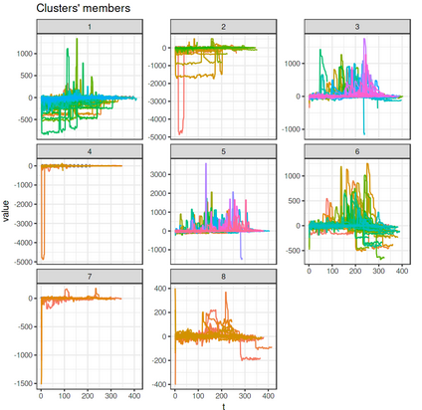
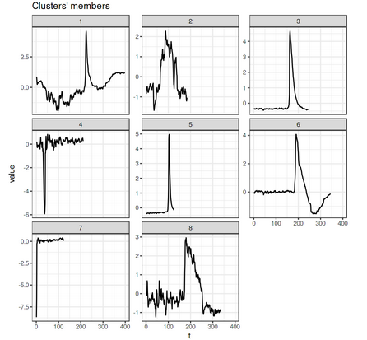
Clustering for filter “c”
Cluster | Count | Avg-distance
1 | 107 | 0.529888
2 | 56 | 0.663098
3 | 157 | 0.199784
4 | 23 | 0.445071
5 | 177 | 0.186835
6 | 89 | 0.259305
7 | 13 | 0.218423
8 | 22 | 0.366018

Slide 18
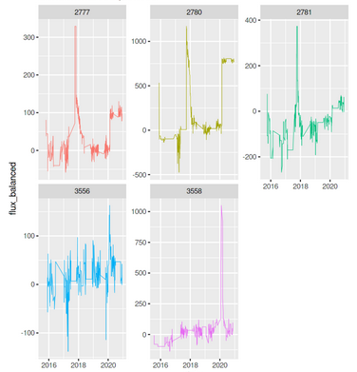
Cluster assignment for each light curve
Light_Curve | Cluster
2776 | 1
2777 | 1
2778 | 2
2779 | 2
2780 | 1
2781 | 1
3501 | 5
3502 | 2
3503 | 2
3556 | 8
3557 | 5
3558 | 2

Slide 19
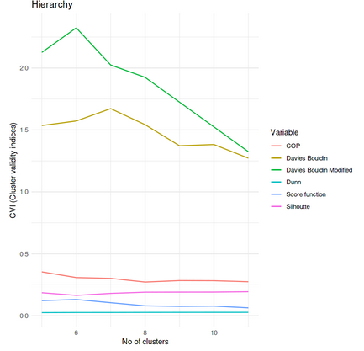
Other Clustering Techniques Performed
Hierarchical clustering using DTW
(Dynamic time wrapping)
Sil | SF | CH | DB | DBstar | D | COP | Cluster
0.185415 | 0.122072 | 128.5436 | 1.535471 | 2.126024 | 0.024837 | 0.353683 | 5
0.164196 | 0.130869 | 76.30091 | 1.572307 | 2.324427 | 0.025764 | 0.307885 | 6
0.180242 | 0.10495 | 75.30091 | 1.672307 | 2.024427 | 0.025911 | 0.301419 | 7
0.189944 | 0.07968 | 73.40748 | 1.672307 | 1.924427 | 0.026474 | 0.271863 | 8
0.190558 | 0.075425 | 48.37878 | 1.372307 | 1.724427 | 0.026798 | 0.28362 | 9
0.190809 | 0.077473 | 47.13705 | 1.382307 | 1.524427 | 0.027025 | 0.282569 | 10
0.193964 | 0.063429 | 45.13705 | 1.272307 | 1.324427 | 0.027094 | 0.274305 | 11
Why Chose K shape method ?
k-Shape is particularly effective for applications involving similar but out-of-phase sequences
Computationally effective
Supports series of different length directly

Slide 20


