Slide 1

G2M Case Study
Virtual Internship
17-June-2021

Slide 2
Background –G2M(cab industry) case study
XYZ is a private equity firm in the US. Due to remarkable growth in the Cab Industry in last few years and multiple key players in the market, it is planning for an investment in the Cab industry.
Objective: Provide actionable insights to help XYZ firm in identifying the right company for making the investment.
The analysis has been divided into four parts:
Data Understanding
Finding the most profitable Cab company
Recommendations for investment

Slide 3
Data Exploration
14 Features in the master dataset
Timeframe of the data: 2016-01-31 to 2018-12-31
Total data points:359392
Datasets:
Cab_Data.csv
Customer_ID.csv
Transaction_ID.csv
City.csv
Assumptions:
Outliers are calculated with Inter Quartile Range (25 <IQR <75)
December is holiday month

Slide 4
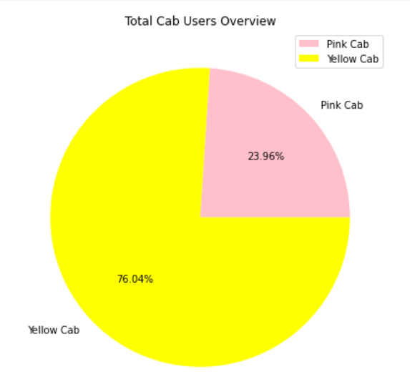
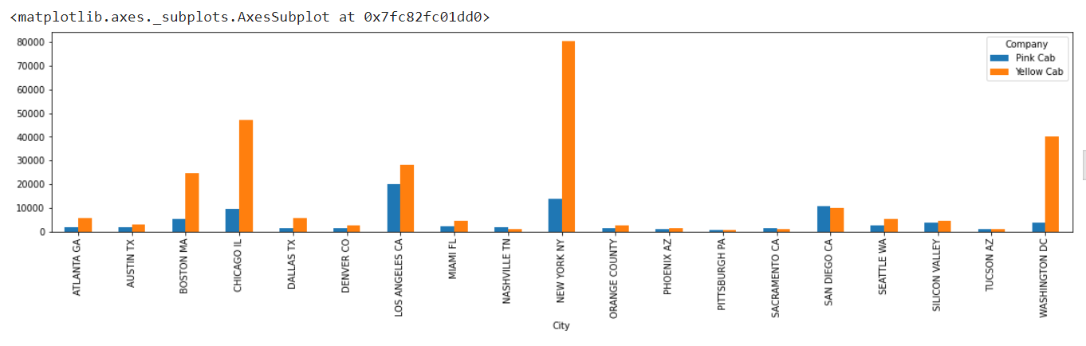
Cab Users Count
Yellow cab has almost 3/4th % of the user, while pink cab holds for 1/4th %.
New York, Chicago, and Washington Dc hold the first 3 positions in the number of yellow cab users, whereas Pink cabs have their strong areas in Los Angeles, New York and San Diego

Slide 5
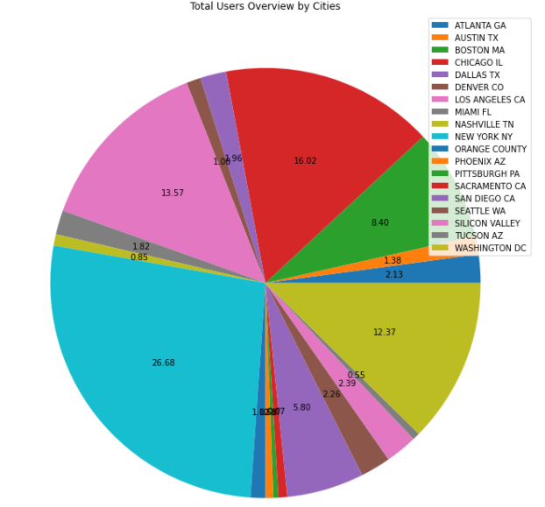
Cab Users Count
New York accounts for almost 26% of cab users, Chicago accounts for 16%, and Los Angeles accounts for 13% of total cab users.

Slide 6
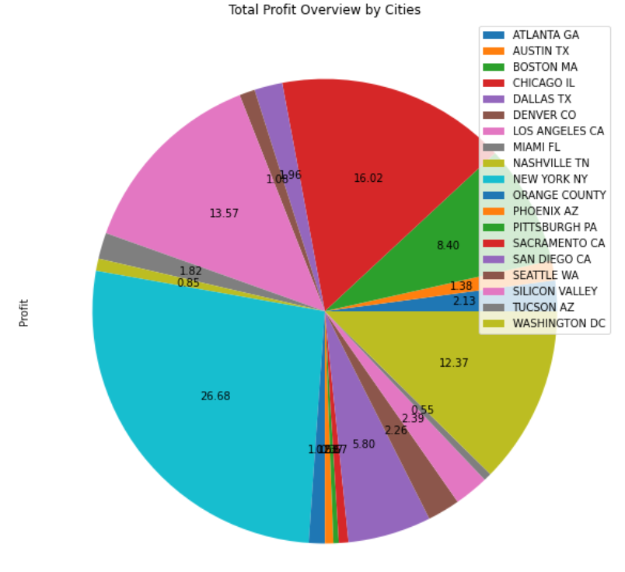
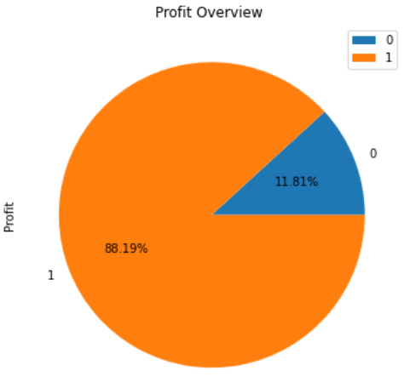
Profit Analysis
Profit Analysis

Slide 7
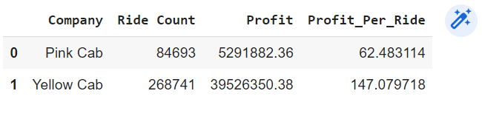
Profit Analysis
Profit Analysis
Pink Cab has a share of 12 % in profit, while yellow cab has 88%.
The profit per ride for pink cab is 62 whereas it is more than double for the yellow cab (147)
New York city generates the largest profit

Slide 8
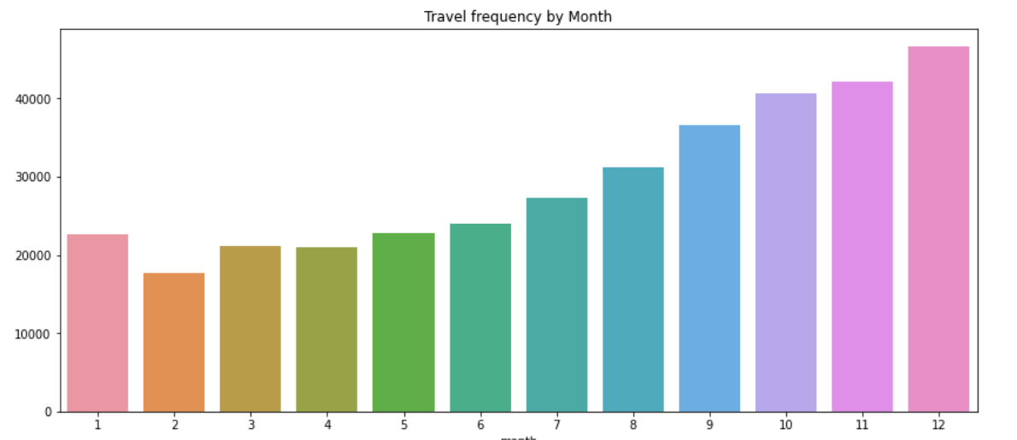
Profit Analysis
Travel Frequency
The number of cab usage increases from February to December, with December being the Holiday season seeing the maximum usage

Slide 9
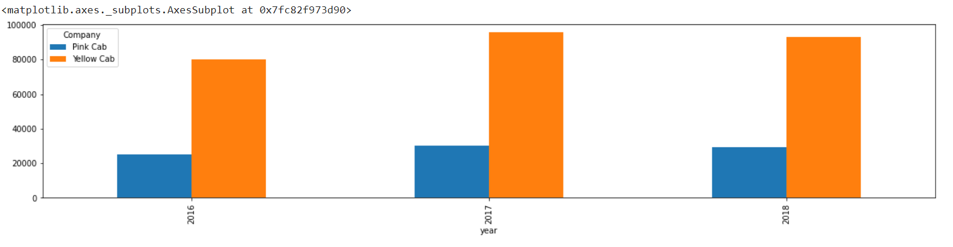
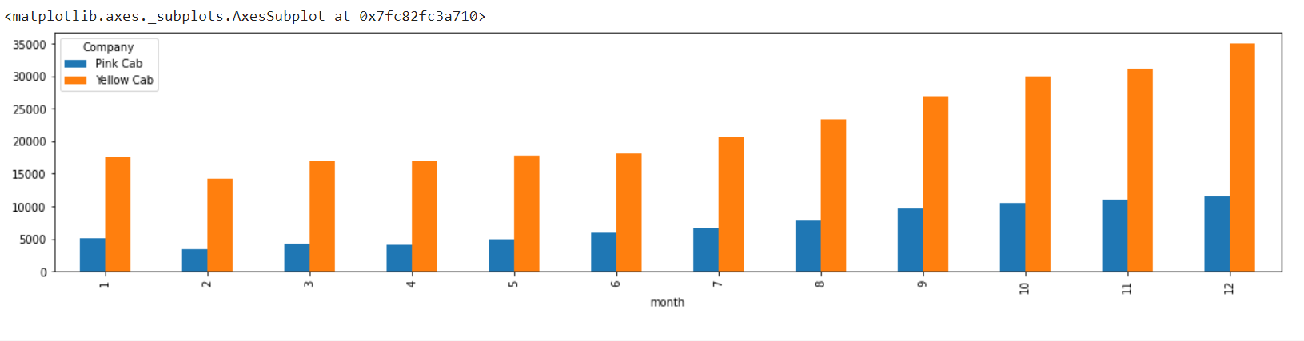
Profit Analysis
Travel Frequency
The travel frequency shows a similar pattern as that of the overview for the individual cab companies as well.
The yearly usage shows a slightly low decline in 2018 than that of 2017 for the yellow cab.
There is a slow steady increase in the usage of the pink cab.

Slide 10
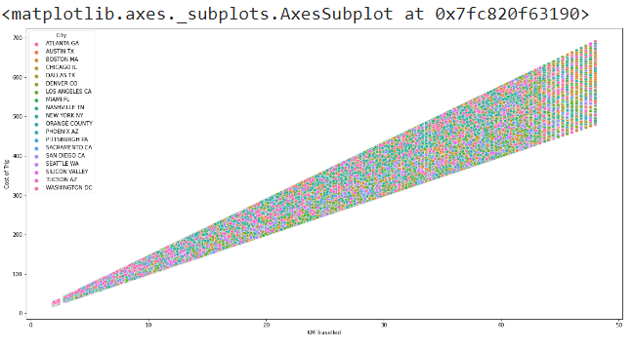
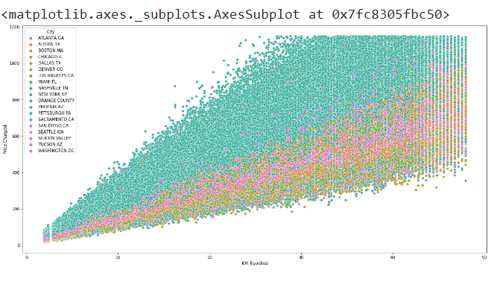
Profit Analysis
Cost & Price Analysis
Cost increases in direct proportion to the distance travelled but shows no relationship with the city.
The price charged is also in direct proportion with the distance travelled, however with the different cities it varies.
New York is a highly charged city for cab travel.

Slide 11
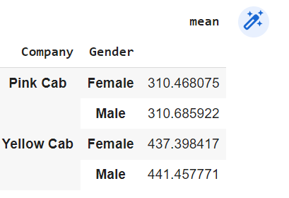
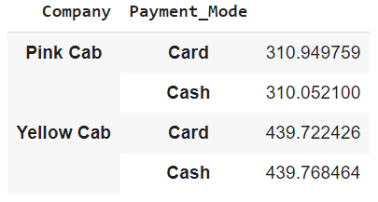
Profit Analysis
Price Analysis
The mean price charged with different modes of payment are same irrespective of the cab company
The price charged by the pink company is the same for the gender of the user.
The Yellow cab provides a discount for the female users in comparison with the male users.

Slide 12
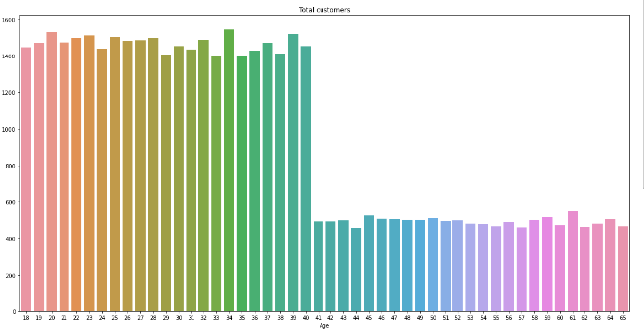
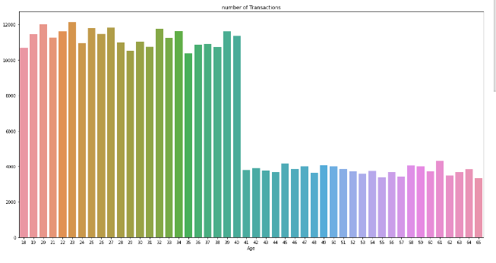
Profit Analysis
Age Group Analysis
The number of unique customers and the number of travel made by the customer shows a similar pattern.
The age group 18 – 40 travels more than double that of from 41 -65

Slide 13
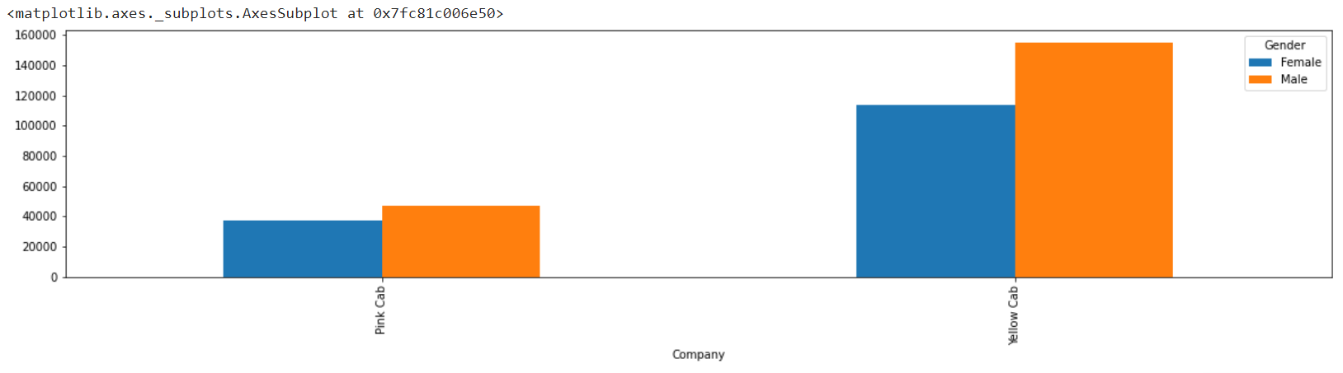
Profit Analysis
Gender Analysis
The number of male customers is more for both the companies than their counterparts.

Slide 14
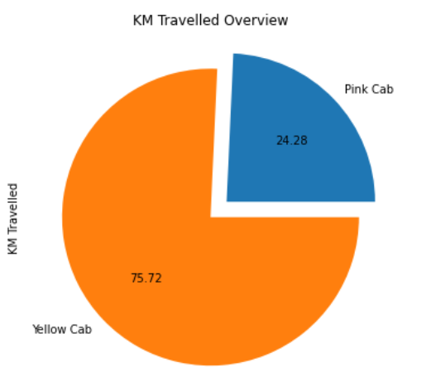
Profit Analysis
Distance Analysis
The KM travelled by yellow cab is more
Pink cab shares only 25% of the distance travelled

Slide 15
Profit Analysis
Recommendations
We have analysed the data and compared various factors as below.
Customer Count: Yellow cab has almost 3 times the customers as that of the pink cab
Profit Analysis: Pink cab shares only 12% of the profit, the rest is taken by Yellow cab.
Travel Frequency: Both the companies show an increase in the usage over the months and years, however, the rate of increase of yellow cabs is more than that of the pink cab.
Gender: Male customers are more for both the companies
Cost & Price Analysis: The price charged by the yellow cab is slightly lower for women to encourage them to use cab more. However, no such initiative from the pink cab.
Age Group: Age group of 18-40 used and spent more on cabs, while that of 41-65 spent less than half. But this pattern is fairly the same with both the groups.
On the basis of the above points, I will suggest the Yellow cab for the Investment.

Slide 16
Recommendations
We have evaluated both the cab companies on following points and found Yellow cab better than Pink cab:
Customer Reach : Yellow cab has higher customer reach in 25 cities while Pink cab has higher customer reach in 4 cities. We have also observed that Yellow cab is doing good in covering other cab users as compared to Pink cab.
Customer Retention: We have analyzed this in two segments : at least 5 drive and at least 10 drive with the same cab company. And we found that Yellow cab is doing far better than Pink cab in both these segments.
Age wise Reach : Yellow cab has customer in all age group and it’s been observed that it’s even popular in 60+ age group as equally as its in 18-25 age group.
Average Profit per KM: Yellow cab’s average profit per KM is almost three times the average profit per KM of the Pink cab.
Income wise Reach :Both the cabs are very popular in high and medium income class but here also Yellow cab is performing better than Pink cab in offering their services to all the three income class group (low, medium and high)
Ride count and Profit Forecasting : Both the companies are facing loss in the profit and no. of ride. Yellow cab’s forecasted profit loss is around 1.83% while Pink cab’s loss in 3.1%.Pink cab is facing more loss even when its forecasted no of ride loss is lesser than Yellow cab.
On the basis of above point , we will recommend Yellow cab for investment.

Slide 17
Thank You

