Slide 1

Hotel Booking Analysis Dashboard
Understanding booking cancellation patterns
Presented by Group 3:
Aiswarya Lakshmi (0856361)
Anju George (0830725)
Kateryna Podopryhora (0864222)
Roshan Joseph (0852827)

Slide 2
INTRODUCTION
OBJECTIVE:
1
Identify Key Factors: Determine the factors that significantly influence booking cancellations.
Visualization : Using PowerBI, present the factors impacting the ‘is_canceled’ variable in a comprehensible and clear manner.
2
Deriving Insights: Understanding trends and patterns in hotel bookings, specifically focusing on whether customers cancel their reservations.
3

Slide 3

DATA OVERVIEW
DATASET:
The dataset contains a diverse range of features , including booking details, customer information and reservation specifics for two types of Hotel, City hotel and Resort hotel.
Data spans across the years 2015, 2016 and 2017.
Dataset consists of 119390 rows and 36 variables.
Dependent variable : ‘is_canceled’ indicates whether the booking was cancelled(1) or not(0).

Slide 4





TOOLS WE USED
MS Excel
Prototypes or mock-ups of dashboards.
Created Pivot charts to group and summarize data.
PowerBI
To gain insights, trends and patterns.
Created interactive Dashboards.
Power Query
Cleaning, Transformations as part of data pre-processing.
Microsoft Azure ML studio
Constructed a decision tree and predict its accuracy.

Slide 5
VARIABLES UNDER CONSIDERATION:
hotel: Type of Hotel (Categorical).
lead_time: Number of days between booking date and arrival date.(Numeric).
arrival_date_year: The year of Arrival date-2015,2016,2017 (Numeric).
arrival_date_month: Month of Arrival date.(Categorical).
reserved_room_type: The Type of Room reserved.(Marked by letters)
country: Country of customer.
market_segment: Market segment designation. In categories, the term "TA" means "Travel Agents" and "TO" means "Tour Operators“.
distribution_channel: Booking distribution channel. The term "TA" means "Travel Agents" and "TO" means "Tour Operators“.
is_repeated_guest: Value indicating if the booking name was from a repeated guest (1) or not (0).
days_in_waiting_list: Number of days the booking was in the waiting list before it was confirmed to the customer.
customer_type: Type of booking.
adr: Average Daily Rate as defined by dividing the sum of all lodging transactions by the total number of staying nights.

Slide 6

DATA CLEANING AND TRANSFORMATION
For an effective data analysis project data cleaning is a crucial step
Data cleaning helps to fix the errors and inconsistencies of data
Makes the data suitable to draw valuable inferences for effective decision making
Here we have done a few data cleaning and transformation steps to make data appropriate for analysis
Dropped unnecessary columns
The columns with data that does not influence the target variable in any significant manner
Unnecessary columns with variables that contain the personal information of customers
The columns such as name, credit card, phone number are removed
Changed data types
Changed datatype of ‘adr’ variable from decimal to whole number
Helps in improving data interpretability and also suitable for visualizations

Slide 7
Deleted outliers
Deleted unidentified categories from the columns ‘distribution_channel’ and ‘market_segment’
Certain grouping of variables are done
Average adr for hotel is found out for both resort hotel and city hotel
Average adr monthly is also found out which helps to obtain average adr for each arrival month
Grouping months into seasons to track season trends which can be more influential
Added new columns
Lead time categorical column is added by classifying the lead time into different categories
Month number column is added so that months can be sorted chronologically
Assignment_to_waiting_list is also added which is a categorical variable
A column named adr_categorical is added based on the column adr which is categorized into low, medium and high
low<=100, medium<=200, high<=350

Slide 8
KEY INSIGHTS FROM THE DATA
More than 60% of the booking are for City Hotel.
Almost 35% of bookings were canceled

Slide 9
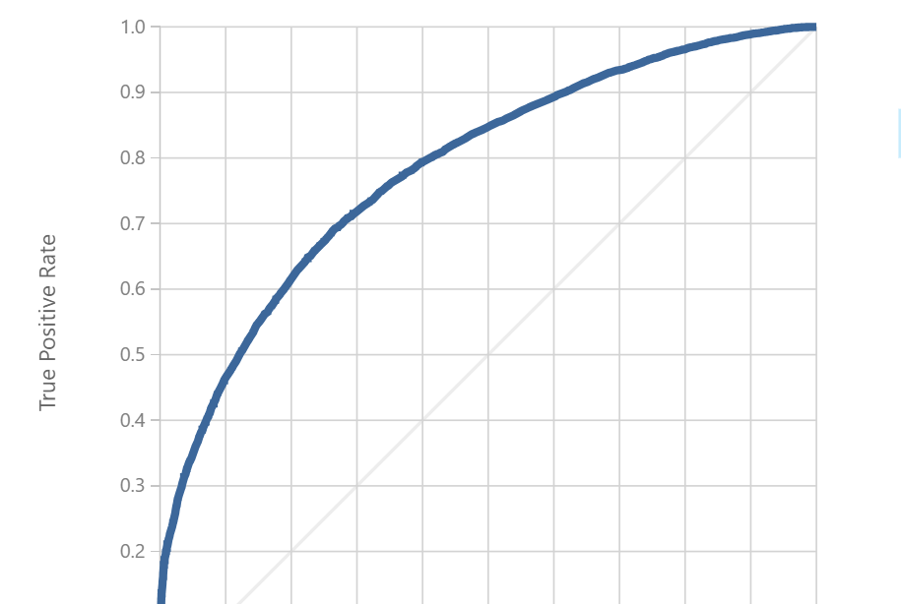
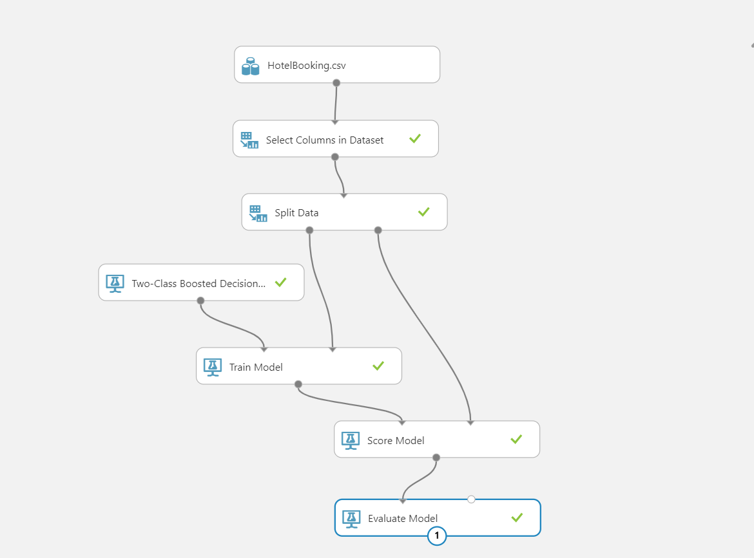
Implementation of Decision Tree

Slide 10
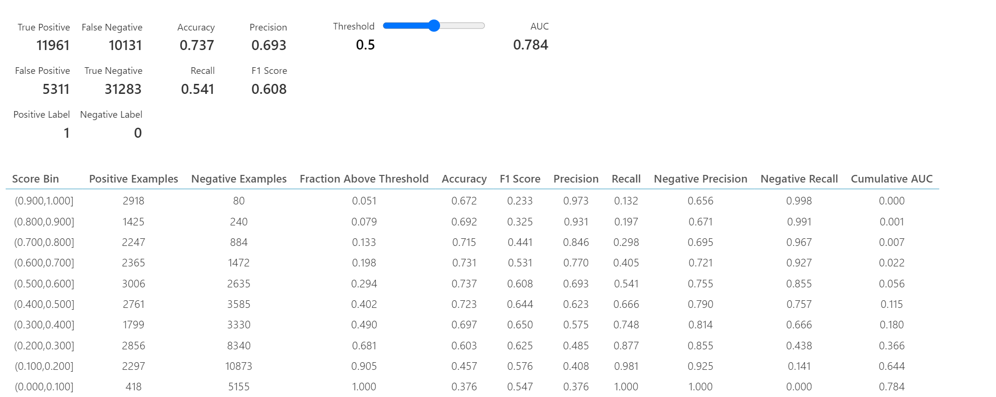

Slide 11
CONCLUSION
One of the four reservations is cancelled.
Majority of the Bookings are through Online platforms.
Most of the customers are new. Only few were preferred for revisiting the hotel.
The busiest months are July and August. Least bookings were made at the start and end of the year.
Average cancellation is higher for rooms in waiting list.
We made a predictive model using Decision tree to predict whether a customer will cancel the booking or not.

Slide 12
REFERENCES
PowerBI essential Training, LinkedIn Learning.
https://www.stat.cmu.edu/capstoneresearch/spring2022/315files_s22/team21.html

