Slide 1

ANALYSIS OF YOUTUBE SONGS
Comprehensive Analysis using Tableau
ANJU GEORGE

Slide 2
INTRODUCTION
Data Cleaning and Preparation: Ensure data accuracy by handling missing values and converting data types appropriately.
Exploratory Data Analysis (EDA): Identify patterns and trends in views, likes, and comments to understand user engagement.
Identify Key Factors: Determine the factors that significantly influence View counts.
Visualization : Using Tableau, present the factors impacting the ‘View count’ variable in a comprehensible and clear manner.

Slide 3
DATA OVERVIEW
Dataset Composition: Includes video ID, channel title, video title, description, tags, published date, view count, like count, favorite count, comment count, duration, definition, and captions.
Time Range: Spans multiple years, allowing analysis of trends and changes in YouTube song video performance over time.
Volume: Contains a significant number of entries, providing a robust dataset for analysis.
Diverse Metrics: Captures various user engagement and content characteristics for comprehensive video performance analysis.

Slide 4
TOOLS WE USED
MS Excel: Prototypes or mock-ups of dashboards. Created Pivot charts to group and summarize data.
Tableau: To gain insights, trends, and patterns. Created interactive Dashboards.
Google ColLab: For exploratory data analysis (EDA).

Slide 5

DATA CLEANING AND TRANSFORMATION
Removed rows with null values in the description column.
Changed data type of "publishedAt" to datetime.
Split "duration" column into minutes and seconds.
Filtered relevant columns for analysis.

Slide 6
EXPLORATORY DATA ANALYSIS
Correlation Analysis:
Like count and comment count are positively correlated with view count.
Higher engagement (likes and comments) generally leads to more views.
Temporal Trends:
View count peaked in the year 2018.
Significant increase in views during 2017-2018, followed by a decline.

Slide 7
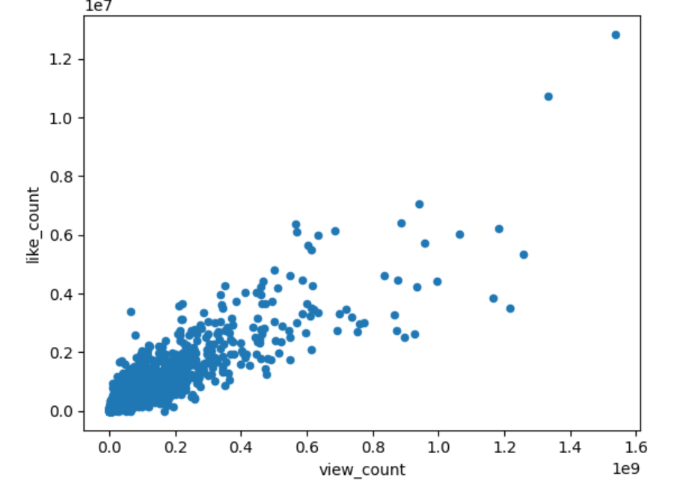
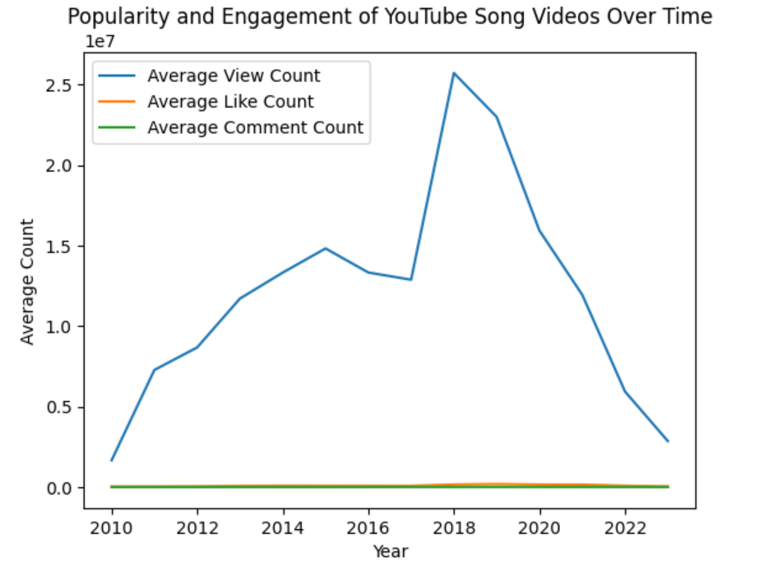
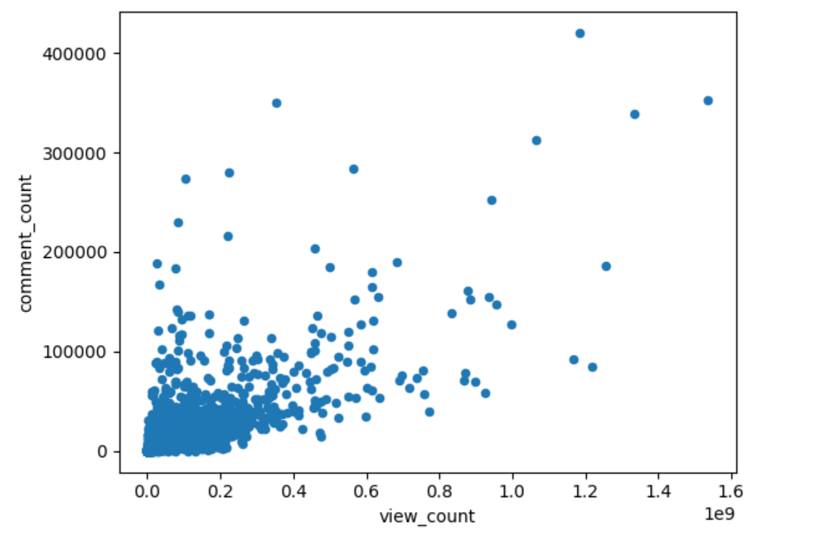

Slide 8
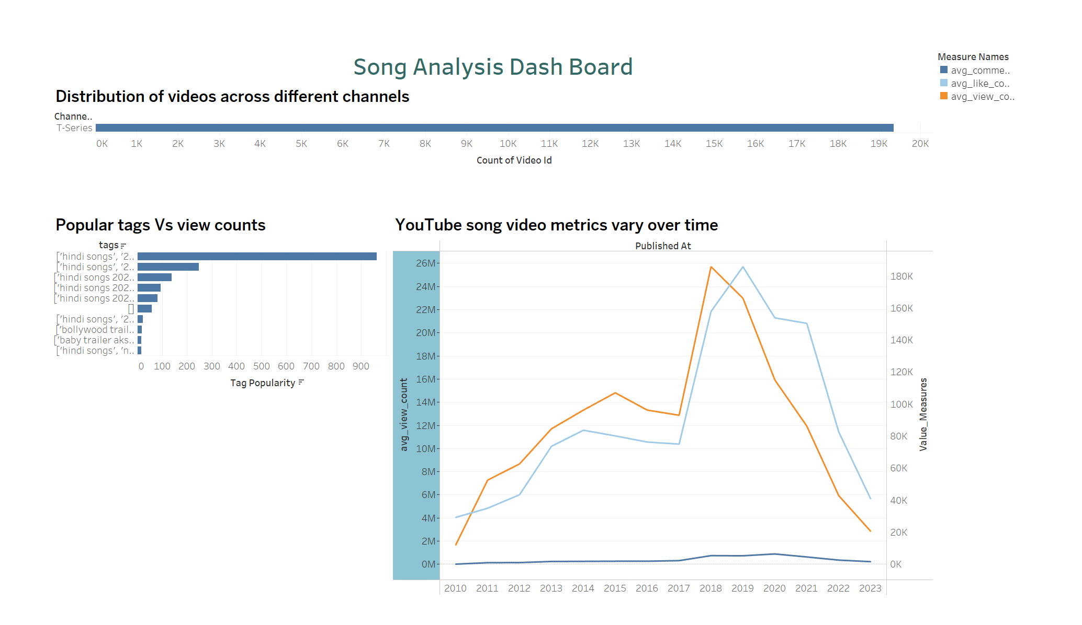
DASHBOARD

Slide 9
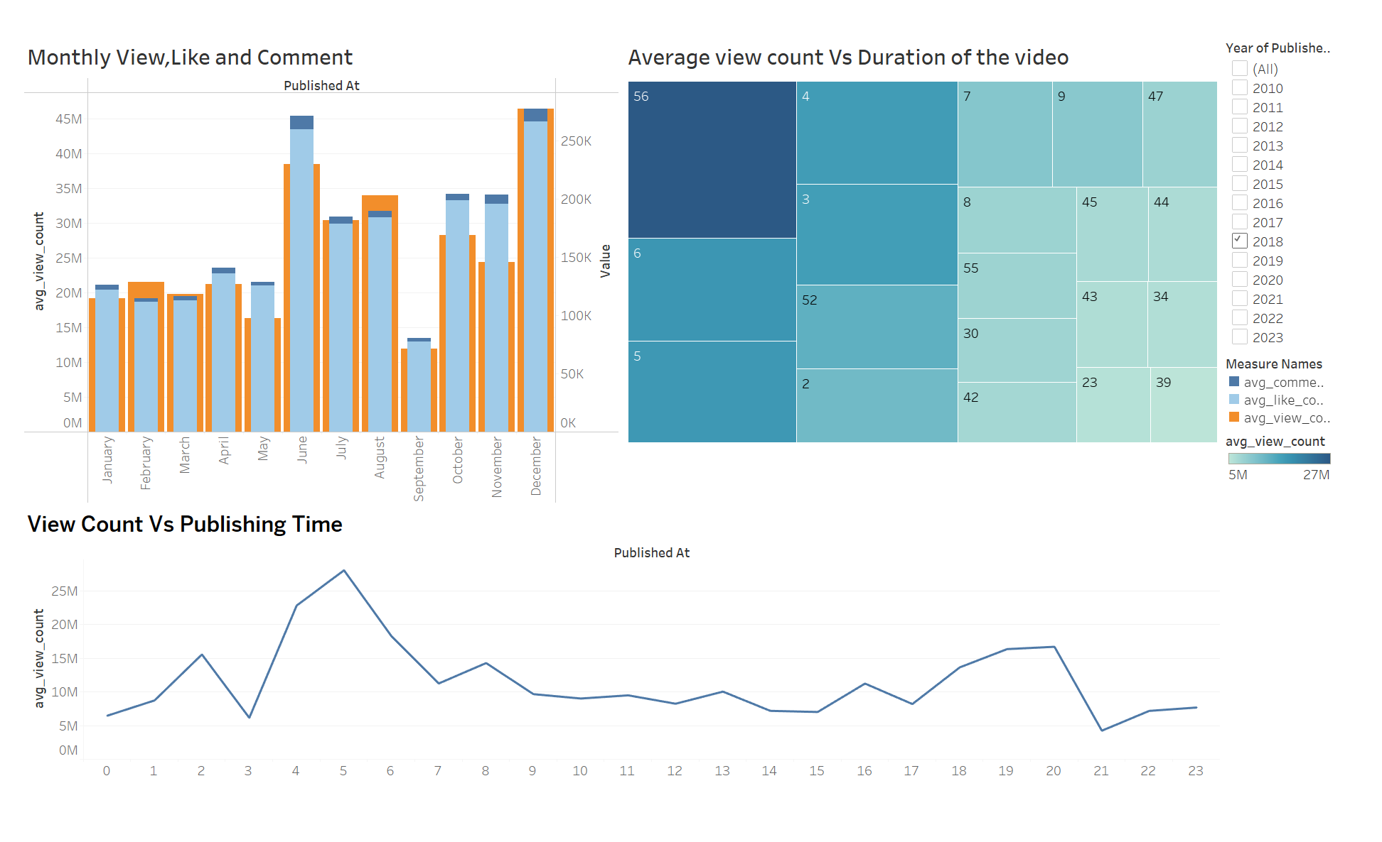

Slide 10
CHANNEL AND CONTENT ANALYSIS REPORTS
Monthly View, Like, and Comment Analysis:
December has the highest average view count, indicating a potential seasonal trend in 2018.
May and June also show high engagement, possibly due to new music releases or events.
Average View Count vs Duration:
Videos with durations around 4-5 minutes tend to have higher average view counts.
Extremely short or long videos tend to have lower engagement.
View Count vs Publishing Time:
There is a significant peak in view counts for videos published around 5 AM.
Engagement surge significantly during early morning hours.
Tag Analysis:
Tags related to 'hindi songs' are the most popular and correlate with high view counts.
Specific tags such as 'bollywood trailer' also show high popularity.

Slide 11
Temporal Trends and User Engagement Insights
Temporal Trends:
A notable increase in average view count and engagement from 2016 to 2019.
A decline in recent years, possibly due to changes in user behavior or content strategy.
User Engagement Insights:
Like count and comment count are positively correlated with view count.
View count is maximum in the year 2018, indicating a peak in content popularity and engagement during that period.

Slide 12

CONCLUSION
Actionable Recommendations:
Implement strategies to optimize video content and publishing times.
Use data-driven insights to enhance user engagement and video performance.

Slide 13

THANK YOU!

