Slide 1
Sampling
Course Instructor:
Dr. Anjula Mehto
Assistant Professor
Thapar Institute of Engineering and Technology,
Patiala, Punjab
Email-anjula.mehto@thapar.edu

Slide 2
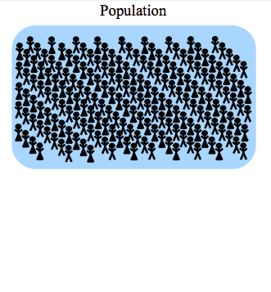
Sampling

Slide 3
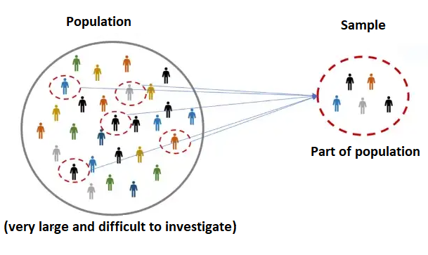
Sampling

Slide 4
Sampling
A process used in statistical analysis.
Process of selecting a portion or subset (sample) of the population to represent the entire population.
Sample- A representative subset of a population.
Goal of sampling is to create a representative and efficient subset that preserves the characteristics of the overall dataset.

Slide 5

Examples
Find the average height of all adults in this class.
Find the average height of all adult females in Patiala.

Slide 6

Examples
Surveys and Opinion Polls:

Slide 7
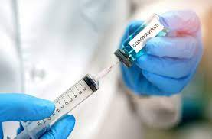
Examples
Medical Studies:
Sampling a group of patients to study the effectiveness of a new treatment.

Slide 8
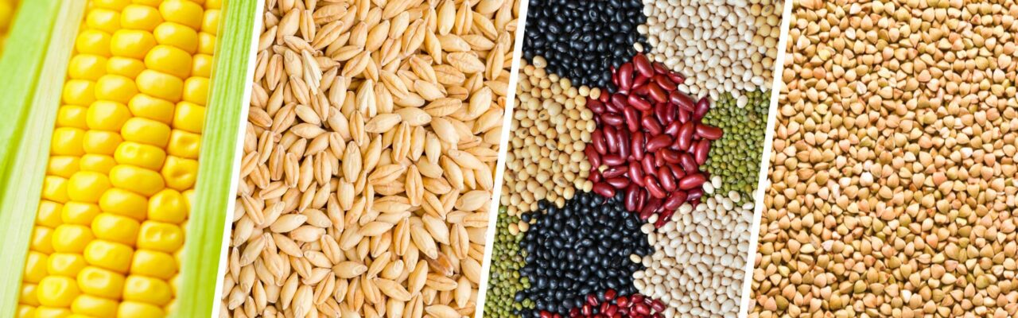
Examples
Agriculture:
Sampling crops to determine their yield and quality.

Slide 9
Steps Involved in Sampling
Define target population
Sampling frame
Sampling method
Sample size
Collect the required data

Slide 10
Steps Involved in Sampling
1. Define Target Population:
  Based on the objective of the study, clearly target the population.
  Example- For regional election, the target population would be all people who are domiciled in the region and eligible to vote.

Slide 11
Steps Involved in Sampling
2. Define Sampling Frame:
  A subset of the population that defines the pool from which a sample to be selected.
  Example- The sampling frame would consist of all the people from the population who are in the state and can participate in the study.
3. Select Sampling Technique:
  Select an appropriate sampling technique.
  Which sampling technique to use? (discuss later )

Slide 12
Steps Involved in Sampling
4. Determine Sample Size:
  Refers to the number of items or elements selected from sample frame.
  If the sample size is too small, the sample may not accurately represent the population.
  If the sample size is too large, it can be inefficient and time-consuming to collect and analyze the data.

Slide 13
Steps Involved in Sampling
The appropriate sample size depends on factors such as:
  The size of the population
  The confidence level and
  The margin of error
Confidence level-: The probability that a sample is true for the entire population from which it was sampled.
Commonly expressed as a percentage and represents the likelihood that a parameter (such as a mean, proportion, or regression coefficient) falls within a specified range.

Slide 14
Steps Involved in Sampling
  The margin of error-: The margin of error is a range of values above and below the actual results from a survey.
  If confidence level is 95% then margin of error is 5%.

Slide 15
Steps Involved in Sampling
5. Data collection:
  Once the sample has been selected, the next step is to collect data from the sample.

Slide 16
Types of Sampling
Probabilistic Sampling
Non-probabilistic Sampling
Probabilistic | Non-probabilistic
Individuals are selected randomly. | Selection is based on accessibility or the researcher's judgment
Bias: Probability sampling is less prone to bias due to its random nature. | Bias: Non-probability sampling can be more prone to bias.

Slide 17
Probabilistic Sampling
Simple Random Sampling
Systematic Sampling
Stratified Sampling
Cluster Sampling
Cross-Validation
Bootstrap Sampling

Slide 18
Non-probabilistic Sampling
Type | Common Use
Convenience | Classroom surveys
Purposive | Expert studies
Quota | Market research
Snowball | Hidden populations
Volunteer | Online polls
Consecutive | Medical research

Slide 19
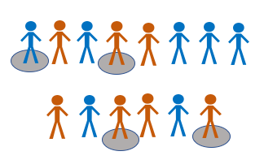
Simple Random Sampling
Pick the sample, at random.
Applicable when population is small, and homogeneous.
Every participant has an equal probability of being selected
Example- I want to ask a question in this class, then I can randomly pick any student

Slide 20
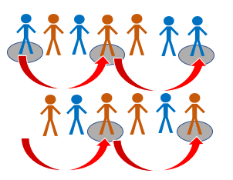
Systematic Sampling
The samples are chosen at regular intervals.
A random start and then proceeds with the selection of every ‘kth’ element.
Example- Select every 10th name from the telephone directory.

Slide 21
Stratified Sampling
The population is divided into subgroups or strata based on a certain characteristic or criterion (age groups, ethnic origin, and gender).
Each stratum is then sampled as an independent sub-population.
Individual elements from a sub-population can be randomly selected.

Slide 22
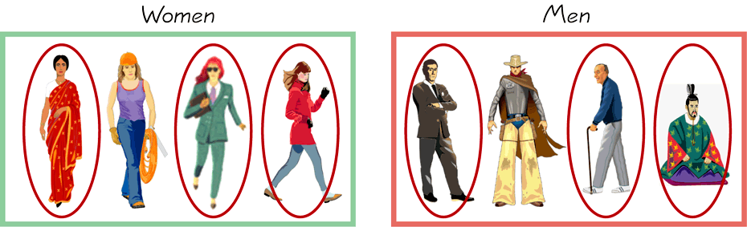
Stratified Sampling
Example-
If a company has 500 male employees and 100 female employees.
To ensure that the sample reflects the gender as well, use stratified sampling

Slide 23
Stratified Sampling
  Requires prior knowledge
  Can be complex
  Can be time-consuming

Slide 24
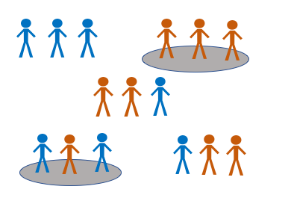
Cluster Sampling
The entire population is divided into smaller groups or clusters, and then a random sample of these clusters is selected.
The sample size is then determined based on the number of clusters selected.

Slide 25
Example
Sample a population of 10,000 schools to estimate the average number of students per school.
Divide the schools into smaller groups or clusters based on geographical locations, for example, schools in each state.
Now, instead of visiting all 10,000 schools, select a random sample of 5 states, and visit all the schools within those 5 states.
The data collected from the schools within the 5 selected states will then be used to estimate the average number of students per school for the entire population of 10,000 schools.

Slide 26
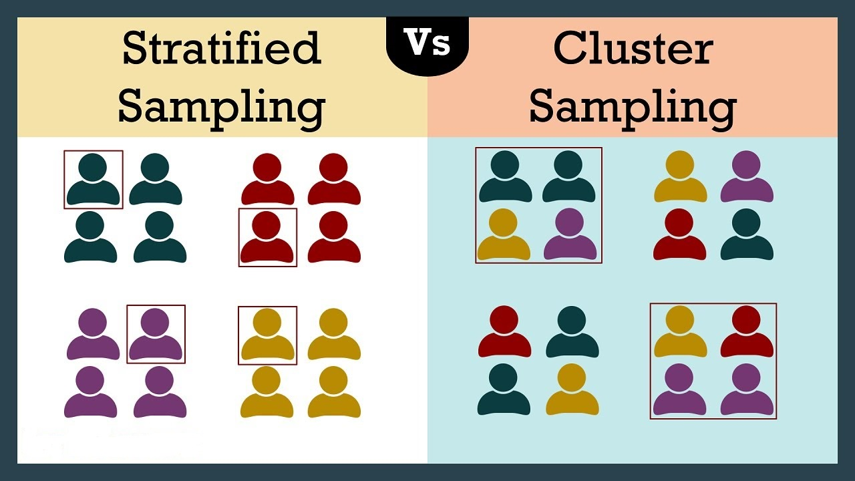
Cluster Vs Stratified Sampling
The main difference between these two methods is how the sample is selected.

Slide 27
Cross-Validation Sampling
Dividing the dataset into multiple folds, training the model on some folds, and testing it on others.
This helps in assessing how well the model generalizes to new data.

Slide 28
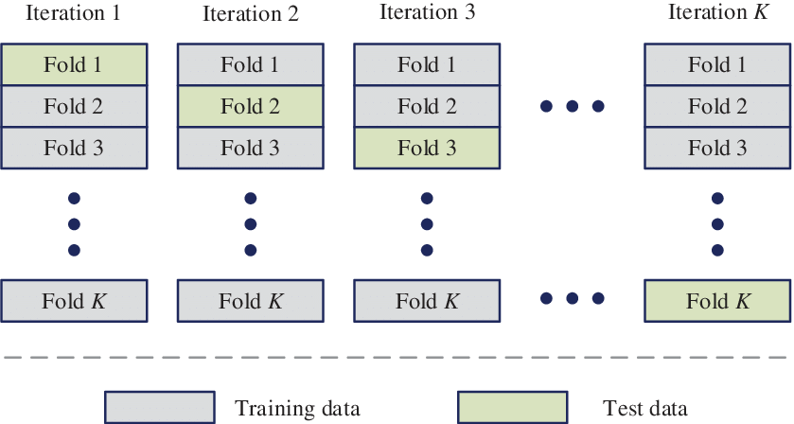
K-Fold Cross-Validation
K-fold cross-validation

Slide 29
K-fold Cross-Validation
The original dataset is divided into ‘k’ subsets or folds of roughly equal size.
The model is trained on ‘k-1’ folds.
The model is validated on the remaining fold.
This process is repeated ‘k’ times so that each fold is used for validation once.
The average performance across all ‘k’ iterations is used to evaluate the model's overall performance.

Slide 30
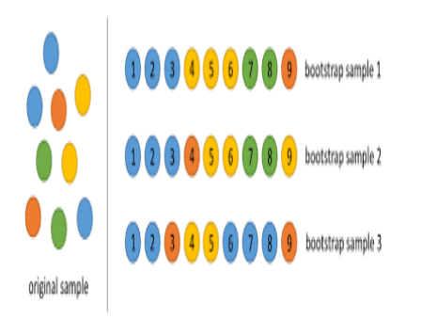
Bootstrap Sampling
It uses the technique of Simple Random Sampling With Replacement (SRSWR).
It randomly picks data instances from the input dataset , with the possibility of the same data instance picked multiple times.

Slide 31
Bootstrap vs Random Sampling
Bootstrap sampling is a resampling technique used for statistical inference and assessing variability.
Simple random sampling is a classic method for obtaining a representative subset from a population for generalization.

Slide 32
Which Sampling Technique to Use ?
Size of the data set:
  Small data sets- Simple random sampling or Systematic Sampling.
  Large data sets- May use a more complex technique like Stratified sampling or Cluster sampling.

Slide 33
Which Sampling Technique to Use ?
Nature of the data:
  For well-defined structured data, Stratified Sampling may be a good choice.
  While for more complex data sets, Cluster or Systematic Sampling may be better.

Slide 34
Which Sampling Technique to Use ?
Cost and feasibility:
Simple random sampling may be the most straightforward and cost-effective.
While more complex techniques like Cluster or Stratified sampling may be more expensive and require more resources.

Slide 35
Why need Sampling?
Reduces computational cost.
Reduces processing time of the entire dataset.
Provides Balance class distribution or treats imbalanced classes.

Slide 36
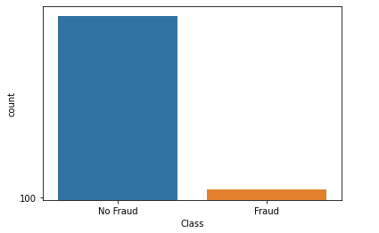
Imbalanced classes
Example: To detect fraudulent credit card transactions.
Suppose your model gives 94% accuracy.

Slide 37
Imbalanced classes
Unfortunately, that accuracy (94%) is misleading:
  All those non-fraudulent transactions, would have “100%” accuracy.
  Those transactions which are fraudulent, would have “0%” accuracy.
  Your overall accuracy would be high simply because the most transaction is not fraudulent.

Slide 38
How to Balance Class Distribution?
Use techniques such as oversampling the minority class or
Use undersampling the majority class.

Slide 39
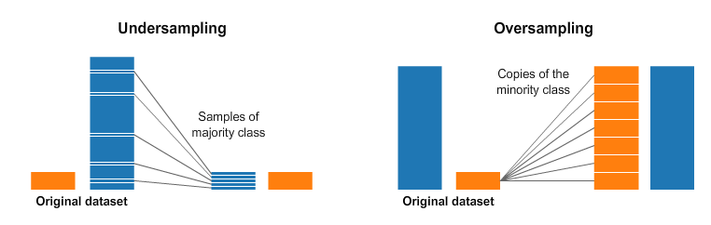
How to Balance Class Distribution?
Undersampling and Oversampling

Slide 40
How to Check Goodness of a Sample?
Central tendency measures:
Describe the center or middle of the sample data.
Common measures of central tendency include the mean, median, and mode.

Slide 41
How to Check Goodness of a Sample?
Central tendency measures:
Example: Dataset- {1, 1, 1, 2, 2}
The mean: (1 + 1 + 1 + 2 + 2) / 5 = 7 / 5 = 1.4
The mode: 1
The median: 1
Mean, Median, and Mode are similar, it indicates that the sample is representative of the population

Slide 42
How to Check Goodness of a Sample?
Dispersion measures:
Describe how spread out the sample data is.
Common measures of dispersion include range, variance, and standard deviation.

Slide 43
How to Check Goodness of a Sample?
Dispersion measures:
Example: Dataset- {1, 1, 1, 2, 2}
The range- 1
The variance: 1.6
The standard deviation: 0.6
The range, variance, and standard deviation are small, it indicates that the sample is tightly grouped and has a good dispersion
Range=Maximum value−Minimum value

Slide 44
How to Check Goodness of a Sample?
Normality tests:
Checks whether the sample data follows a normal distribution.
Common normality tests include the Shapiro-Wilk test, and the Anderson-Darling test.
Both the tests can be implemented using the scipy.stats library in Python.

Slide 45
How to Check Goodness of a Sample?
On the basis of type of dataset
Numerical data:
  Can use measures of central tendency, dispersion, and normality.
Categorical data:
  Can use measures such as relative frequencies or proportions.

Slide 46
How to Check Goodness of a Sample?
On the basis of type of dataset:
Time series data:
  Can use measures such as autocorrelation and partial autocorrelation.
  statsmodels library in Python provides functions to calculate these measures.
  Autocorrelation- Degree of correlation of the same variables between two successive time intervals.

Slide 47
How to Check Goodness of a Sample?
On the basis of type of dataset:
Image or multimedia data:
  Can use measures such as image quality metrics, such as mean squared error or structural similarity index.
  scikit-image library in Python provides functions to calculate these metrics.

Slide 48
How to Check Goodness of a Sample?
1. Suppose there is a dataset
[3, 1, 6, 2, 4, 4, 2, 0, 1, 6, 4, 6, 4, 5, 9, 6, 8, 9, 7, 7] with four samples: [6, 2, 2, 4, 9], [7, 2, 8, 2, 9], [7, 8, 9, 5, 4], [1, 2, 0, 1, 3], Which one is a good sample?)

Slide 49
How to Check Goodness of a Sample?
Range- Difference between the largest and smallest values.
Variance = (1 / (n - 1)) * ∑(x_i - x̄)^2
  where
  x_i represents each individual data point,
  x̄ represents the sample mean,
  n data points in the sample
Standard Deviation- The square root of the variance

Slide 50
How to Check Goodness of a Sample?
Samples 1: [6, 2, 2, 4, 9]
Sample Mean: 4.6
Sample Median: 4.0
Sample Mode: 2
Sample Range: 7
Sample Variance: 7.0
Sample Standard Deviation: 2.7

Slide 51
How to Check Goodness of a Sample?
Samples 2: [7, 2, 8, 2, 9]
Sample Mean: 5.6
Sample Median: 7.0
Sample Mode: 2
Sample Range: 7
Sample Variance: 9.0
Sample Standard Deviation: 3.0

Slide 52
How to Check Goodness of a Sample?
Samples 3: [7, 8, 9, 5, 4]
Sample Mean: 6.6
Sample Median: 7.0
Sample Mode: 4
Sample Range: 5
Sample Variance: 3.44
Sample Standard Deviation: 1.8

Slide 53
How to Check Goodness of a Sample?
Samples 4: [1,2,0,1,3]
Sample Mean: 1.4
Sample Median: 1.0
Sample Mode: 1
Sample Range: 3
Sample Variance: 1.04
Sample Standard Deviation: 1.0

Slide 54
How to Check Goodness of a Sample?
Answer- Sample 4 is good.

Slide 55
How to Check Goodness of a Sample?
2. Data set [80, 41, 95, 53, 82, 33, 84, 32, 7, 27, 30, 23, 40, 20, 44, 16, 19, 28, 21, 97] with 4 samples [16, 28, 82, 80, 97], [30, 53, 84, 33, 97], [19, 7, 41, 21, 28], [7, 19, 80, 53, 27]. Which one is good?

Slide 56
How to Check Goodness of a Sample?
Sample 1
Sample Mean: 60.6, Sample Median: 80.0 Sample Mode: 16, Sample Range: 81, Sample Variance: 1042.24, Sample Standard Deviation: 32.2
Sample-2
Sample Mean: 59.4, Sample Median: 53.0, Sample Mode: 30, Sample Range: 67, Sample Variance: 724.24, Sample Standard Deviation: 26.91

Slide 57
How to Check Goodness of a Sample?
Sample 3
Sample Mean: 23.2, Sample Median: 21.0, Sample Mode: 7, Sample Range: 34, Sample Variance: 124.96, Sample Standard Deviation: 11.17
Sample-4
Sample Mean: 37.2, Sample Median: 27.0, Sample Mode: 7, Sample Range: 73, Sample Variance: 685.76, Sample Standard Deviation: 26.18

Slide 58
Calculate Size of a Sample
Simple Random Sampling:
n = (Z^2 * p * (1-p)) / E^2
where
n - sample size
Z - Z-score corresponding to the desired level of confidence (e.g. 1.96 for 95% confidence)
p - estimated proportion of the population with a certain characteristic (often assumed to be 0.5)
E - desired margin of error

Slide 59
Calculate Size of a Sample
Stratified Sampling:
n = (Z^2 * p * (1-p)) / (E/S)^2
where
n - sample size,
Z - Z-score corresponding to the desired level of confidence (e.g. 1.96 for 95% confidence)
p - estimated proportion of the population with a certain characteristic (often assumed to be 0.5),
E - desired margin of error
S - number of strata.

Slide 60
Calculate Size of a Sample
Cluster Sampling:
n = (Z^2 * p * (1-p)) / (E/C)^2
where
n - sample size,
Z - Z-score corresponding to the desired level of confidence (e.g. 1.96 for 95% confidence)
p - estimated proportion of the population with a certain characteristic (often assumed to be 0.5),
E - desired margin of error
C - average size of the clusters.

Slide 61
Calculate Size of a Sample
Consider a population of 10,000 individuals, and a desired confidence level of 95% and margin of error of 5%. Determine the sample size.

Slide 62
Calculate Size of a Sample
Consider a population of 10,000 individuals, and a desired confidence level of 95% and margin of error of 5%. Determine the sample size.
Solution- Simple random sampling:
n = (Z^2 * p * (1-p)) / E^2
n = (1.96^2 * 0.5 * (1 - 0.5)) / (0.05^2) = 384.16
n=384.16
n=384

Slide 63
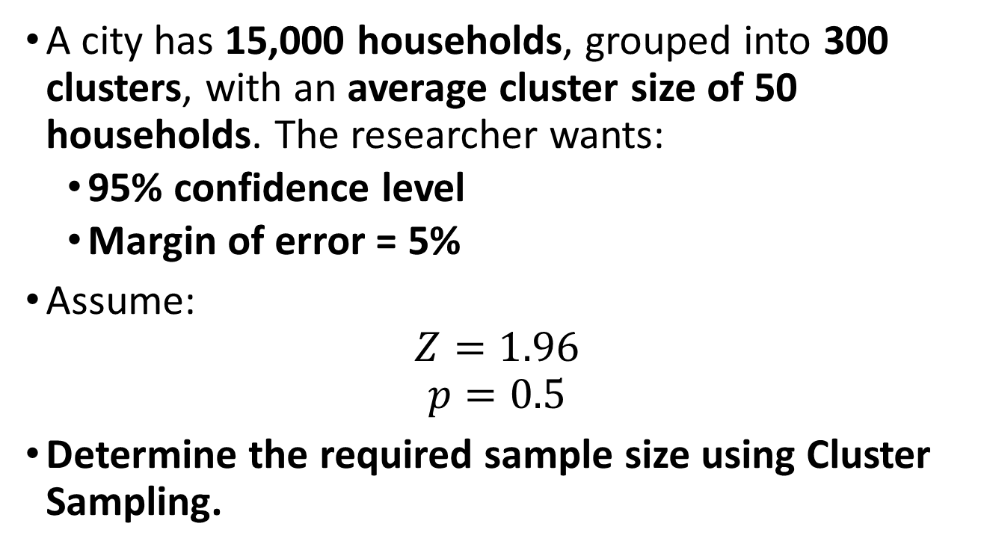
Question-2
A city has 15,000 households, grouped into 300 clusters, with an average cluster size of 50 households. The researcher wants:
  95% confidence level
  Margin of error = 5%
Assume:
$$Z=1.96$$
$$p=0.5$$
Determine the required sample size using Cluster Sampling.

Slide 64
Question-3
A university has 8,000 students distributed across 5 departments.To ensure proportional representation, …………..sampling is used. If the confidence level is 95% and margin of error is 5%, calculate the sample size.

