Slide 1
LIBRARY
MANAGEMENT SYSTEM
A simple web application for managing library books
FSD-2 External Lab Project
Name: Syed Waseema Anjum Roll No.: 24KT1A05M7

Slide 2
1. Aim and Project Overview
Aim: To develop a web-based Library Management System to manage book records.
The application allows users to add, view, search, update and delete books.
The frontend sends HTTP requests to an Express.js backend.
Book records are stored temporarily in a JavaScript array; no external database is connected.
FSD-2 | Library Management System
2

Slide 3
2. Technologies Used
HTML
CSS
JavaScript
Creates the structure of the webpage.
Styles the page, forms, buttons and table.
Handles user actions and frontend requests.
Node.js
Express.js
Runs JavaScript on the server.
Provides routes and REST API endpoints.
Development tools: Visual Studio Code, Git Bash and a web browser.
FSD-2 | Library Management System
3

Slide 4
3. System Architecture and Working
User
Frontend
Express API
Book Array
Enters book details
HTML + JavaScript
Handles HTTP request
Temporary in-memory data
The server sends a JSON response back to the frontend, which refreshes the book table.
Run command: node server.js | Browser: http://localhost:5000
FSD-2 | Library Management System
4

Slide 5
4. Main Features and CRUD Operations
CREATE
Add a new book using its title and author.
POST
READ
Retrieve and display all books.
GET
UPDATE
Modify the title or author of a selected book.
PUT
DELETE
Remove a selected book from the list.
DELETE
Search is performed on the displayed book titles in the frontend.
FSD-2 | Library Management System
5

Slide 6
5. Important Express.js Code
app.use(cors());
app.use(express.json());
// GET - display books
app.get("/books", (req, res) => {
res.json(books);
});
// POST - add a book
app.post("/books", (req, res) => {
books.push(req.body);
res.json(books);
});
// Server start
app.listen(5000, () => {
console.log("Server running on port 5000");
});
Remember the four routes:
GET – Read
POST – Create
PUT – Update
DELETE – Delete
FSD-2 | Library Management System
6

Slide 7
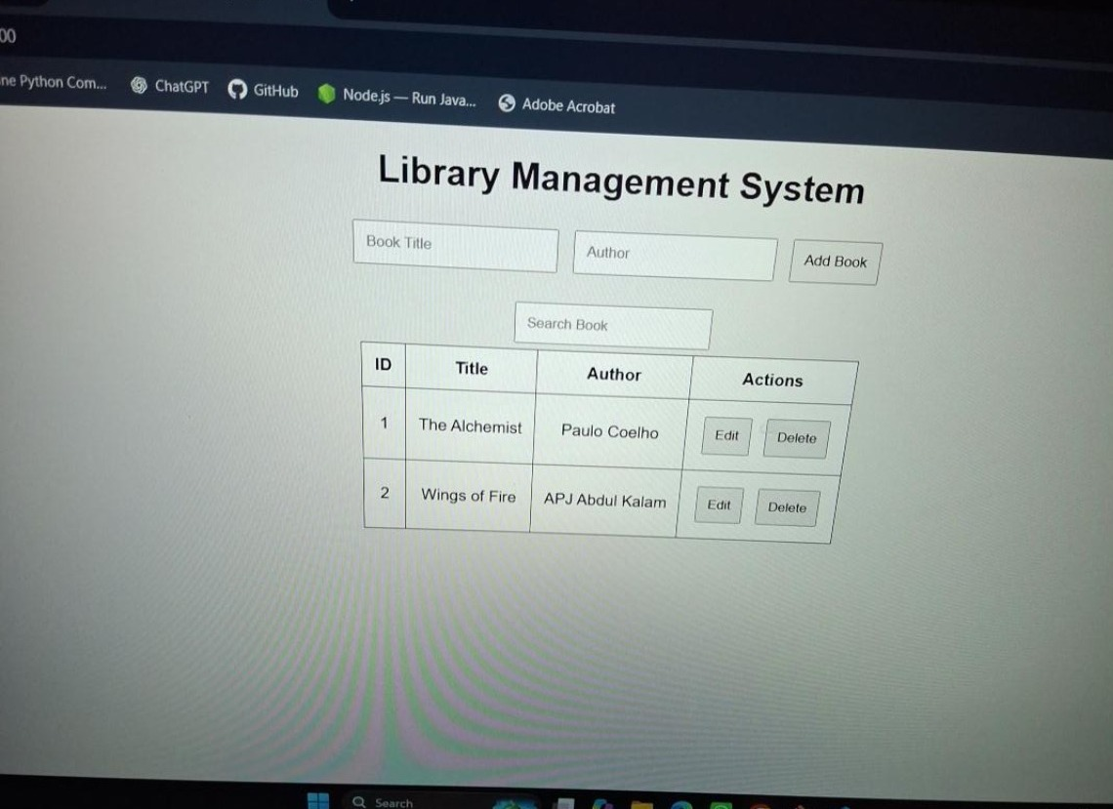
6. Executed Output
Application opened successfully at http://localhost:5000
FSD-2 | Library Management System
7

Slide 8
7. Conclusion
The Library Management System was developed using HTML, CSS, JavaScript, Node.js and Express.js.
It demonstrates REST API routing and the four CRUD operations.
The application can add, display, search, update and delete book records.
The current version uses temporary in-memory storage and does not require a database.
THANK YOU
FSD-2 | Library Management System
8

