Slide 1


INTELLIGENT MEDICATION FOR A HEALTHIER TOMORROW
BATCH NO: 13
Mehattar Anjum B Jhansi Reddy Supraja Asthanaditta
Roll no:219X1A3320 Roll no:219X1A3303 Roll no:219X1A3301
Under the guidance of
B. Sreedhar M.Tech.,(Ph.D)
Assistant Professor
Department of Emerging Technologies in Computer Science
G. PULLA REDDY ENGINEERING COLLEGE(Autonomous):
KURNOOL
(Affiliated to JNTUA, ANANTAPURAMU)

Slide 2
Contents
Abstract
Introduction
Objectives
Literature Survey
Existing System
Proposed System
Algorithms & Planning
Design
Outputs
Paper Publication
References
B-13
DEPT. OF EMERGING TECHNOLOGIES IN COMPUTER SCIENCE
G PULLA REDDY ENGINEERING COLLEGE
2

Slide 3
Abstract
An all-around health platform presented here in the proposal to help the users identify potential health conditions, access relevant advice on medication, and, accordingly, manage their overall well-being effectively. This platform applies machine learning algorithms that help adequately predict the chances of diseases, given when users report symptoms.
The patient portal will also be provided- administered as a user-friendly point of access for secure medical history storage, medication tracking, personalized reminders, and health goal management. This site further empowers user engagement as well as improves medication adherence with functionalities that track intake of medication and patterns of adherence.
It also integrates local pharmacies to check medication availability. The integration of both functionalities should enable people to take a more active role in healthcare, which might lead to improved medication adherence and outcomes generally in healthcare.
B-13
DEPT. OF EMERGING TECHNOLOGIES IN COMPUTER SCIENCE
G PULLA REDDY ENGINEERING COLLEGE
3

Slide 4
PROBLEM STATEMENT
The problem statement for the proposed project is to improve the accessibility, accuracy, and efficiency of healthcare by developing a machine learning-based disease prediction and drug recommendation system.This system aims to address the challenges faced by patients in accessing timely and accurate healthcare information, especially in rural areas where medical experts may be scarce.
B-13
DEPT. OF EMERGING TECHNOLOGIES IN COMPUTER SCIENCE
G PULLA REDDY ENGINEERING COLLEGE
4

Slide 5
INTRODUCTION
A vast number of people rely on the internet for health advice, with about 60% of adults reporting
searching for healthcare topics online.
This system is meant to fill that gap through recommending the right medication for the user, based on the symptoms, medical history, and sentiment analysis,thereby improving decision making in health care and reducing prescription errors.
Literature Survey Machine learning (ML) is revolutionizing drug discovery and development as it proffers tools enhancing good decision making in complex, data-driven environments. It has emerged as a successful tool for target verification, predictive biomarker identification, and virtual pathology analysis.
Nevertheless, there are challenges, especially concerning the interpretability and repeatability of ML results, which renders its more practical utility somewhat limited. Further improvements along these lines will allow ML to further facilitate drug discovery while reducing the generally high failure rates in drug development.
B-13
DEPT. OF EMERGING TECHNOLOGIES IN COMPUTER SCIENCE
G PULLA REDDY ENGINEERING COLLEGE
5

Slide 6
OBJECTIVES
Develop a Patient Portal: Create an intuitive platform where users cansecurely store their medical history, track current medications, and receive personalized reminders for medication schedules and refills.
Implement User Interaction Features: Enable functionalities for users to record their medication intake (taken, postponed, or skipped) to improve adherence tracking and personalized recommendations.
Local Pharmacy Integration: Integrate a feature that uses the user’s pincode to suggest nearby medical shops, ensuring easy access to prescribed medications and enhancing patient convenience.
B-13
DEPT. OF EMERGING TECHNOLOGIES IN COMPUTER SCIENCE
G PULLA REDDY ENGINEERING COLLEGE
6

Slide 7
LITERATURE SURVEY
Garcia et al. (2019) focused on developing a drug recommendation system based on natural language processing (NLP), utilizing TF-IDF (Term Frequency-Inverse Document Frequency) and Vader sentiment analysis. By analyzing patient reviews, their system assessed drug effectiveness and side effects, which enabled personalized medication suggestions based on user sentiment analysis and review data.
Chen et al. (2021) conducted sentiment analysis on drug reviews to gauge the effectiveness and side effects reported by users. Their research utilized natural language processing (NLP) techniques to extract insights from reviews, demonstrating that user feedback can significantly inform the decision-making process for prescribing drugs. The study emphasized the relevance of opinion mining in improving patient care and ensuring that healthcare providers are equipped with the most recent patient experiences.
B-13
DEPT. OF EMERGING TECHNOLOGIES IN COMPUTER SCIENCE
G PULLA REDDY ENGINEERING COLLEGE
7

Slide 8
LITERATURE SURVEY
Lee et al. (2023) implemented a recommendation system using the R library “recommenderlab” to provide personalized suggestions for medications based on user ratings and health conditions. Their system demonstrated that automated recommendations can improve patient outcomes by streamlining the medication selection process.
Singh et al. (2024) explored advanced hybrid approaches for enhancing recommendation accuracy in medicine selection. They emphasized the effectiveness of machine learning techniques, particularly how their hybrid recommendation algorithm combines user ratings and contextual data to provide tailored suggestions.
Khan et al. (2022) implemented a drug recommendation system that combines support vector machines (SVM) with a knowledge graph, achieving notable performance improvements in identifying suitable medications based on user history.
B-13
DEPT. OF EMERGING TECHNOLOGIES IN COMPUTER SCIENCE
G PULLA REDDY ENGINEERING COLLEGE
8

Slide 9
EXISTING SYSTEM
In the earlier part, Mohammad Mehedi Hassan et al. developed an existing system CADRE that recommends drugs by using collaborative filtering methods.This system clusters drugs based on specific features and gives top-N prescriptions for their users.However, the above system has several drawbacks such as high computational costs, cold start problems and sparse data.
To address these issues, the tensor decomposition-based cloud approach was implemented and used, which,while offering more efficient and accurate drug recommendations than its predecessors, it had much
to be desired in terms of performance and accuracy.
Unlike most such commercial recommendation systems, the system is going to be a fully functional digital health assistant.
B-13
DEPT. OF EMERGING TECHNOLOGIES IN COMPUTER SCIENCE
G PULLA REDDY ENGINEERING COLLEGE
9

Slide 10
PROPOSED SYSTEM
Comprehensive Medication Management and Recommendation Platform
Objective: Personalized medication recommendations, improved adherence, and enhanced patient engagement.
Key Components:
Patient Portal (medical history, reminders, tracking)
Drug Recommendation System (SVM, TF-IDF algorithms)
Local Pharmacy Integration (location-based, real-time availability)
User Interaction Features (medication tracking, health advice)
Healthcare Professional Portal (electronic prescriptions, monitoring)
This project aims to transform medication management and improve patient outcomes.
B-13
DEPT. OF EMERGING TECHNOLOGIES IN COMPUTER SCIENCE
G PULLA REDDY ENGINEERING COLLEGE
10

Slide 11
ALGORITHMS AND PLANNING
tf idf
Decision Trees provide transparent and interpretable results, allowing clinicians to understand the reasoning behind the recommended medication, to provide personalized medicine based on patient’s genetic profile of symptoms, medical history.
TF-IDF stands for Term Frequency Inverse Document Frequency of records. It can be defined as the calculation of how relevant a word in a series or corpus is to a text. The meaning increases proportionally to the number of times in the text a word appears but is compensated by the word frequency in the corpus (data-set).
Support Vector Machine (SVM) is a powerful machine learning algorithm widely used for both linear and nonlinear classification, as well as regression and outlier detection tasks. SVMs are highly adaptable, making them suitable for various applications such as text classification, image classification, spam detection, handwriting identification, gene expression analysis, face detection, and anomaly detection.
B-13
DEPT. OF EMERGING TECHNOLOGIES IN COMPUTER SCIENCE
11

Slide 12
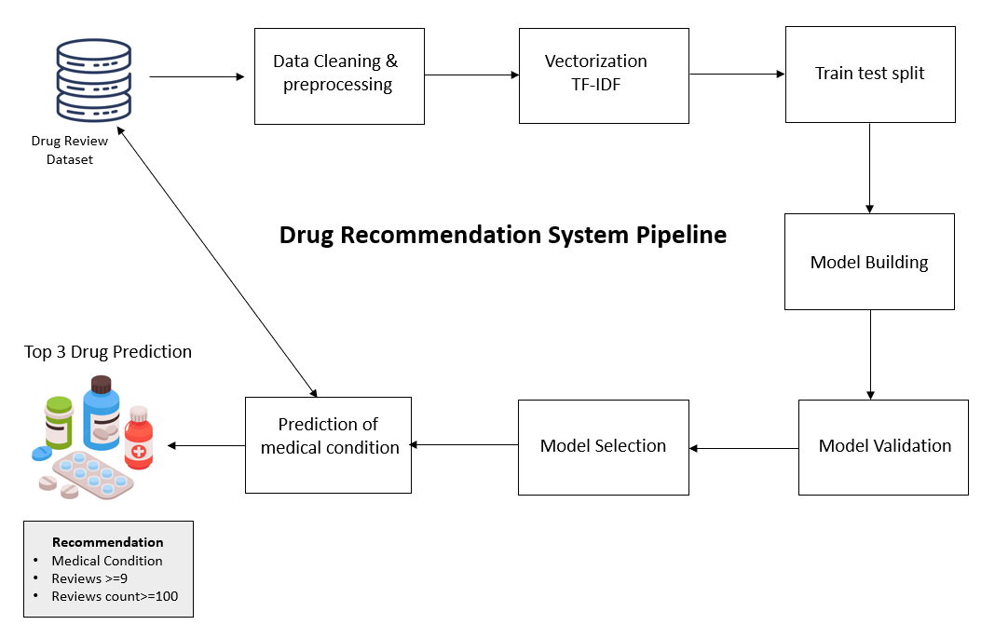
DESIGN

Slide 13
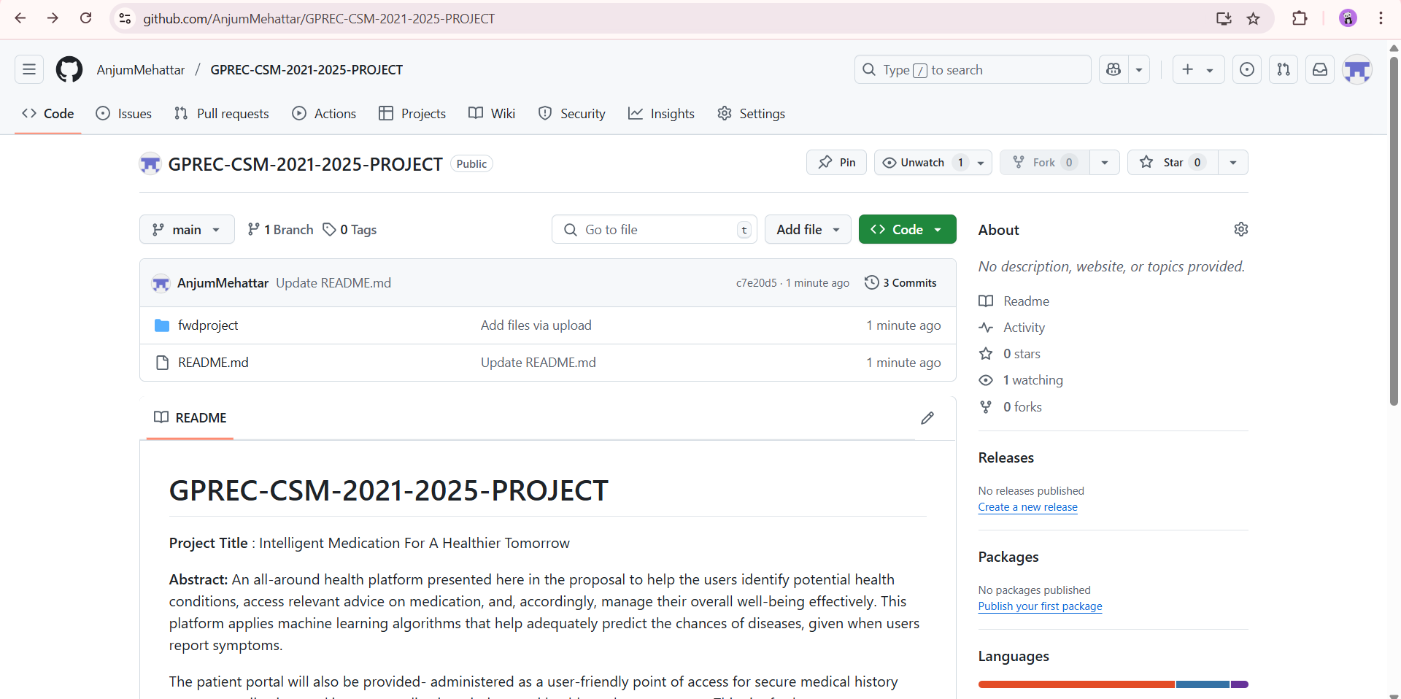
GIT HUB LINKS

Slide 14
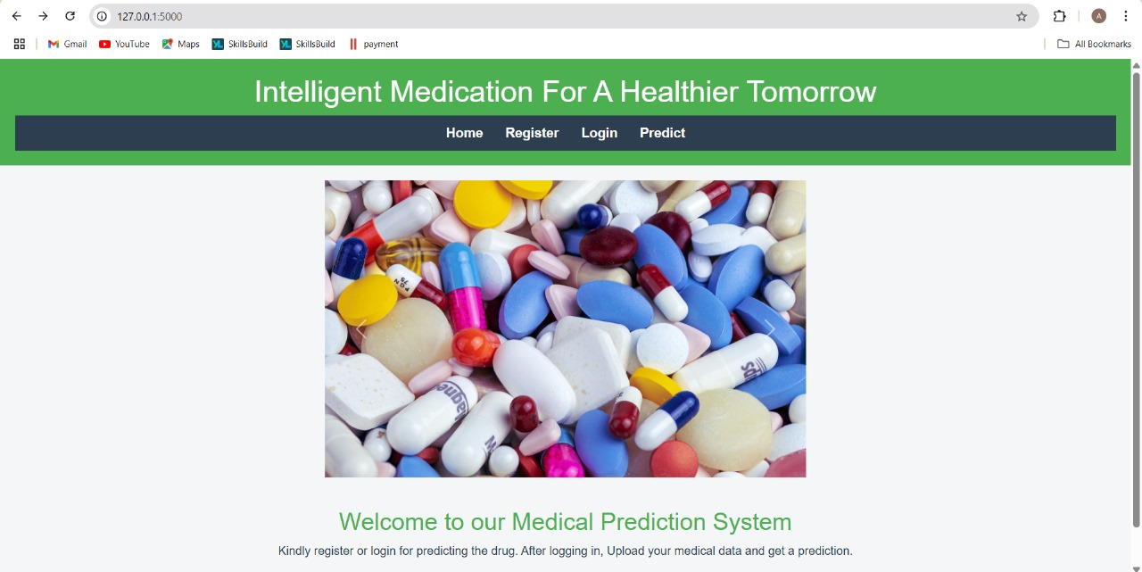

Slide 15
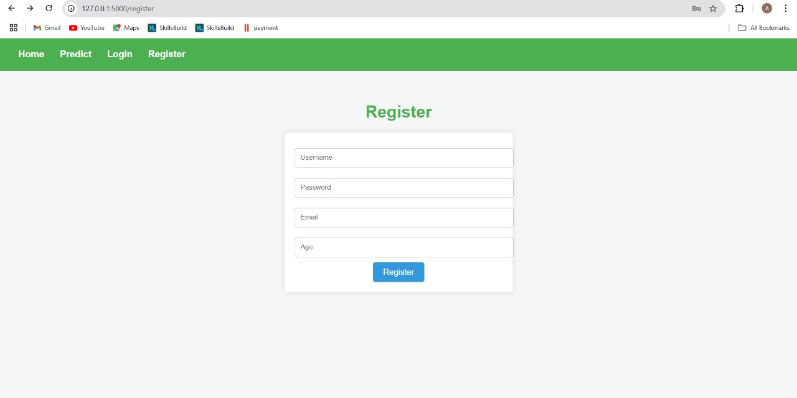

Slide 16
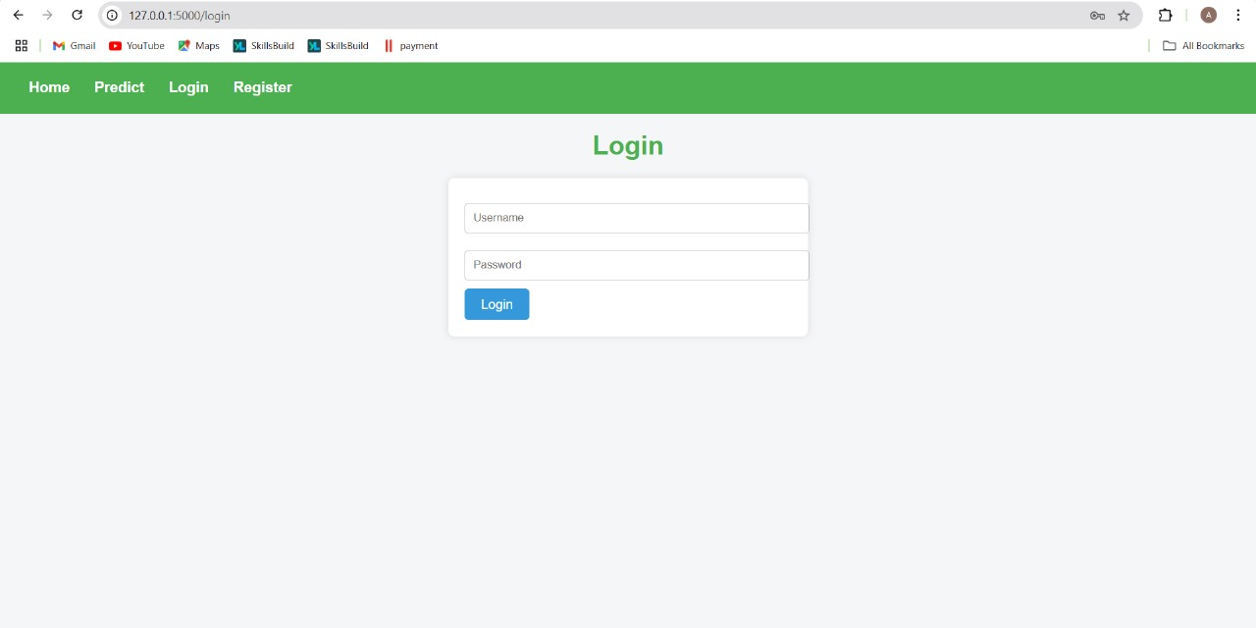

Slide 17
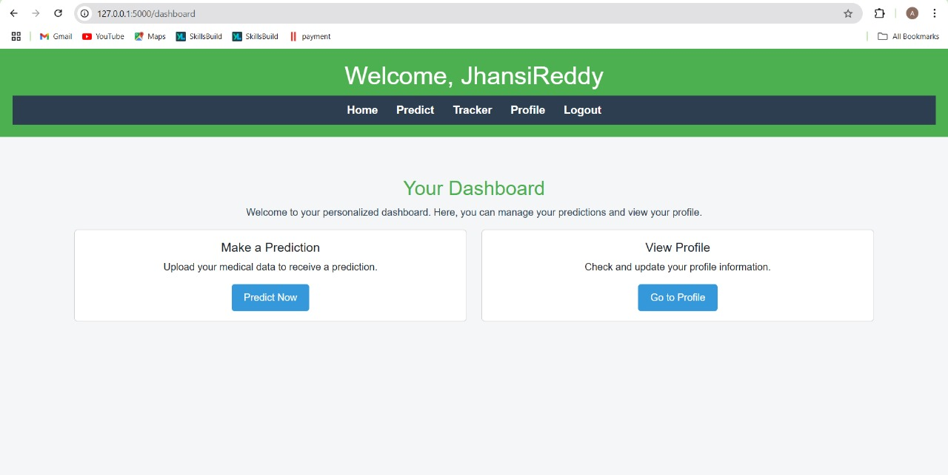

Slide 18
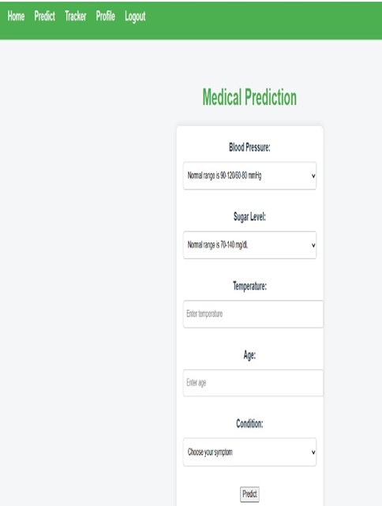
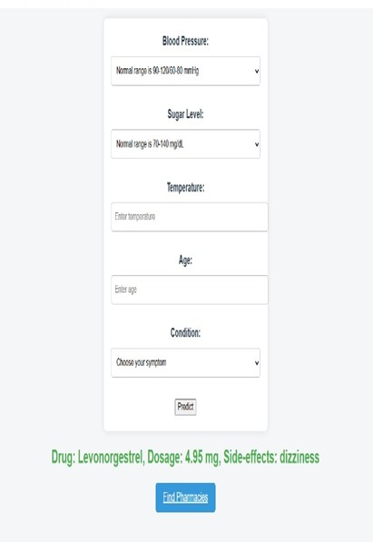

Slide 19
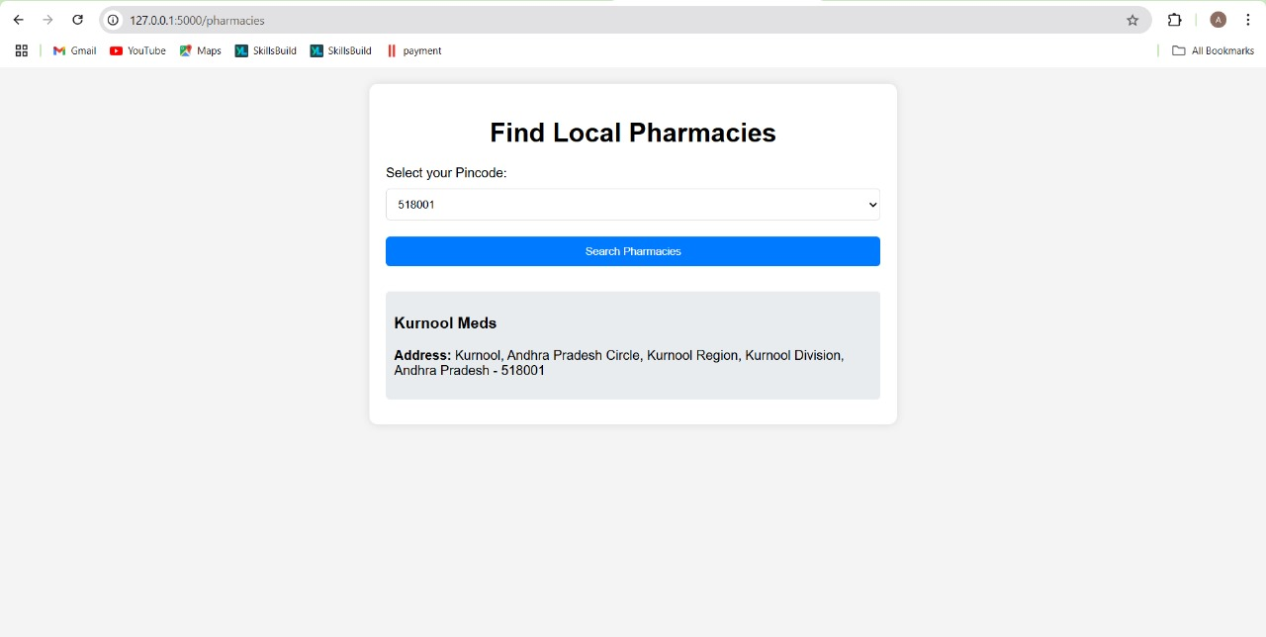

Slide 20
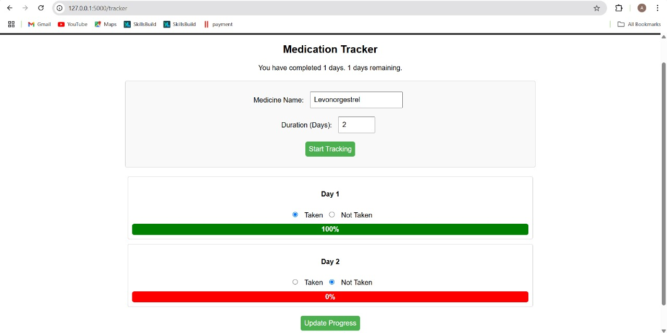

Slide 21
FUTURE ENHANCEMENT
Telemedicine Integration Service: Include telemedicine service for remote consultations.
Patient Specific Treatment Recommendation: Machine learning can be used to recommend suitable treatment for patients.
Working with the Local Healthcare Providers: Work with the local health care providers to set patients appointments and other health care services

Slide 22
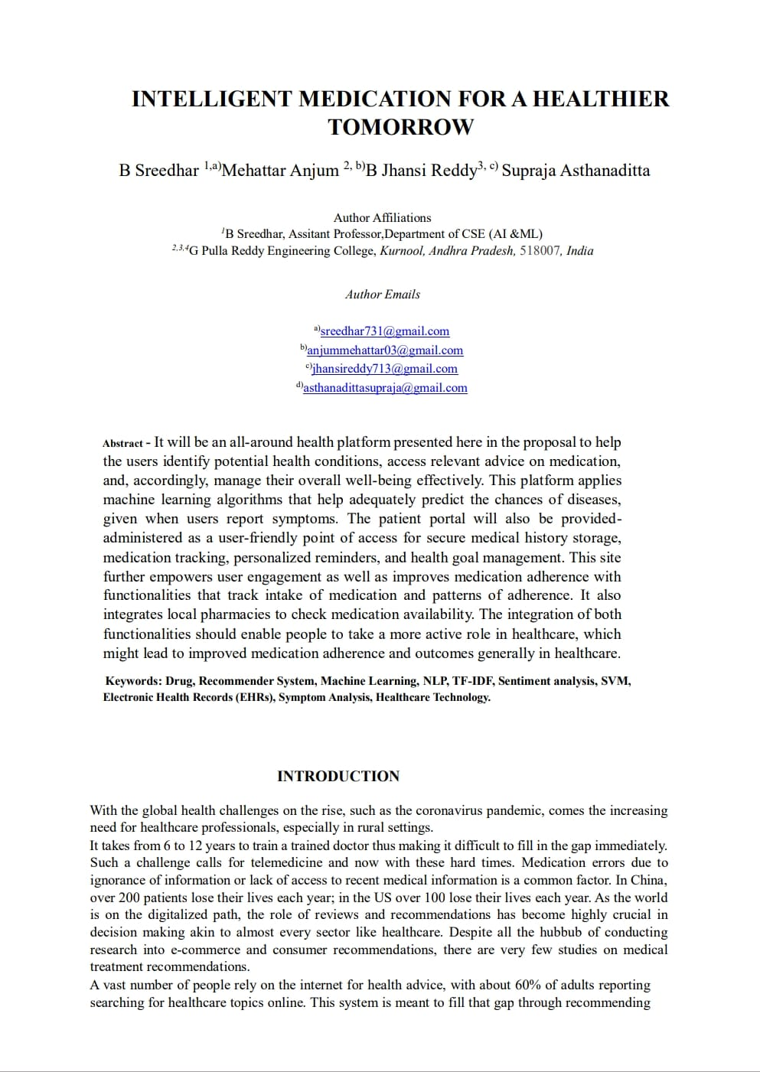
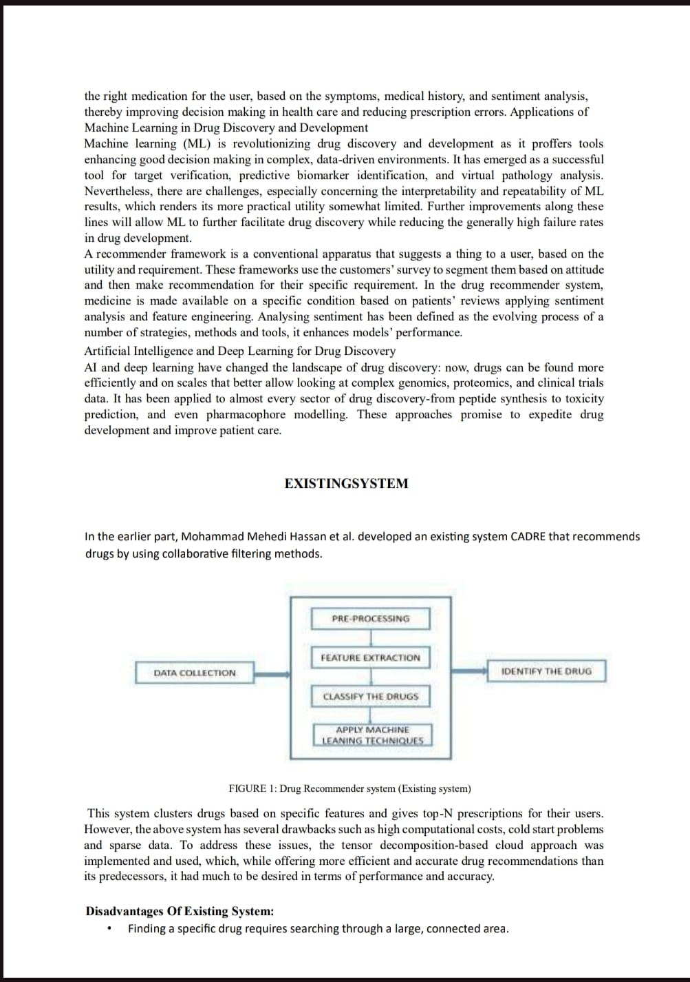
Paper Publication

Slide 23
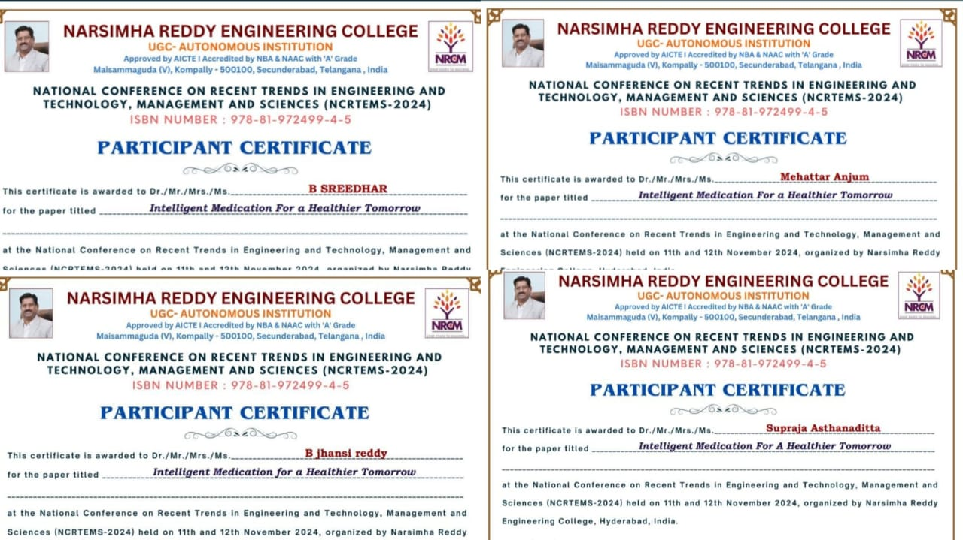

Slide 24
REFERENCES
[1] Chengquan Zhang et al., "Look More Than Once: An Accurate Detector for Text
of Arbitrary Shapes", arXiv preprint arXiv:1904.06535, 2019.
[2] Y. Wu, X. Yang, J. Bian, Y. Guo, H. Xu and W. Hogan, "Combine Factual
Medical Knowledge and Distributed Word Representation to Improve Clinical
Named Entity Recognition", AMIA, 2018.
[3] Shi Baoguang, Xiang Bai and Serge Belongie, "Detecting oriented text in natural
images by linking segments", Proceedings of the IEEE Conference on Computer
Vision and Pattern Recognition, 2017.
[4] A. Stubbs, M. Filannino and Ö. Uzuner, "De-identification of psychiatric intake
records: Overview of 2016 CEGS N-GRID shared tasks Track 1", J.
Biomed. Inform, vol. 75S, pp. S4-S18, Nov. 2017.[5] T. Mikolov, E. Grave, P. Bojanowski, C. Puhrsch and A. Joulin, "Advances in
Pre-Training Distributed Word Representations", CoRR, vol. abs/1712.09405, 2017.

Slide 25


