Slide 1
Prescripto Smart Doctor Appointment System A MERN Stack Healthcare Solution
Presented by: Mirza Anjuman Ara Juman

Slide 2
Problem and Solution
Problem:
• Time-consuming appointment booking
• Double booking issues
• No real-time availability tracking
• Poor communication
Solution: Prescripto
• Digital appointment management
• Real-time availability
• Seamless communication
• Automated scheduling

Slide 3
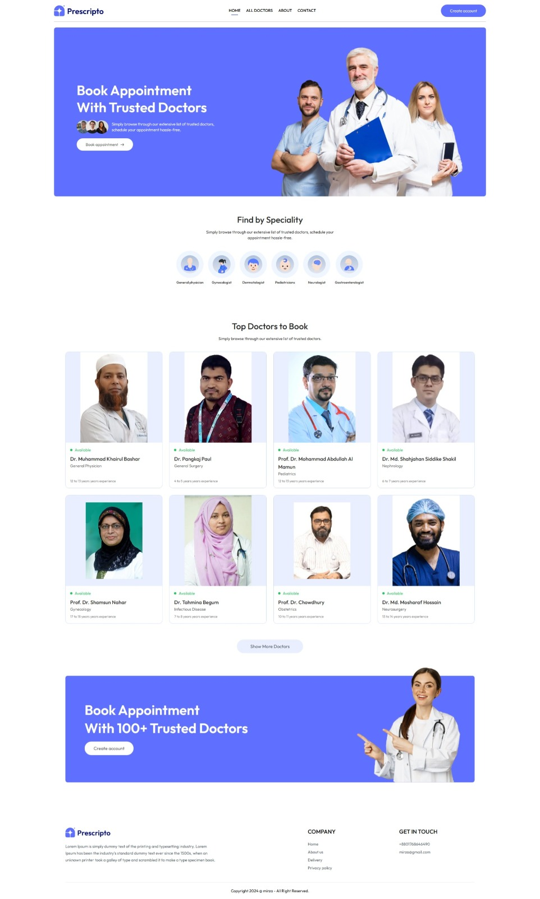
Home page

Slide 4
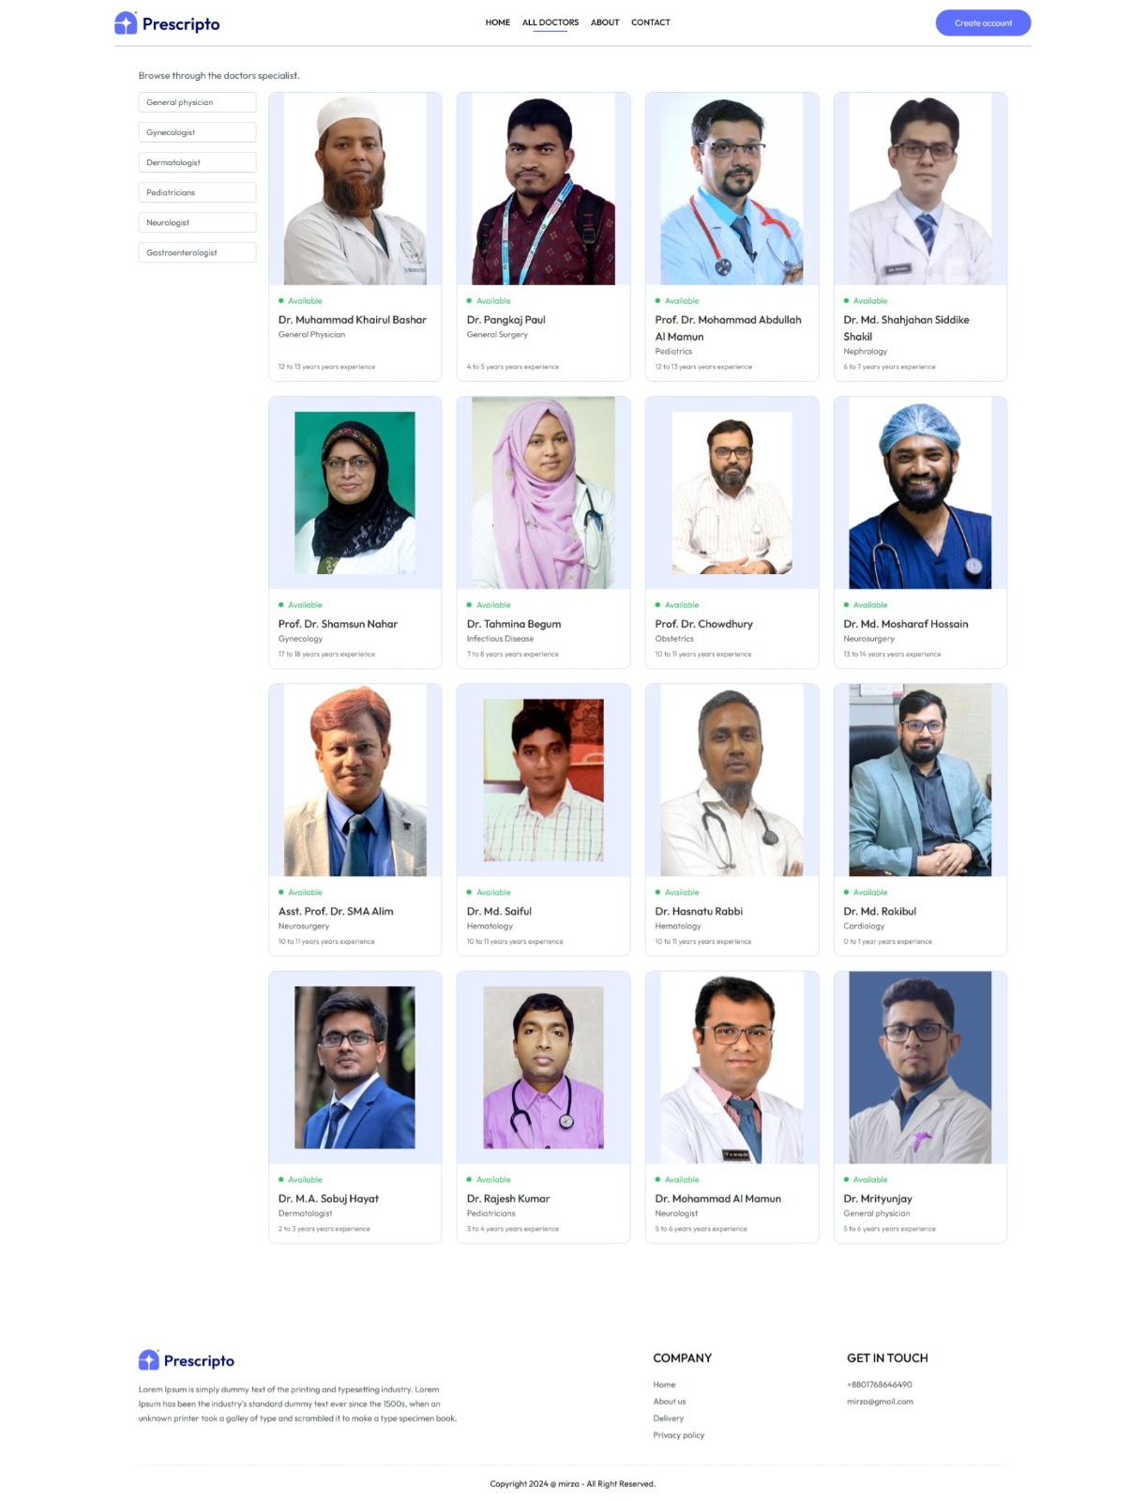
All Doctors page

Slide 5
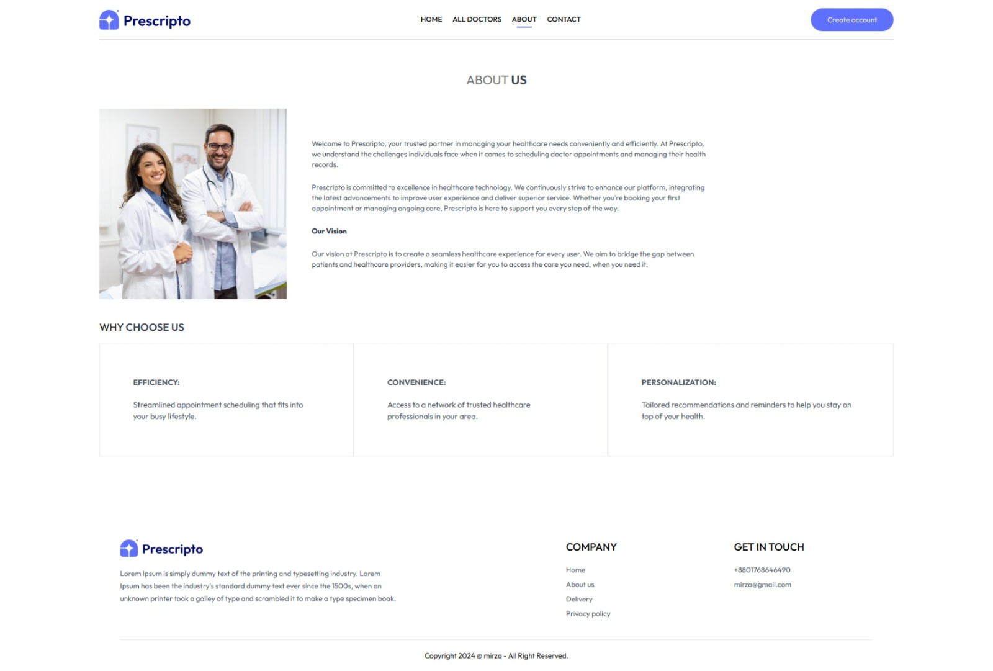
ABOUT US

Slide 6
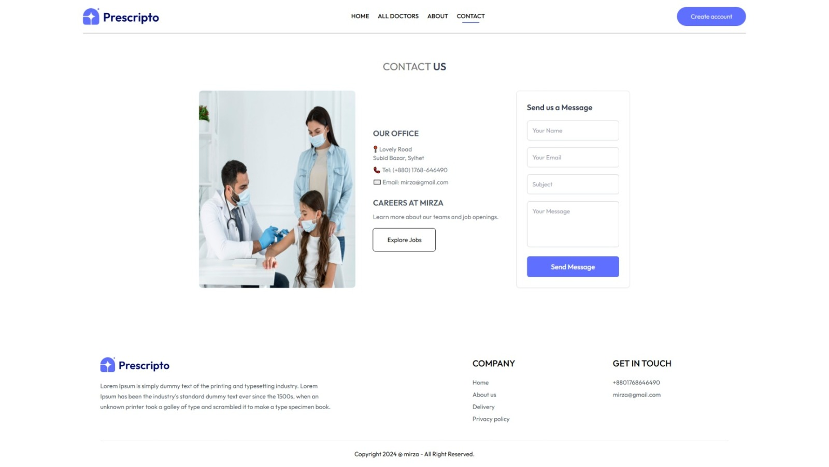
Contact Page

Slide 7
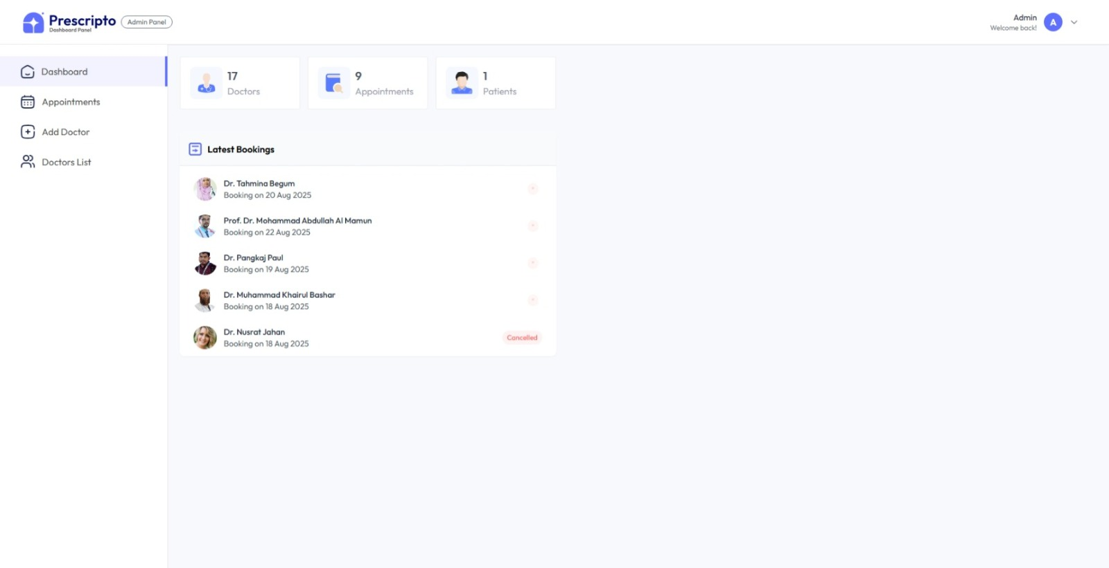
Admin Login

Slide 8
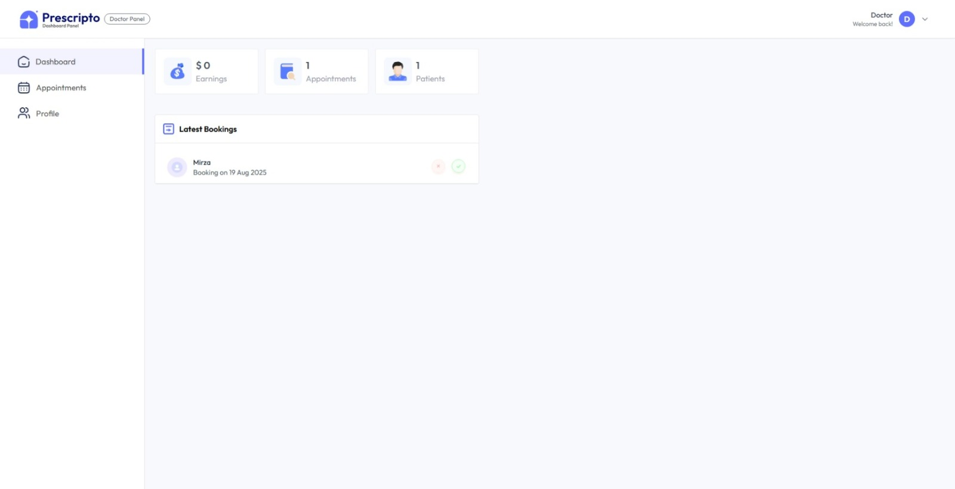
Doctor login

Slide 9
Security Features
• JWT Authentication
• Bcrypt Password Hashing
• Protected API Routes
• Role-based Access Control
• Secure Password Generation

Slide 10
Development Features
• Component Architecture
• Responsive Design
• Real-time Loading States
• Error Handling
• Form Validation
• Image Upload Preview

Slide 11
Challenges & Solutions
1. Authentication Challenge:
✓ Implemented JWT with role-based middleware
2. Real-time Availability:
✓ Created robust booking validation system
3. Image Management:
✓ Cloudinary integration

Slide 12
Future Enhancements
• Video Consultations
• AI Doctor Recommendations
• Multi-language Support
• Medical Records Integration
• Mobile Applications

Slide 13
THANK YOU

