Slide 1
DSO-547: Designing Spreadsheet-Based Business Models
Introduction
Hiroshi Ochiumi

Slide 2
I. Course Overview

Slide 3
Central Theme
Learn the art and skills of logical reasoning with formal models -- how to think and think better.
(Context: Business World)

Slide 4
Course Objectives
Modelers with Excel Skills Who Can:
Transform business situations into well defined quantitative/ analytic problems
Develop spreadsheet-based models
Analyze models, identify “near optimal” solutions
Provide critical managerial insights

Slide 5
Knowledge/Skill Sets
Modeling
Skills
EXCEL
Skills
Functional Area
Applications

Slide 6
EXCEL Skills
Basic Excel
Formula – logical, mathematical
Formatting – conditional formatting, naming ranges
Advanced Excel
Data Tabulation –Filtering, Pivot tables
Special Functions/Tools
Solver
Crystal Ball
Spreadsheet Engineering
Defining Modules
Layout of Spreadsheet
Testing & Debugging

Slide 7
Textbook
Business Analytics: The Art of Modeling With Spreadsheets
Stephen G. Powell
Kenneth R. Baker
John Wiley and Sons, Inc.

Slide 8
Organization of the Book
Modeling basics and craft skills
Effective abstraction, model debugging, and translating models into managerial insights
Excel basics & spreadsheet engineering
How to design, build, test, and perform analysis with a spreadsheet model
Advanced management science models
Data and statistics
Optimization
Decision analysis
Simulation

Slide 9
Classes of Problems/Models
Managerial Problems | Models | Time Plan
Resource Allocation | Optimization | 60%
Risk Analysis | Simulation | 40%

Slide 10
Grading
Homework Assignments 30%
Midterm Exam 20%
Final Exam 40%
Class Participation 5%
Problem of the Day 5%

Slide 11
Pedagogy
Lectures
Hands on spreadsheet modeling
Lots of examples - bring your laptop
Practice problems
Group homework assignments
We may do a case (if we can find time)

Slide 12
Expectations
Read the assigned material
Participate in class discussion
Complete the assigned exercises

Slide 13
II. Basics of Modeling

Slide 14
Questions
What does modeling mean?
What are the standard types of models?
What are the benefits of modeling for managers?
What is the modeling process?
What role does Excel play?

Slide 15
What is Modeling?
Creating a simplified representation of reality
Working with this version to understand or control some aspect of the world

Slide 16
Types of Models
time to school, hiring criteria
Mental:
Visual:
Physical:
Analytical:
map
robot, airplane wing model
population growth model

Slide 17
Benefits of Modeling
Improves thinking skills
Break problems down into components
Make assumptions explicit
Saves costs
Relative to alternatives (e.g., surveys)
Avoiding expensive errors
Allows exploration of the impossible
Improves business intuition
Serves as a means of communication

Slide 18
Classes of Managerial Problems
Resource Allocation (optimization)
Optimally allocate limited resources
Risk Analysis (simulation)
Explicitly incorporating uncertainty
Evaluating the impact of different scenarios
Contingent Decisions (Decision Analysis)
Sequential decision making
Reacting to changes
Anticipating changes

Slide 19
Classes of Managerial Problems
Data Analysis
Sort / Filtering / Organizing data to find useful information
Statistical Learning
Regression
Clustering
Support Vector Machine
Estimation & Forecasting
Projecting into the future

Slide 20
Standard Models in Management
Managerial Problems | Models | Excel Add-ins
Resource Allocation | Optimization | Solver Analytic Solver Platform Open Solver Evolver
Risk Analysis | Simulation | Crystal Ball @RISK Argo

Slide 21
Functional Area Applications
Operations:
Production planning & scheduling, Capacity Planning, Manpower planning, Routing telephone calls, Managing waiting lines, Designing logistics systems, Scheduling airplanes and flight crews…
Finance:
Capital Budgeting, Portfolio Optimization, Bond & Option Pricing…
Marketing:
Sales forces planning, pricing, forecasting, media budgeting, New product planning…
Strategy:
Strategic equilibriums, Real options and investment planning…

Slide 22
Example: A Simple Profit Model (Influence Chart)
Profit
Revenue
Cost
Unit price
Quantity sold
Unit cost
Fixed
costs
Quantity
produced

Slide 23
Relationships
Profit = revenue - cost
Profit = (unit price)(quantity sold) - cost
Profit = (unit price)(quantity sold) - [fixed cost + (unit cost)(quantity produced)]

Slide 24
Developing a Mathematical Model
Profit
R
C
Revenue
Cost
Unit price
Quantity sold
p
S
Unit cost
Fixed
costs
Quantity
produced
Profit = R - C
= pS - (cQ + F)
c
Q
F

Slide 25
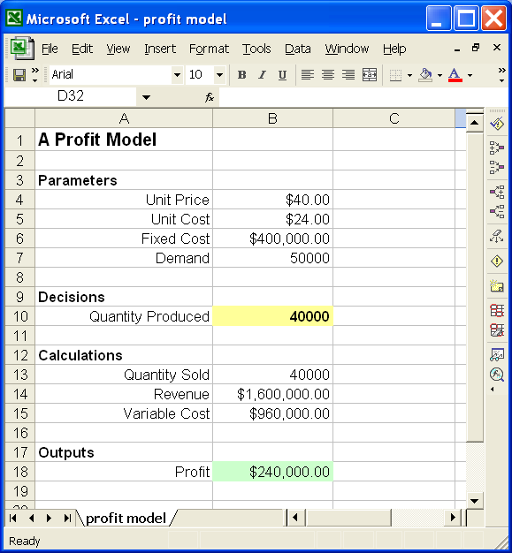
Spreadsheet Model

Slide 26
The Creative Problem-Solving Process
Exploring the mess
Search mess for problems and opportunities.
Accept a challenge and undertake systematic efforts to respond to it.
2. Searching for information
Gather data, impressions, feelings, observations; examine situation from many different viewpoints.
Identify most important information.
3. Identifying a problem
Generate many different potential problem statements.
Choose a working problem statement.

Slide 27
(Cont.)
4. Searching for solutions
Develop many different alternatives and possibilities for solutions.
Select one or a few ideas that seem most promising.
5. Evaluating solutions
Formulate criteria for reviewing and evaluating ideas.
Select the most important criteria. Use criteria to evaluate, strengthen, and refine ideas.
6. Implementing a solution
Consider possible sources of assistance and resistance to proposed solution. Identify implementation steps and required resources.
Prepare most promising solution for implementation.

Slide 28
Another View (By Donald Knuth)
Five stages of modeling:
1. Decide what you want the model to do;
2. Decide how to build the model;
3. Build the model;
4. Debug the model;
5. Trash stages 1 through 4 and start again, now that you know what you really wanted in the first place.

