Slide 1
DSO-547: Spreadsheet-Based Business Modeling
Optimization: 1. Introduction
Hiroshi Ochiumi

Slide 2
Optimization
Find the best set of decisions for a particular measure of performance
Refer to both the goal and an algorithm

Slide 3
Model Components
Decision variables
What must be decided? Be explicit with units
Objective
What measure compares decision variables?
Use only one measure
Constraints
What restrictions limit our choice of decision variables?

Slide 4
Success Stories
The San Francisco Police Department improved the way it scheduled its patrol officers & saved $11 million per year, improved response time by 20%, & increased revenue from traffic citations by $3 million.

Slide 5
Success Stories
American Airlines, three years of improvement to the TRIP crew scheduling model have yielded annual savings of $20 million! Optimization models of overbooking, discount allocation, and traffic management contributes $500 million per year to American Airlines.

Slide 6
Success Stories
Reynolds Metals Company uses a central dispatch model to assign shipments to 14 trucking firms for its over 200 locations; it has improved delivery time and reduced annual freight costs by over $7 million.

Slide 7
Success Stories
Digital Equipment Corporation (DEC) used a Global Supply Chain Management model to locate its facilities, & plan its sourcing, production, & distribution networks. The restructuring has reduced cumulative costs by $1 billion.

Slide 8
More…
GTE Corp. uses NETCAP to plan its $300 million annual investment in new telephone lines and other customer access facilities.

Slide 9
Example: Boat Manufacturer
Two types of boats
Sailboats & Motor Boats
Unit profit
$1200/sailboat, $1000/motor boat
Raw material requirements and availability
Raw Materials | Sailboat Requirements | Motor Boat Requirements | On Hand
Sailcloth | 4 | 0 | 400
Glass Fiber | 8 | 4 | 1000
Engines | 0 | 1 | 120

Slide 10
Building Optimization Models
Three Questions
What am I trying to decide?
What is the objective to be maximized or minimized?
What limitations or requirements restrict the values of the decision variables?

Slide 11
Models
Math model
Excel model – by Data Table (next page)
Maximize 1200S + 1000M
Subject to
4S + 0M ≤ 400
8S + 4M ≤ 1000
0S + 1M ≤ 120
S, M ≥ 0

Slide 12
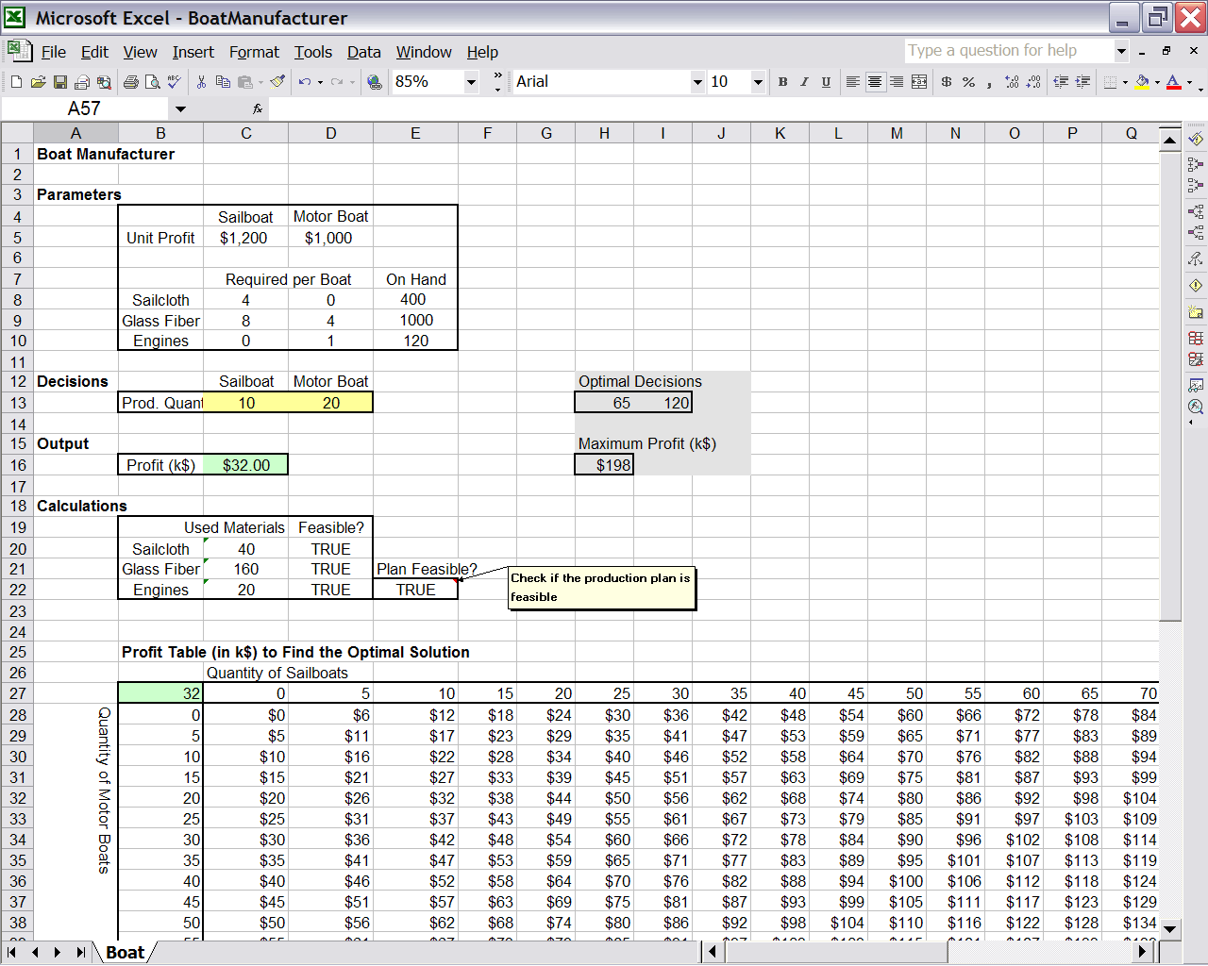

Slide 13
Example Summary
This example demonstrates:
An Excel model layout
Functions: If, And, Match, Index, Sumproduct, Max
Two-variable Data Table
Relative and absolute references
Auditing tools

Slide 14
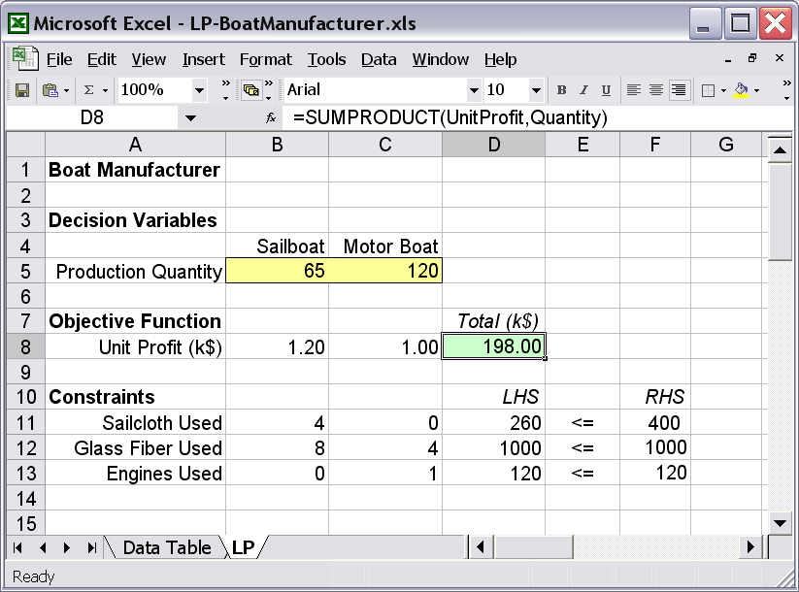
Excel Model – by Linear Programming

Slide 15
Excel Optimization Software
Solver
Standard with Excel
Developed and supported by Frontline Systems, Inc. (www.frontsys.com)
Analytic Solver Platform
Comes with textbook, but we don’t need it for our course materials.
More advanced than standard solver (but past students had technical issues.)

Slide 16
Solver Parameters Window
Target (set) cell -- objective cell
Maximize, minimize, or set equal to target value
Changing cells -- decision variables
Constraints
Restrictions on decision variables

Slide 17
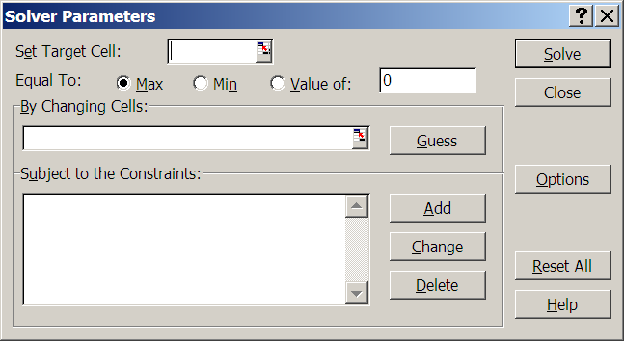
Solver Parameters Dialog Box
Not used for optimization
Objective
Decision variables
Constraints

Slide 18
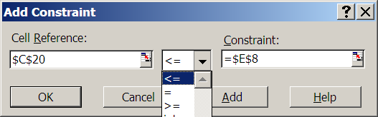
Adding Constraints
Click on Add button in Parameters window
Formula cell on left
Number cell on right

Slide 19
Constraints
Left-hand-side (LHS)
Usually a function
Right-hand-side (RHS)
Usually a number (i.e., a parameter)
Three types of constraints
LHS <= RHS (Capacities or ceilings)
LHS >= RHS (Commitments or thresholds)
LHS = RHS (Material balance)

Slide 20
Ranges for Decision Variables and Constraints
Changing cells allows for commas but better to put in one contiguous range
Add Constraint window allows for ranges
Group LT, GT, EQ, constraints together
Enter as ranges
LHS will be matched with RHS in one-to-one correspondence

Slide 21
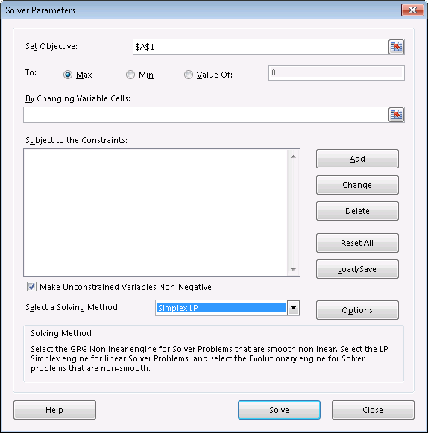
Solver Options
Simplex LP if model is linear
Check if decision
variables are
non-negative

Slide 22
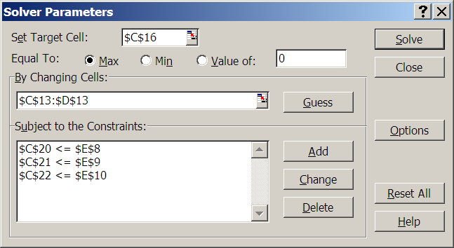
Example: Solving the Boat Manufacturer Problem

Slide 23
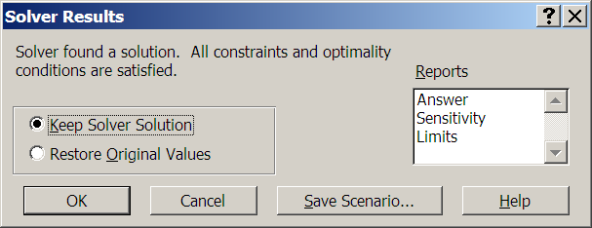
Solver Results

Slide 24
Possible Outcomes
Unique Optimal Solution
Alternative Optimal Solutions
Unbounded Problem
Infeasible Problem

Slide 25
Interpreting Results
Optimal values of decision variables
Best course of action for the model
Optimal value of objective function
Best level of performance possible
Constraint outcomes
Constraint is tight or binding if LHS=RHS in “<=“ or “>=“ constraint, otherwise slack

Slide 26
A Standard Model Template Is Recommended
Enhances ability to communicate
Provides common language
Reinforces understanding how models shaped
Improves ability to diagnose errors
Permits scaling more easily

Slide 27
Layout
Organize in modules
Decision variables, objective function, constraints in a logical format
Use descriptive labels to the left or above
Place decision variables in single row or column
Use color or border highlighting
Place objective in single highlighted cell
Use SUM or SUMPRODUCT where appropriate
Arrange constraints to make LHS and RHS clear
Use SUMPRODUCT for LHS where appropriate

Slide 28
Computer Manufacturer
A computer manufacturer produces 2 types of computers HS (High Speed) and LS (Low Speed).
The profit margin for HS computer is $100 per unit and for LS computer is $75 per unit.
One assembling machine is used for both models. The machine operates 600 minutes a day. A HS unit needs 30 minutes, and a LS unit needs 10 minutes.

Slide 29
Computer Manufacturer
One testing machine is also used for both models.
The machine operates 600 minutes a day.
A HS unit needs 10 minutes and A LS unit needs 20 minutes.

Slide 30
Computer Manufacturer
We also need a packaging machine.
The machine operates 600 min a day.
Every single product needs 20 min for packing.

Slide 31
Computer Manufacturer
Identify:
Objective function
Decision variable(s)
Constraints

