Slide 1
DSO-547: Spreadsheet-Based Business Modeling
2. Linear Programming
Hiroshi Ochiumi

Slide 2
Properties of Linear Functions
Example:
Profit = UnitPrice x SalesQuant – UnitCost x ProdQuant
= 100 x SQ – 60 x PQ
Additivity
Proportionality
Divisibility

Slide 3
Model Classification
Linear optimization/programming (LP)
Objective and all constraints are linear functions of the decision variables
Nonlinear optimization/programming (NP)
Either objective or a constraint (or both) are nonlinear functions of the decision variables
Techniques for solving linear models are more powerful
Use wherever possible

Slide 4
Standard Linear Programming Problems
Allocation models: Maximize objective (e.g., profit) subject to “<=“ constraints on capacity
Covering models: Minimize objective (e.g., cost) subject to “>=“ constraints on required coverage
Blending models: Mix materials with different properties to find best blend
Network models: Describe patterns of flow in a connected system

Slide 5
Steps in Formulation
Define the decision variables
Write the objective as a function of these variables
Write the constraints as functions of these variables
Determine the variable restrictions, e.g. non-negative, integer

Slide 6
Example 1: Boat Manufacturer
Math model
Excel model
Maximize 1200S + 1000M
Subject to
4S + 0M ≤ 400
8S + 4M ≤ 1000
0S + 1M ≤ 120
S, M ≥ 0

Slide 7
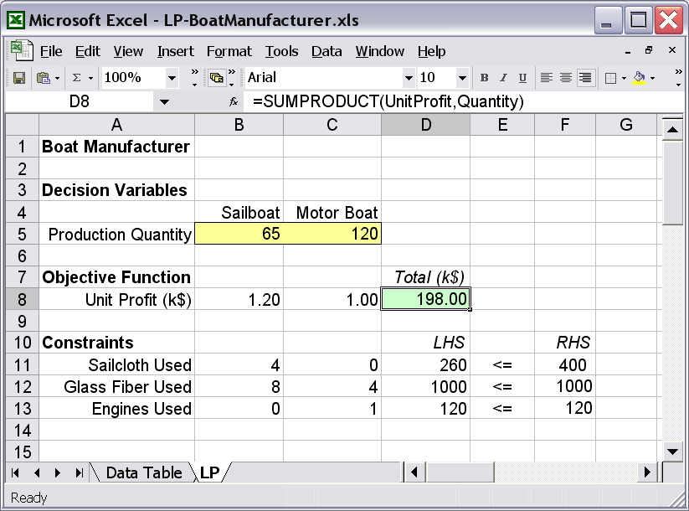
(Cont.)

Slide 8
Example 2: An Allocation Model
Veerman Furniture Company
Decisions: Chairs (C), Desks (D), Tables (T)
Maximize 15C + 24D + 18T (Profit)
Subject to
(Fabrication) 4C + 6D + 2T ≤ 1850
(Assembly) 3C + 5D + 7T ≤ 2400
(Distribution) 3C + 2D + 4T ≤ 1500
(Demand) C ≤ 360, D ≤ 300, T ≤ 100
(Non-negative) C, D, T ≥ 0

Slide 9
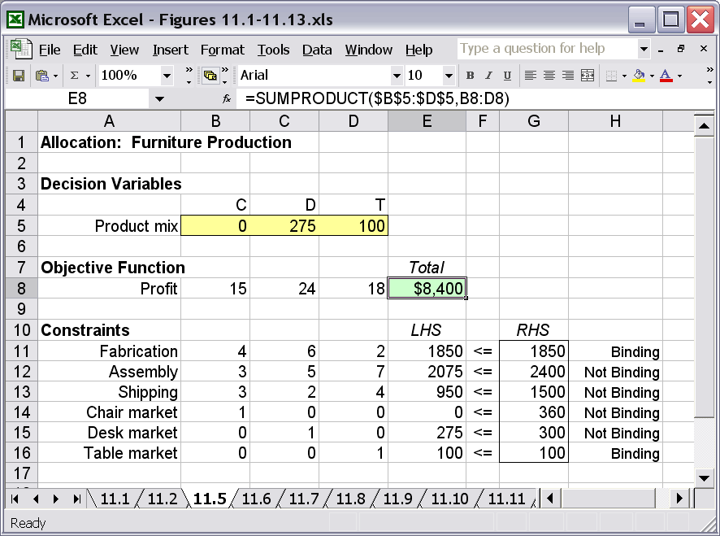
(Cont.)

Slide 10
Example 3: A Covering Model
Dahlby Outfitters
Decisions: Seeds (S), Raisins (R), Flakes (F), Pecans (P), Walnuts (W)
Minimize 4S + 5R + 3F + 7P + 6W (Cost)
Subject to
(Vitamin) 10S + 20R + 10F + 30P + 20W >= 20
(Mineral) 5S + 7R + 4F + 9P + 2W >= 10
(Protein) 1S + 4R + 10F + 2P + 1W >= 15
(Calories) 500S + 450R + 160F + 300P + 500W >= 600
(Non-negative) S, R, F, P, W >= 0

Slide 11
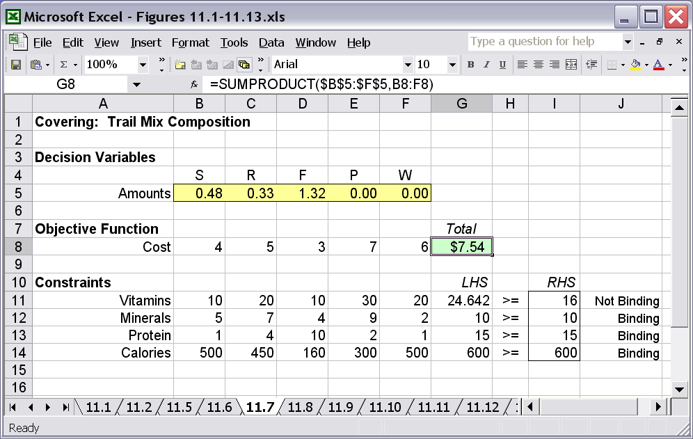
(Cont.)

Slide 12
Example 4: A Blending Model
Diaz Coffee Company
Make a weighted-average constraint linear
Aroma rating:
Strength:

Slide 13
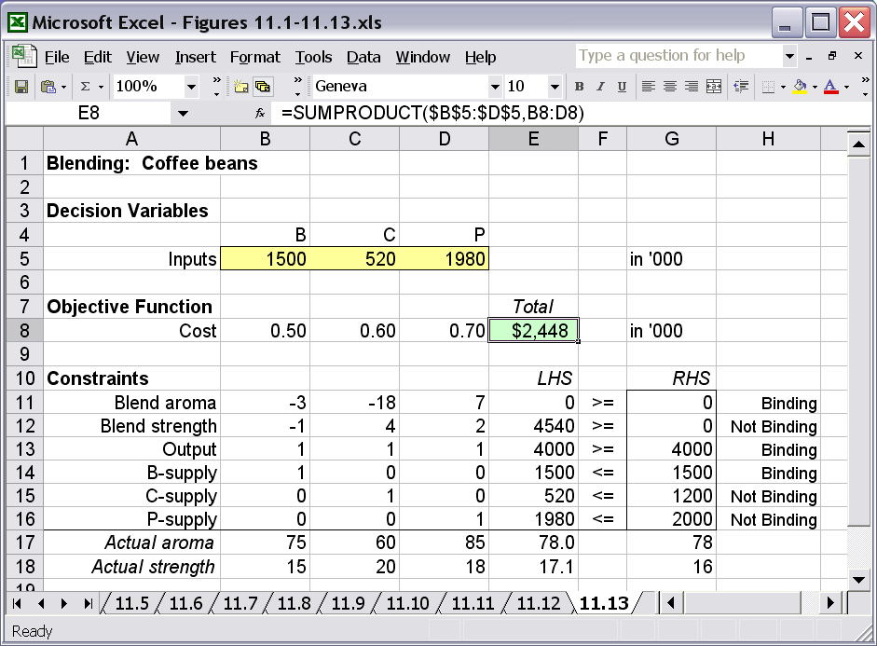
(Cont.)

Slide 14
Example 5: Advertising Mix
A cable television advertising campaign is aimed at three demographic groups: single adult males, single adult females, and married couples.
The campaign requires 500,000 viewers among the single males, and 200,000 viewers in each of the other two groups.
Five channels are available, each with its own audience demographics. The table below shows the number of viewers of each type per $1,000 of advertising for each of the five channels.

Slide 15
(Cont.)
 | Single Men | Single Women | Couples
Channel 1 | 300 | 850 | 1200
Channel 2 | 100 | 900 | 2000
Channel 3 | 0 | 1200 | 800
Channel 4 | 2000 | 0 | 200
Channel 5 | 750 | 500 | 500
That is, $2000 spent on channel 2 would reach 200 Single Men, 1800 Single Women, and 4,000 couples, etc.
What is the minimum cost media purchase that will meet your goals for each of the three demographic groups?

Slide 16
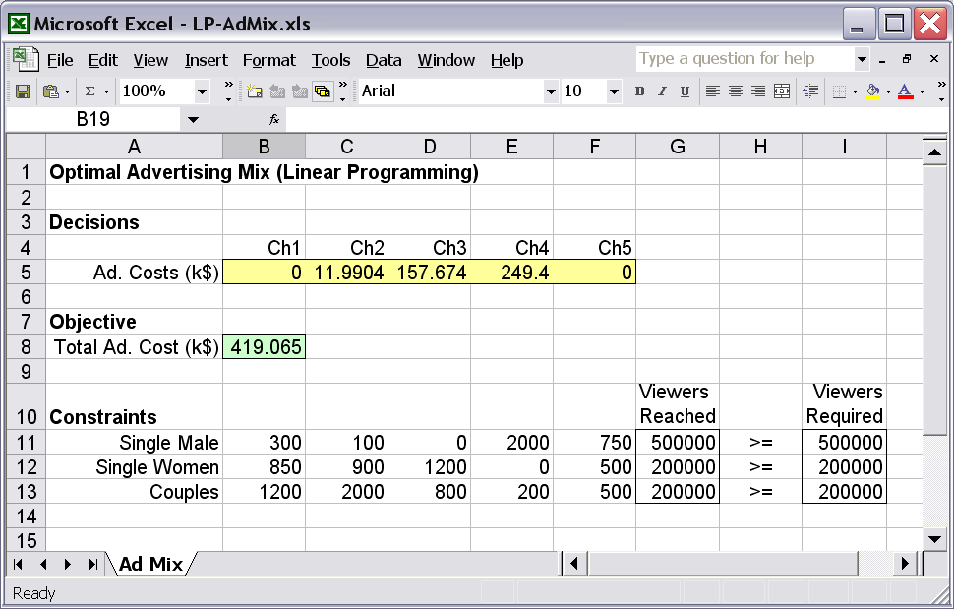
(Cont.)

