Slide 1
DSO-547: Spreadsheet-Based Business Modeling
3. Network Models
Hiroshi Ochiumi

Slide 2
EXCEL Tip: Capture the Screen/Window
“PrtScn” copies the entire screen
“Alt-PrtScn” copies the active window only
Can paste to an Office document

Slide 3
Network Diagrams
Also called flow diagrams
Used when material flows across space or time
Consumer products in a distribution system
Cash in an investment account over time
Show relationships among main elements of a model
Delineate the boundaries of a model

Slide 4
(Cont.)
Network is a collection of connected elements. For examples:
Factories, connected by delivery routes
Bank accounts, connected by electronic fund- transfer routes
People, connected by organizational reporting relationships
Elements shown as circles and boxes (or nodes)
Connections shown as arrows (or arcs)

Slide 5
Example 1: Transportation Problem
Transportation problem: Bonner Electronics
7.5
?
A
MA
9
M
8.5
B
Plants
12
Warehouses
P
C
9.5
13
T
?
(Capacities)
TD
8
D
(Requirements)

Slide 6
Constraints
For plants: (capacity)
For warehouses: (requirement)
MA + MB + MC + MD <= 9
…
MA + PA + TA >= 7.5
…

Slide 7
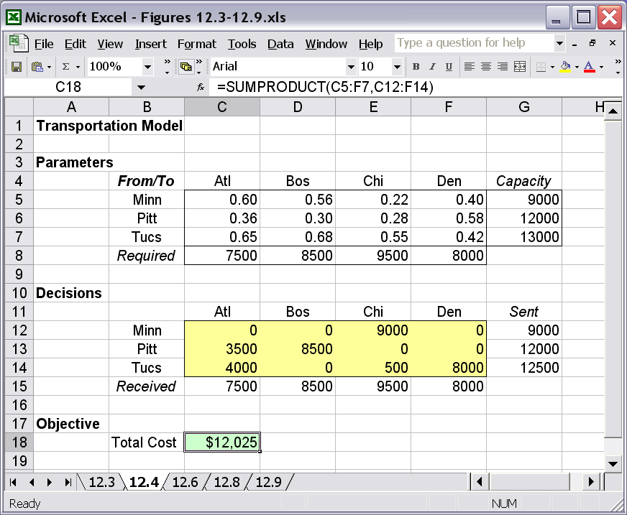
Layout in Excel

Slide 8
Layout Convention
Arrange parameters and decision variables in two rectangles, of the same size and same direction.
Arrange the constraints accordingly, in the most convenient way.

Slide 9
Example 2: Assignment Problem
Example: Europa Auto Company
Six manufacturing plants
Six vehicle types to produce
Produce each vehicle at a unique plant
Annual cost table on next page
How to minimize the total cost of the assignment?

Slide 10
(Cont.)
Annual costs (million $)
 | Compact (1) | Coupe (2) | Sedan (3) | SUV (4) | Truck (5) | Van (6)
Akron | 80 | 56 | 43 | 62 | 46 | 58
Buffalo | 94 | 50 | 88 | 64 | 63 | 52
Columbus | 94 | 46 | 50 | 40 | 55 | 73
Detroit | 98 | 79 | 71 | 65 | 91 | 59
Evansville | 61 | 59 | 89 | 98 | 45 | 52
Flint | 77 | 49 | 65 | 95 | 72 | 91

Slide 11
Relationship with the Transportation Problem
The assignment problem is a special case of the transportation problem:
All capacities and all requirements equal to 1
The numbers of sources and destinations are the same (not important)

Slide 12
Network Diagram
(Capacities)
(Requirements)
?
A1
1
A
1
1
1
B
2
1
···
C
3
···
Plants
Vehicles
D
4
E
5
F
6

Slide 13
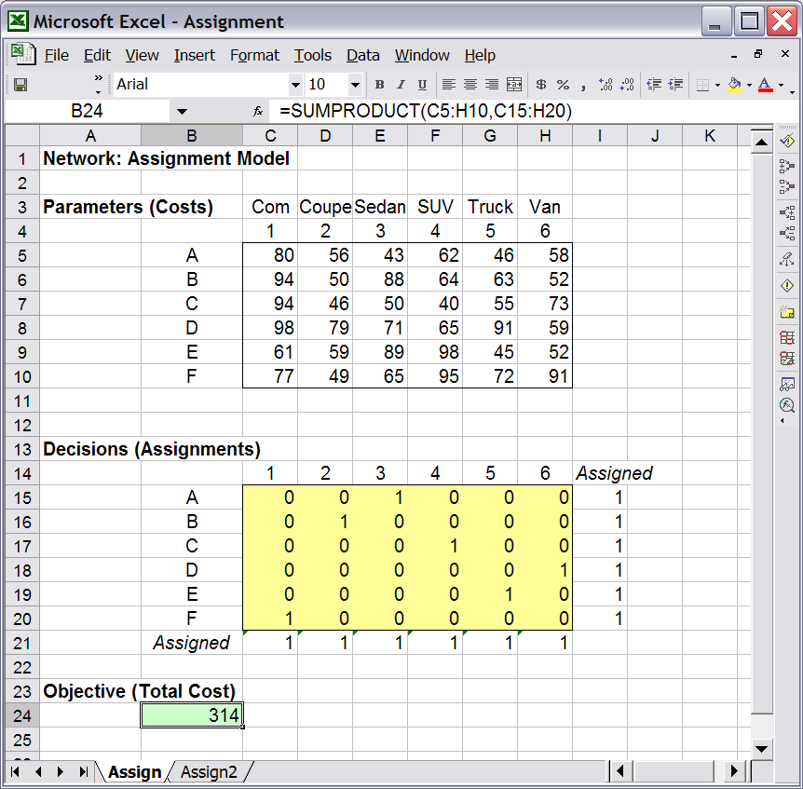
Layout in Excel

Slide 14
Applications
Assign workers to shifts, courses to time slots, airline crews to flights, purchase contracts to supplier bids

Slide 15
Standard Form of Networks: Using Flow Balance Equations
Flow must be balanced at every node
The formula at each node:
(flow out) – (flow in) = 0
Or,
flow out = flow in
Move constants to the RHS

Slide 16
Layout Conventions
Arrange decision variables (flow on the arcs) in a single row
Arrange the balance equation of each node in a row; place all balance equations in adjacent rows

Slide 17
Example 3A: Oil Pipeline Network (Maximum Flow Problem)
Pumping Station A
Capacity
A
300
700
Oil Field
Refinery
F
400
R
400
B
600
Pumping Station B
How much oil can be sent from F to R?
(maximize flow throughput)

Slide 18
Oil Pipeline (cont.)
Decision variables
Objective
Constraints
Units of flow through each pipeline (arc): FA, FB, AB, AR, BR
Maximize total flow out of the Oil Field or into the Refinery, that is, FA + FB or AR + BR.
Capacity constraints: FA <= 700, FB <= 400, …
Flow balance constraints

Slide 19
Flow Balance Equations for Intermediate Nodes
Flow Balance Equations for the Pumping Stations
Pumping Station A
AB
FA
A
AR
FB
BR
B
AB
Pumping Station B
AR + AB - FA =0
BR - AB - FB =0

Slide 20
Flow Balance Equations for Source(s) and Sink(s)
A source is where all flows go in; A sink is where all flows go out.
Two alternative ways to treat sources and sinks:
Simply ignore balance equations
Or, add dummy arcs and decision variables when writing balance equations
FA
AR
Oil Field
Refinery
F
R
IN
OUT
FB
BR
Source
Sink

Slide 21
Example 3B: Oil Pipeline Network (Minimum Cost Problem)
Pumping Station A
Unit cost
A
$8
$4
Oil Filed
Refinery
F
$2
R
$7
B
$5
Pumping Station B
What is the minimum cost to send one unit of flow from F to R? (minimize flow costs)

Slide 22
The model (cont.)
Decision variables
Objective
Constraints
Units of flow through each pipeline (arc): FA, FB, AB, AR, BR
Minimize total flow cost
4 FA + 7 FB + 2 AB + 8 AR + 5 BR
(a Sumproduct formula)
Flow balance constraints (same as before)
Total flow is one unit: FA + FB = 1, or AR + BR = 1

Slide 23
Example 3C: Oil Pipeline Network (Shortest Path Problem)
Pumping Station A
Distance (mi)
A
500
200
Oil Filed
Refinery
F
100
R
400
B
300
Pumping Station B
What is the shortest path to send flow from F to R?

Slide 24
The Model
Idea:
Send one unit of flow through the network to find the “minimum distance” way
Can use the previous minimum-cost model by replacing “cost” with “distance”

Slide 25
Example 3D: Oil Pipeline Network (Maximum Profit Problem)
Combining capacities and costs
The problem:
Old information:
Same network structure, pipeline capacities, and unit costs as before
New information:
Price of selling one unit of oil (at the refinery) is $15
What is the maximum profit the network can achieve and how?

Slide 26
The Model
Can still use most part of the Maximum-flow model
New objective function (to be maximized):
Profit = Revenue – Cost
= 15×(AR + BR) – (4 FA + 7 FB + 2 AB +
8 AR + 5 BR)
= -4 FA - 7 FB - 2 AB + 7 AR + 10 BR

Slide 27
Example 3E: Oil Pipeline Network (Capacitated Min-Cost Problem)
Another problem combining capacities and costs
The problem:
Old information:
Same network structure, pipeline capacities, and unit costs as before
No new information
What is the minimum cost to send 800 units of oil from the field to the refinery?

Slide 28
The Model
Can modify from the minimum-cost model
Same objective function
Add capacity constraints
Change the unit-flow constraint to:
FA + FB ≥ 800,
Or, AR + BR ≥ 800

Slide 29
Example 4: Tuition Expenses (Flows with Yields)
Planning for Tuition Expenses
Investments | Available | Maturity | Return
A | Every yr | In 1 yr | 5%
B | Yr 1, 3, 5, 7 | In 2 yrs | 11%
C | Yr 1, 4 | In 3 yrs | 16%
D | Yr 1 | In 7 yrs | 44%
Year | 5 | 6 | 7 | 8
Tuition (k$) | 24 | 26 | 28 | 30

Slide 30
Flow Diagram
V
24
26
28
30
A1
A2
A3
A4
A5
A6
A7
0
1
2
3
4
5
6
7
B1
B3
B5
C1
C4
D1

Slide 31
Flow Balance Equations
V
24
A1
0
A4
A5
4
B1
B3
B5
C1
D1
A5 + B5 + 24 - 1.05A4 - 1.11B3 = 0
A5 + B5 - 1.05A4 - 1.11B3 = -24
A1 + B1 + C1 + D1 – INI = 0

Slide 32
Write All Balance Equations
V
24
26
28
30
A1
A2
A3
A4
A5
A6
A7
0
1
2
3
4
5
6
7
B1
B3
B5
C1
C4
D1

Slide 33
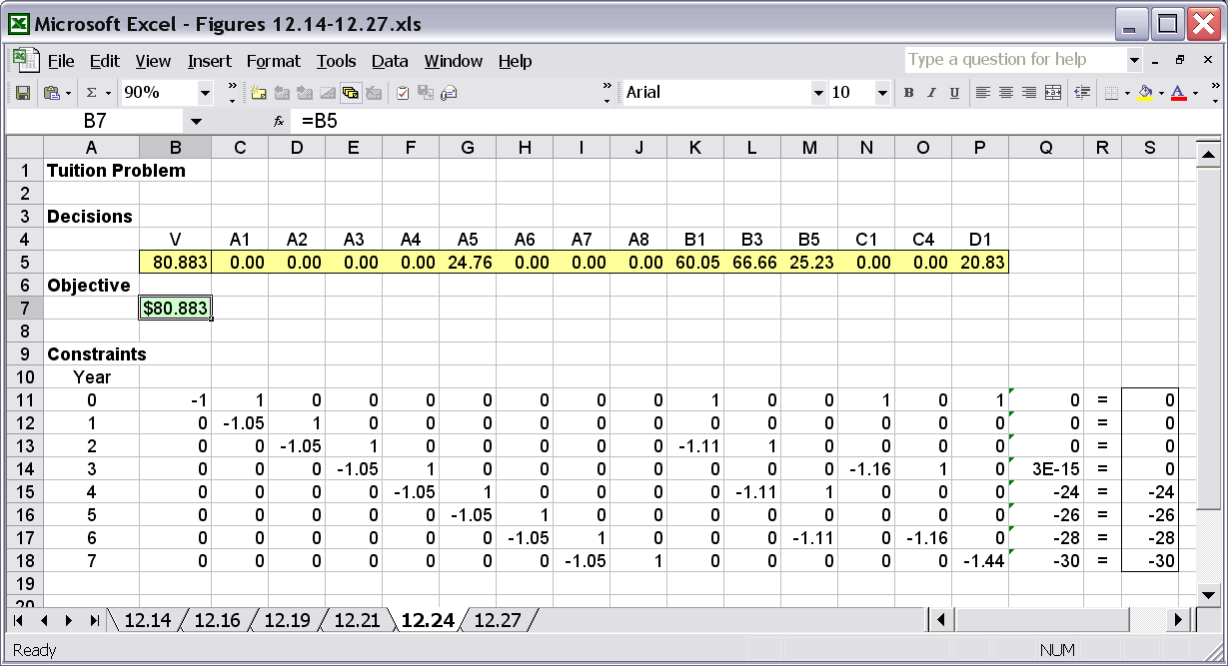
Layout in Excel

Slide 34
What Happens If …
return of C is increased to 18%?
the investments are available every year?
the investments are dedicated for different years: B to year 5, C to year 7 and D to year 8?

Slide 35
Compare the Two Formulations
The balance equation formulation is always available.
The rectangular formulation is more convenient, but only a few problems have this formulation.
When both exist, they are essentially equivalent.
What is the balance equation formulation of the transportation model?
Does the tuition problem have a rectangular layout?

Slide 36
Example 5: Multiperiod Production Planning
Sailco manufactures sailboats
Demand for the next 4 months (must be met)
At the beginning of month 1, has 10 boats in inventory
In each month, can produce up to 40 boats with regular-time labor at $400 per boat
Can produce any amount with overtime labor at $450 per boat
$20 to hold one boat in inventory at the end of a month
What is the minimum cost to meet the demand?
Month | 1 | 2 | 3 | 4
Demand | 40 | 60 | 75 | 25

Slide 37
Flow Diagram
Flows on the arcs (decision variables)
R
V
V1
R1
R2
V4
1
2
3
4
10
I1
I2
40
60
75
25

Slide 38
Flow Diagram
Capacities (constraint parameters)
R
40
V
40
40
40
1
2
3
4

Slide 39
Flow Diagram
Unit costs (objective parameters)
R
400
V
450
400
400
450
450
400
450
1
2
3
4
20
20
20
20

Slide 40
The Model
Decision variables
Objective
Constraints
Amounts of flows on the arcs:
R1, V1, I1, R2, V2, I2, R3, V3, I3, R4, V4
Minimize total cost of the flows in the network:
400 R1 + 450 V1 + 20 I1 + 400 R2 + 450 V2 + 20 I2 + …
Capacity constraints: R1 <= 40, R2 <= 40, …
Non-negativity constraints: R1 >= 0, V1 >= 0, …
Flow balance constraints

Slide 41
Flow Balance Equations
Month 1
Month 2
R1
R2
V2
V1
1
2
10
I1
I1
I2
40
60
I1 + 40 – R1 – V1 – 10 = 0
I1 – R1 – V1 = -30
I2 + 60 – R2 – V2 – I1 = 0
I2 – R2 – V2 – I1 = -60

