Slide 1
DSO-547: Spreadsheet-Based Business Modeling
Simulation: Introduction
Hiroshi Ochiumi

Slide 2
Motivation
Two investment alternatives
A: Invest $10,000.
Probability of a $100,000 gain is 0.10
Probability of a $10,000 loss is 0.90
B: Invest $10,000
Probability of a $500 gain is 1.0
Which would you choose?
Why?

Slide 3
(Cont.)
On average/expectation, “A” is twice as good as “B”
Do we ever actually receive the average?
Decisions made based only on the average can be poor

Slide 4
Simulation
What is simulation?
Monte Carlo simulation
System simulation
Why simulate?
Key concepts underlying simulations
Probability Distributions
Input and output parameters
Interpreting solutions
How to simulate
We could use dice or roulette.
Random number generation using Excel
Crystal Ball

Slide 5
Ideal problem.
We know the exact costs.
We know the exact duration.
We know the exact cash flows.
We can formulate the problem and solve it.

Slide 6
More realistically..
We may not know the exact cost.
We may not know the exact duration.
We may not know the exact demand.

Slide 7
We want to see…
“You know, we solved the (static version of the) problem, but what if the cost was uncertain? What if the demand was uncertain, etc?”
Would our decision/objective value change significantly? (Risk Profile)
Is our decision/objective very sensitive to our cost or market?

Slide 8
What if analysis using best case, worst case may not be enough
They may not offer enough detail
There may be many variables, resulting in too many combinations
Can not assess the likelihood of different outcomes

Slide 9
Simulations & Decision Trees
Both deal with uncertainty
Decision Trees:
Discrete or Small number of alternate outcomes:
Fire or No Fire.
Demand High, Low, or Medium
Product Design: Succeeds or Fails
Simulations
Large number of alternatives
Loss due to fire can take on many values
Demand can be a range with associated probabilities

Slide 10
Simulation Models
Logical descriptions of the interrelationships among elements in a decision problem (Monte Carlo simulation), or the sequence of events that occur over time in a system (system simulation).
Simulation models provide distributions of potential outcomes and likelihood of occurrence.

Slide 11
Simulation and Risk Analysis
Simulation allows us to evaluate the risk of a particular situation.
Risk: Typically defined as the uncertainty associated with an undesirable outcome (such as financial loss).
Risk is not the same as just being uncertain about something, and is not just the possibility of a bad outcome.
Risk considers the likelihood of an undesirable outcome (e.g., the probability) as well as the magnitude of that outcome.

Slide 12
Random numbers
Uniformly distributed (usually between 0 and 1)
No discernible pattern; appear random
In EXCEL: =RAND()
0
.75
.25
.5

Slide 13
Random number simulation

Slide 14
Foundation of Simulation: Probability Distributions
Randomness, Uncertainty, Risk
Probability Distribution: A description of an uncertain event or parameter, a list of probabilities of the outcomes.
Toss a coin: Head or tail, with equal (1/2) probability
Roll a dice: 1 through 6, with equal (1/6) probability
Draw a card
Random Variable: Numerically-valued outcome generated from a distribution
Toss a coin: 1 (head), 0 (tail)

Slide 15
Probability Distributions of Random Variables (R.V.)
Distribution of discrete R.V.
Number of objects, …
Can be described by a list of probabilities. They must sum to 1.
Distribution of continuous R.V.
Time, Length, …
Can be described by a function f(x). The area under the function must be 1.

Slide 16
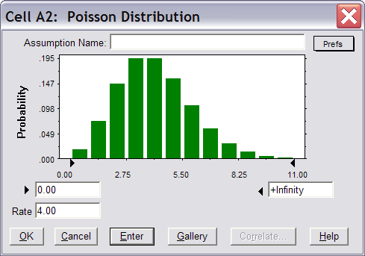
Example of Discrete Distributions: Poisson
The occurrences of random events in a given period with the rate of occurrence λ.
Illustration by Crystal Ball (rate = 4.0):

Slide 17
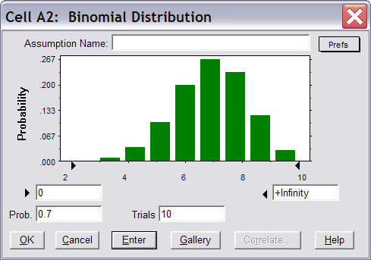
Example of Discrete Distributions: Binomial
The number of successful outcomes in a series of n independent trials, each with a success probability of p.
Illustration by Crystal Ball (p=0.7, n=10):

Slide 18
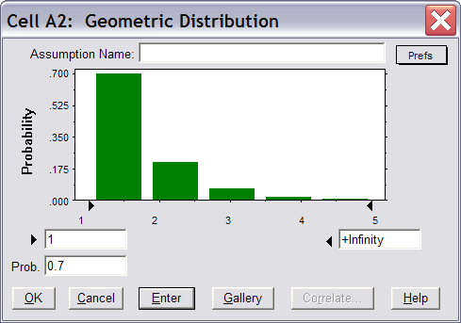
Example of Discrete Distributions: Geometric
The number of trials needed to generate the first success, in a series of independent trials, each with a success probability of p.
Illustration by Crystal Ball (p=0.7):

Slide 19
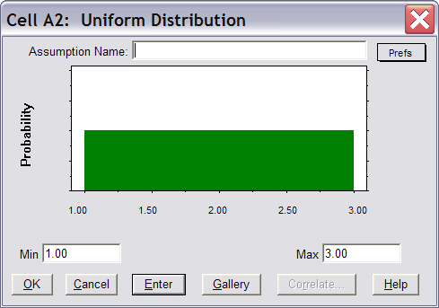
Example of Continuous Distributions: Uniform
An outcome is equally likely to fall anywhere between a minimum and a maximum.
Illustration by Crystal Ball (Min=1, Max=3):

Slide 20
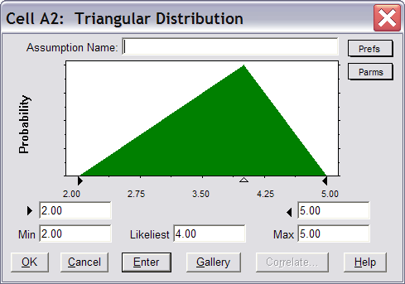
Example of Continuous Distributions: Triangular
An outcome has a minimum and maximum value but is most likely to occur at an intermediate point.
Illustration by Crystal Ball (Min=2, Likeliest=4, Max=5):

Slide 21
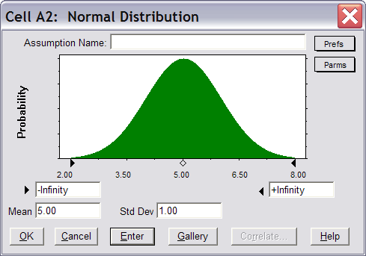
Example of Continuous Distributions: Normal
An outcome is most likely to be in the middle of the distribution, with progressively smaller likelihoods as moving away from the center.
Illustration by Crystal Ball (Mean=5, Std Dev=1):

Slide 22
Distribution and Histogram
Illustration: Student Grades
Shows how numbers of a population are distributed according to some criterion.
Can be transformed into a distribution by dividing each bin with the total population.
Tools -> Data Analysis -> Histogram
Input Range: Data for the entire population
Bin Range: Define columns of the histogram

Slide 23
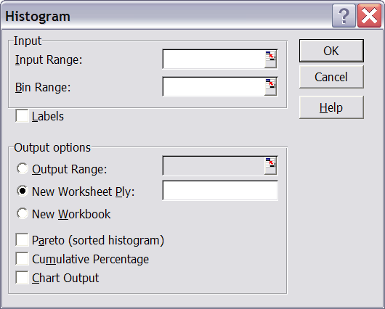
(Cont.)

Slide 24
General Simulation Modeling Process
Develop a model that “behaves like” the real problem, with a special consideration of the random or probabilistic input variables
Conduct a series of computer runs (called trials) to learn the behavior of the model output(s)
Compute the summary (output) statistics and make inferences about the real problem

Slide 25
Example
You have developed a new home networking device. Preliminary estimates:
Selling price: $249
Administrative costs: $400,000 (first year)
Advertising costs: $600,000 (first year)
Uncertainties:
Labor costs (around $45)
Part costs (around $90)
Demand (around 15,000)
Managerial concern: Profits

Slide 26
Random Inputs
Labor costs estimated to be between 43 and 47
Could be subjective estimates, or from engineering models
Direct Labor | Probability
43 | 0.1
44 | 0.2
45 | 0.4
46 | 0.2
47 | 0.1

Slide 27
(Cont.)
Part Costs:
Uniform between $80 and $100/ part
Demand:
Normal with mean 15,000 and standard deviation 4500
Probability
Density
1/20
80
100

Slide 28
Output: Profits
Profits = (price – labor cost – part cost) × demand
- advertising costs – administrative costs
= (249 – LC – PC) × D – 1,000,000
Depend on Labor costs, Part Costs and Demand

Slide 29
Extreme-Case Analysis
Extreme-case analysis
Scenarios: Best Case, Worst Case, etc
Using best case, worst case may not be enough
They may not offer enough detail
There may be many variables, resulting in too many combinations
Can not assess the likelihood of different outcomes

Slide 30
Conduct Simulation
Use a random number generator (a “digital dice”) to generate costs and demand
Calculate the profit
Repeat the experiment a number of times
Determine the distribution of the output (profits)
Analyze the output

Slide 31
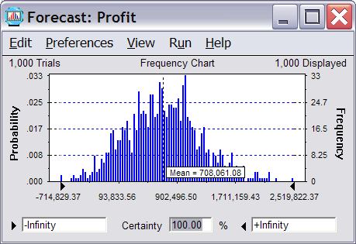
Output Window by Crystal Ball

Slide 32
Output Analysis
Profits are random numbers
Interested statistics: Mean, Median, Standard deviation, …
Can get slightly different results from each simulation
How do we know we obtained the right values for these variables?
What if we ran 5000 trails ?

Slide 33

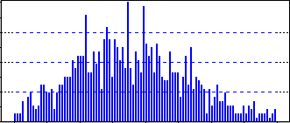
What is (Monte Carlo) Simulation?
Repeated sampling from probability distributions of random inputs to characterize the distributions of model outputs
Excel add-in: Crystal Ball
Random Inputs
(random variables)
Analysis
r₁, r₂, …, r_{n}
Controllable
Inputs
Model
Outputs

Slide 34
The Example
RANDOM INPUTS
Labor & Part Cost, Demand
Selling Price,
Ad & Admin Costs
MODEL
Profit
OUTPUTS
CONTROLLABLE INPUTS

Slide 35
Steps in Monte Carlo Simulation
Develop a deterministic model
Select uncertain parameters
Tornado charts can be helpful
Select probability distributions
Using data analysis and/or judgment
Select output(s)
What do we want to analyze?
Run
How many trials?
Analyze output

