Slide 1
DSO-547: Spreadsheet-Based Business Modeling
Simulation: Financial Models
Hiroshi Ochiumi

Slide 2
Example 1: Cash Budgeting at Butson Stores
Butson Stores faces a problem in maintaining sufficient cash balances for operations over the first six months of the year
Each month, they must pay certain fixed costs and taxes, as well as materials costs that run about 80% of the current month's sales
Monthly cash receipts consist of revenues from the previous month's sales, as well as 0.5% interest on short-term cash balances
Butson's marketing department has made estimates for the mean and standard deviation of sales in each of the next six months

Slide 3
(cont.)
December sales was $1.54 million
The company enters the six-month period with a cash balance of $250,000 and wishes to maintain at least that balance each month
If Butson finishes a month with less than $250,000 in cash, the company can take out a one-month loan at 1% interest. The principal and interest are repaid in the following month.
How large their maximum monthly loan is likely to be? How likely they are to exceed their current credit limit of $750,000? How much they will have to pay in interest costs for loans?

Slide 4
Assumption Cells
Can enter cell references as parameters (see next slide) and also be copied & pasted
e.g., =E6 or =C7
To copy & paste assumption cells, do not use Edit – Copy and Paste
Cell colors will be copied but distribution will not
Use Cell – Copy Data and Cell – Paste Data to copy and paste
Only sampled when CB is run

Slide 5
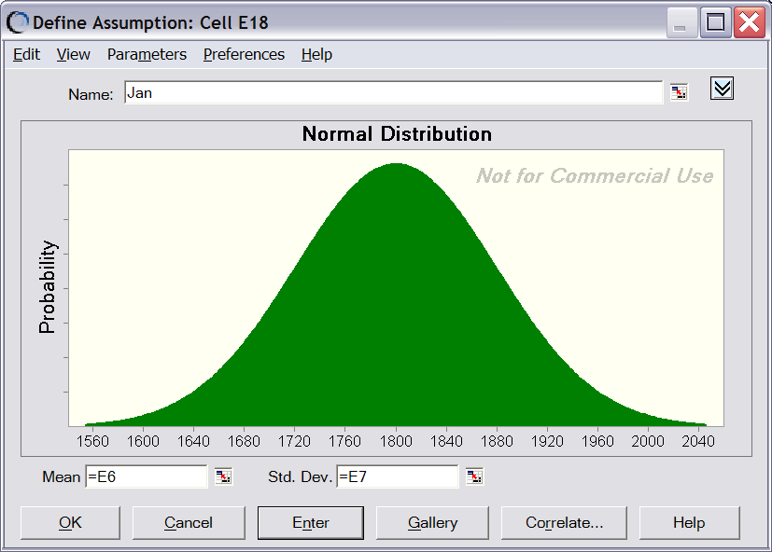
Illustration

Slide 6
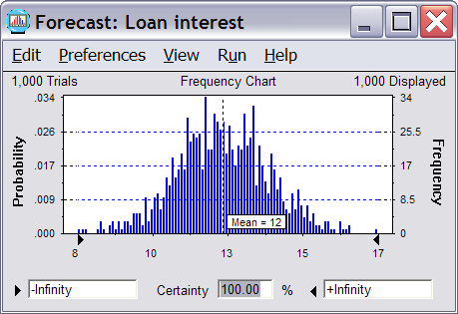
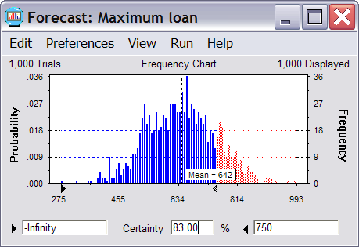
Analyzing Outputs

Slide 7
Correlated Assumptions
Choose Cell – Define Assumption
Click on “Correlate…”
Must have another assumption defined
Select appropriate assumption(s) from Select Assumption menu
Enter correlation coefficient
Calc option calculates it from data
Press Enter

Slide 8
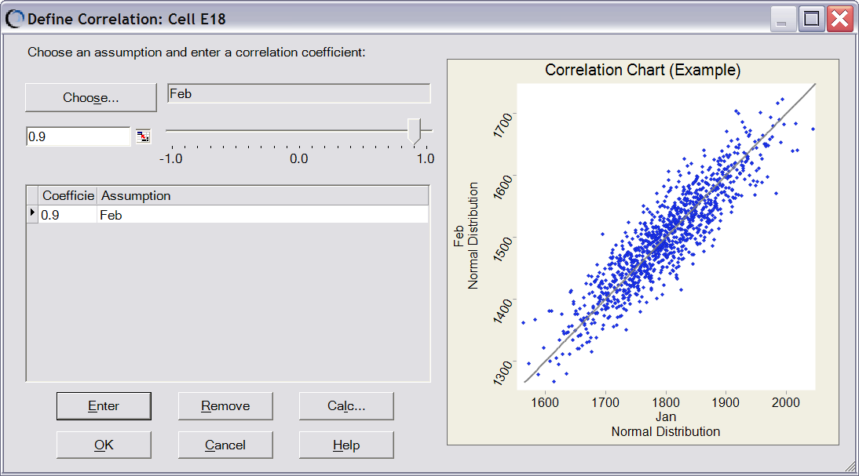
Illustration

Slide 9
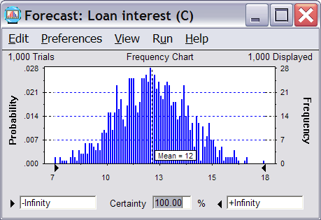
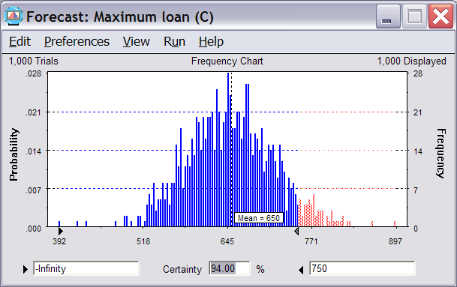
Outputs under Correlation

Slide 10
Example 2: Valuing Netscape
The initial public offering (IPO) of Netscape Communications Corporation on August 9, 1995, is thought to have signaled the beginning of the Internet boom.
The underwriters of the IPO planned to offer five million shares at $28 per share, thereby raising $140 million.
Up to that point, about $27 million had been invested in Netscape, and the company had yet to show a profit.
At $28 per share, Netscape's market value would be more than $1 billion, despite a book value of just $16 million.

Slide 11
(cont.)
The IPO underwriters calculated the value of the firm by adding:
Present value of the free cash flows through 2005
Assume: annual revenue growth rate at 65%
Present value of the firm after 2005 (known as the terminal value)
Assume: free cash flows after 2005 grow forever at rate 4%

Slide 12
(cont.)
Other assumptions:
Tax rate 34%
Cost of sales 10.4% of revenues
R&D 34.6% of revenues
Depreciation 5.5% of revenues
Operating expenses 80% of revenues in 1995 decreasing to 20% by 2005
Capital expenses 45% of revenues in 1995 decreasing to 10% by 2005
Beta 1.50
Riskless rate 6.71%
Market risk premium 7.50%

Slide 13
Discounted Cash-Flow Model (Deterministic)
Fig 16.15

Slide 14
Explanation
Compute the cost of equity (Cell B16):
(CAPM) Re = Rf + Beta * (Rm – Rf)
Compute the net present value of cash flows in years 1995 through 2005 (Cell B33):
Use NPV(discount rate, value1, value2, …)
Starting one period in the future
Find the year in which cash flows first turn positive (Cell B42):
Compute cumulative free cash flows (B47:L47)
Then, use IF(), or MATCH() and INDEX()

Slide 15
Explanation
Terminal value after 2005 (Cell B34):
F—cash flow in year 2005
g—terminal value growth rate (4%)
k—cost of equity (17.96%)
d—terminal discount rate, equals k-g
Terminal value:
F(1+g)/(1+d) + F(1+g)/(1+d)² + F(1+g)/(1+d)³ +…
= F(1+g)/d
= F(1+g)/(k-g)
Discount back to 1995 (Cell B36)

Slide 16
Results and Aspects of the Value of Netscape
Total present value: $1.057 b
Ratio of the terminal value to the total present value: 0.77
Year cash flows first turn positive: 2002
Maximum loss: $172 m
Price per share: $28

Slide 17
Risk Analysis By Simulation
How does the uncertainty in the parameters affect the valuation of Netscape
Was the IPO valuation justified in light of these uncertainties?

Slide 18
Choosing Probability Distributions
Revenue growth rate
Normal, mean 65%, standard deviation 5%
R&D percentage
Triangular, min 32%, most likely 37%, max 42%
Market risk premium
Uniform, min 5%, max 10%

Slide 19
Simulation Model in CB
Inputs (Assumption cells):
Previous three parameters with proposed
distributions
Outputs (Forecast cells):
Five result cells discussed before
Run 1000 trials

Slide 20
Simulation Results (Fig 16.19 – 16.23)
Total present value: $236m ~ $3.7b
Ratio of the terminal value to the total present value: >= 0.70
Maximum loss: mean $173m, up to $217m, less than 1% chance of less than $140m
Year cash flows first turn positive: 2002 or 2003 (the former at least 88% chance)
Price per share: $6 ~ $97, mean $31.

Slide 21
Summary
This approach is used throughout the finance industry
A single growth rate is used for revenues over a period as long as ten years
Terminal value often dominates the overall value of the firm
Highly sensitive to the assumptions
Simulation reveals the range of uncertainty in the valuation, and other aspects of the firm’s future, such as the adequacy of funding

Slide 22
Follow Up …
On the day of Netscape's IPO in August of 1995, it popped from $28 to $54 in the first few minutes of trading, valuing the company at $2 billion
What happened next?
Google IPO uses another method—auction

Slide 23
Example 3: Option Pricing
An option is the right to buy or sell an asset, without the corresponding obligation
For example, an option to purchase a sports franchise at any time in the coming year for a set price
If the team does well and its value increases, we might decide to exercise the option and make the purchase
If the team does poorly, there is no obligation to buy

Slide 24
Financial Options
Include the right to buy or sell stocks
Central to modern finance and investment
Have value primarily because they allow the holder to hedge against changes in the value of the underlying stock
Every buyer or seller of an option has a stake in determining a fair price for the option
The theory behind option pricing is based on advanced mathematics, but the principles involved can be readily understood

Slide 25
Pricing a European Call Option
A European call option on a stock gives the owner the right to purchase the stock at a specified price (strike price) on a given date (expiration date)
A stock is currently selling at $35.00
A call option with a strike price of $40.00 and an expiration date six months away
If the stock price on the expiration date is $45.00, we could make a profit of $5.00 by purchasing the stock for $40.00 and then selling it for $45.00.
If the stock price on the expiration date is $30.00, we would not exercise the option.
What would be a fair market price for the option?

Slide 26
A Simple Model
Value of an option depends on the actual price of the underlying stock at the expiration date
Need to develop a probability distribution for the stock price at that date
A simple way:
Assume equal chance of $45 and $35 at expiration date, 7% annual discount rate
Expected value of the option = $2.41
Validated by theory and practice

Slide 27
A More Realistic Model: Simulate Stock Prices
Stocks are subject to small random changes every day, with a small upward trend
Stock prices at any date in the future tend to follow an asymmetrical distribution, with a maximum value farther above the mean than the minimum is below it
Lognormal distribution is generally accepted as fitting actual stock prices quite well
X = e^{N} where N is a normal random variable has a lognormal distribution
Note: e^{N} ≈ 1+N when N small (≈10% or less)

Slide 28
Daily Stock Prices
P₀—Initial price, at beginning of Day 1
Price at the end of Day t:
μ: average t-day return
σ: standard deviation of the t-day return
About 250 trading days per year (125 days per six months)
When pricing options, use risk-free rate in place of μ to simulate the underlying stock

Slide 29
Two Way To Generate Random Distributions
Use Crystal Ball “Assumptions”
Makes functions implicit and therefore model harder to read, debug, and understand. Useful if correlations are needed (see later)
Use Crystal Ball functions
Under Insert | Function, select Crystal Ball, will see a list of all CB functions and associated parameters
Faster than using assumption cells

Slide 30
Useful Crystal Ball Distributions
CB.Binomial(p,n)
setting n=1 makes a 0-1 r.v.
CB.Normal(mean, std. dev.)
CB.Uniform(min, max)
Use trunc(CB.Uniform(min, max+1)) to get integers uniformly distributed between min and max
CB.Triangular(min, likeliest, max)

Slide 31
Five Price Paths (Fig 16.28)

Slide 32
Option Price (Cell G7)

Slide 33
What Affect Option Price
Volatility of the stock, strike price and time to expiration

Slide 34
Accuracy of the Prices
Our option prices were estimates
Based on a simulation of 1000 stock prices six months out
How accurate are they?
Take repeated samples of 1000 prices and compare the mean values
Range from $1.52 to $1.84
Need larger sample to achieve better precision

