Slide 1
DSO-547: Spreadsheet-Based Business Modeling
Simulation: Marketing Models
Hiroshi Ochiumi

Slide 2
Example 1: Forecasting Sales of a New Product
Kardjian Brothers has invented a fundamentally new way to control the photolithography process used in manufacturing computer chips
Before they sell or license this technological breakthrough, they’d like to have some idea of how rapidly it might gain market share
To use the previous model, must decide p, q and N₀
May be estimated from earlier new product introductions

Slide 3
New Product Introduction
Assumptions:
A fixed population of potential users, all of whom will eventually adopt
Adoptions from innovators are proportional to the current number of potential adopters
marketing efforts, such as advertising, convert some percentage of potential adopters every time period.
Adoptions from imitators are proportional to the product of the current number of adopters and the remaining potential adopters
Through word of mouth, every contact between an adopter and a potential adopter results in a new adoption with some probability.

Slide 4
Algebraic Model (Bass Diffusion Model)
n(t) = p(N₀ - N(t)) + (q/N₀)N(t)(N₀ - N(t))
= pN₀ + (q - p)N(t) - (q/N₀)N(t)²
Where
n(t) = customers adopting at time t
N₀ = total number of potential adopters
N(t) = cumulative adopters at time t
p = propensity to innovate (percentage of potentials per time period)
q = propensity to imitate (percentage of potentials times adopters per time period)

Slide 5
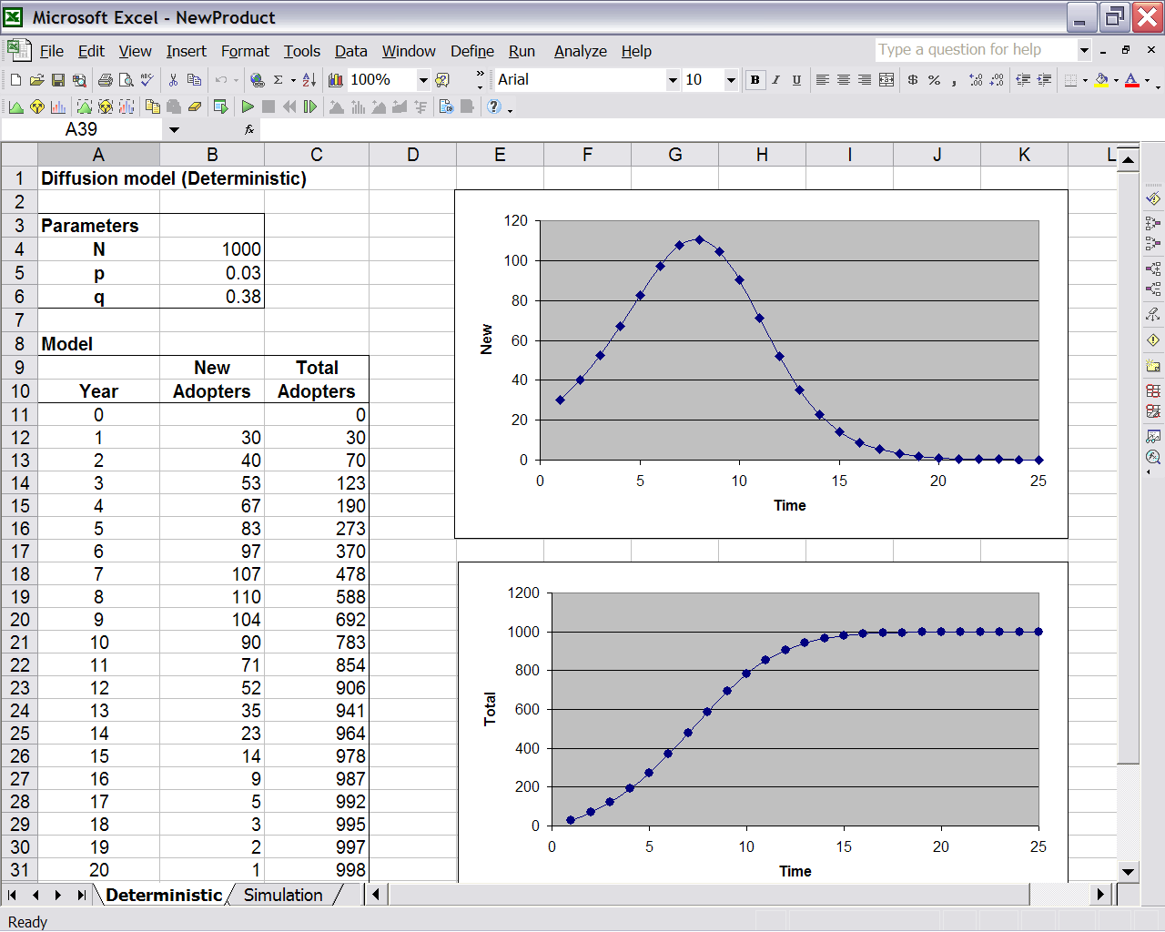
Deterministic Model

Slide 6
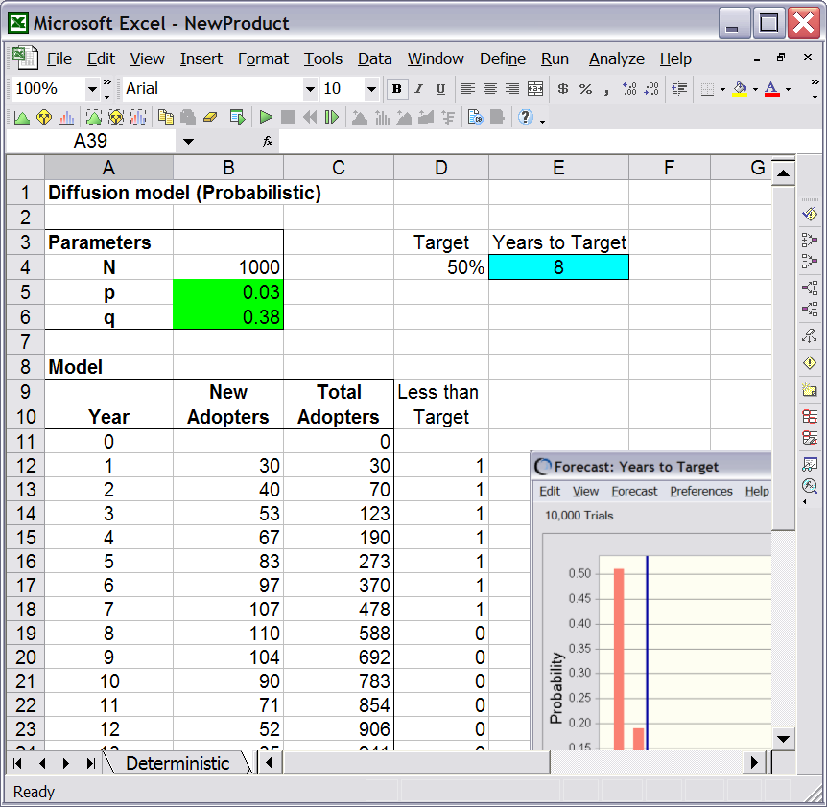
Simulation Model
Assume p~U(0, 0.5) and q~U(0.28, 0.48)
Interested in the years to achieve 50% penetration
Can also use Match() & Index() or Vlookup()

Slide 7
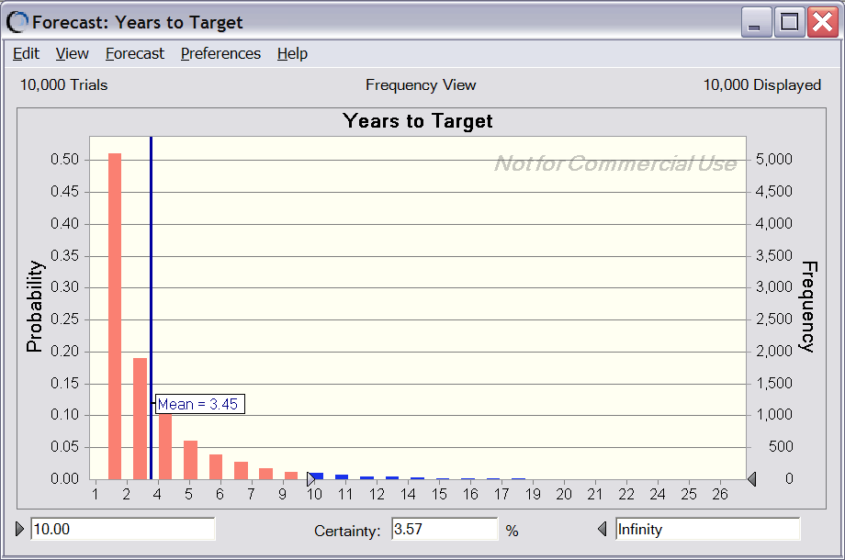
Simulation Result

Slide 8
Example 2: Value of Customer
Possible extensions:
Changing mean and stdev
Estimate from historical data
Changing Probability of retention
Let r(n) be the probability that a customer who has purchased for n-1 consecutive years does not purchase in the n-th year
r(1) = 1 - p for some 0 ≤ p ≤ 1
r(n) = qr(n-1) for n > 2, where q is a positive constant

