Slide 1
DSO-547: Spreadsheet-Based Business Modeling
Simulation: Operations Models
Hiroshi Ochiumi

Slide 2
Example 1: A Newsvendor Problem
Data:
Unit Price: $40
Unit Cost: $24
Fixed Cost: $400,000
Demand: 50,000
Quantity Produced: 40,000
What is the profit?

Slide 3
(Cont.)
Uncertainties:
Unit Cost:
$22, $23, $24, or $25, equally likely
Fixed Cost:
$400,000 or $450,000, equally likely
Demand:
Triangular distribution with min 40,000, most likely 50,000, max 60,000
What is the profit?

Slide 4
Example 2: Hastings Sportswear –A Newsvendor Problem
In November, Jeff Hastings of the fashion skiwear manufacturer Hastings Sportswear, Inc., faces the task of committing to specific production quantities for each skiwear item the company will offer in the coming year's line.
Commitments are needed immediately, in order to reserve space in production facilities located throughout Asia. Actual demand for these products will not become known for at least six months. In fact, demand for the current year's line is only beginning to become available.
In an initial experiment, Jeff has asked six of his most knowledgeable people to make forecasts of demand for the various models of parkas.

Slide 5
(Cont.)
Six forecasts of demand for one product:
Actual std. dev. ≈ 2 × Std. dev. in the forecasts
Wholesale price $110
Production costs ≈ 75% of Wholesale Price
Unsold parkas salvage value ≈ 8% of Wholesale Price.
How many should be ordered for this model of parka?
#1 | #2 | #3 | #4 | #5 | #6 | Avg | Std Dev
900 | 1,000 | 900 | 1,300 | 800 | 1,200 | 1,017 | 194

Slide 6
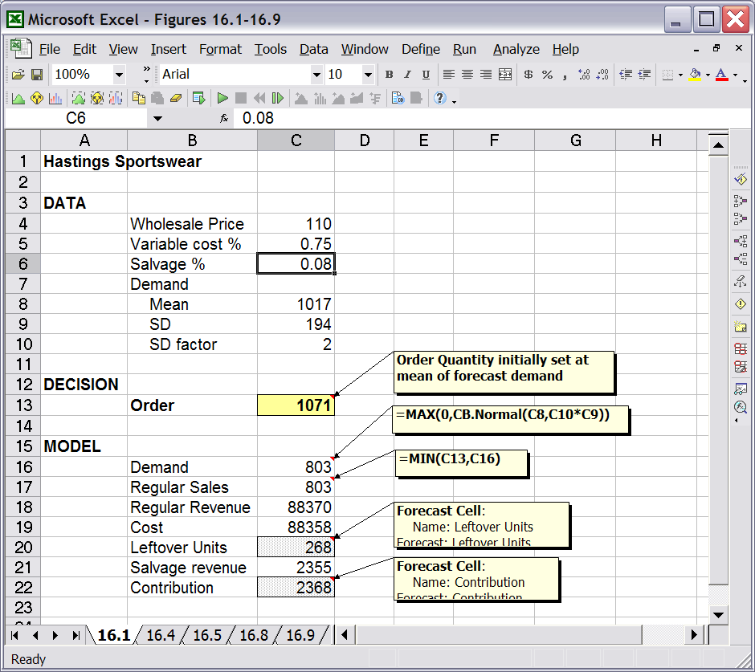
Model

Slide 7
Example 3: Bidding for a Contract
The Miller Construction Company is trying to decide whether to make a bid on a construction project.
It will cost the company $10,000 to complete the project (if it wins), and $350 to prepare a bid.
Four potential competitors against Miller
The lowest bid will win the contract, and the winner will then be given the winning bid amount to complete the project.

Slide 8
(Cont.)
Each competitor's bid will be a multiple of Miller's cost to complete the project, where this multiple has a triangular distribution with minimum, most likely, and maximum values 0.9, 1.3, and 2.5.
These bids are independent
What is Miller’s optimal bid to maximize its expected profit?
Assume the bid is a multiple of $500 in the range from $10,500 to $15,000

